Slide 1


with
Dr.
Billye
Brim

Slide 2
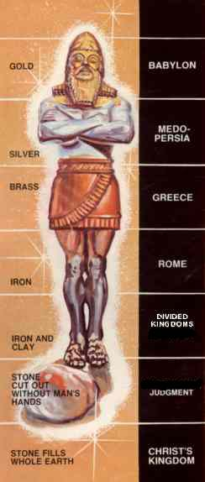
Daniel- Image from dream
Notes:
Daniel- Image from Nebuchadnezzar’s dream

Slide 3
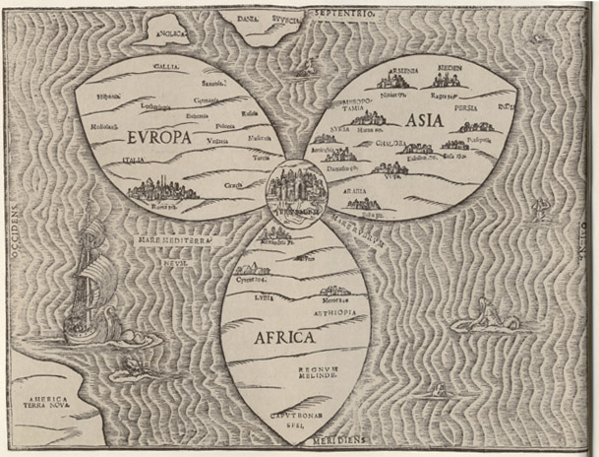
Map- Old Map-Leafs
Notes:
Old Map-Leaf Shape

Slide 4
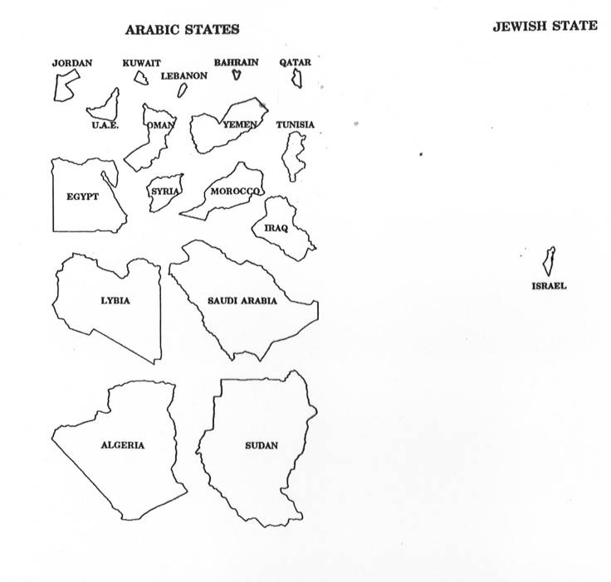
Map- Arabic States/Jewish States
Notes:
Map- Arabic States vs Jewish State comparison

Slide 5
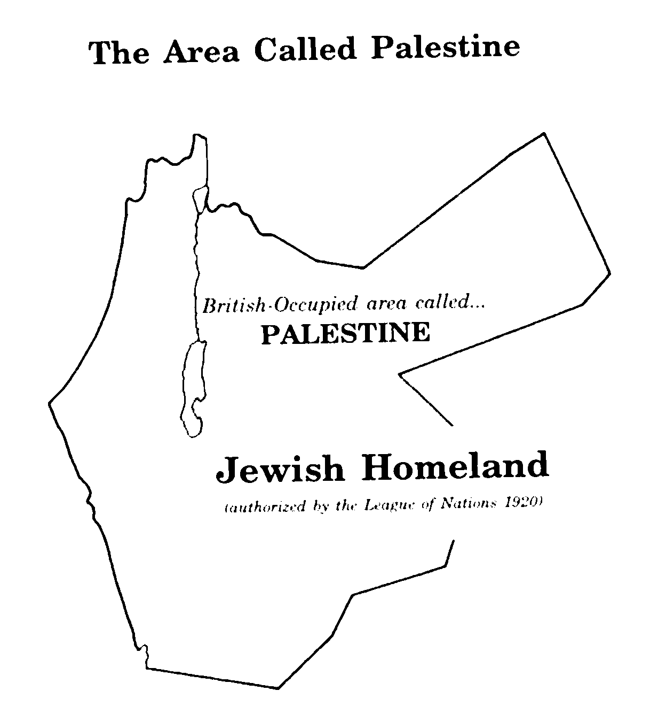
Map- Jewish Homeland
Notes:
250 Map- Jewish Homeland

Slide 6
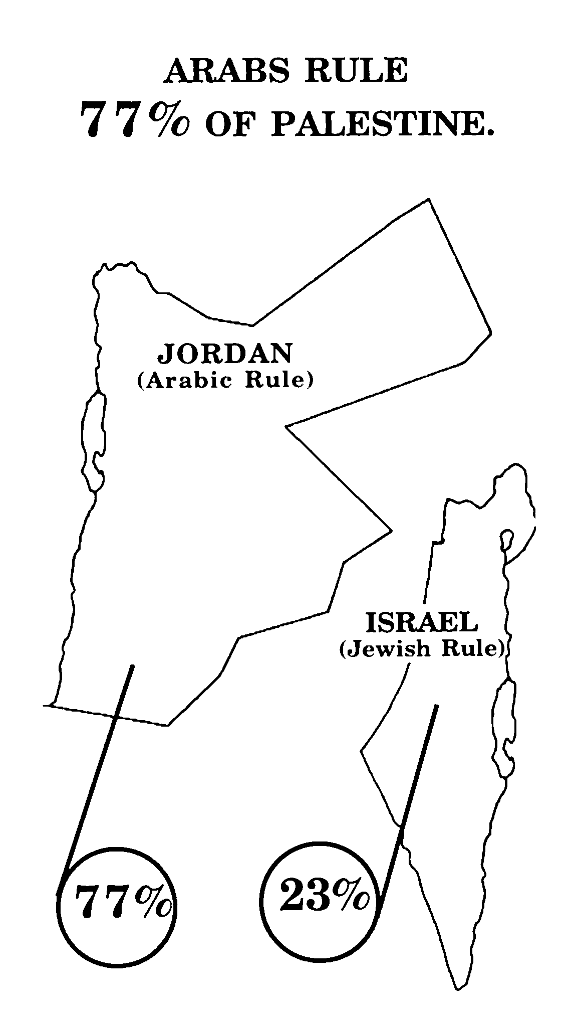
Map- Arabs Rule 77% of Palestine
Notes:
Map- Arabs Rule 77% of Palestine

Slide 7
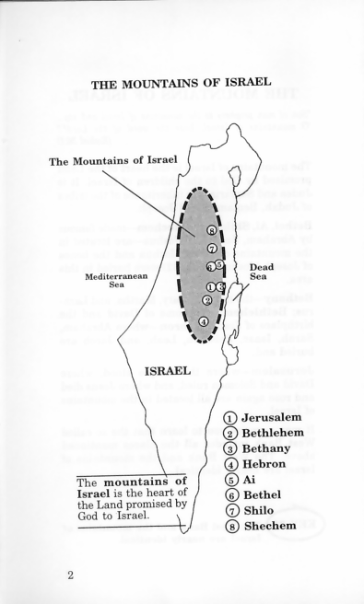
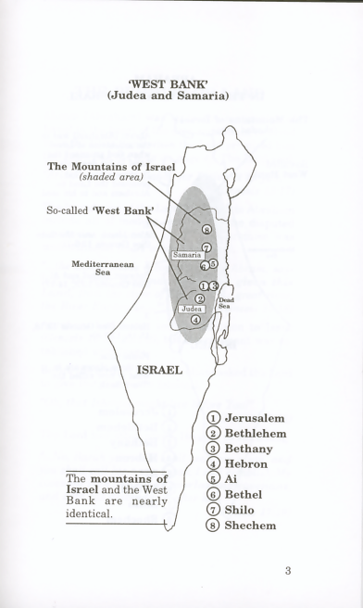
Map- Mountains of Israel/West Bank
Notes:
Map- Mountains of Israel & West Bank

Slide 8
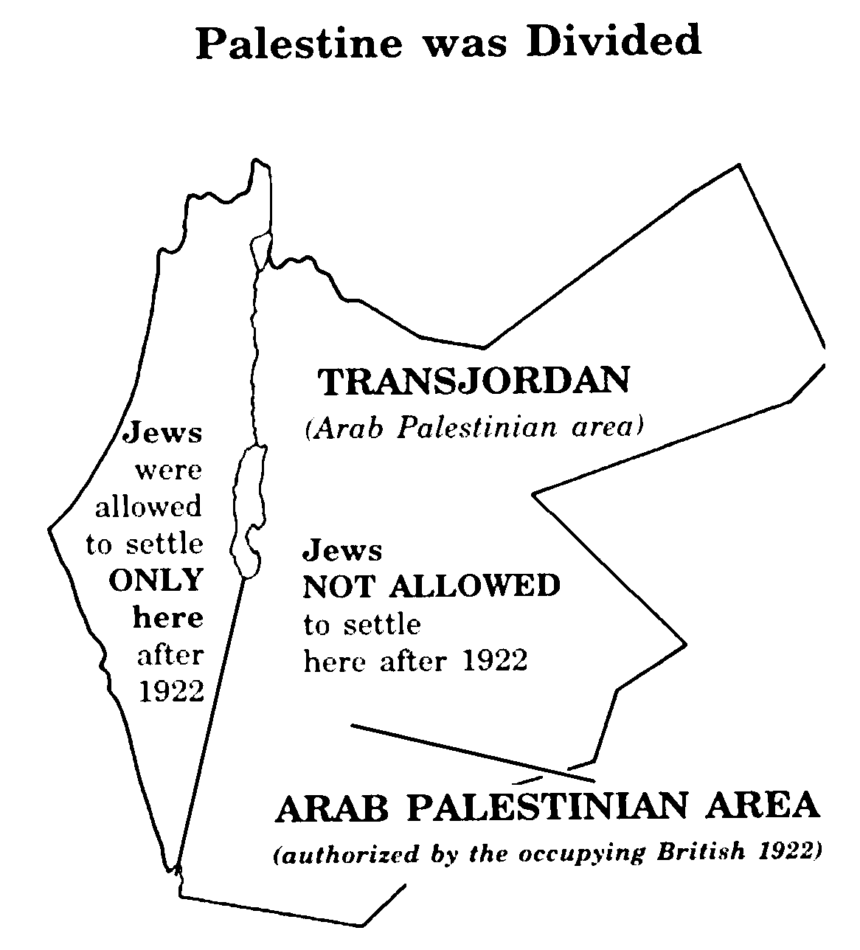
Map- Palestine Divided
Notes:
Map- Palestine was Divided

Slide 9
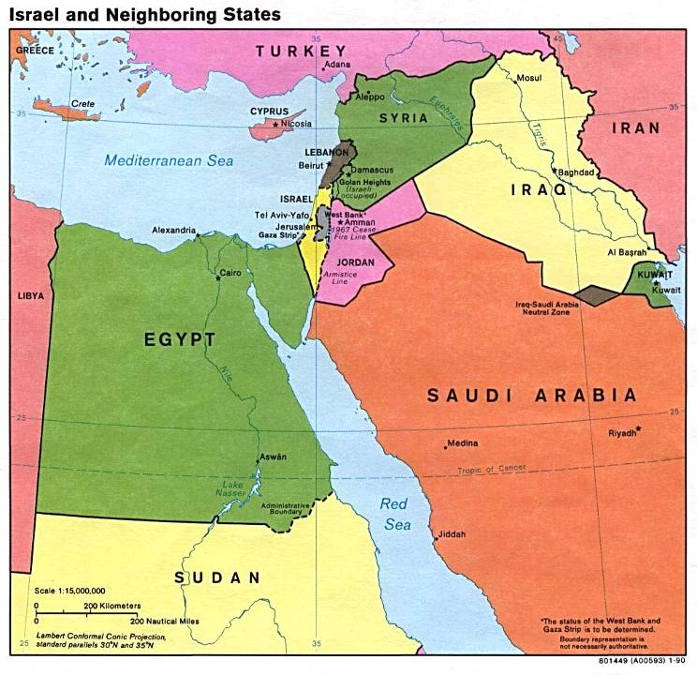
Maps- Israel & Neighboring states
Notes:
Map- Israel & Neighboring states

Slide 10
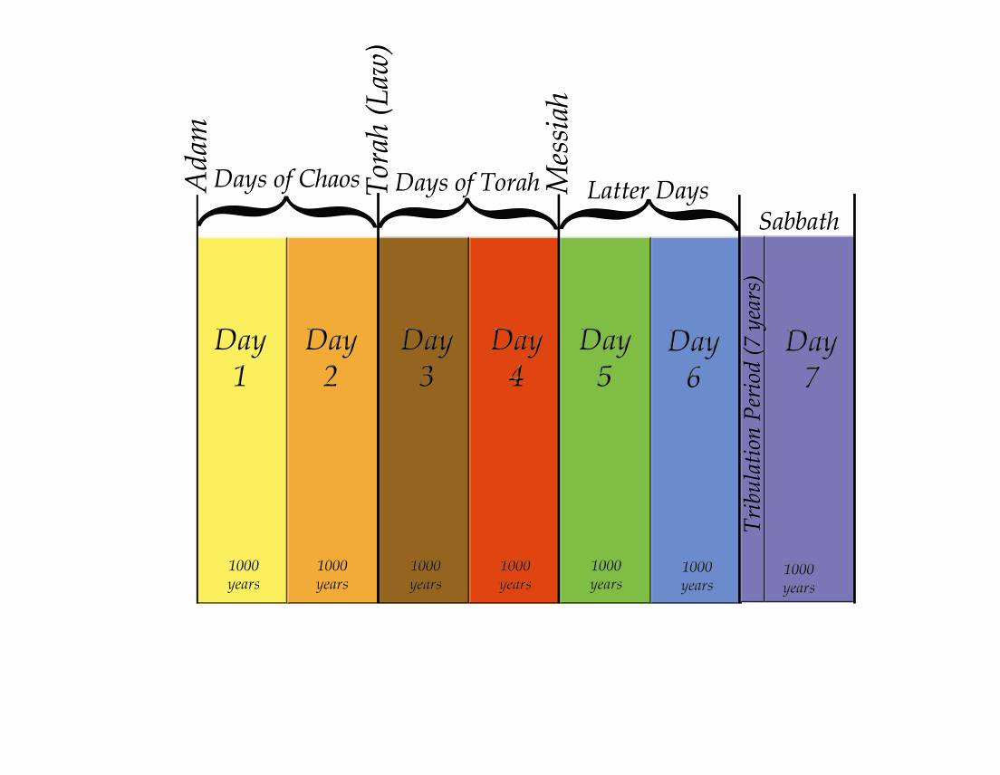
Time Lime
End of Days
Notes:
7 Day Chart - Timeline

Slide 11
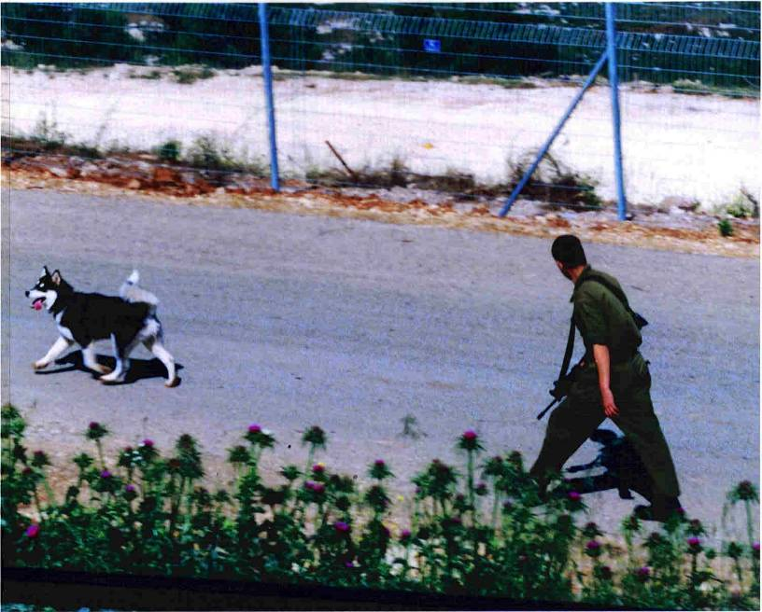
Misgav Am-Soldier & Dog
Notes:
Misgav Am-Soldier & Dog

Slide 12
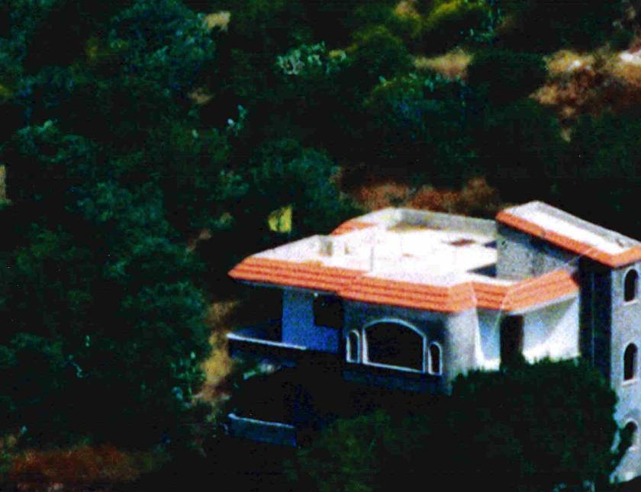
Misgav Am- Hezbollah Flag Closeup
Notes:
Misgav Am- Hezbollah Flag Closeup

Slide 13
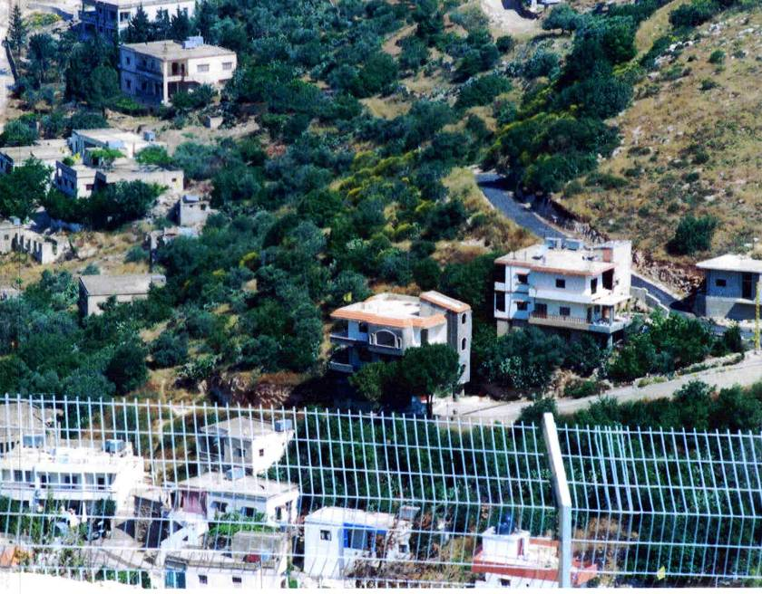
Misgav Am- Hezbollah Flag Distant
Notes:
Misgav Am- Hezbollah Flag Distant

Slide 14
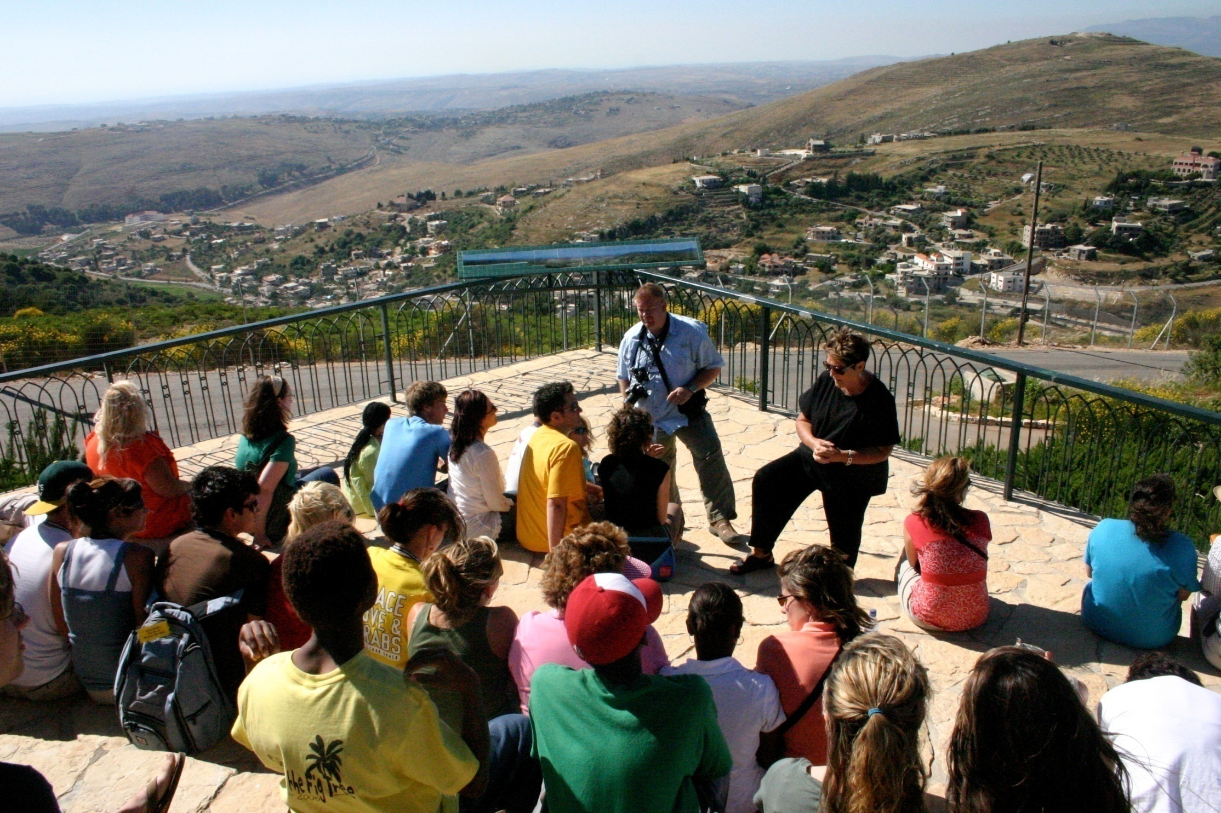
Misgav Am billye/kids hills
Notes:
Youth Tour - Misgav Am - Lebanon

Slide 15
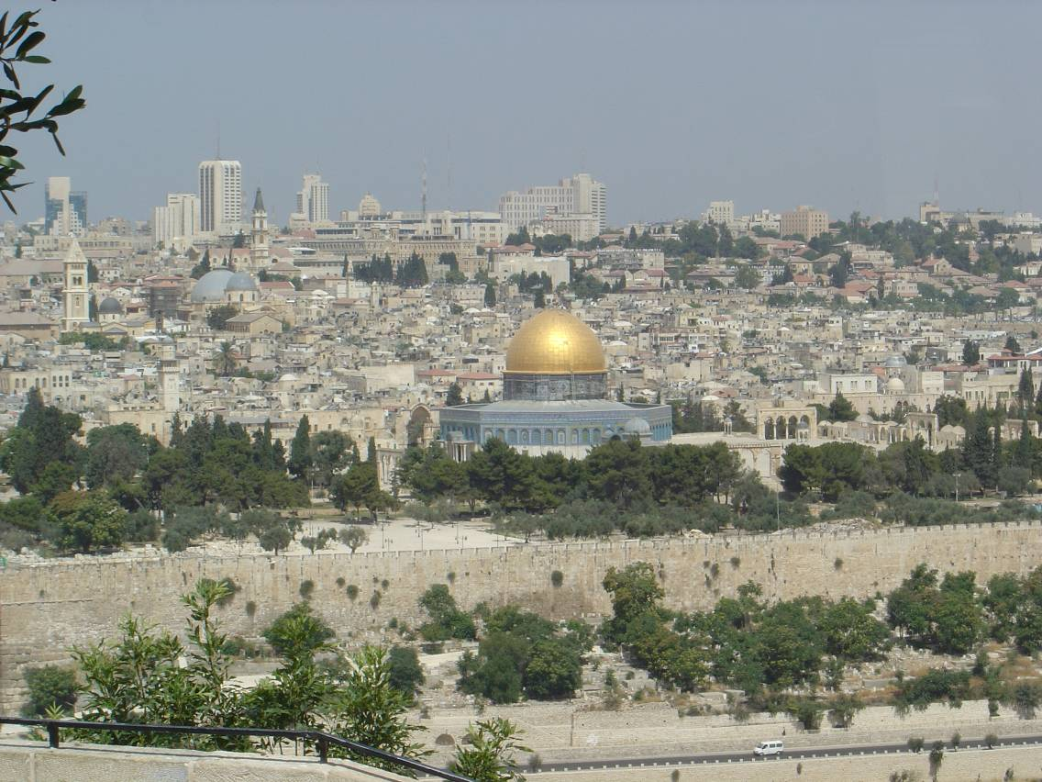
Temple Mnt w/dome
Notes:
Jerusalem - Temple Mount with dome

Slide 16
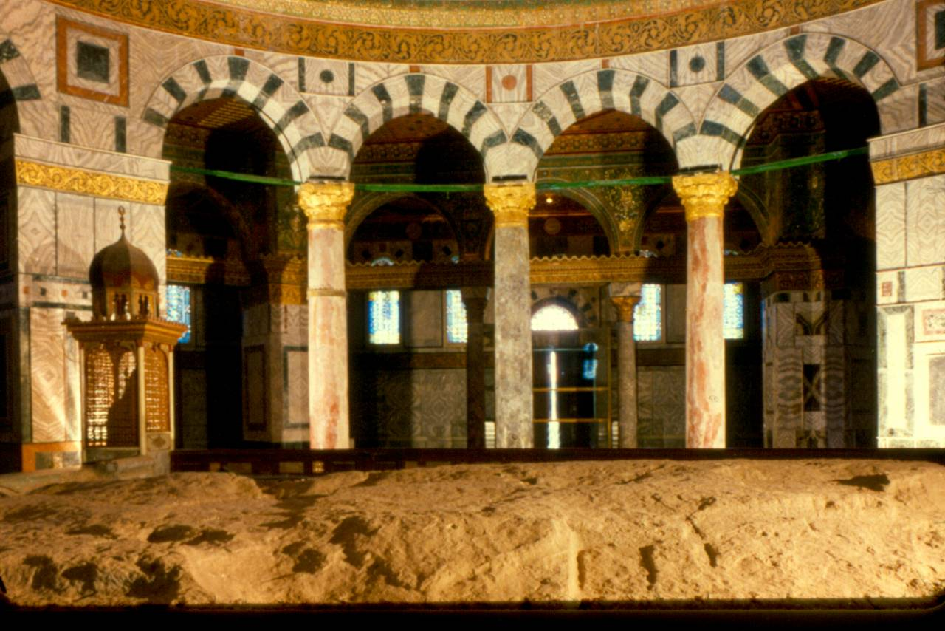
Inside Dome
Notes:
Dome of the Rock – Inside view

Slide 17
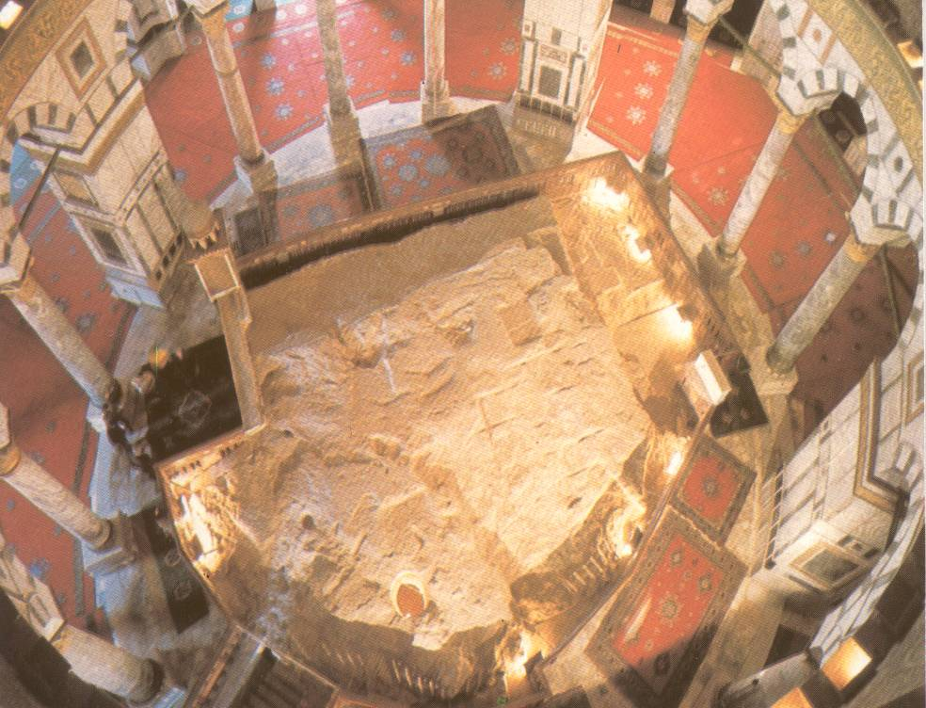
Rock top-view
Notes:
Dome of the Rock – Inside – Top down view

Slide 18
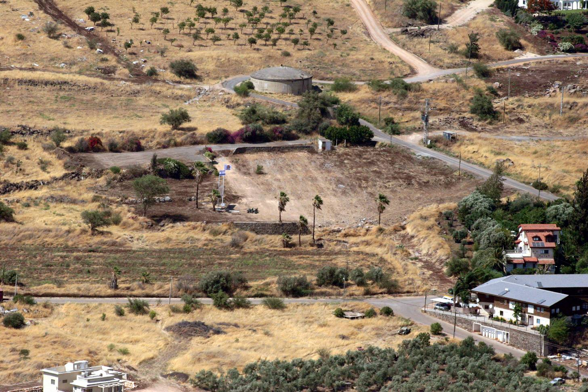
Migdal View
Notes:
Migdal - Aerial View

Slide 19
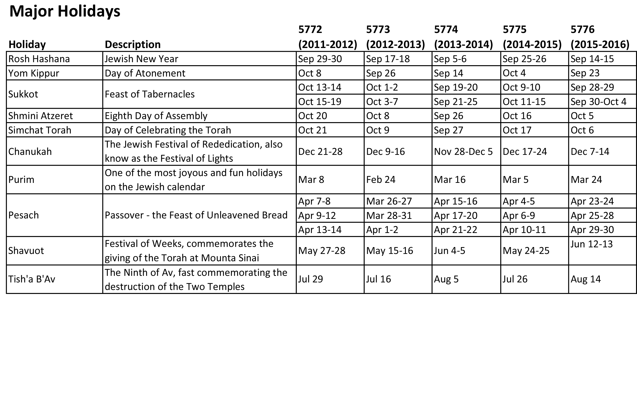
Notes:
Hebrew Calendar – Major Holidays

Slide 20
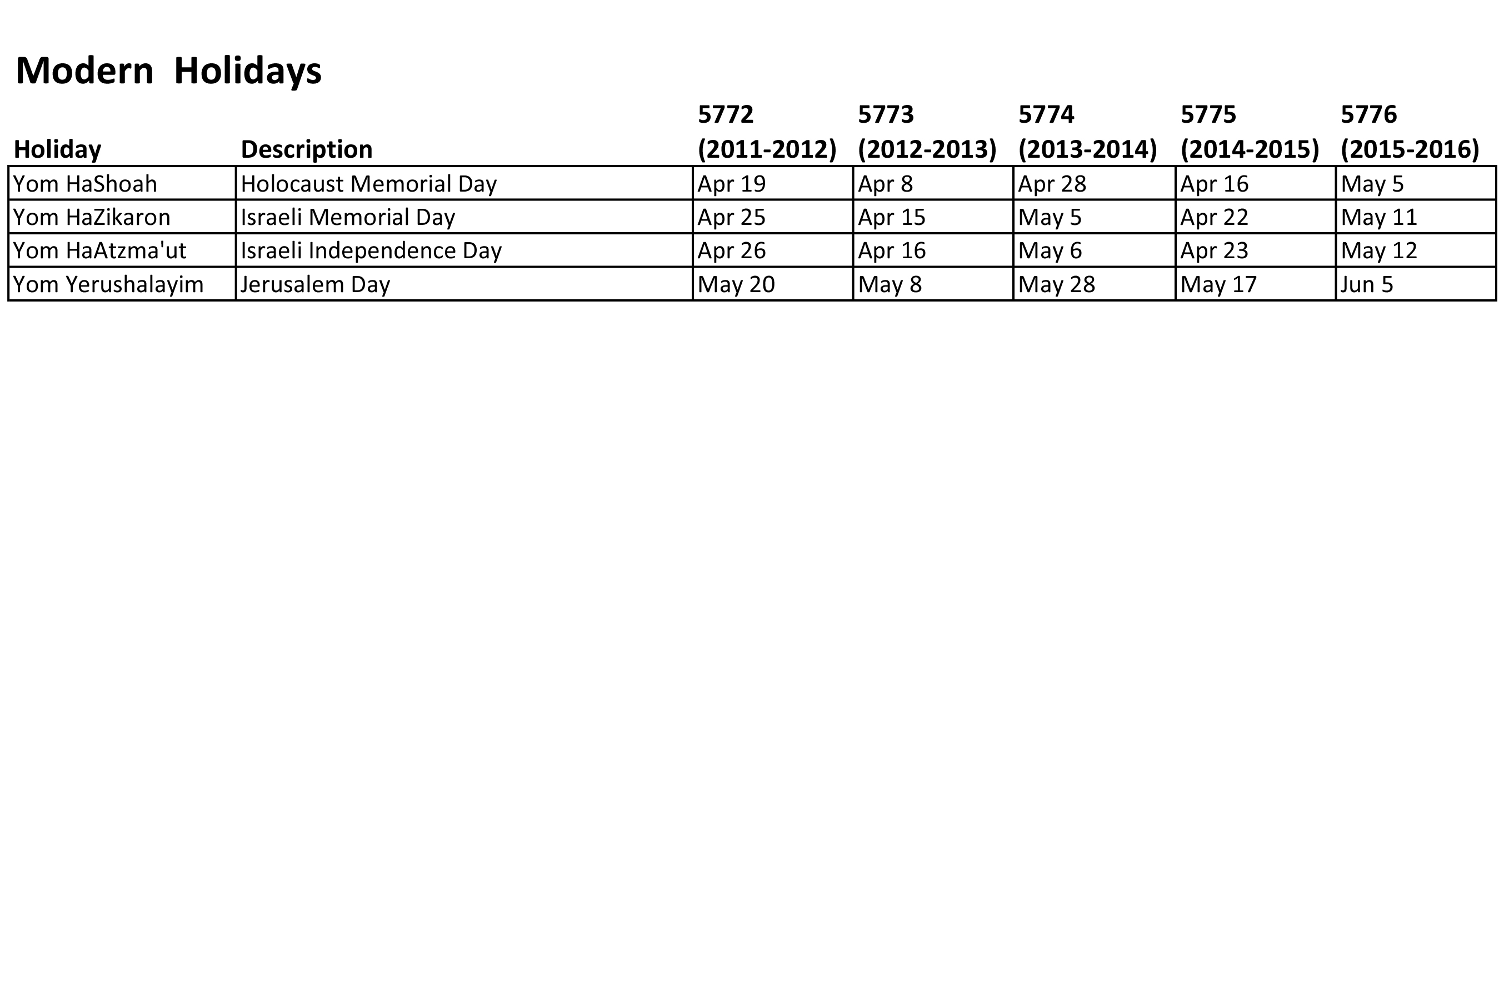
Notes:
Hebrew Calendar – Modern Holidays

Slide 21
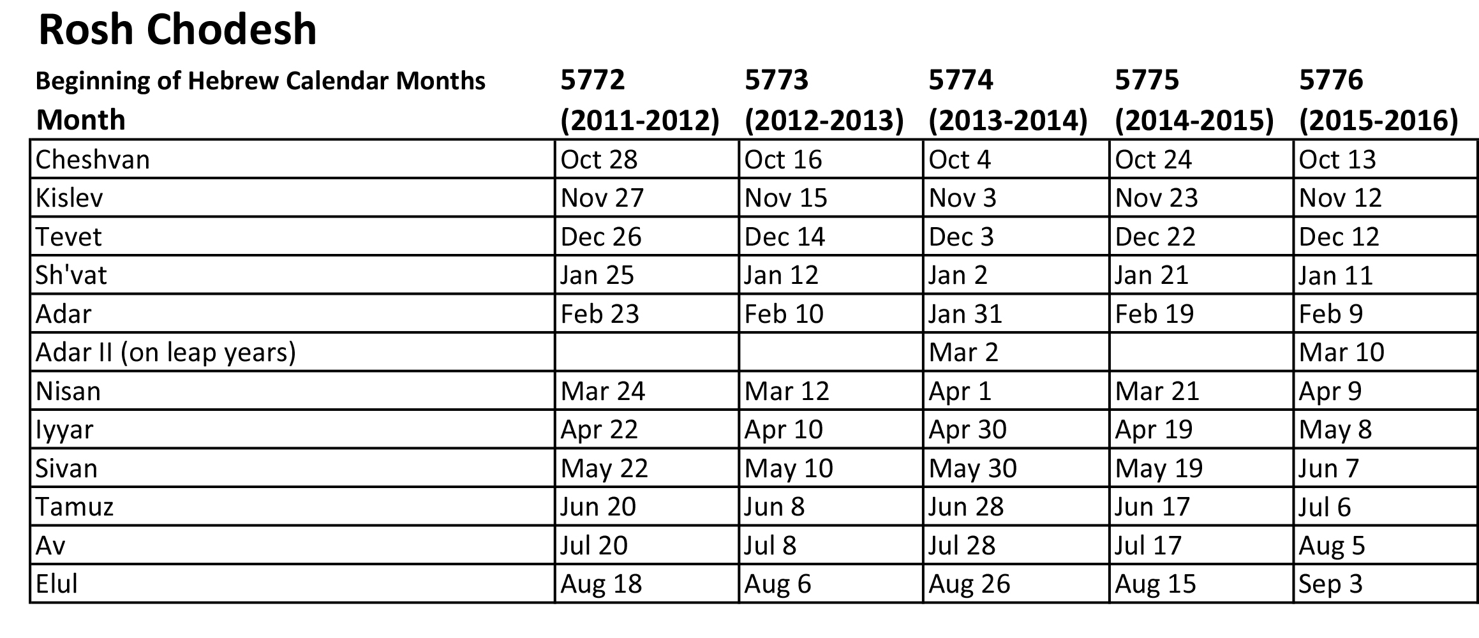
(Beginning of Hebrew Months)
Notes:
Hebrew Calendar – Rosh Chodesh

Slide 22
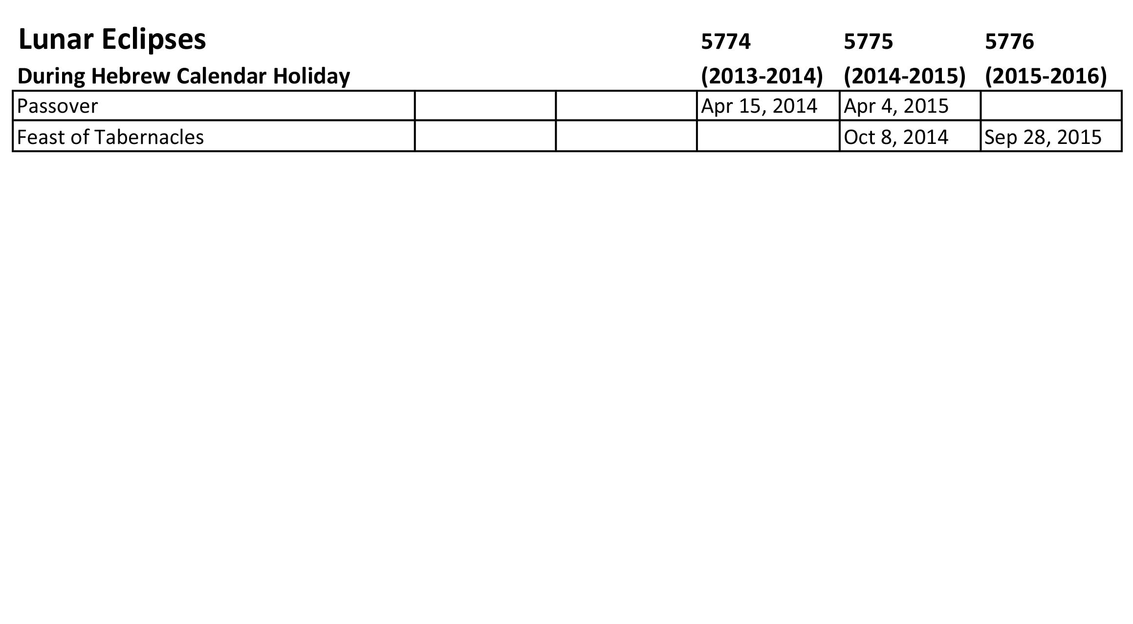
Notes:
Hebrew Calendar – Lunar Eclipses

Slide 23
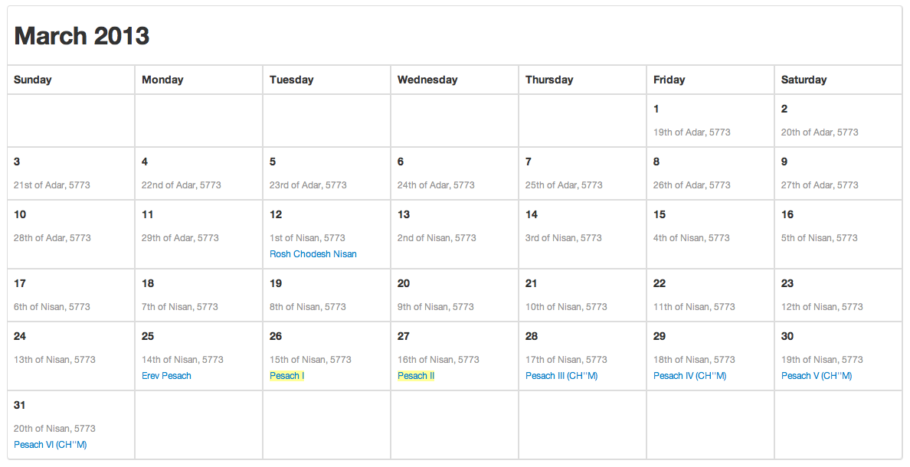
Notes:
Hebrew Calendar – March 2013

Slide 24
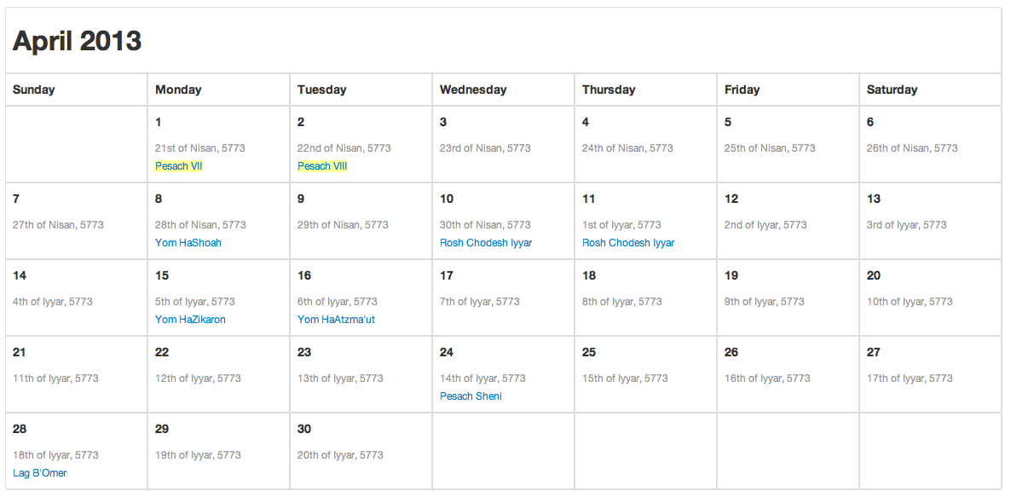
Notes:
Hebrew Calendar – April 2013

Slide 25
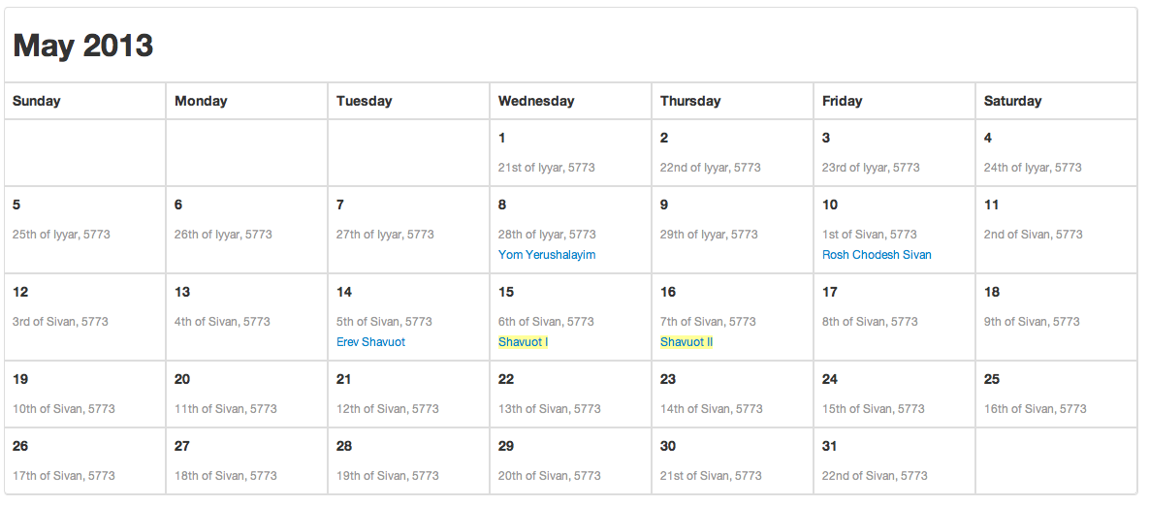
Notes:
Hebrew Calendar – May 2013

Slide 26
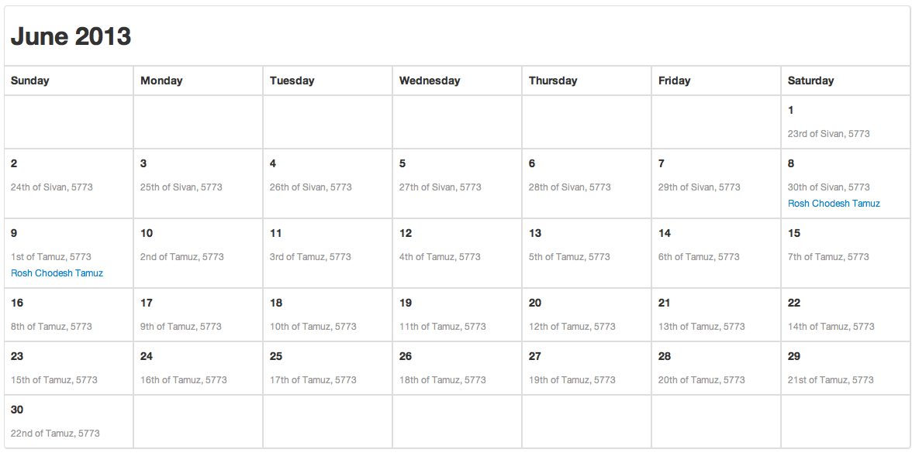
Notes:
Hebrew Calendar – June 2013

Slide 27
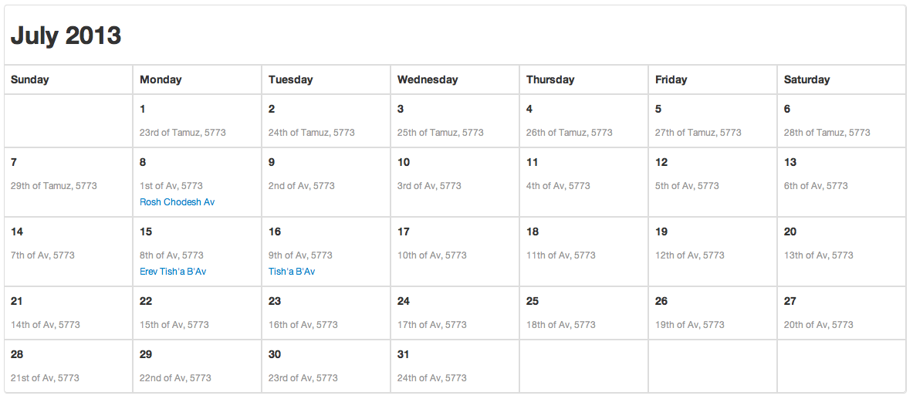
Notes:
Hebrew Calendar – July 2013

Slide 28
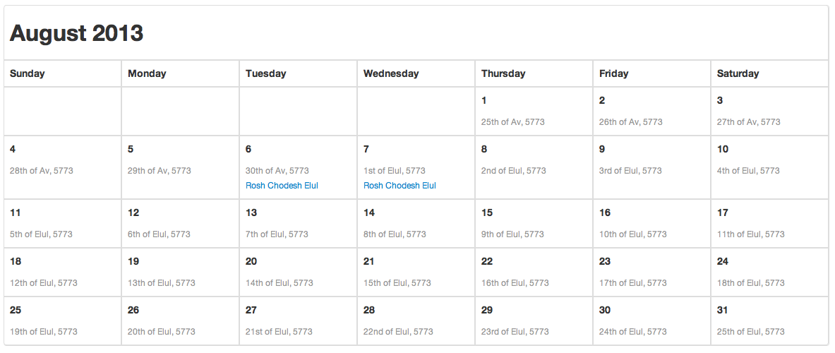
Notes:
Hebrew Calendar – August 2013

Slide 29
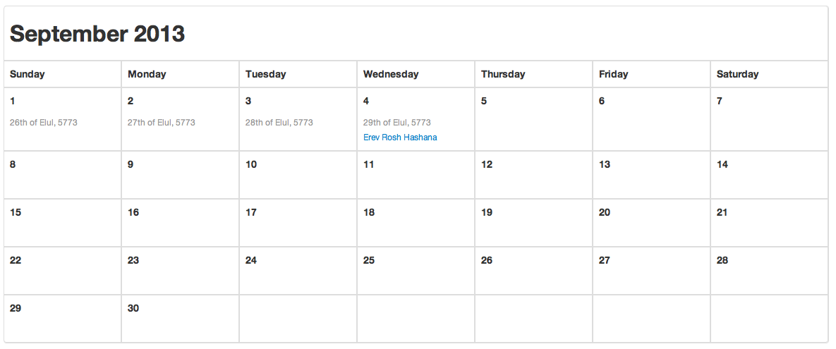
Notes:
Hebrew Calendar – September 2013

Slide 30
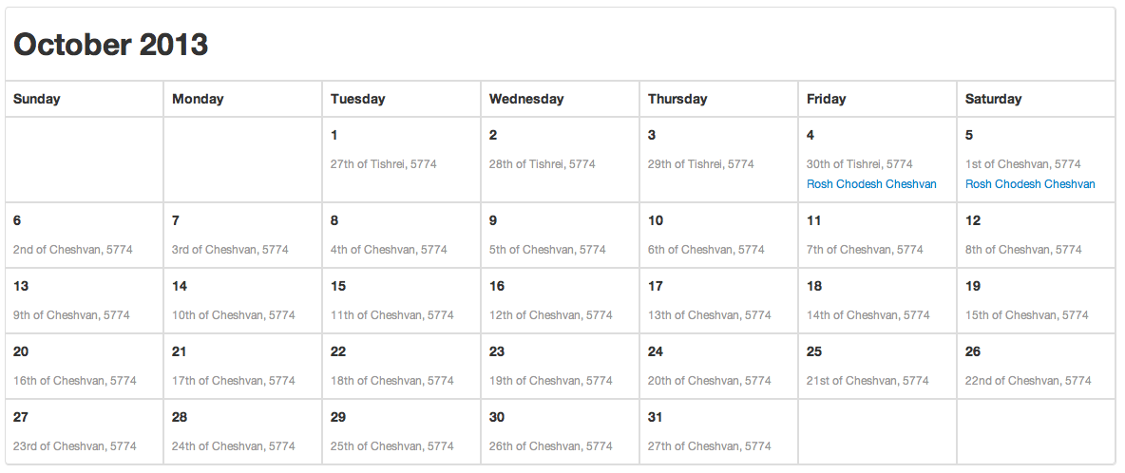
Notes:
Hebrew Calendar – October 2013

Slide 31
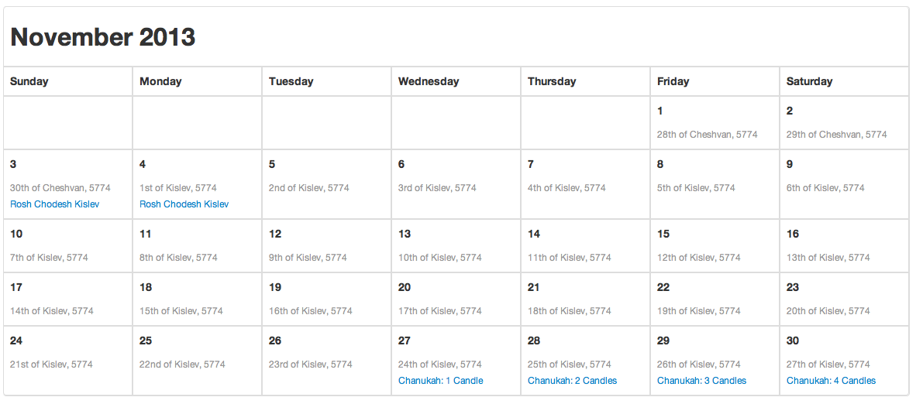
Notes:
Hebrew Calendar – November 2013

Slide 32
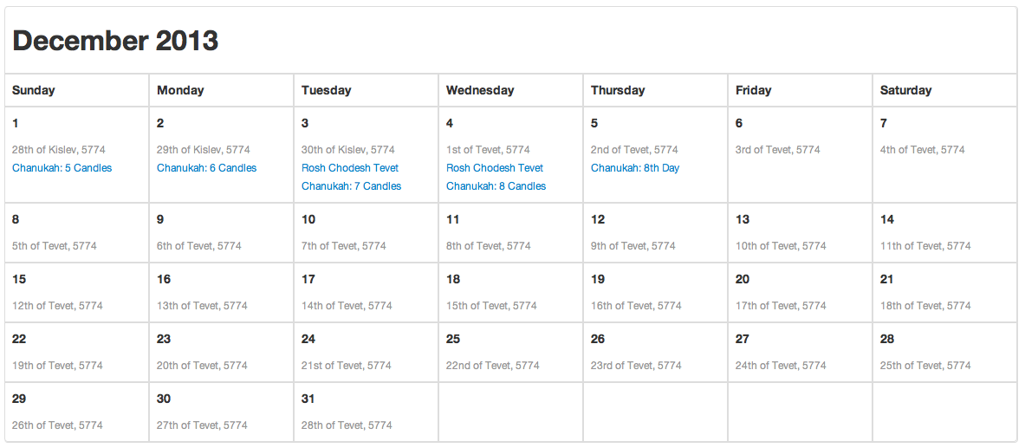
Notes:
Hebrew Calendar – December 2013

Slide 33
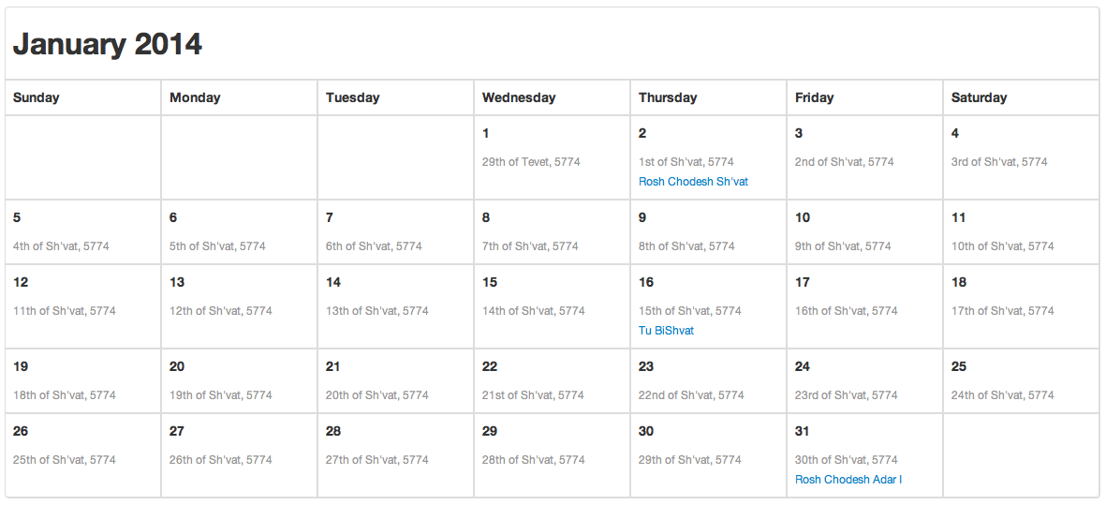
Notes:
Hebrew Calendar – January 2014

Slide 34
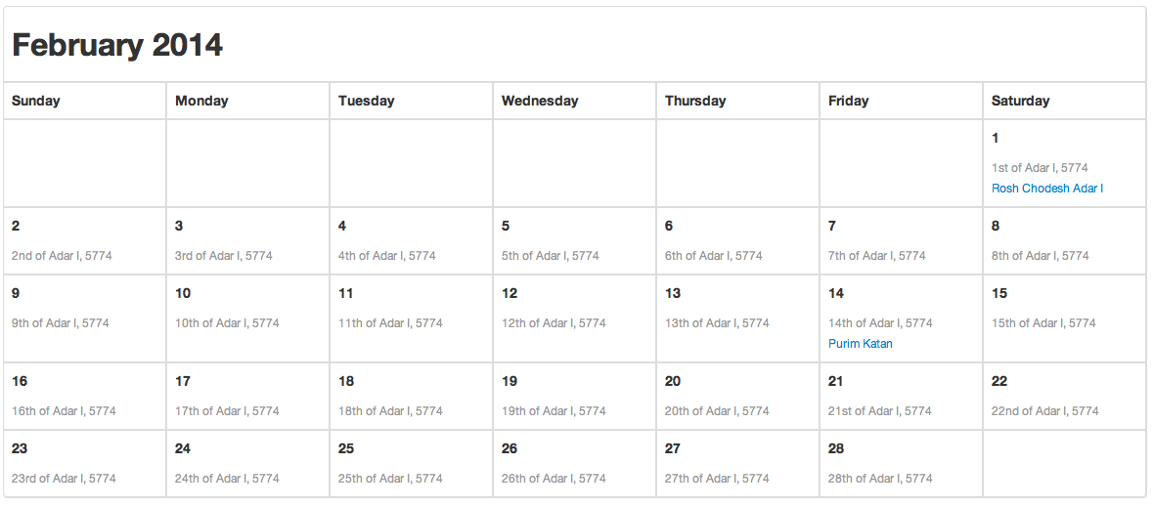
Notes:
Hebrew Calendar – February 2014

Slide 35
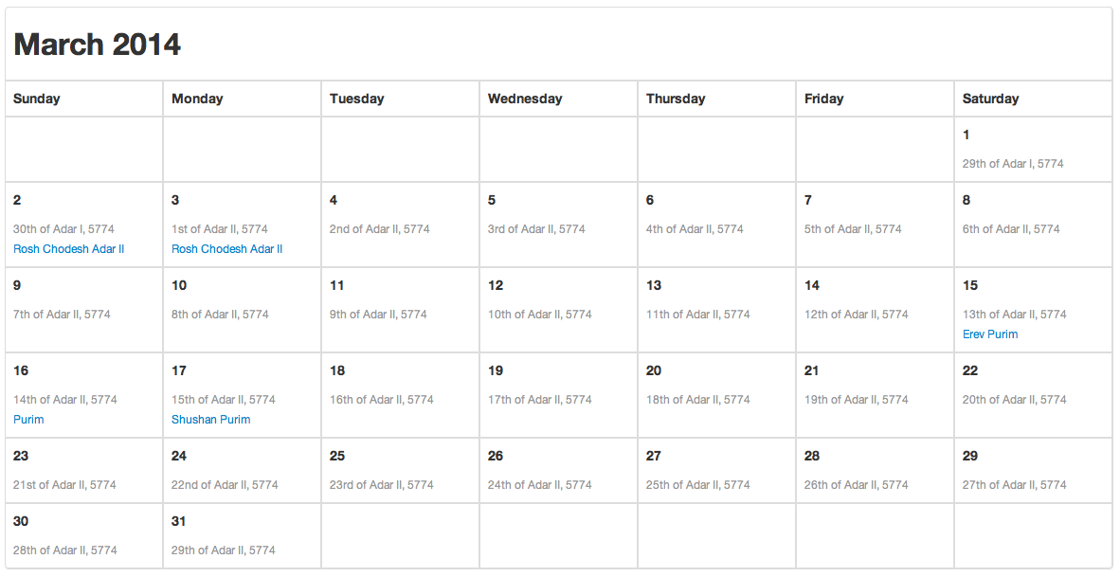
Notes:
Hebrew Calendar – March 2014

Slide 36
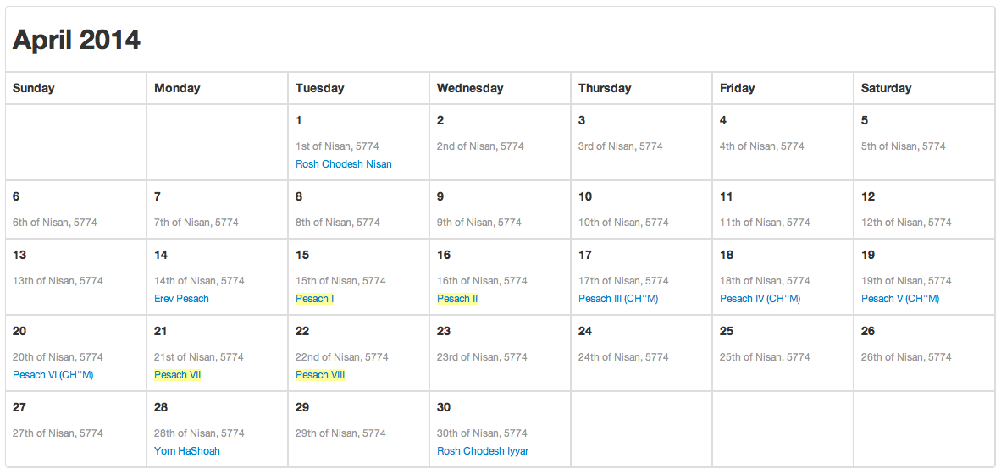
Notes:
Hebrew Calendar – April 2014

Slide 37
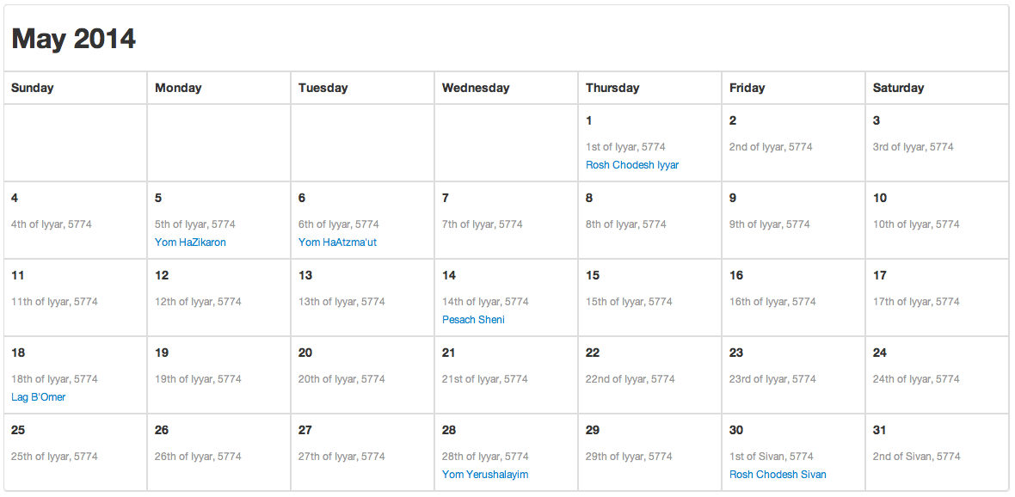
Notes:
Hebrew Calendar – May 2014

Slide 38
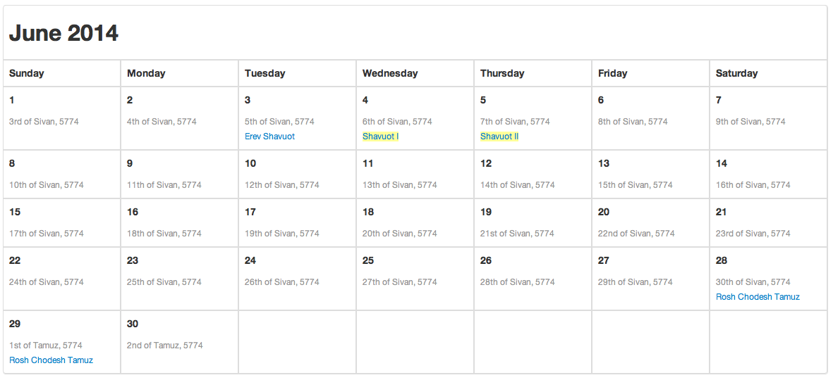
Notes:
Hebrew Calendar – June 2014

Slide 39
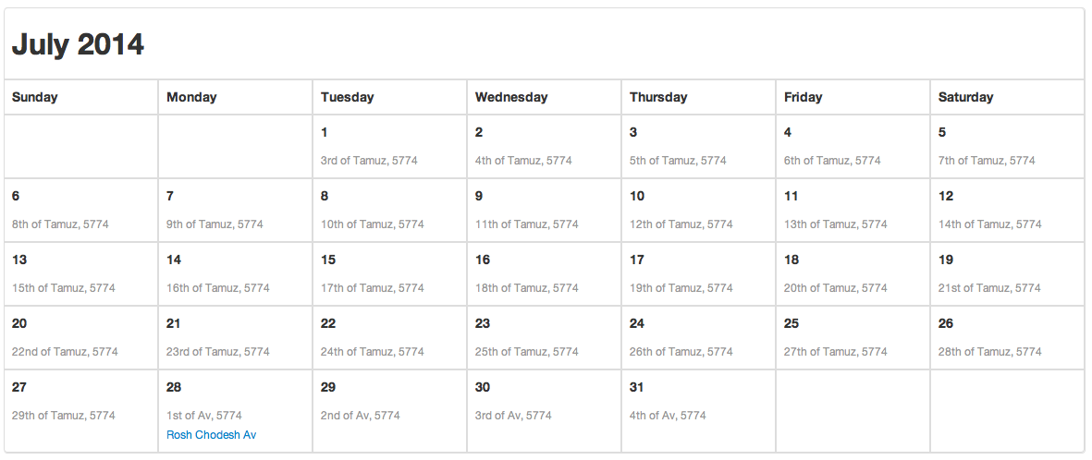
Notes:
Hebrew Calendar – July 2014

Slide 40
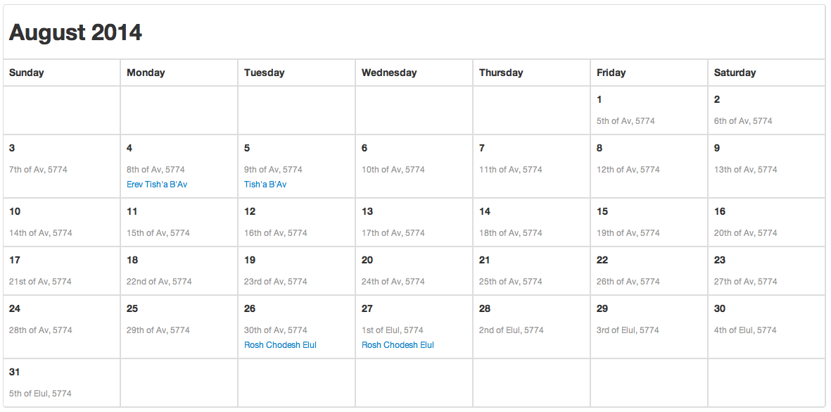
Notes:
Hebrew Calendar – August 2014

Slide 41
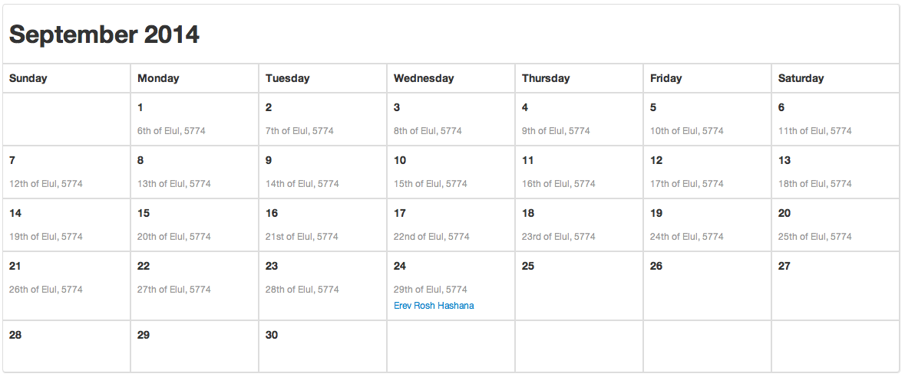
Notes:
Hebrew Calendar – September 2014

Slide 42
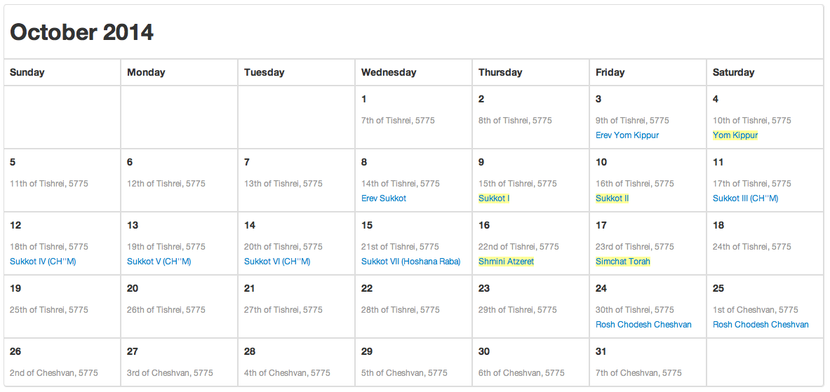
Notes:
Hebrew Calendar – October 2014

Slide 43
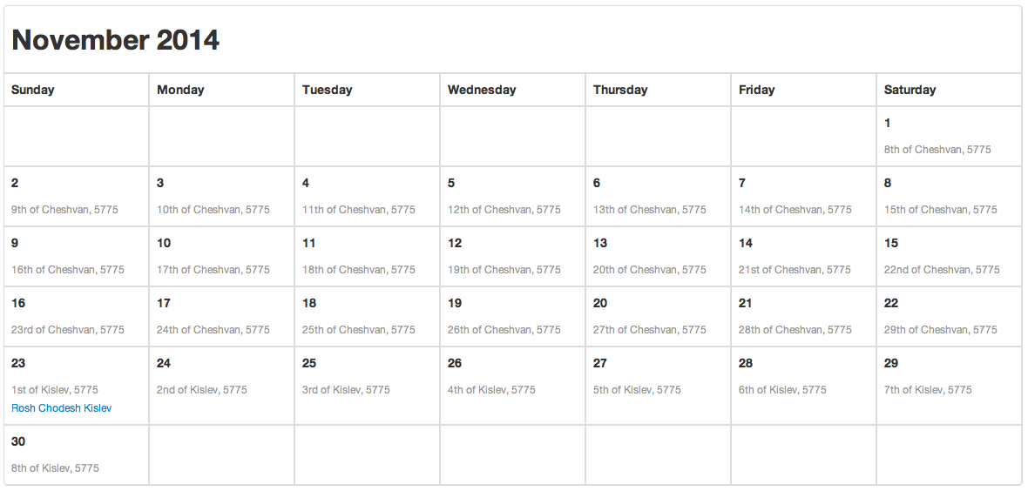
Notes:
Hebrew Calendar – November 2014

Slide 44
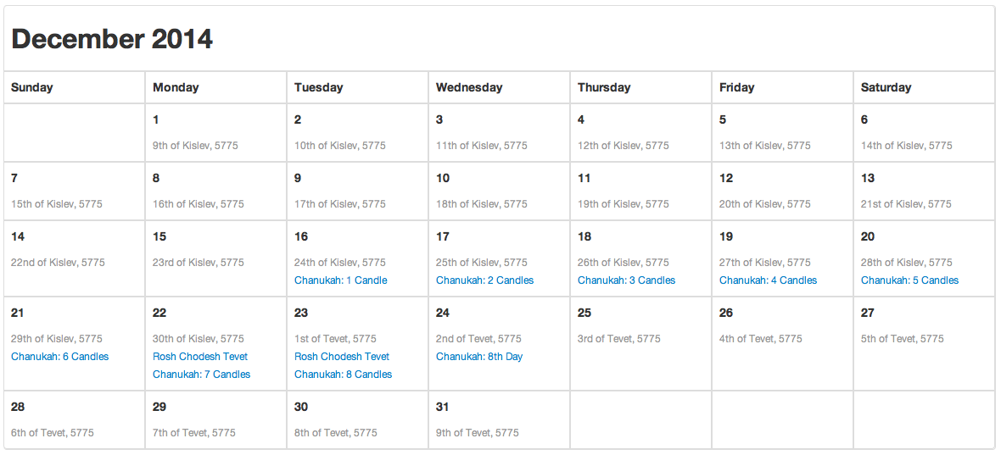
Notes:
Hebrew Calendar – December 2014

Slide 45
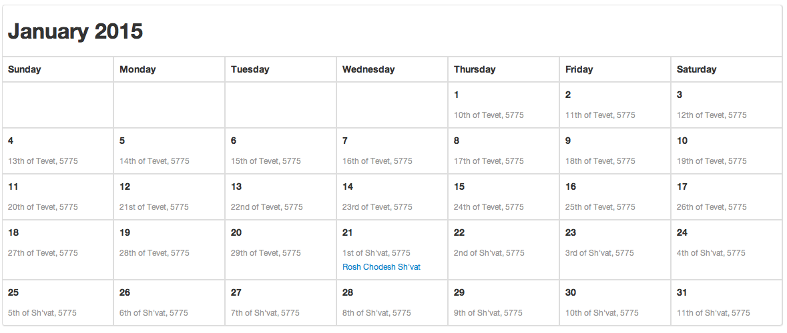
Notes:
Hebrew Calendar – January 2015

Slide 46
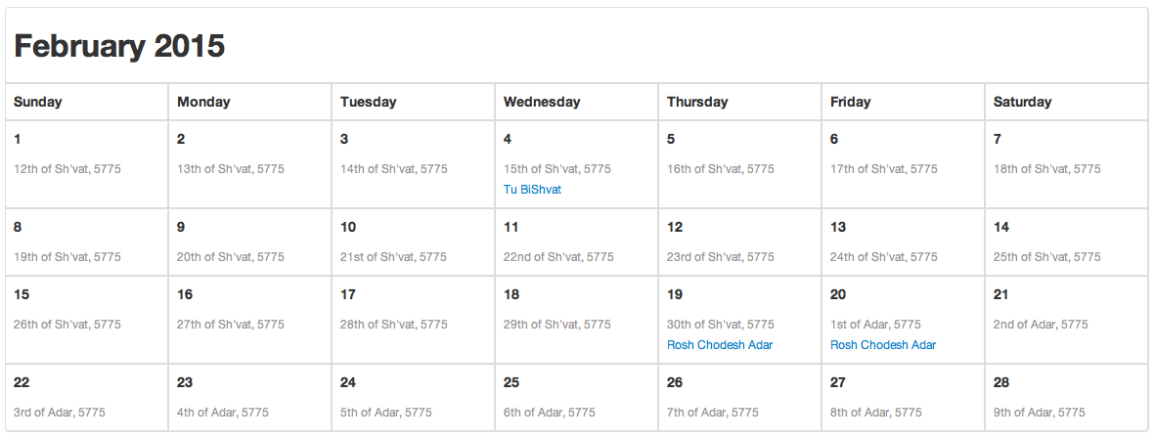
Notes:
Hebrew Calendar – February 2015

Slide 47
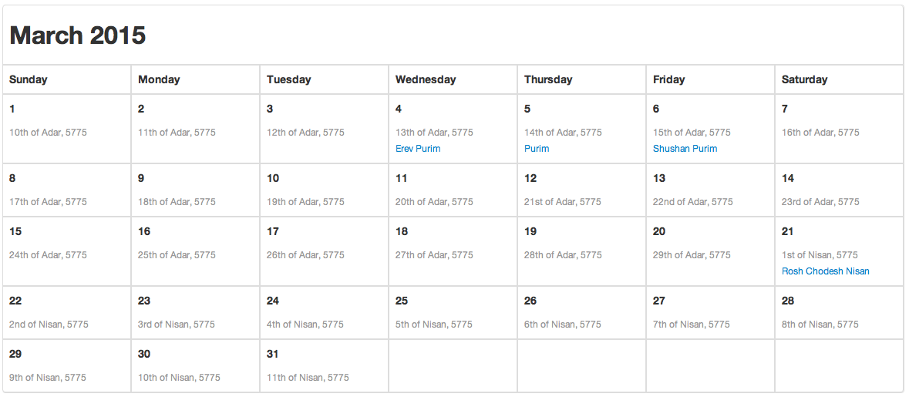
Notes:
Hebrew Calendar – March 2015

Slide 48
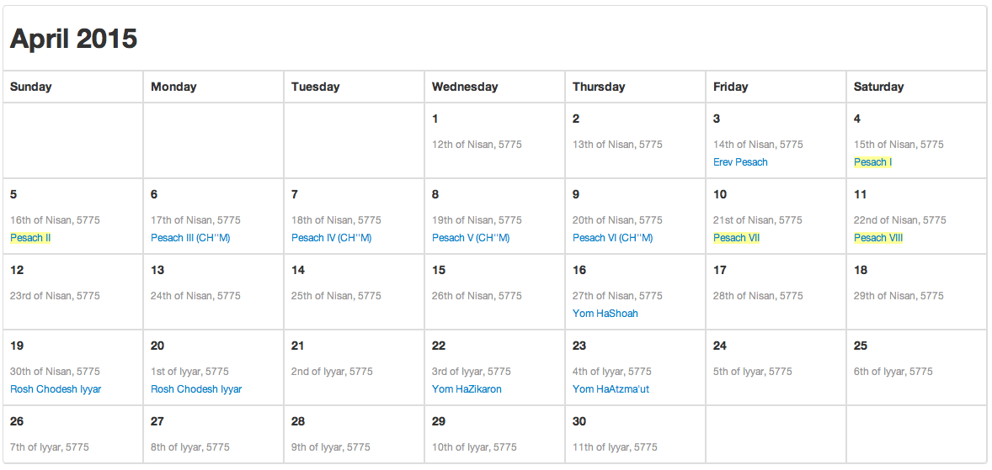
Notes:
Hebrew Calendar – April 2015

Slide 49
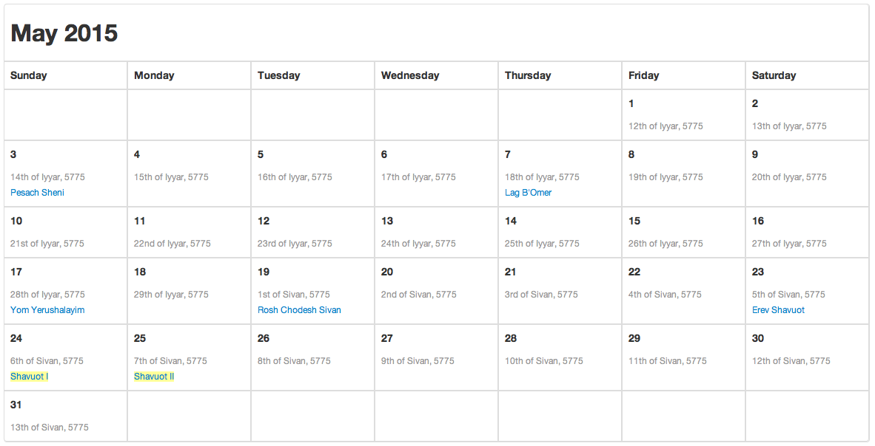
Notes:
Hebrew Calendar – May 2015

Slide 50
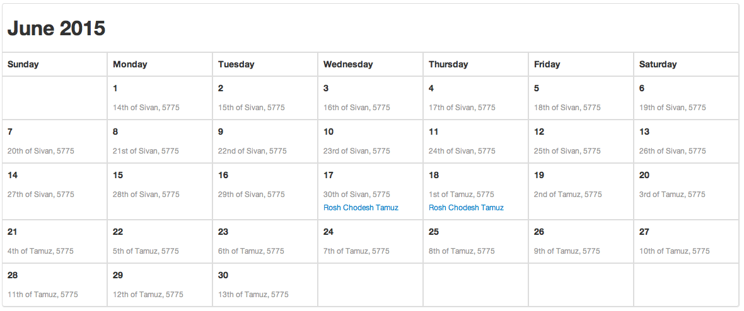
Notes:
Hebrew Calendar – June 2015

Slide 51

Notes:
Hebrew Calendar – July 2015

Slide 52

Notes:
Hebrew Calendar – August 2015

Slide 53

Notes:
Hebrew Calendar – September 2015

Slide 54
Notes:
Black

