Slide 1

With Delta stewardesses – Linda & Anat

Slide 2
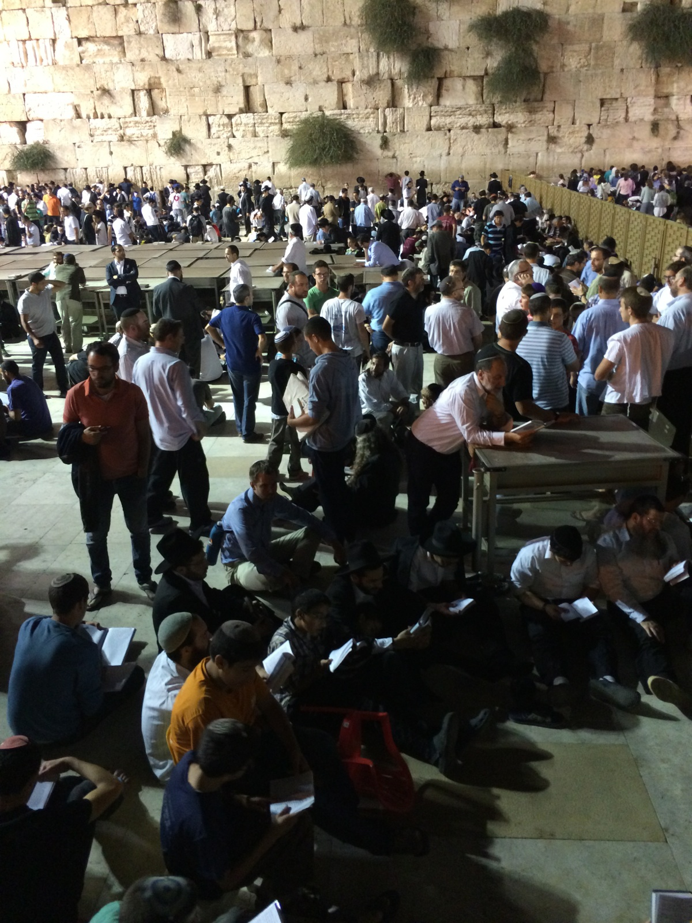
The Western Wall on Tisha b’Av

Slide 3
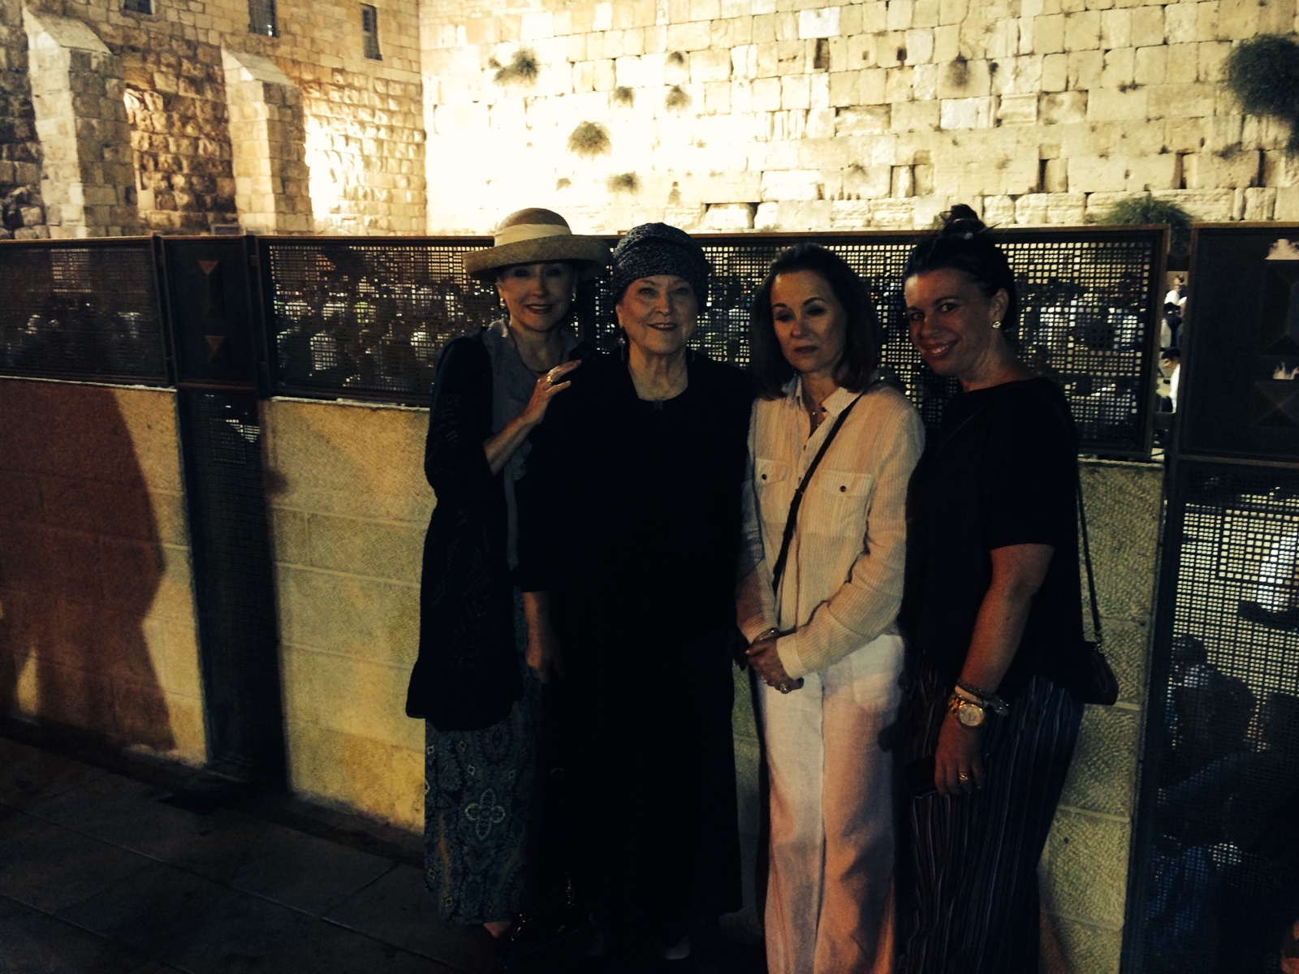
Western Wall – Shelli, Billye, Lynne, Heather

Slide 4
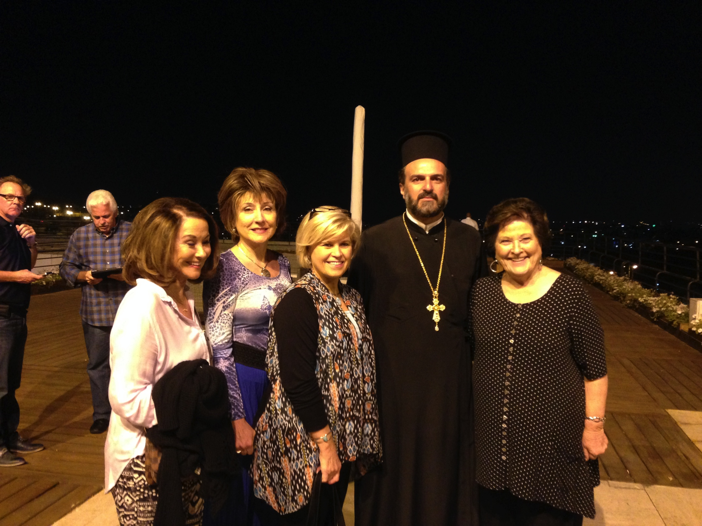
With Sharon Daugherty & Father Gabriel Naddaf

Slide 5
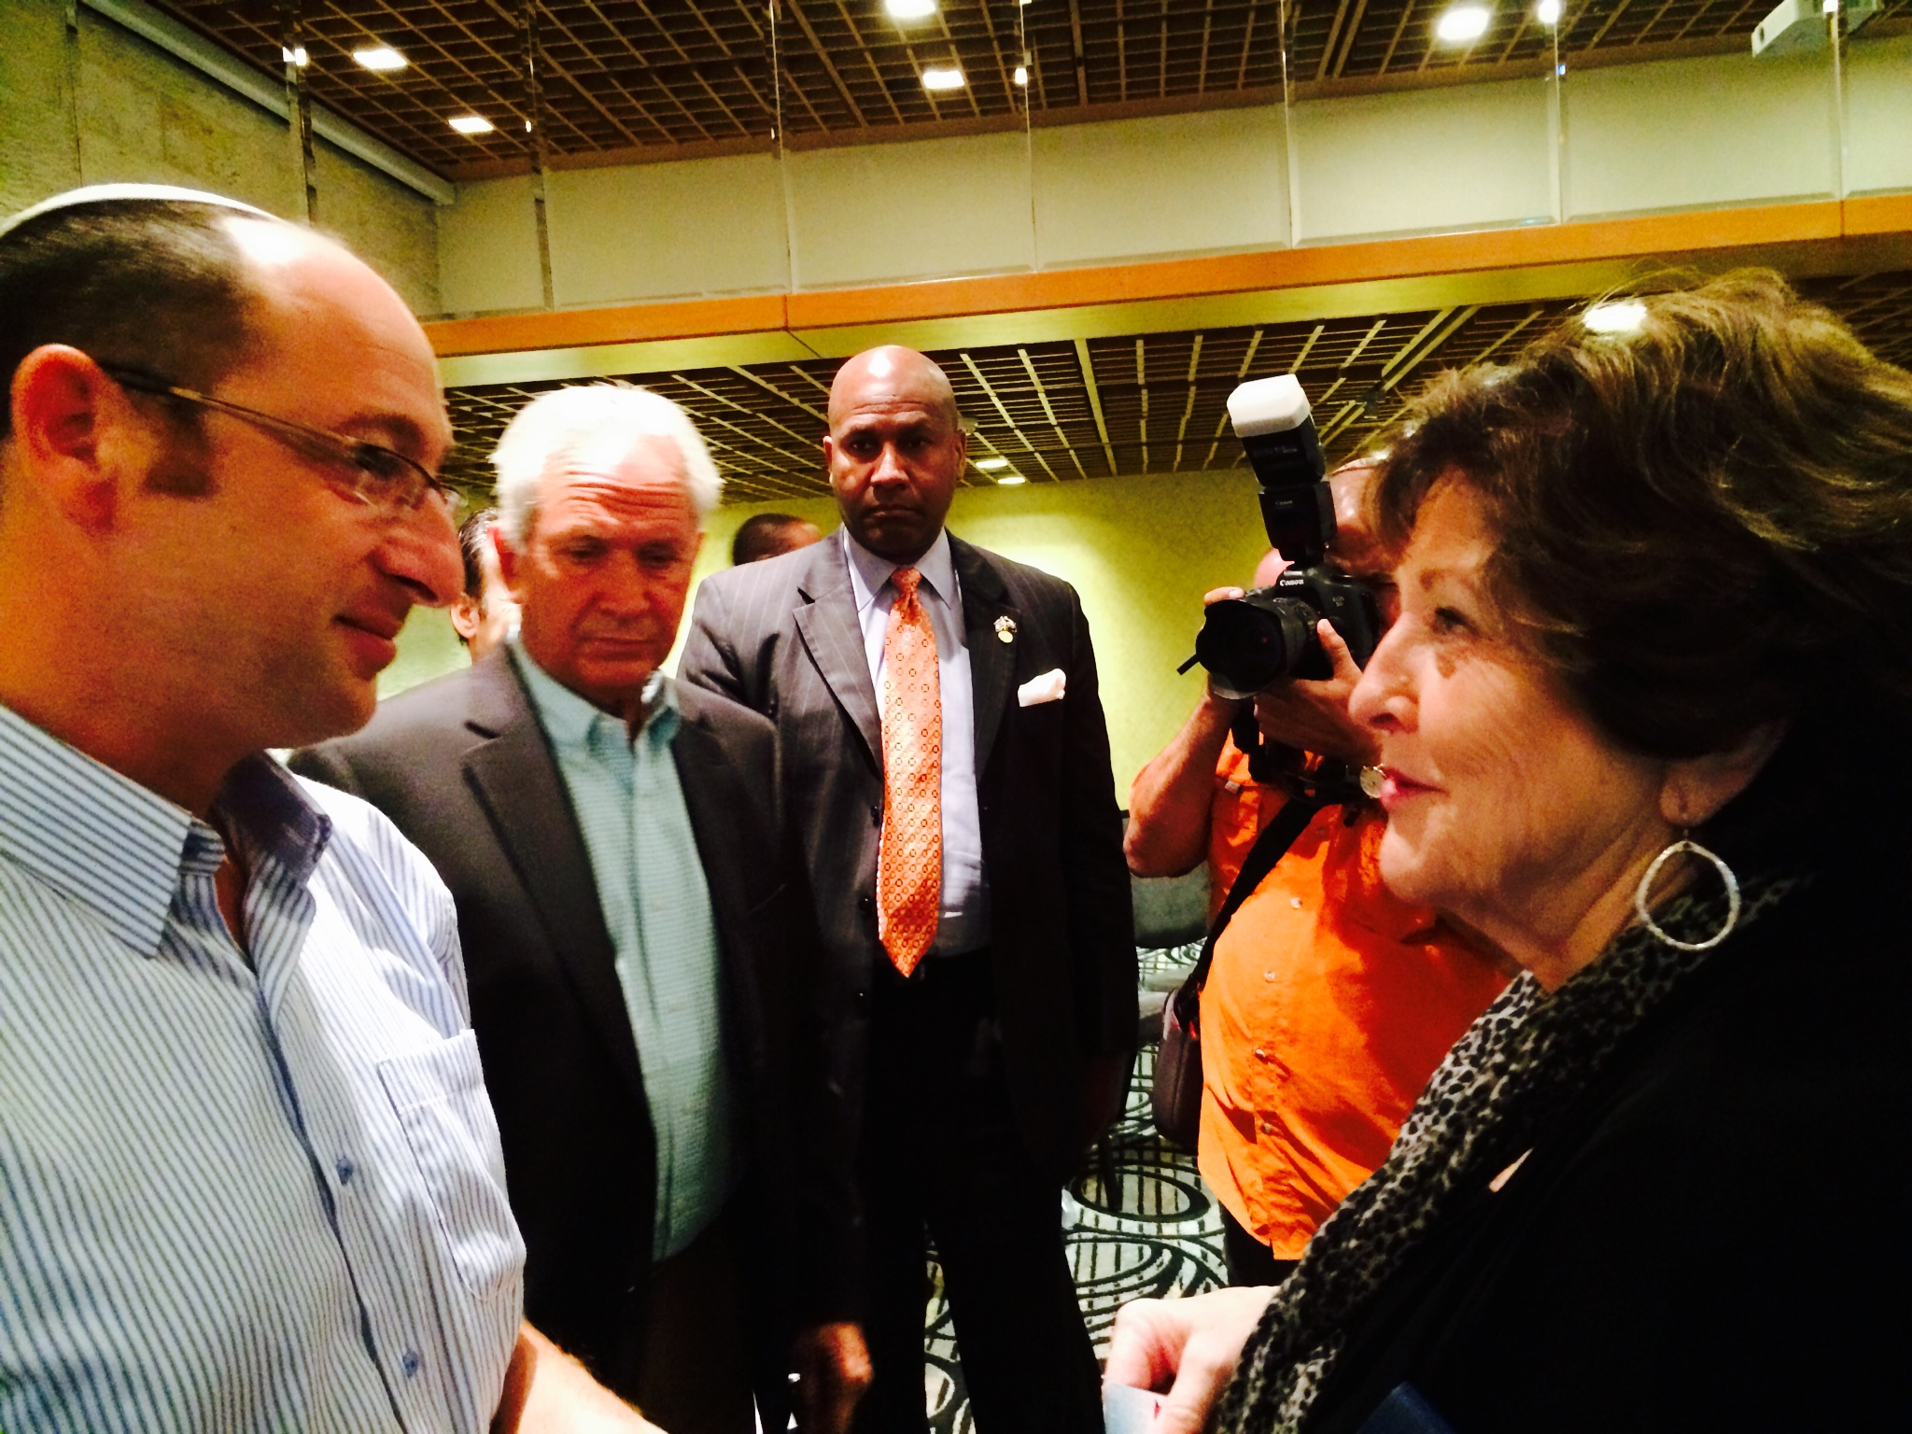
Billye w/ Father of one of teenagers killed

Slide 6
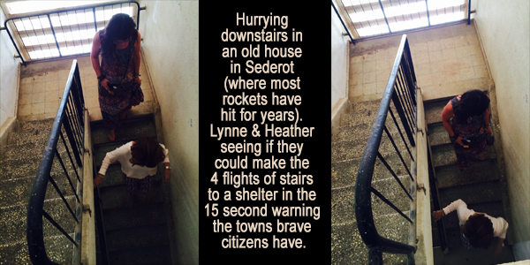
Sederot – Lynne & Heather running stairs

Slide 7
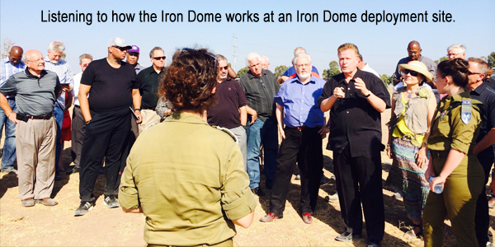
Listening to speaker at Iron Dome deployment site

Slide 8
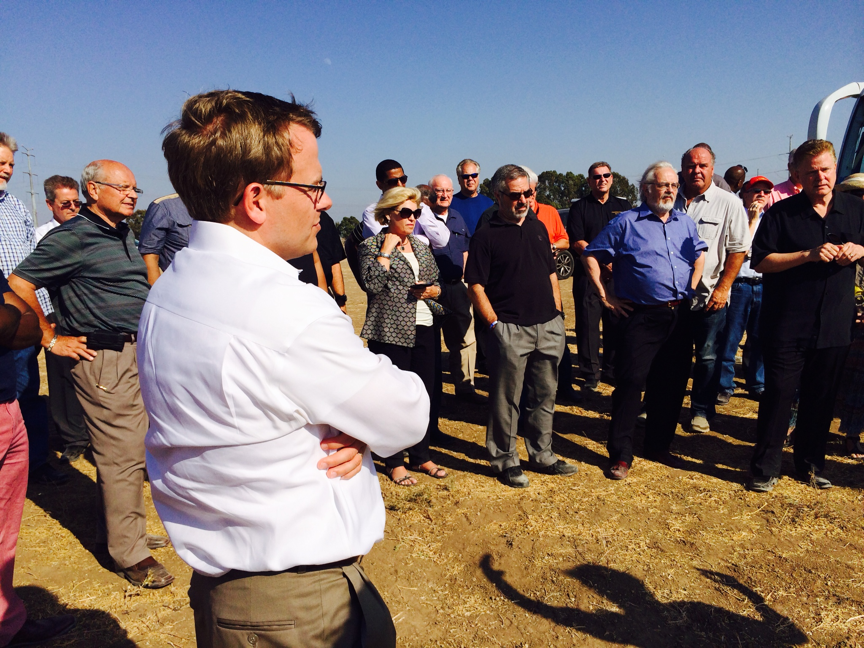
Todd Burpo at Iron Dome deployment site

Slide 9
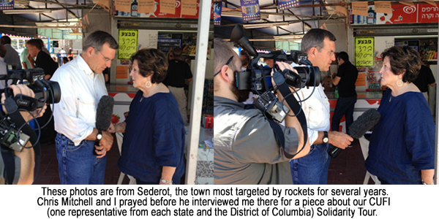
Interview w/ Chris Mitchell

Slide 10
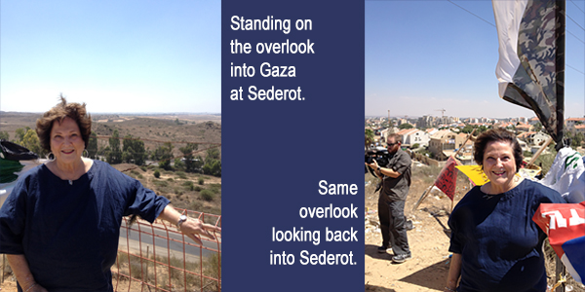
Billye on overlook into Gaza at Sederot

Slide 11
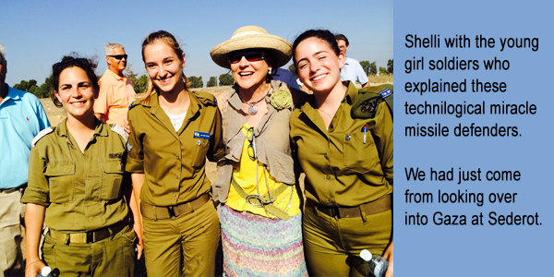
Shelli with young girl soldiers

Slide 12
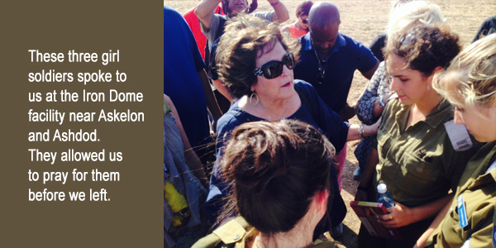
Billye praying with girl soldiers

Slide 13
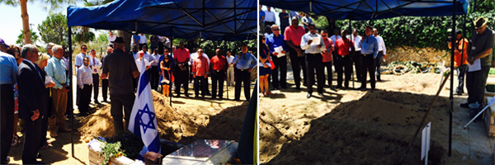
Mt Herzl Cemetary, graves of soldiers

Slide 14
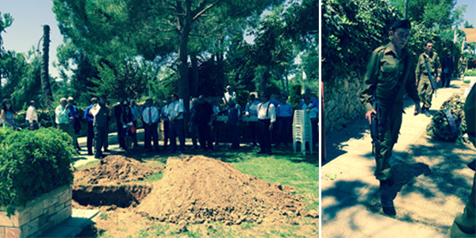
Graveside, young soldiers walking

Slide 15
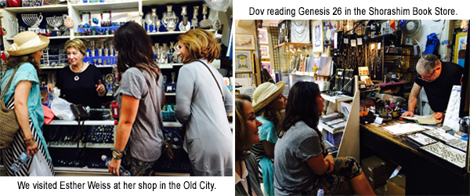
Shops in Jerusalem-Esther Weiss, Dov reading Gen 26

Slide 16
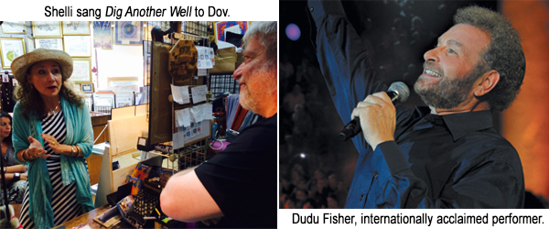
Shelli singing to Dov, Dudu Fisher

Slide 17
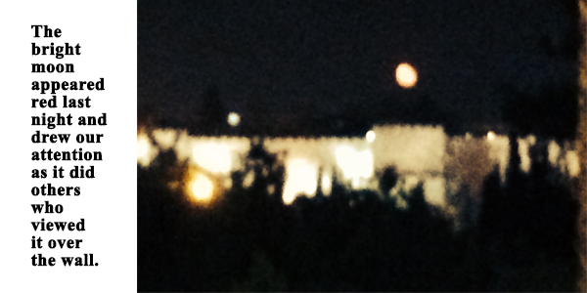
Red moon over the wall

Slide 18
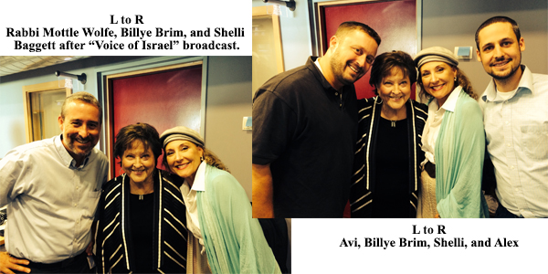
Rabbi Mottle Wolfe, Avi, & Alex – Voice of Israel radio

Slide 19
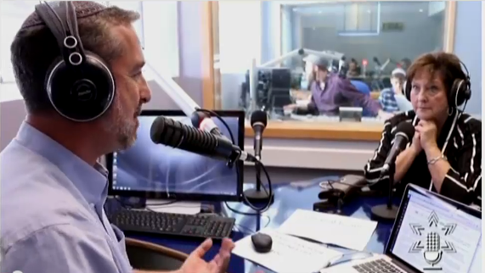
Voice of Israel 1

Slide 20
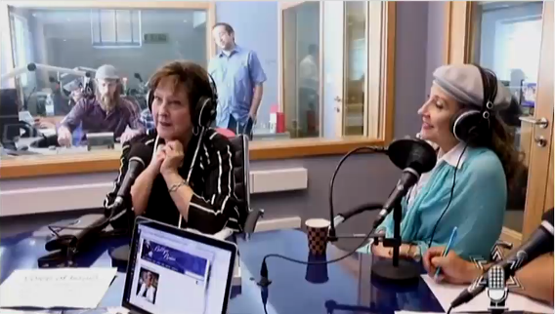
Voice of Israel 2

Slide 21
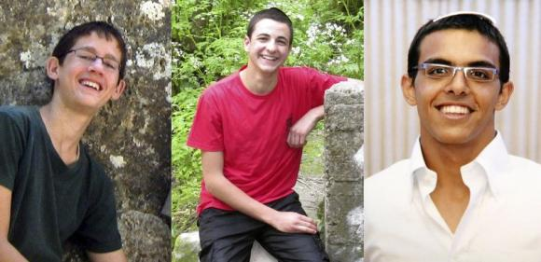
3 Israeli Teens
Naftali Fraenkel Gilad Sharr Eyal Yifrach

Slide 22
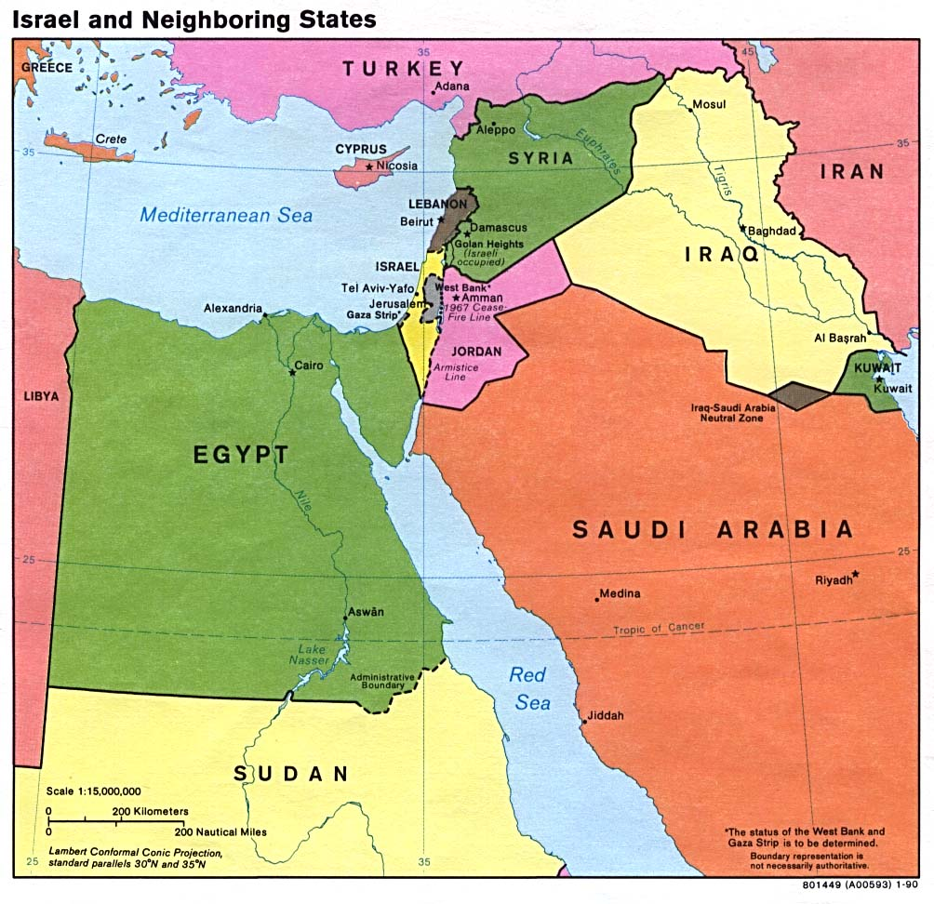
Map –Israel & Neighboring

Slide 23
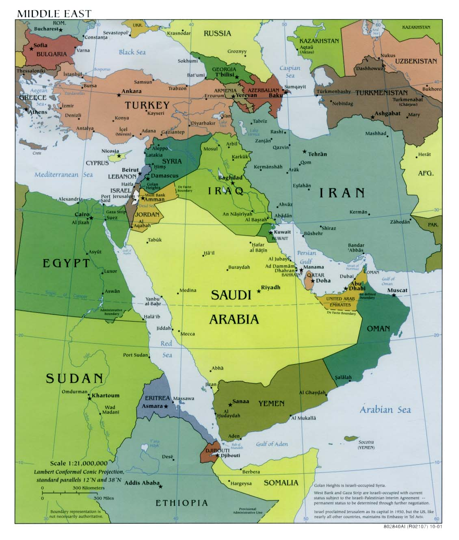
Map –Middle East

Slide 24
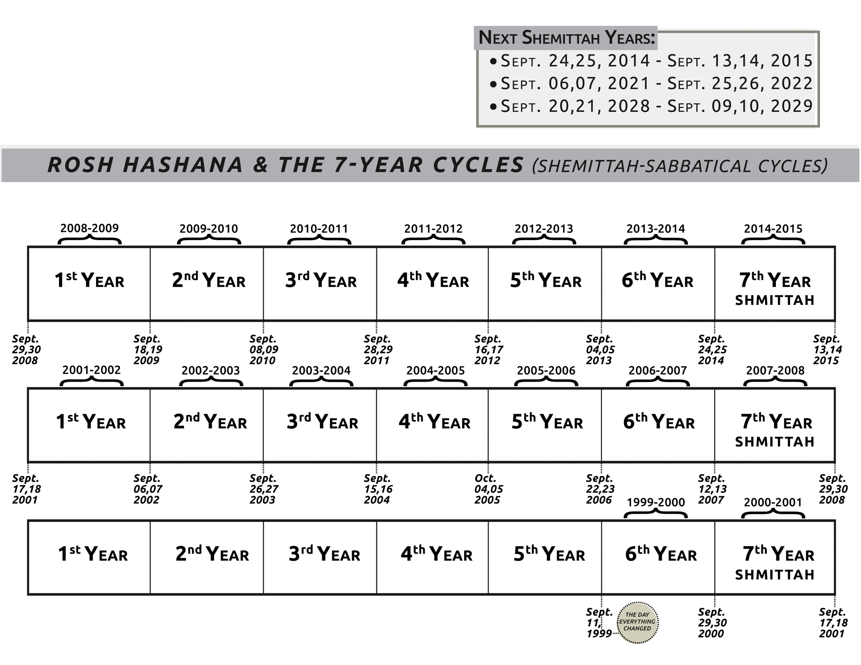
Shemittah chart

Slide 25
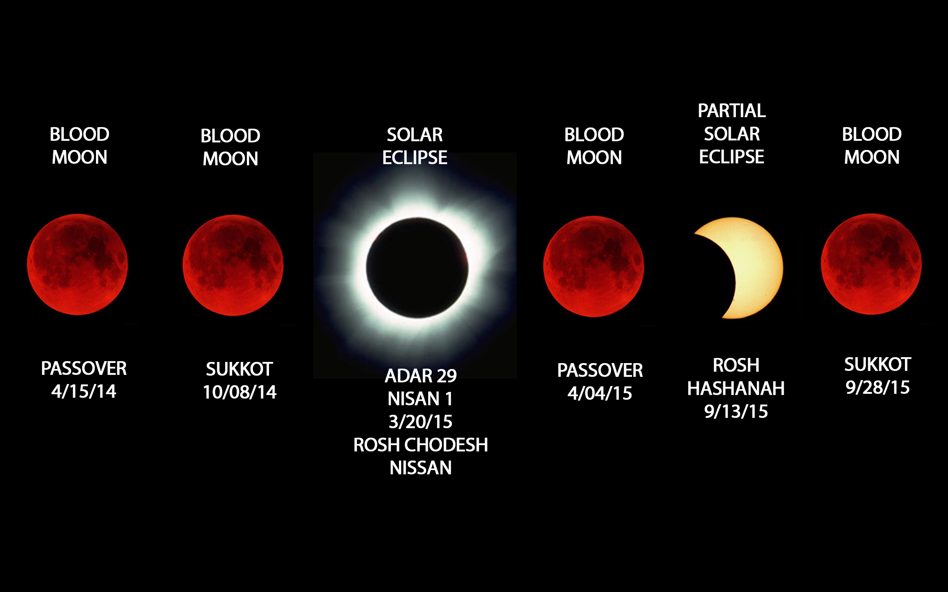
Blood Moons chart

Slide 26
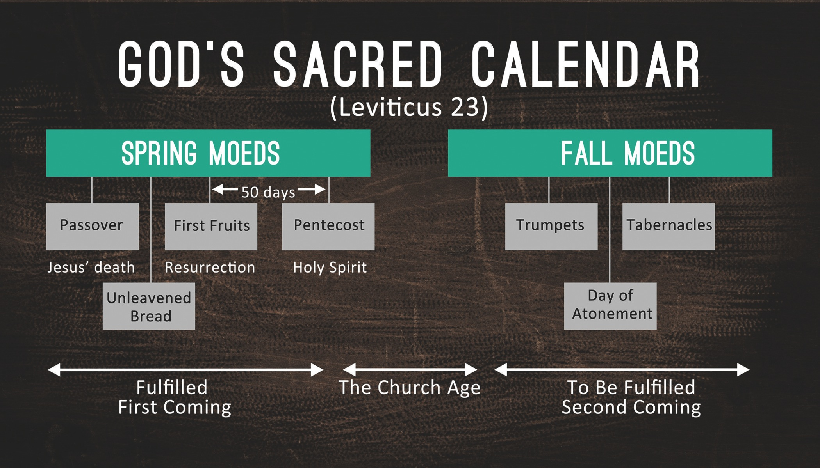
God’s Sacred Calendar

Slide 27
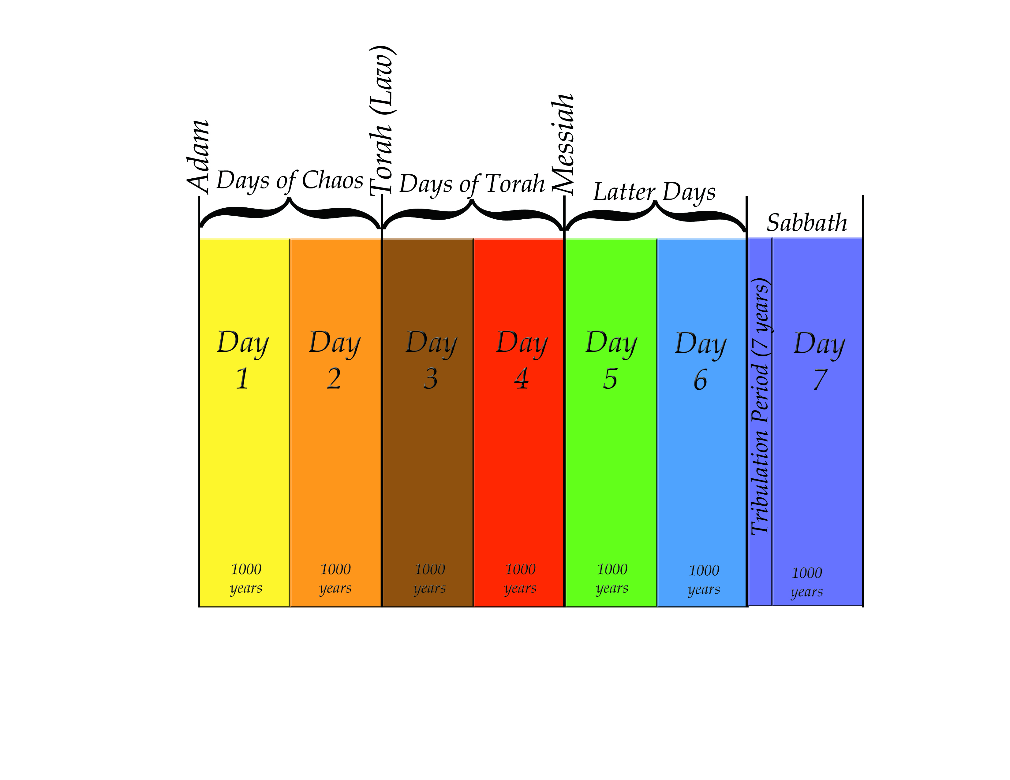
7 Day Chart

Slide 28
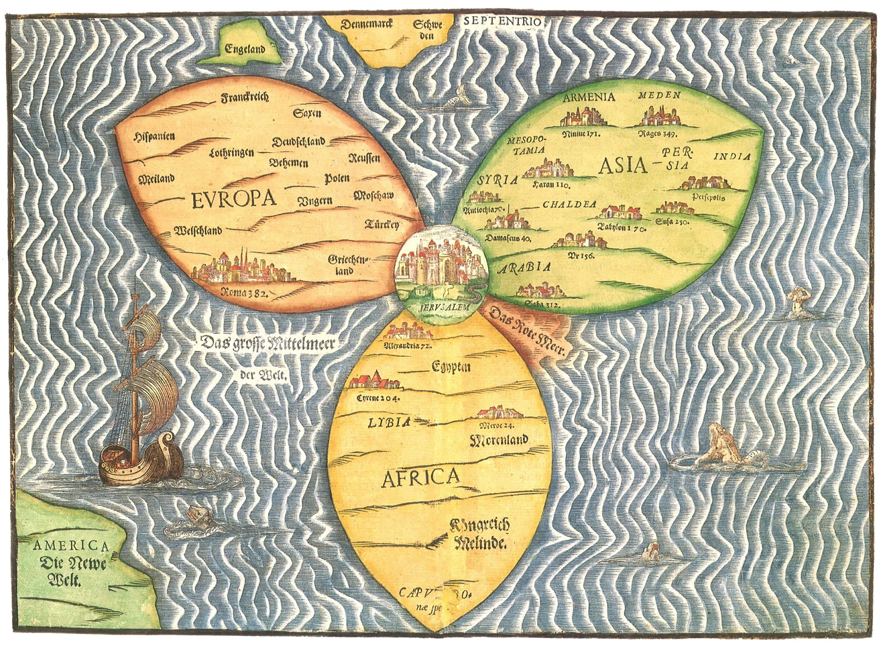
Ancient 3 Petal Map

Slide 29
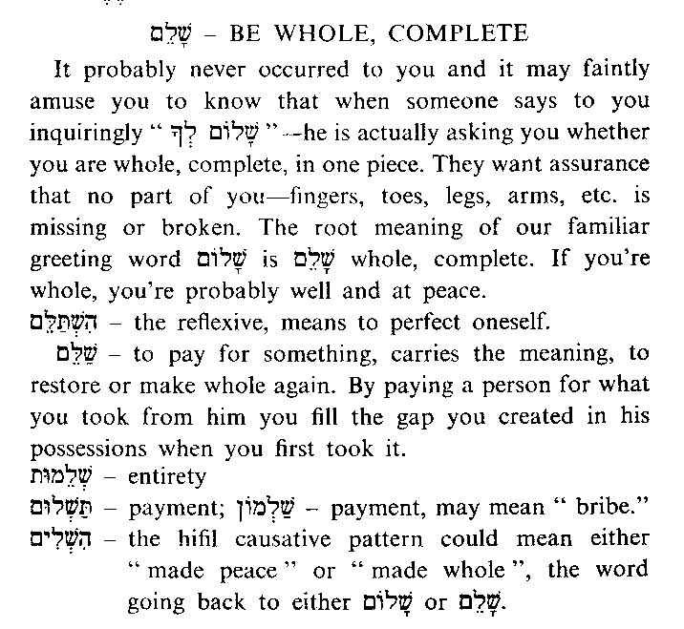
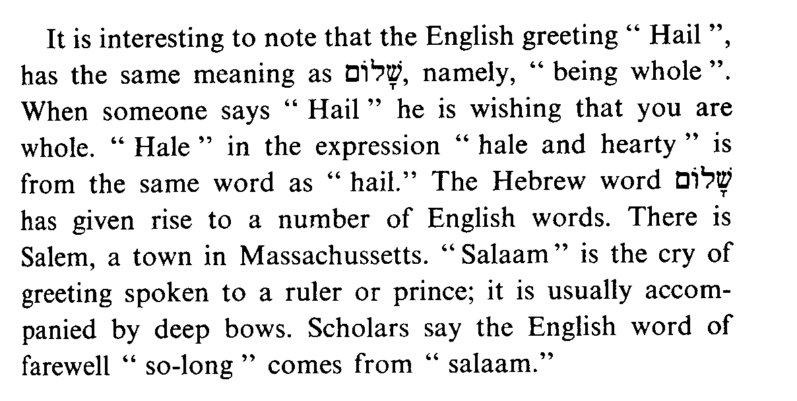
Shalom-Be Whole,
Complete

Slide 30
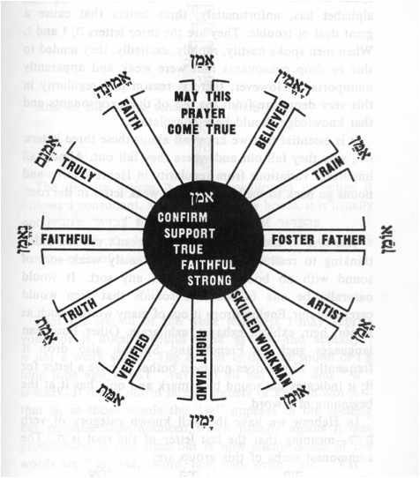
Amen Word Wheel

Slide 31
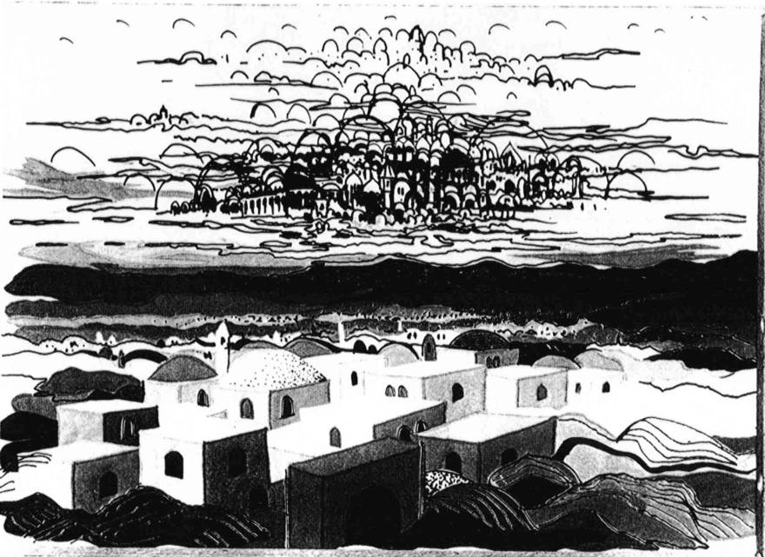
2 Jerusalems Painting B&W

Slide 32
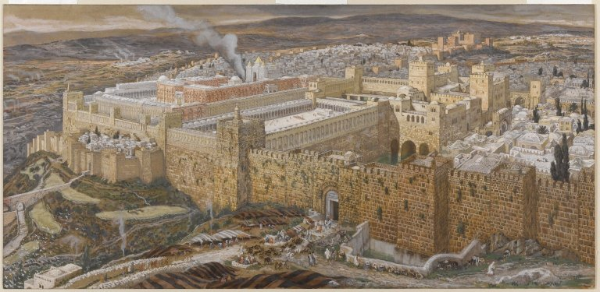
Jerusalem w/Temple Painting
Notes:
James Tissot - Reconstruction of Jerusalem and the Temple of Herod - Brooklyn Museum
This image was uploaded as a donation by the Brooklyn Museum, and is considered to have no known copyright restrictions by the institutions of the Brooklyn Museum.

Slide 33
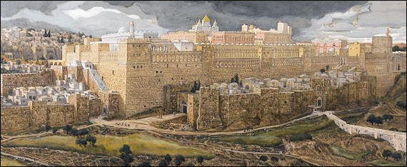
Jeruslaem w/Temple Painting 2
Notes:
James Tissot - Reconstruction of Jerusalem and the Temple of Herod - Brooklyn Museum
This image was uploaded as a donation by the Brooklyn Museum, and is considered to have no known copyright restrictions by the institutions of the Brooklyn Museum.

Slide 34
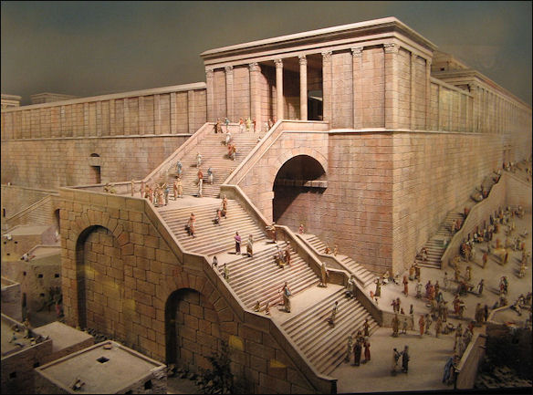
Temple w/Steps Painting
Notes:
This image was uploaded as a donation by the Brooklyn Museum, and is considered to have no known copyright restrictions by the institutions of the Brooklyn Museum.

Slide 35
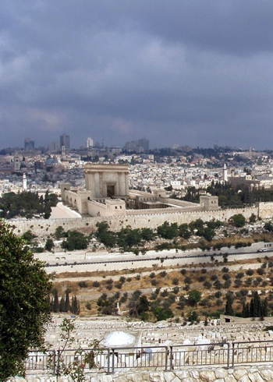
Temple of Tomorrow from The
Temple Institute
Notes:
Taken from www.TheTempleInstitute.org
Used by Permission.

Slide 36
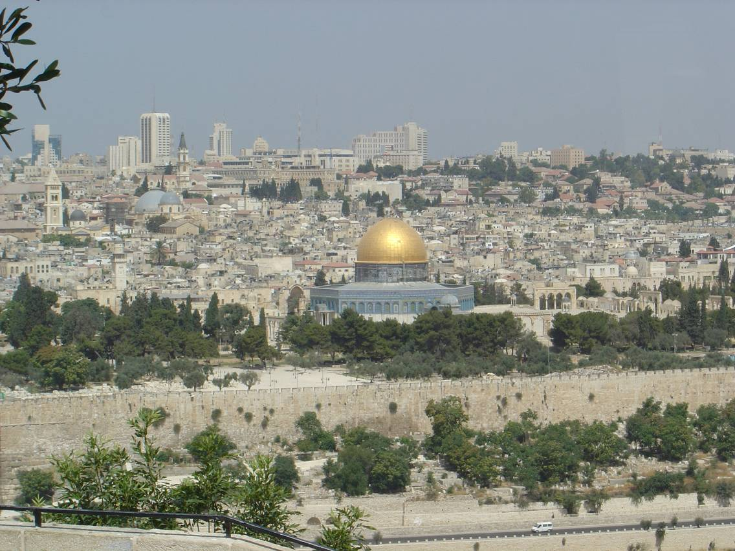
Jerusalem Temple Mount w/Dome

Slide 37
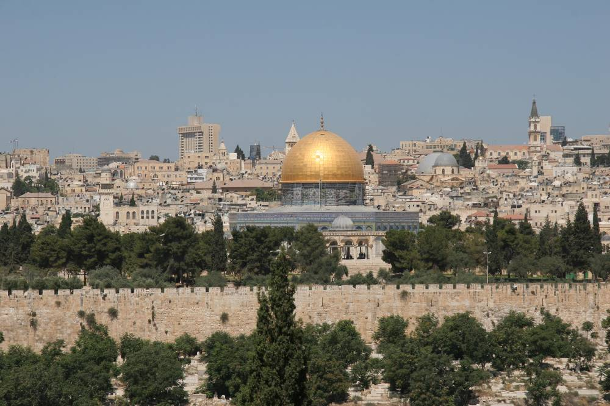
Jerusalem w/Dome

Slide 38
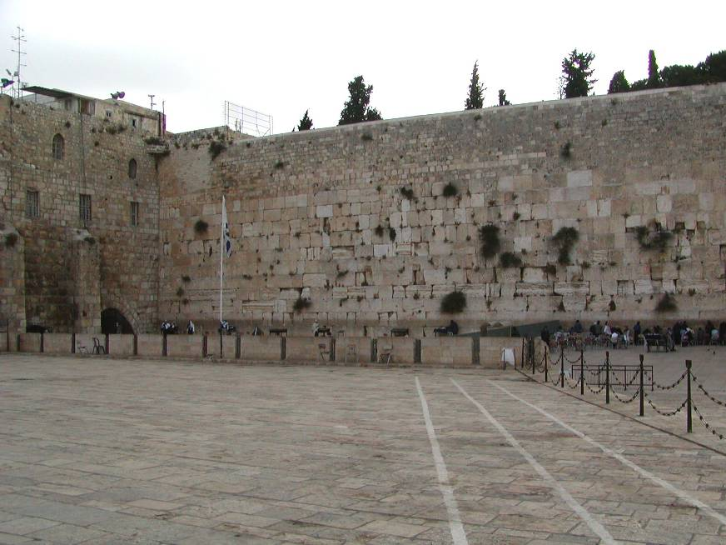
Jerusalem – Western Wall

Slide 39
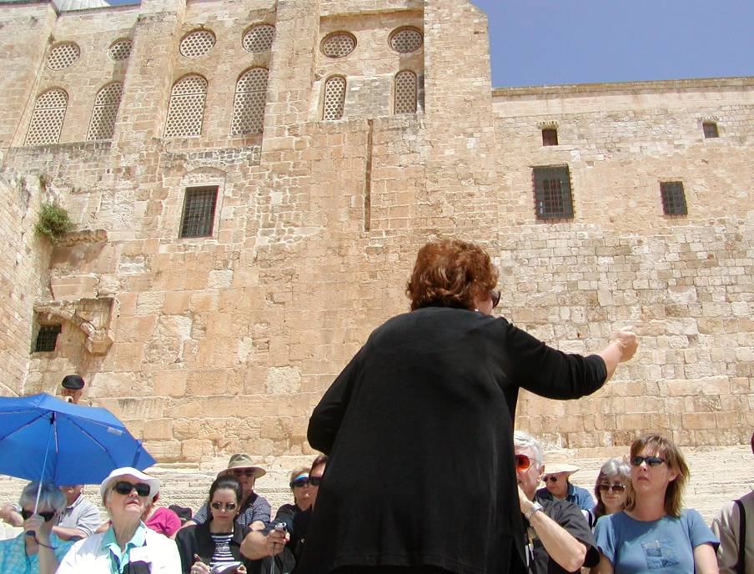
Jerusalem – Temple Southern Steps

Slide 40
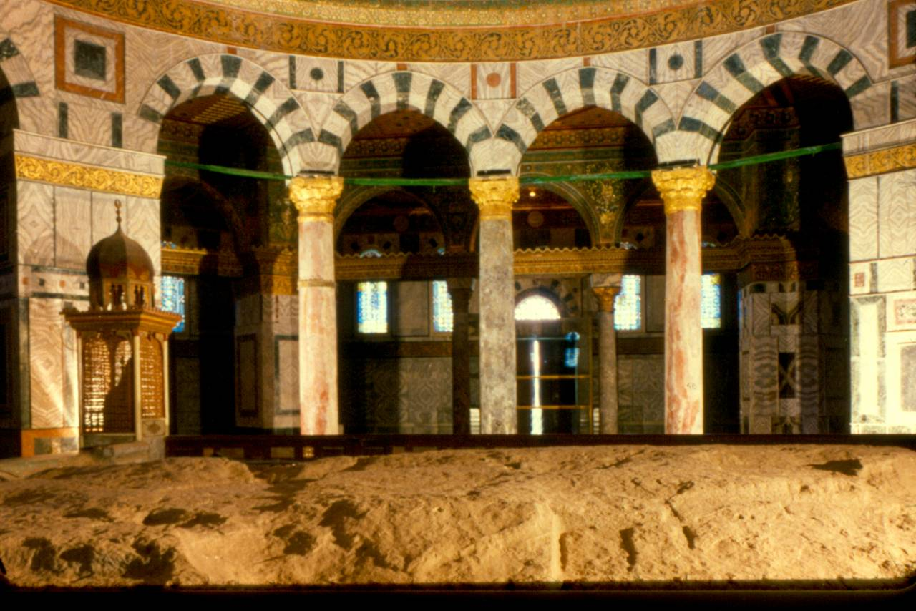
Inside Dome of the Rock

Slide 41
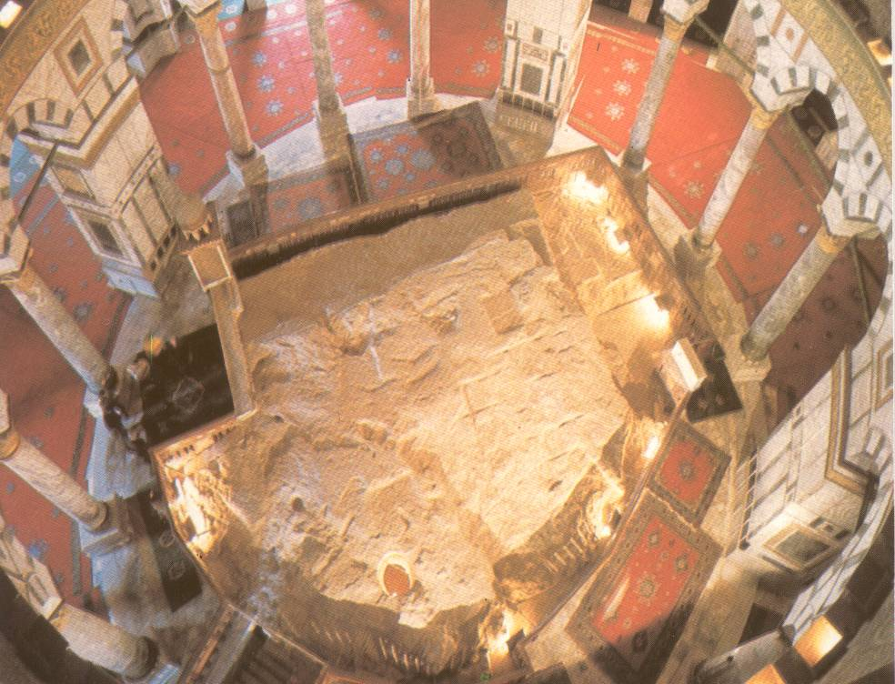
The Rock under the Dome

Slide 42
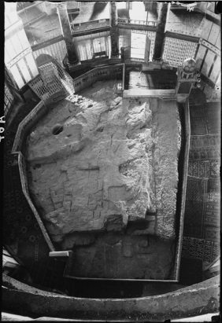
Rock under
Dome B&W

Slide 43

Autumn Assembly ad

Slide 44
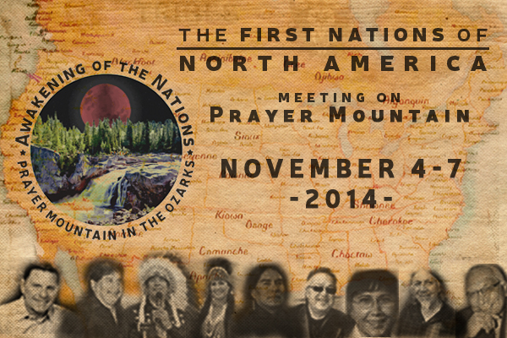
Awakening of the Nations mtg

