Slide 2
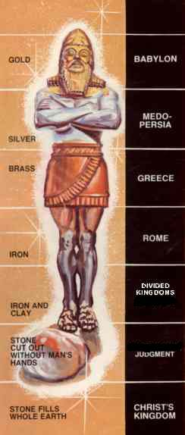
Daniel- Image from dream
Notes:
94 Daniel- Image from dream

Slide 3
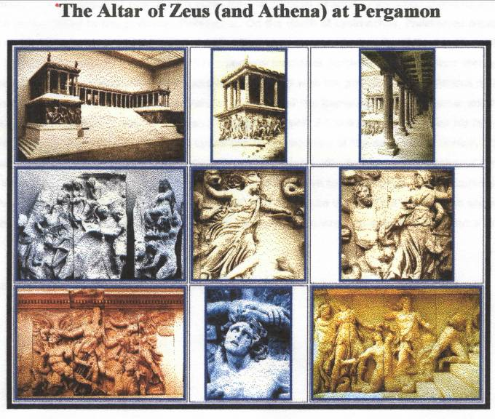
Brussels: The Altar of Zeus (and Athena) at Pergamon
Notes:
67 Brussels: The Altar of Zeus (and Athena) at Pergamon

Slide 4
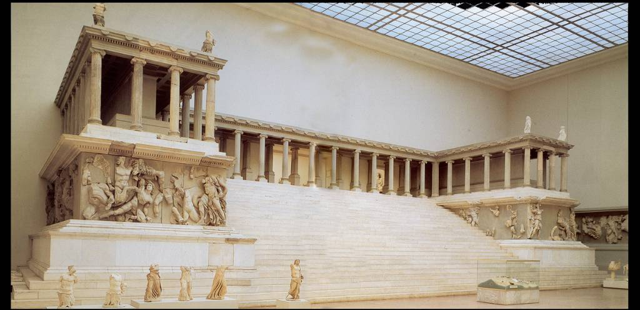
Notes:
68 Brussels: Pergamon Altar Picture from book, full view

Slide 5
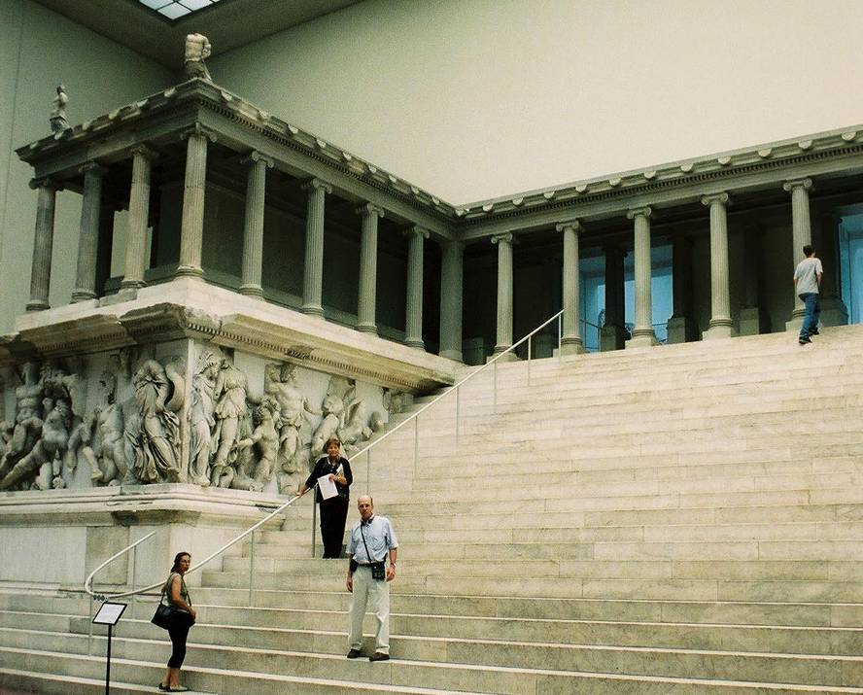
Brussels-Pergamon Altar, BB & Pastor on steps
Notes:
69 Brussels-Pergamon Altar, Billye Brim & Pastor on steps

Slide 6
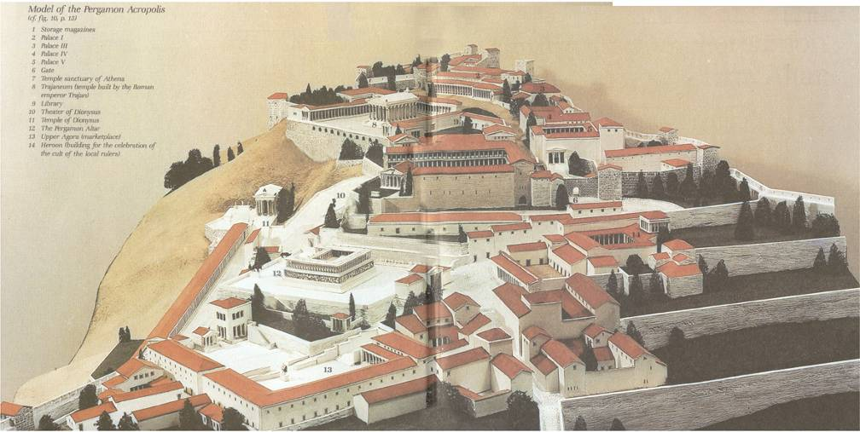
Notes:
70 Brussels-Pergamon Acropolis showing
Athena Temple Location
(from book, p.1)

Slide 7
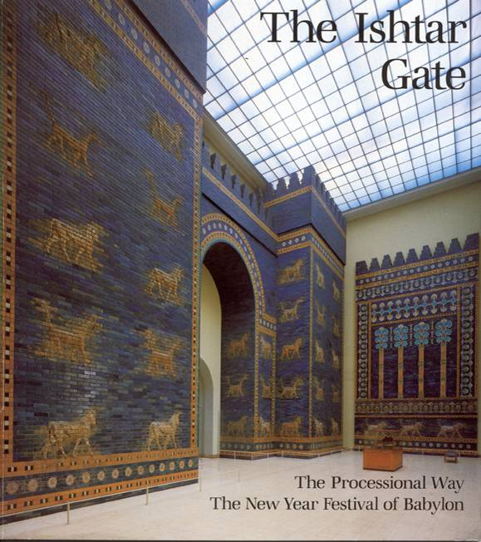
Ishtar Gate
Cover page
Notes:
178 Ishtar Gate
Cover page

Slide 8
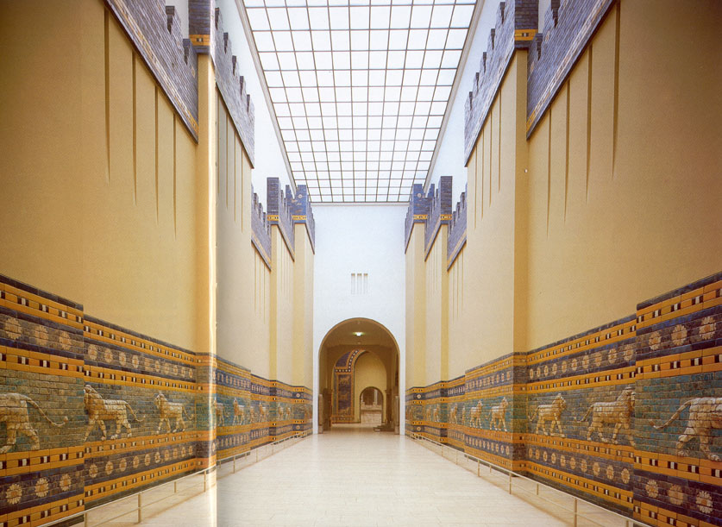
Ishtar Gate-The Processional Way p.10,11
Notes:
179 Ishtar Gate-The Processional Way p.10,11

Slide 9
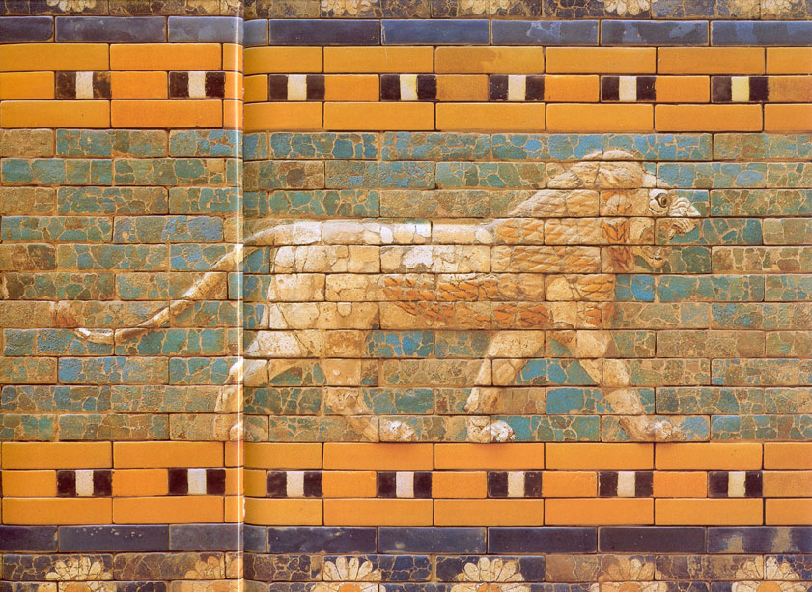
Ishtar Gate-Detail of the Lion Frieze on the Processional Way p.12
Notes:
180 Ishtar Gate-Detail of the Lion Frieze on the Processional Way p.12

Slide 10
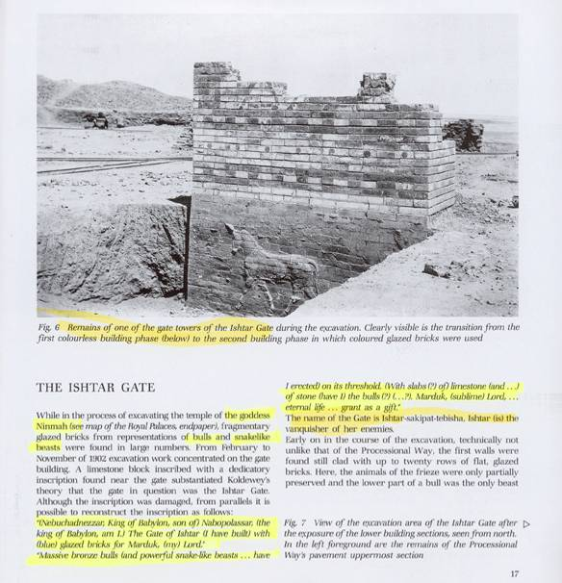
Notes:
181 Ishtar Gate- During excavation p.17

Slide 11
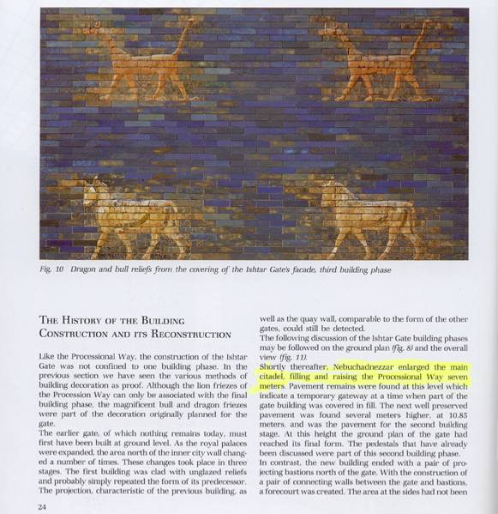
Notes:
182 Ishtar Gate- Bulls & Dragons p.24

Slide 12
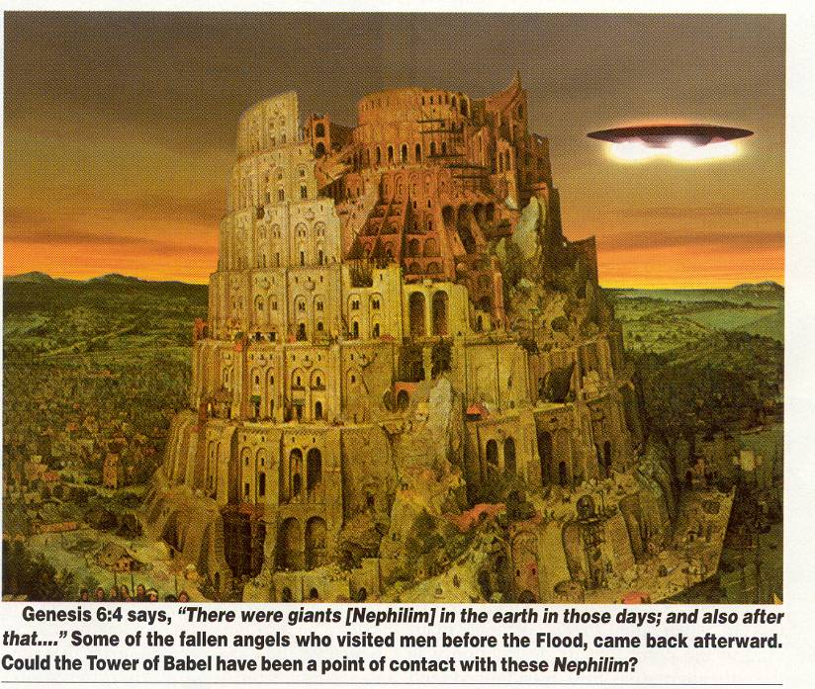
Tower of Bable w ufo
Notes:
476 Tower of Bable w ufo

Slide 13
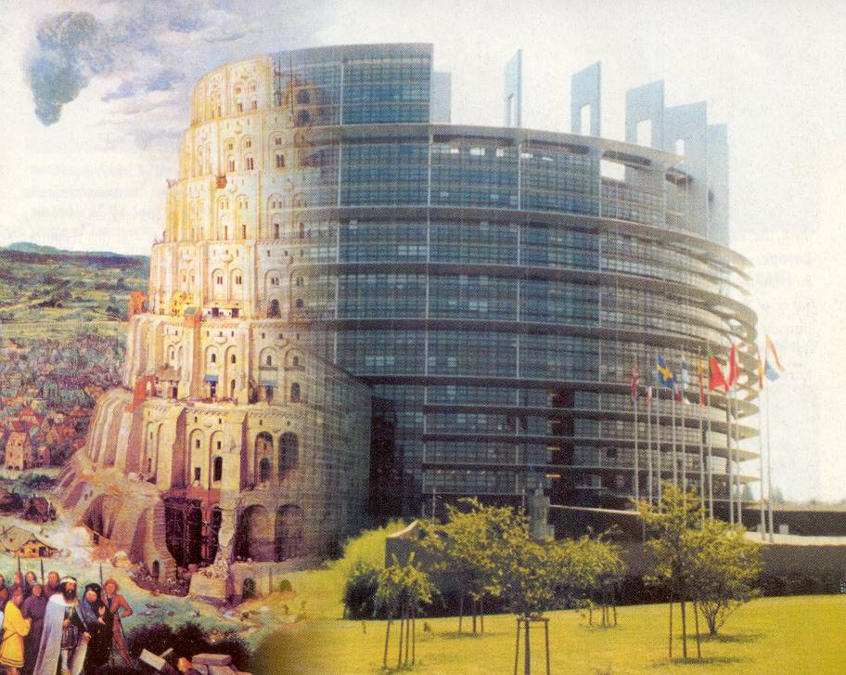
Tower of Babel – ½ Parliament bldg
Notes:
479 Tower of Babel – ½ Parliament bldg

Slide 14
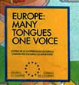
Notes:
483 Europe: Many Tongues One Voice – Close-up

Slide 15

Notes:
484 EU Stamp – Woman on bull with stars

Slide 16
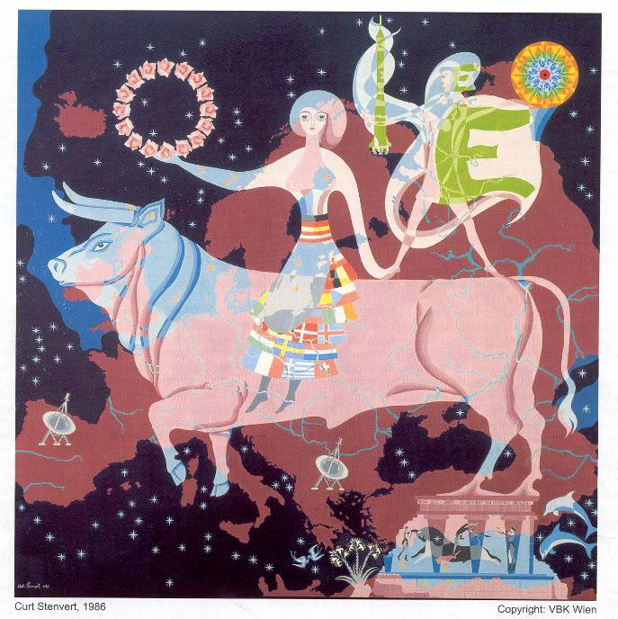
Notes:
485 EU – Discovering Europe painting – Woman on bull

Slide 17
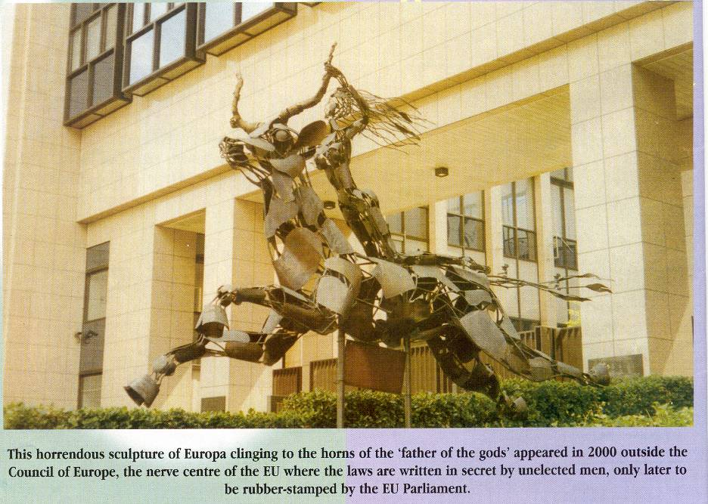
EU Woman on bull – metal sculpture

Slide 18
Notes:
EU – Discovering Europe painting – Woman on bull

Slide 19
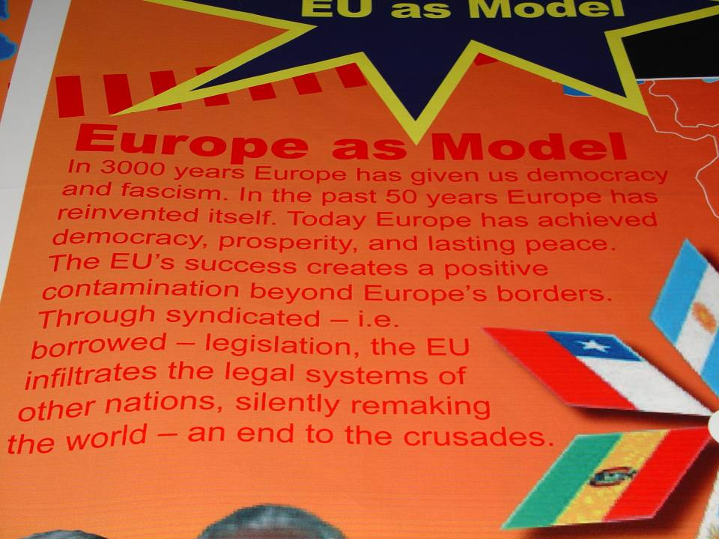
Europe as a Model
Notes:
499 Europe as a Model

Slide 20

Eu Passport
Notes:
501 Eu Passport

Slide 21
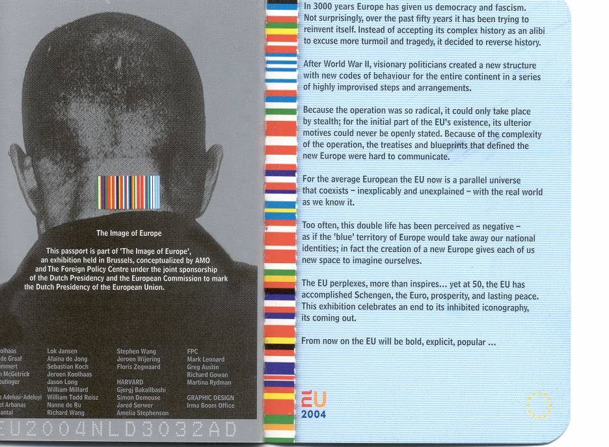
Eu Passport The Image of Europe
Notes:
510 Eu Passport The Image of Europe

Slide 22
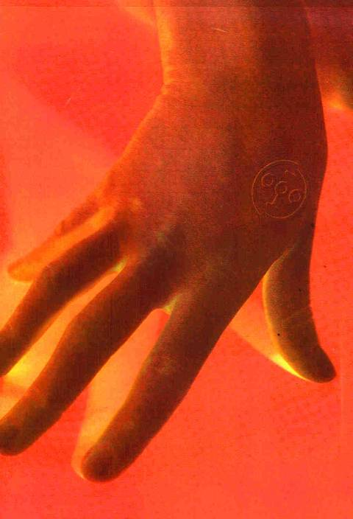
Notes:
14 Antichrist/Chip- Chip in hand

Slide 23
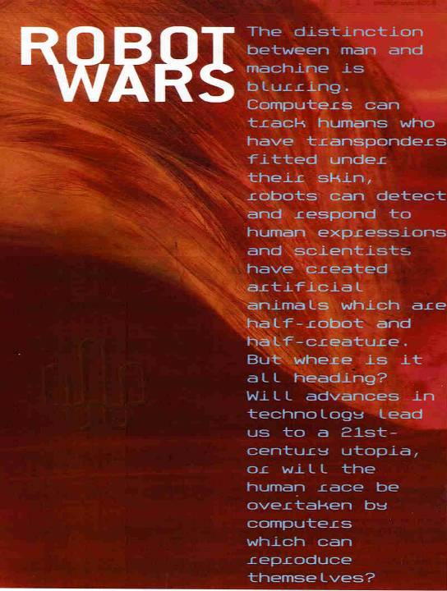
Notes:
15 Antichrist/Chip- Robot Wars article

Slide 24

Notes:
16 Antichrist/Chip- Design Closeup

Slide 25
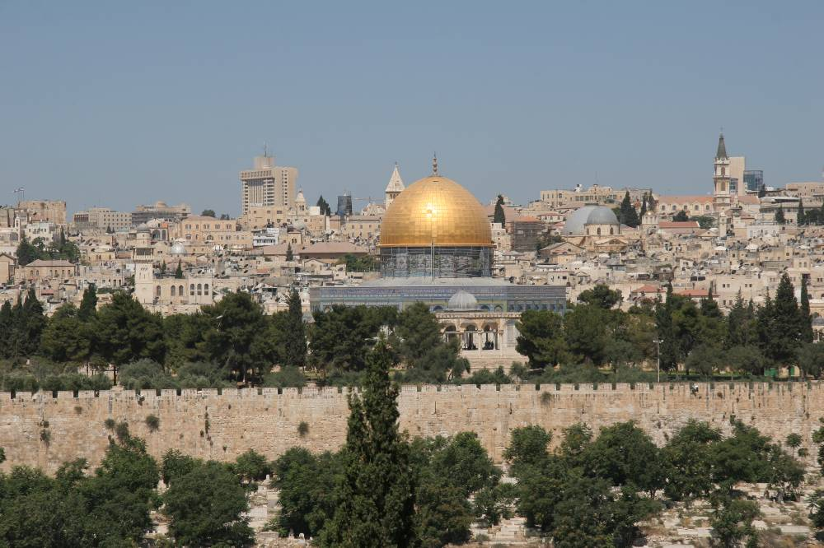
Templemount
Notes:
558 Temple mount

Slide 26
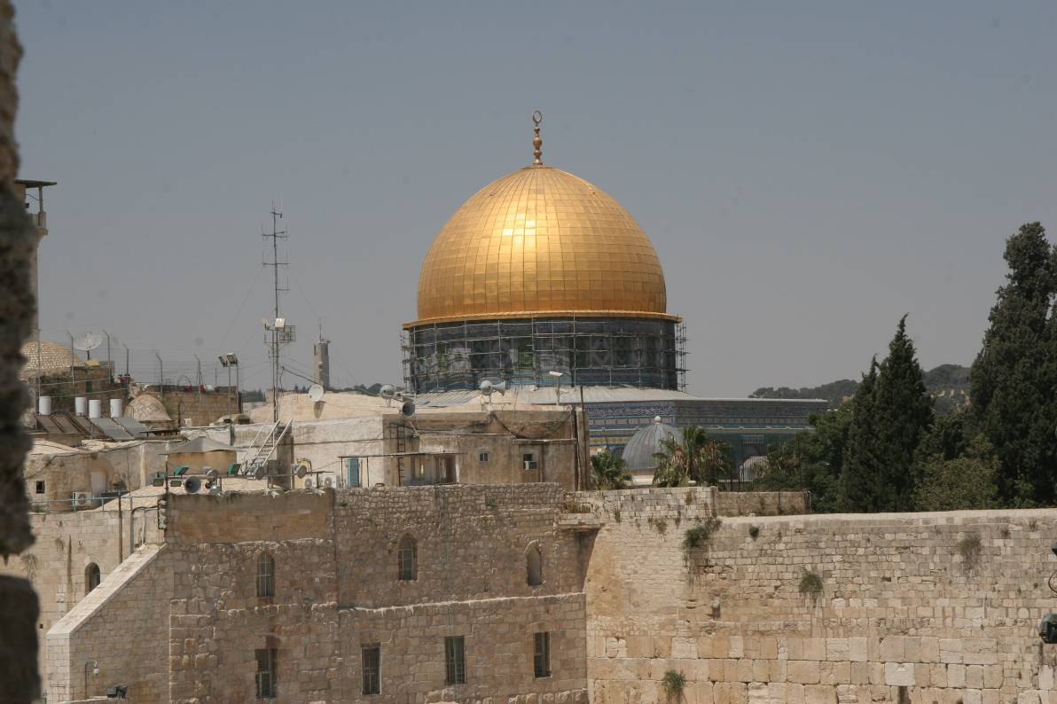
Dome
Notes:
538 Dome

Slide 27
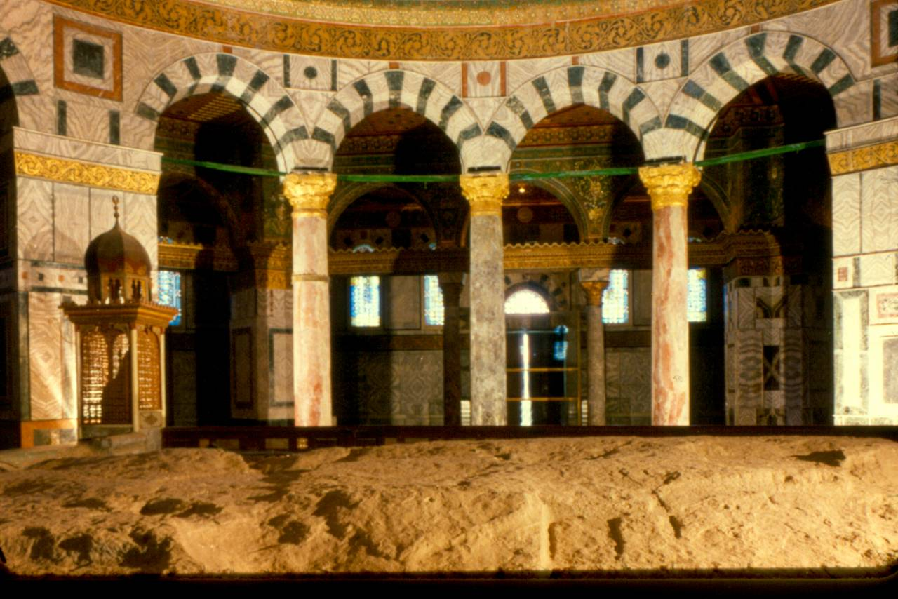
Inside Dome
Notes:
540 Inside Dome

Slide 28
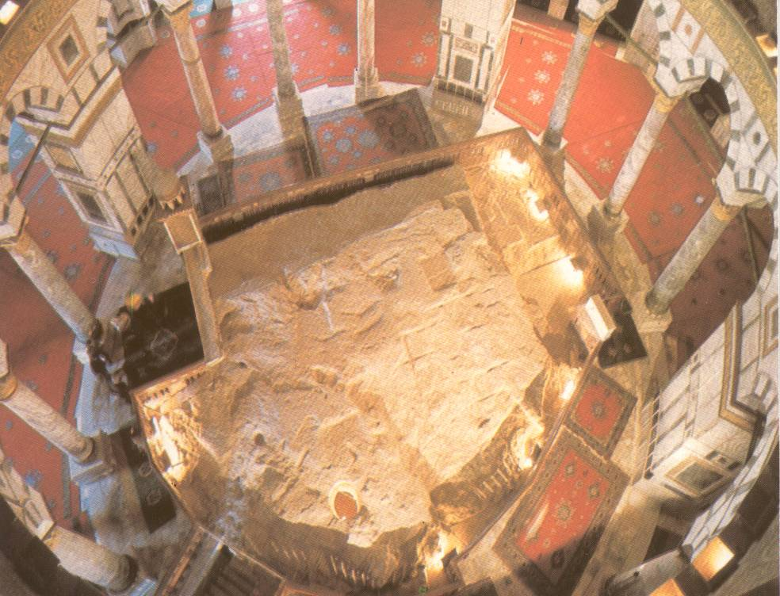
Rock top-view
Notes:
557 Rock top-view

Slide 29
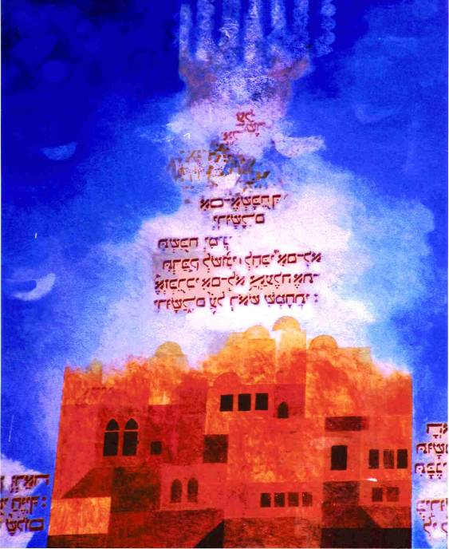
Heavenly Jerusalem- Synagogue
Notes:
158 Heavenly Jerusalem- Synagogue

Slide 30
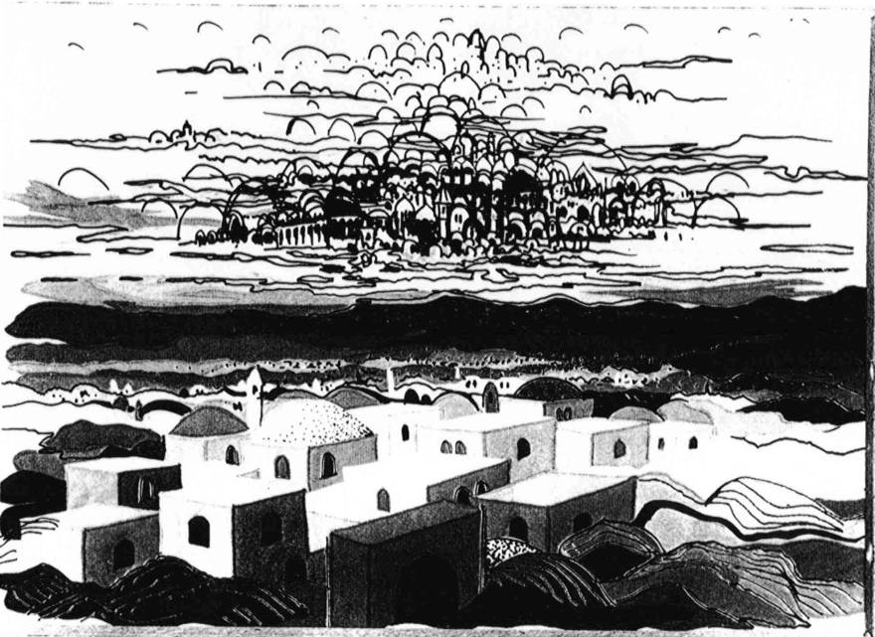
Heavenly Jerusalem- Baracha Laver
Notes:
159 Heavenly Jerusalem- Baracha Laver

Slide 31
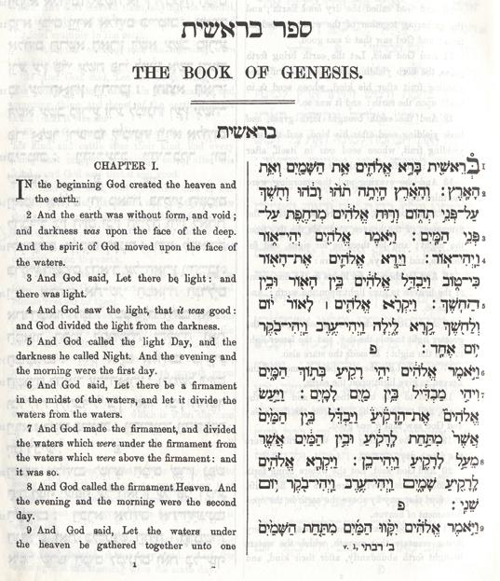
Hebrew- Genesis 1 page
Notes:
161 Hebrew- Genesis 1 page

Slide 32
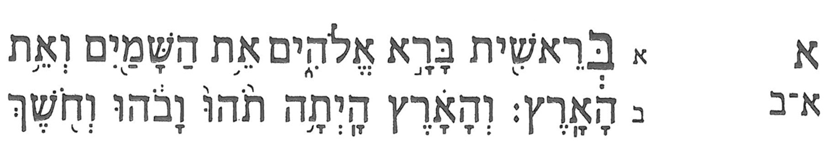

Slide 34
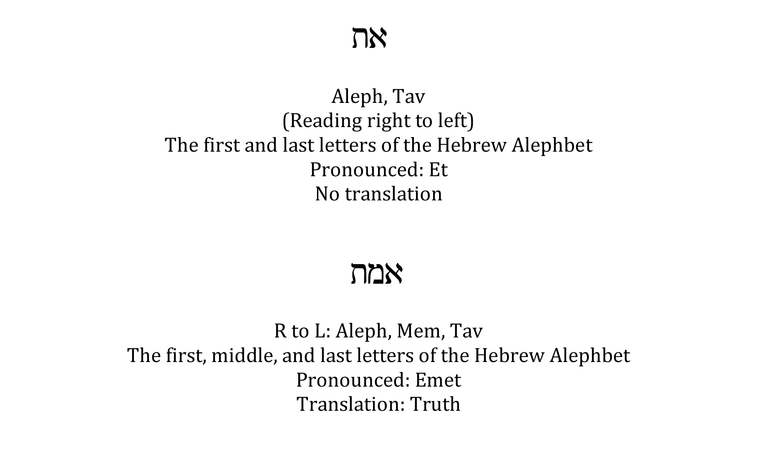

Slide 35
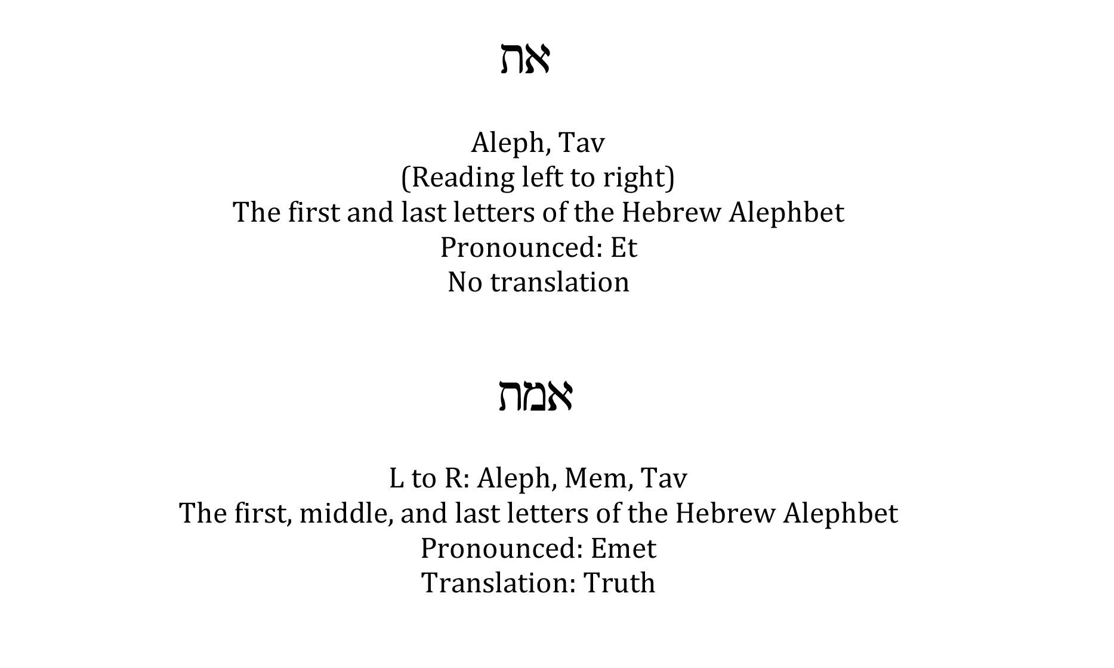

Slide 36
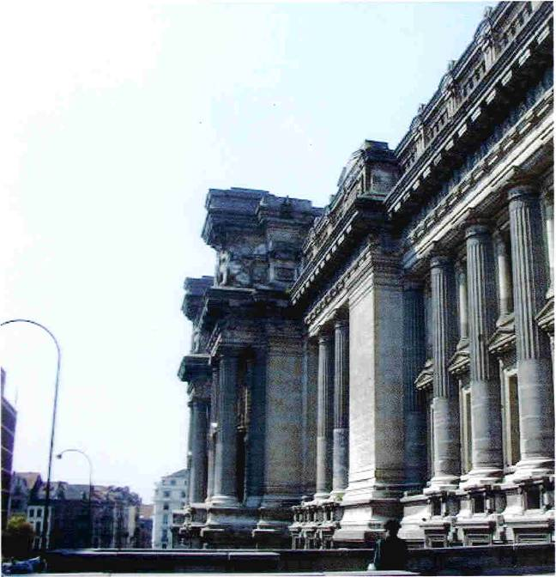
Notes:
340 Palais De Justice- Outside Front from Side

Slide 37
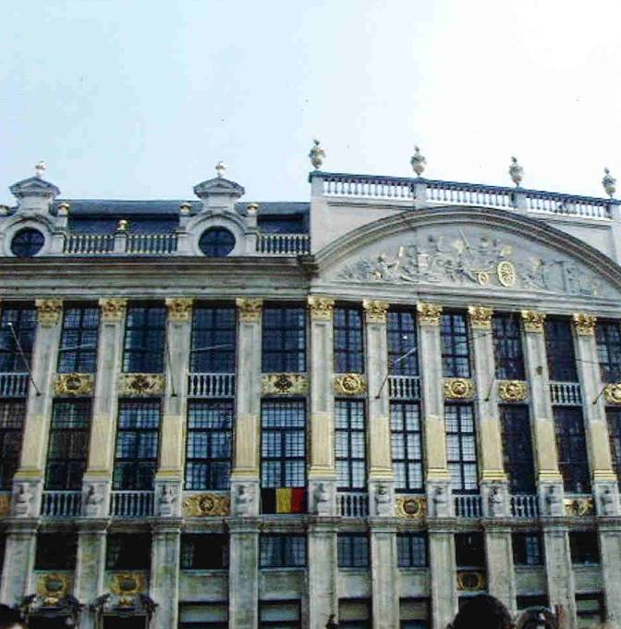
Notes:
341 Palais De Justice- Outside Front

Slide 38
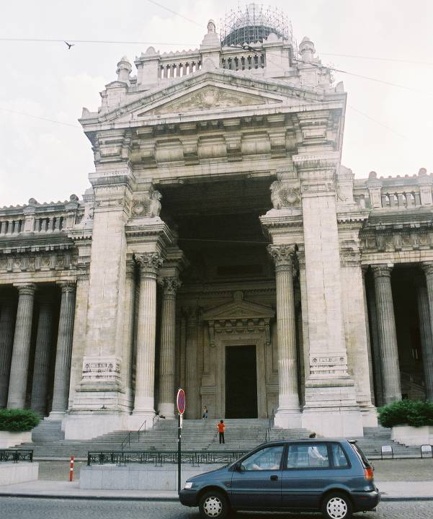
Notes:
342 Palais de Justice- Entry (shows Athena)

Slide 39
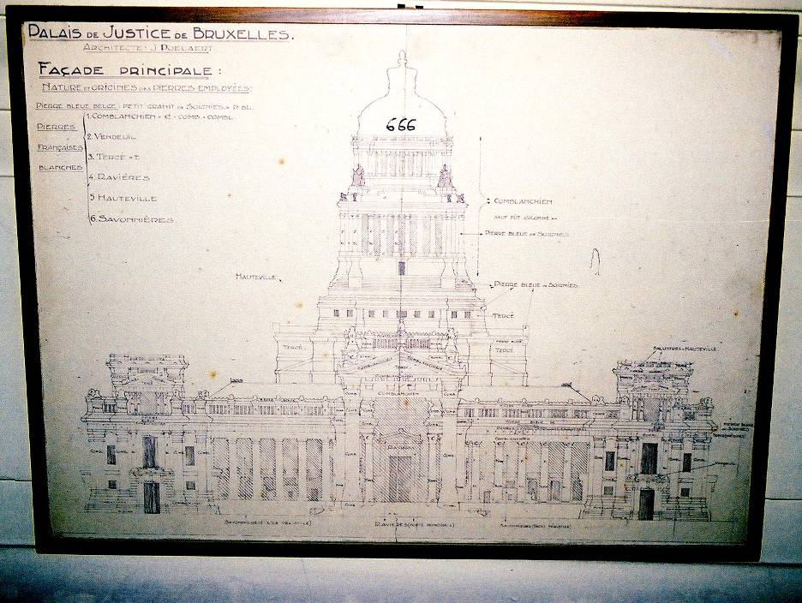
Palais De Justice-Architectural Drawing
Entire Building 666
Notes:
343 Palais De Justice-Architectural Drawing
Entire Building 666

Slide 40
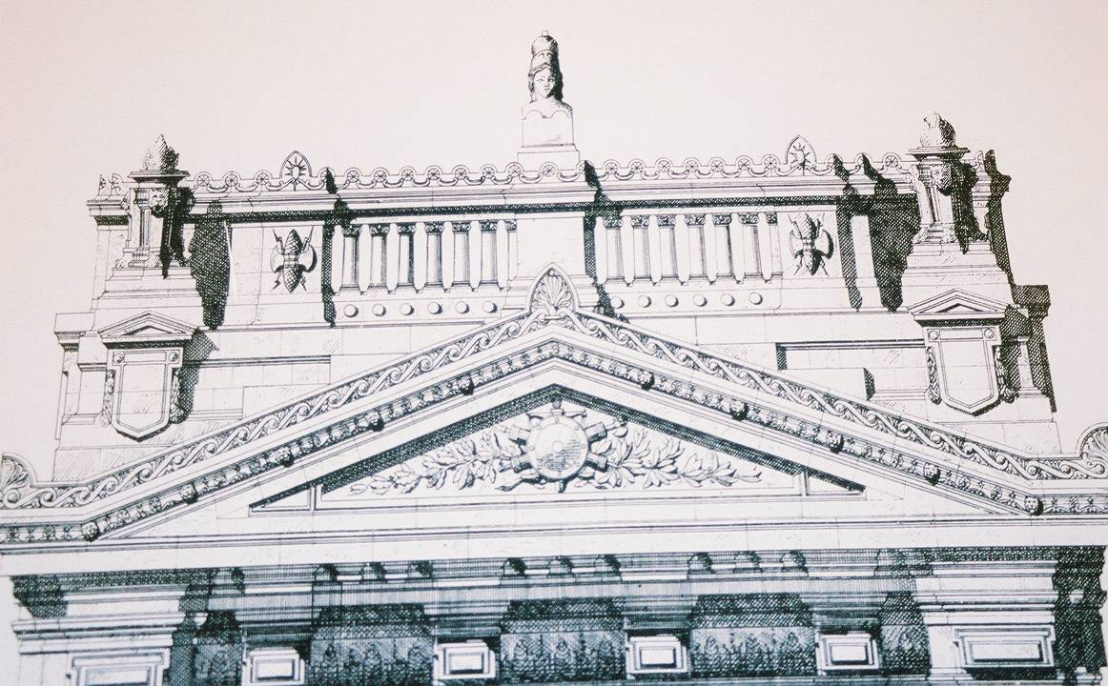
Palais De Justice-Architectural Drawing
Entry Top - Athena
Notes:
344 Palais De Justice-Architectural Drawing
Entry Top - Athena

Slide 41
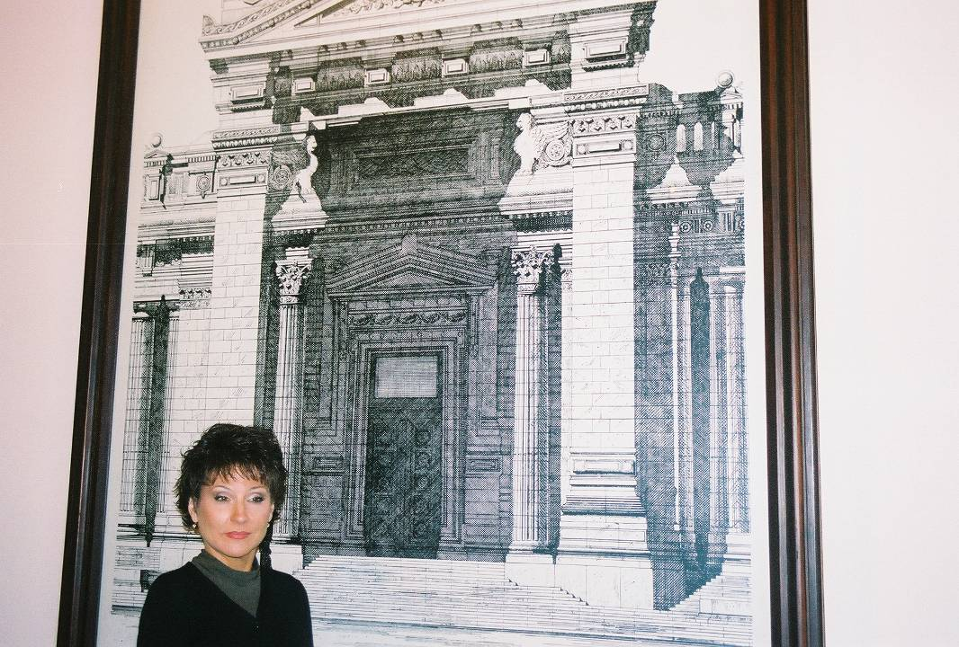
Palais De Justice-Architectural Drawing
Entry - Babylonian Lions
Notes:
345 Palais De Justice-Architectural Drawing
Entry - Babylonian Lions

Slide 42
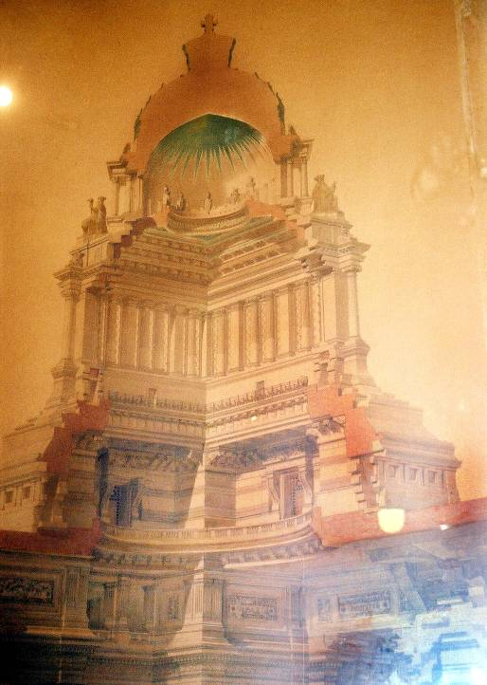
Notes:
346 Palais De Justice-Arch. Drawing
Dome (shows crown)

Slide 43
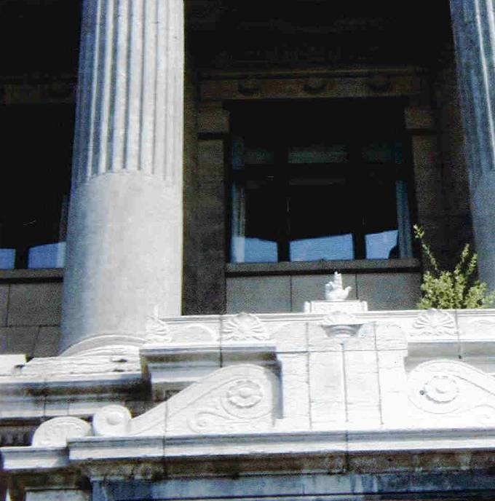
Notes:
347 Palais De Justice- Hand Outside Bldg.

Slide 44
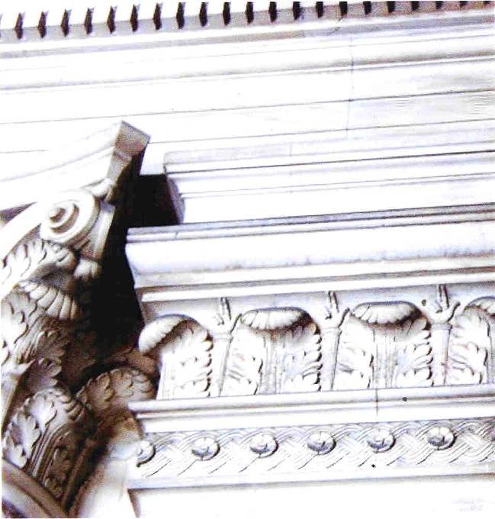
Palais De Justice- Hands
Notes:
348 Palais De Justice- Hands

Slide 45
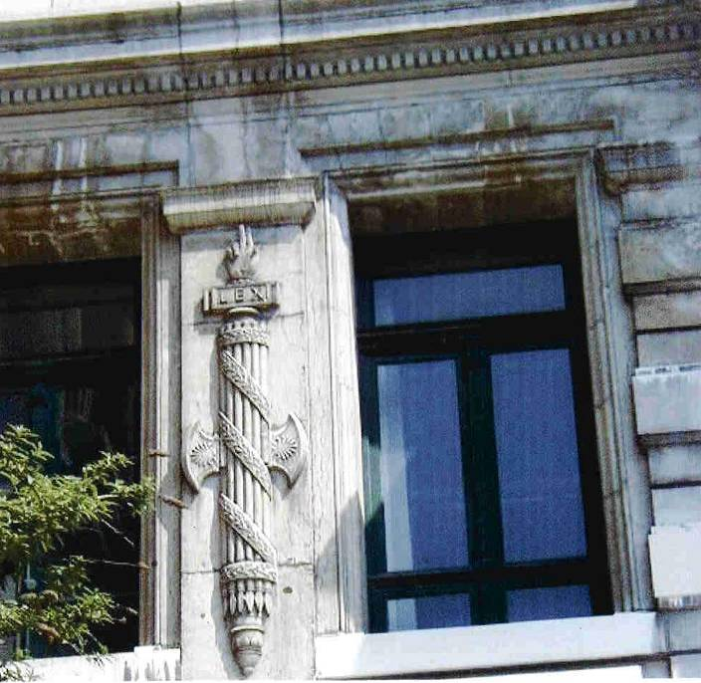
Notes:
349 Palais De Justice- Hand on Window

Slide 46
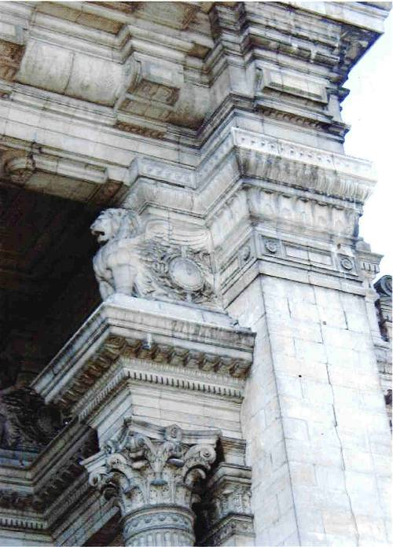
Notes:
350 Palais De Justice- Winged Lion Outside Bldg.

Slide 47
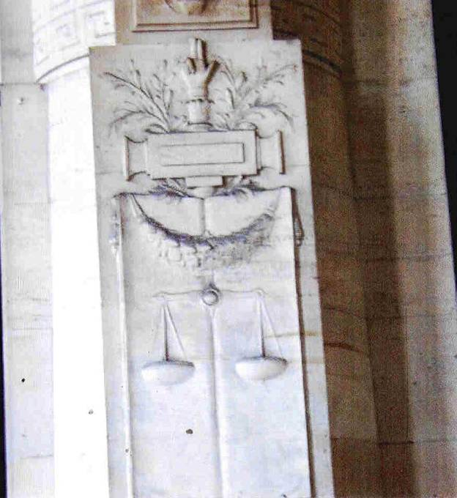
Notes:
351 Palais De Justice- Hand Outside Closeup

Slide 48
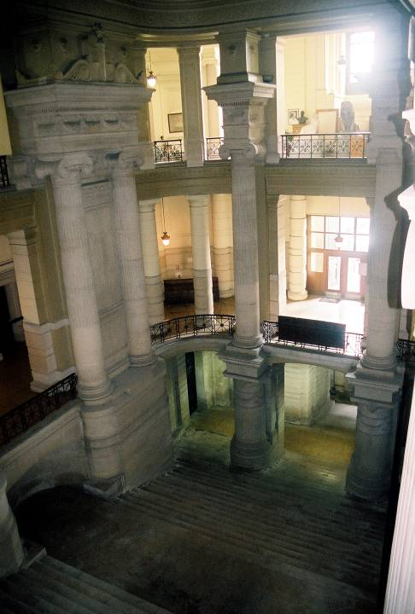
Notes:
352 Palais De Justice- Inside

Slide 49
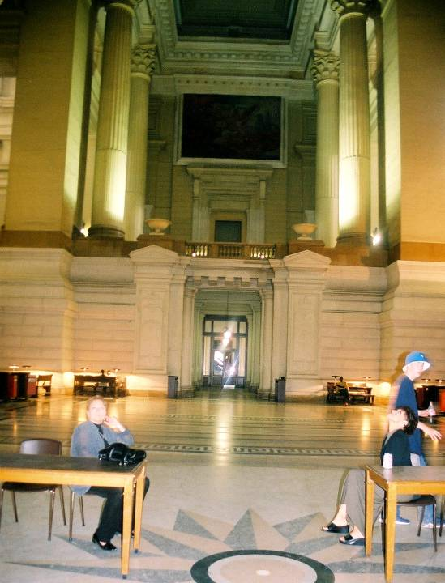
Notes:
353 Palais De Justice- Inside, Floor design

Slide 50
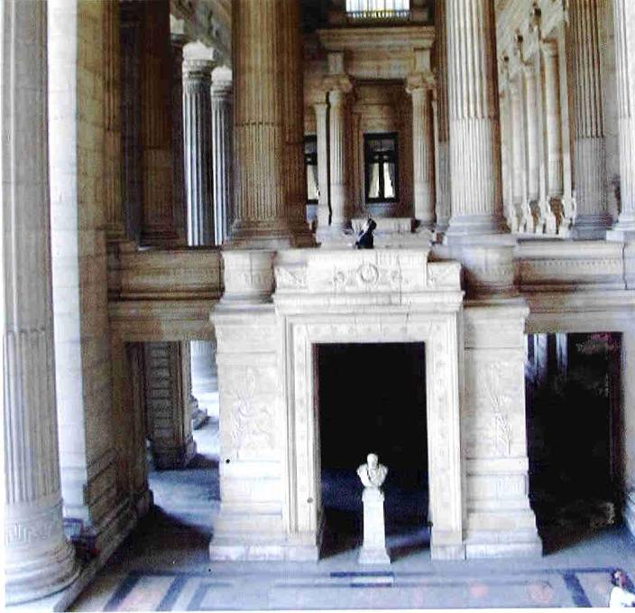
Notes:
354 Palais De Justice- Poiullant Architect

Slide 51
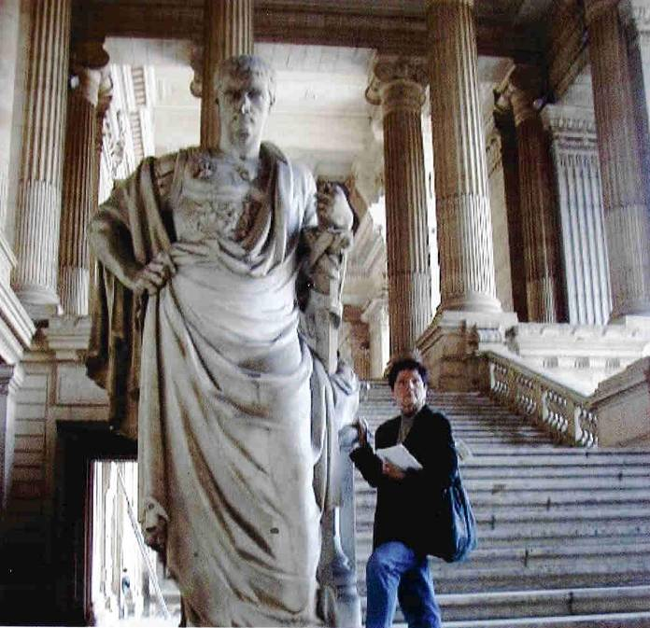
Notes:
355 Palais De Justice- Billye Brim with Statue (Proportion)

Slide 52
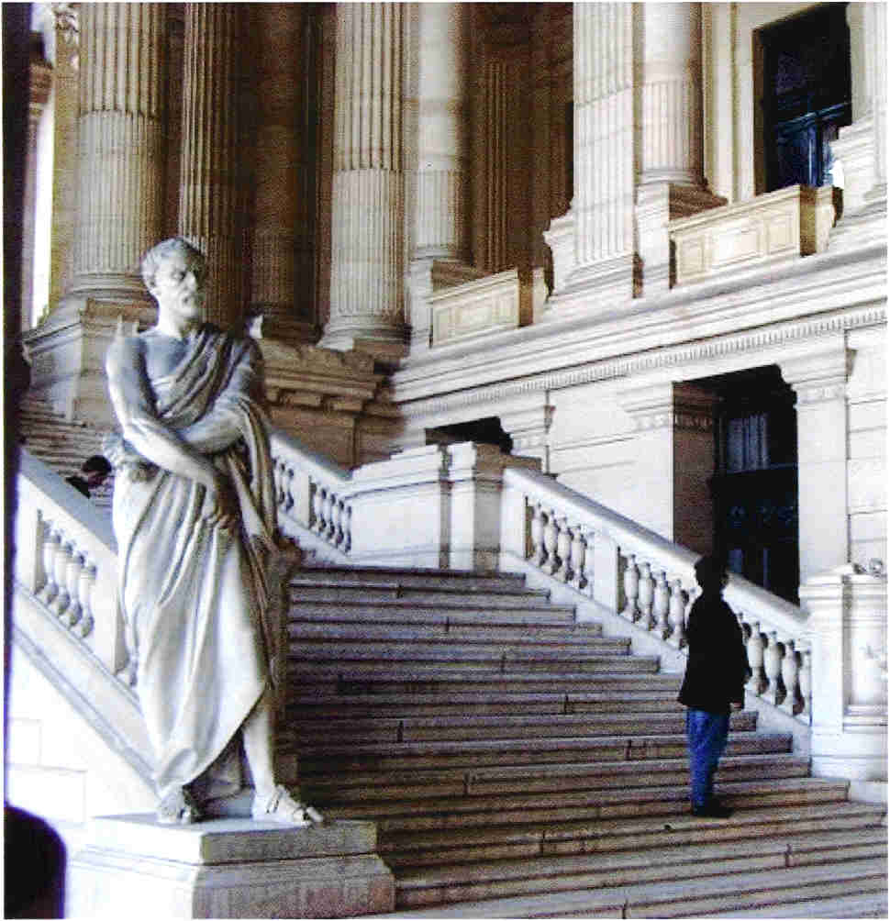
Notes:
356 Palais De Justice- Billye Brim Steps Statue

Slide 53
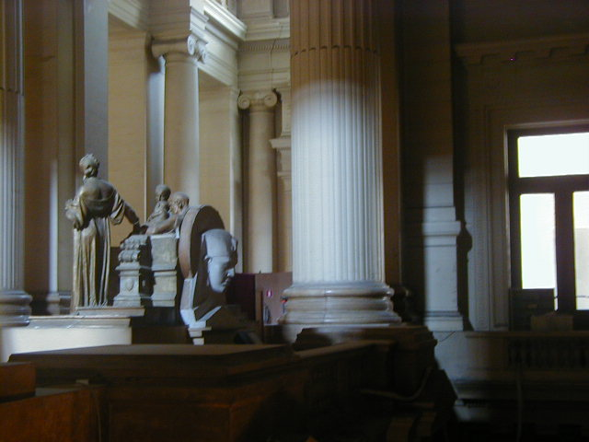
Palais De Justice- Sphinx From Inside
Notes:
357 Palais De Justice- Sphinx From Inside

Slide 54
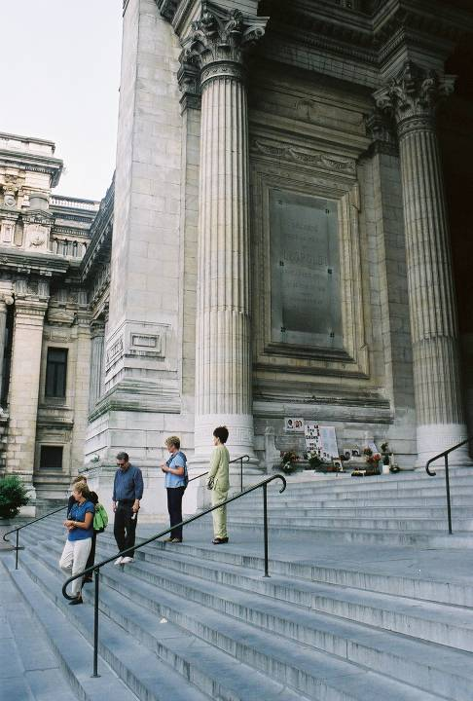
Notes:
358 Palais De Justice-Altar to Children 1 (approach)

Slide 55
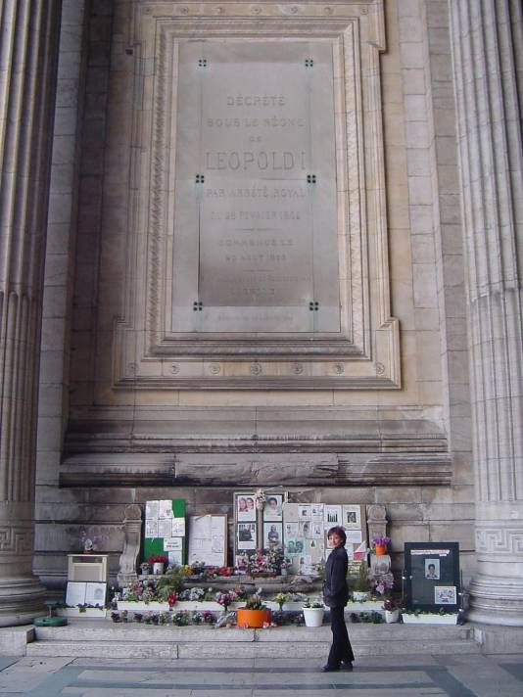
Notes:
359 Palais De Justice- Altar to Children

Slide 56
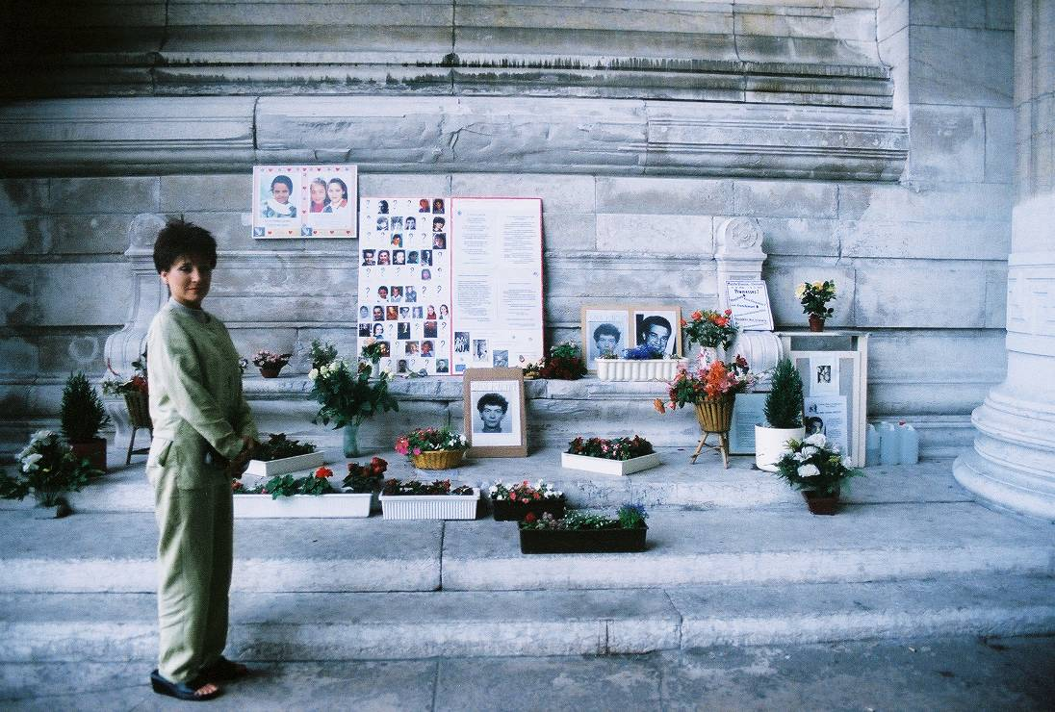
Palais De Justice-Altar to Children (close-up 2003)
Notes:
360 Palais De Justice-Altar to Children (close-up 2003)

