Slide 1

Title slide address info

Slide 2
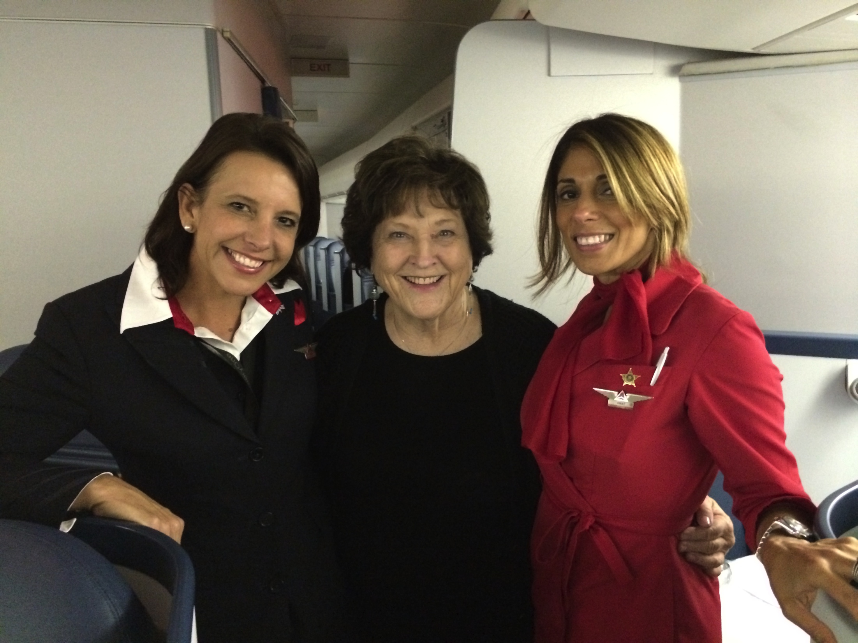
With Delta stewardesses – Linda & Anat

Slide 3
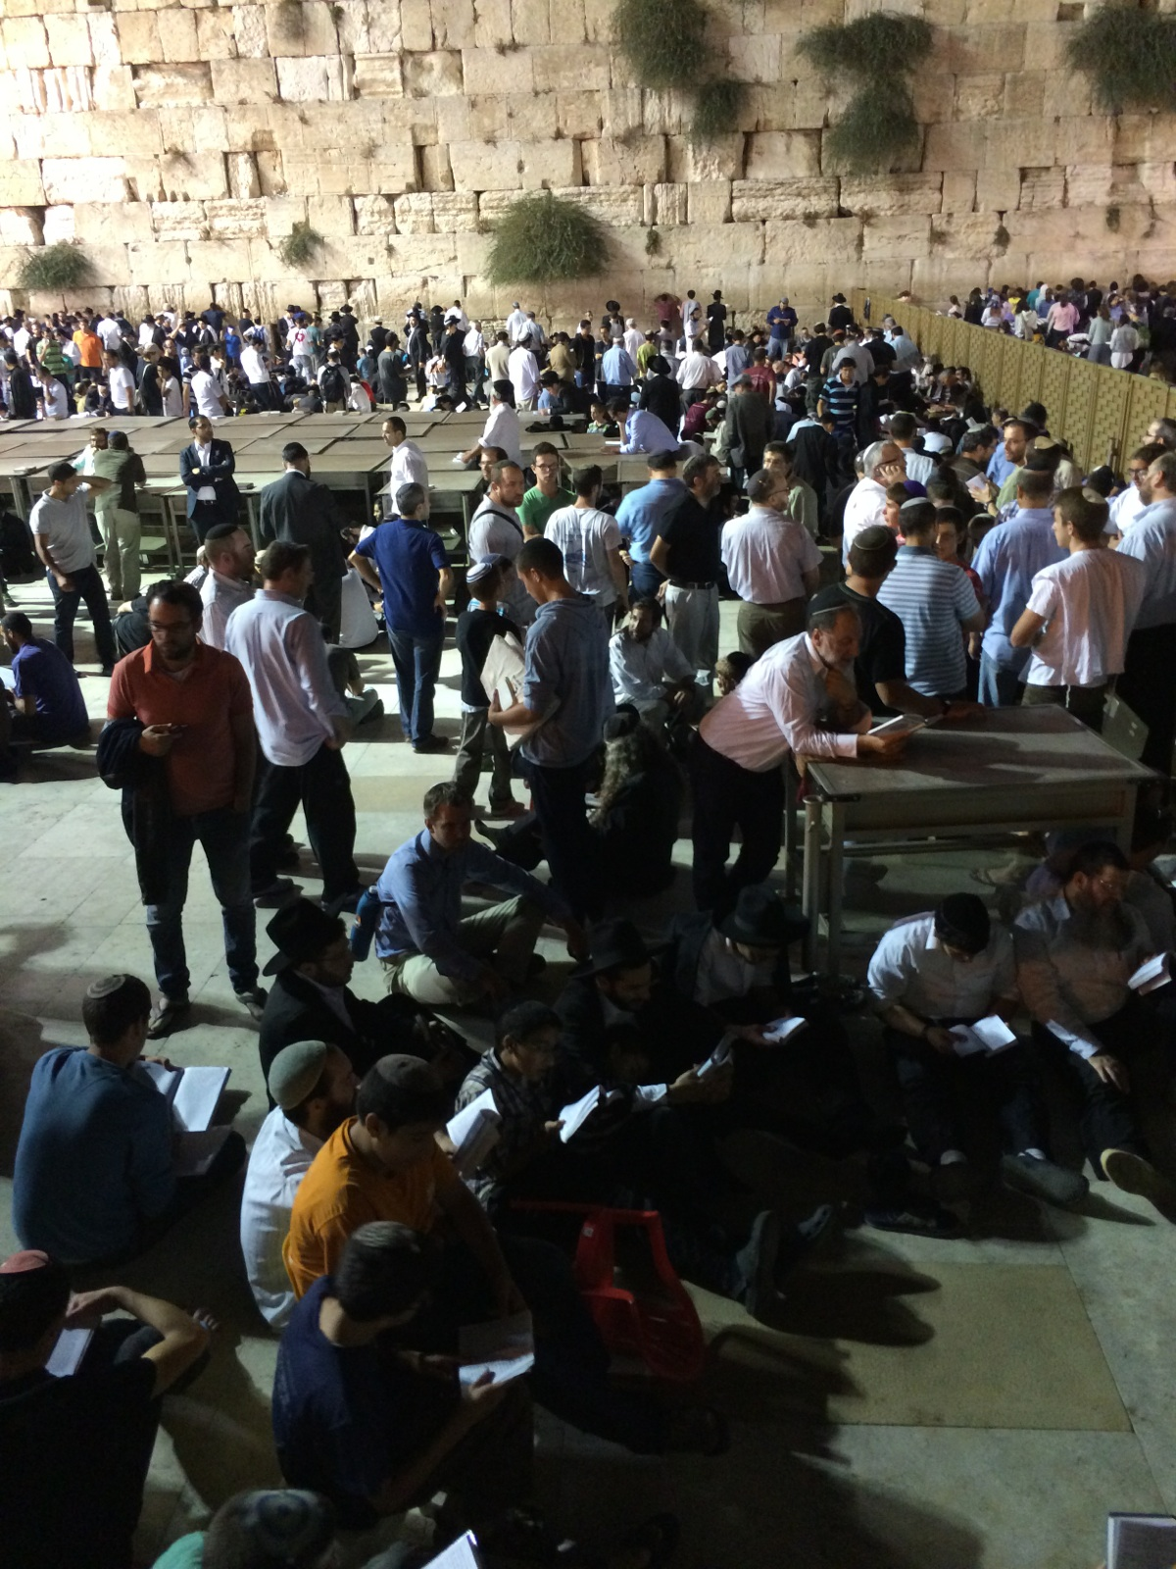
The Western Wall on Tisha b’Av

Slide 4
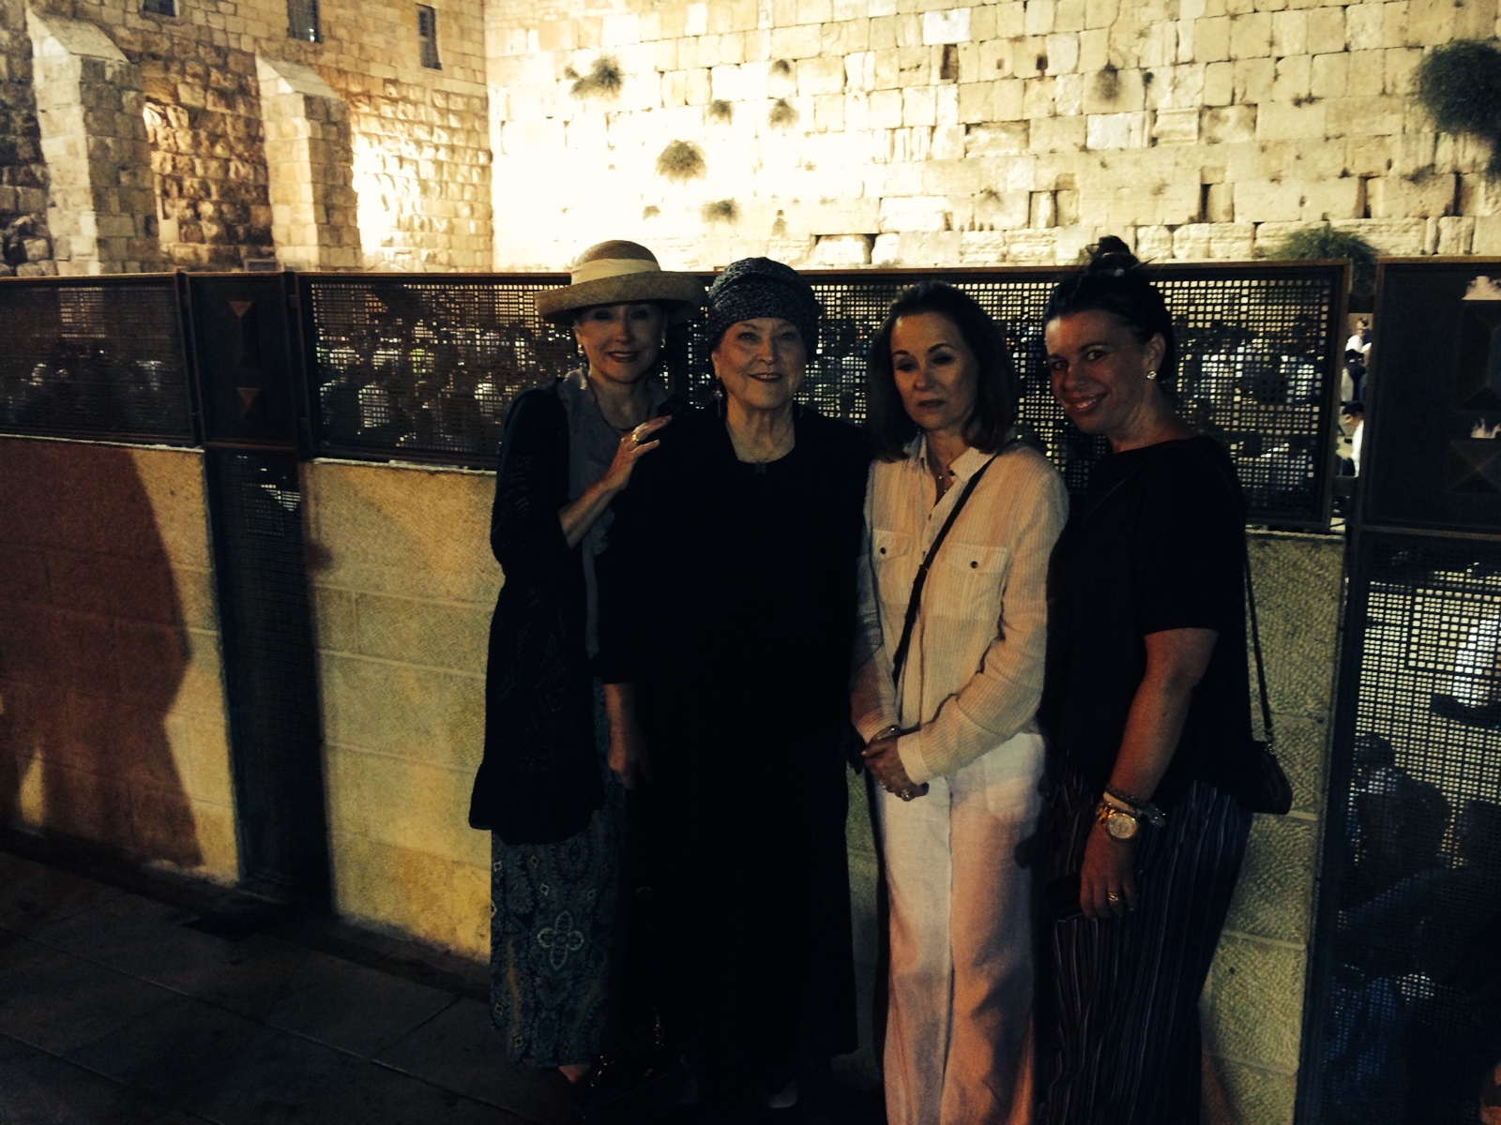
Western Wall – Shelli, Billye, Lynne, Heather

Slide 5
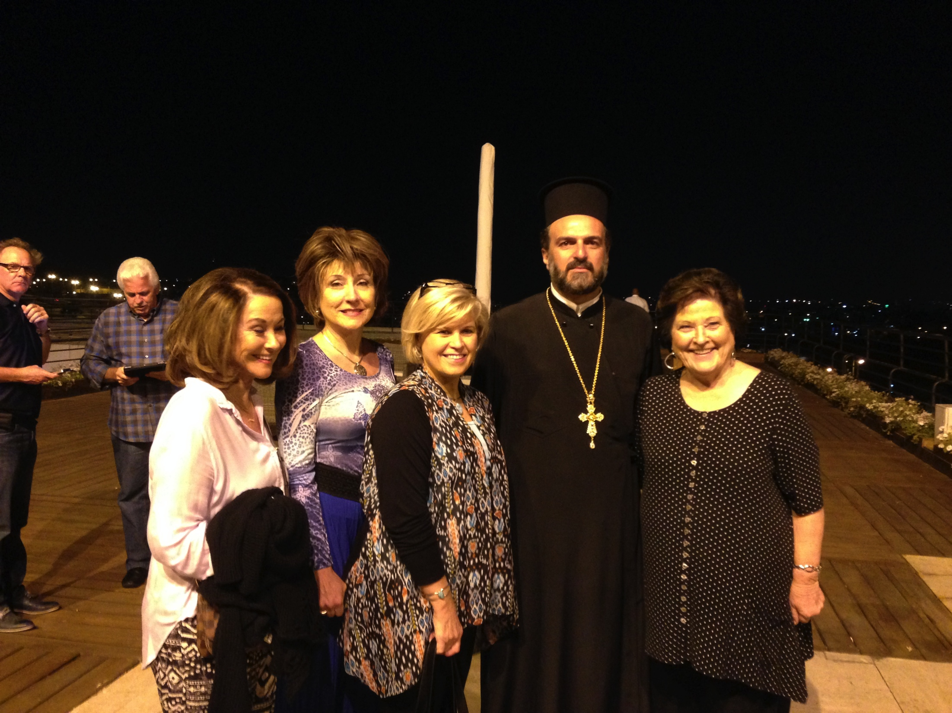
With Sharon Daugherty & Father Gabriel Naddaf

Slide 6
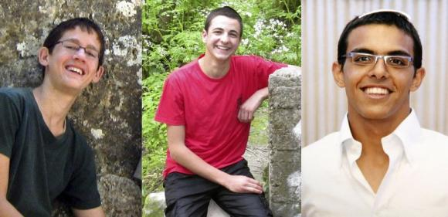
3 Israeli Teens
Naftali Fraenkel Gilad Sharr Eyal Yifrach

Slide 7
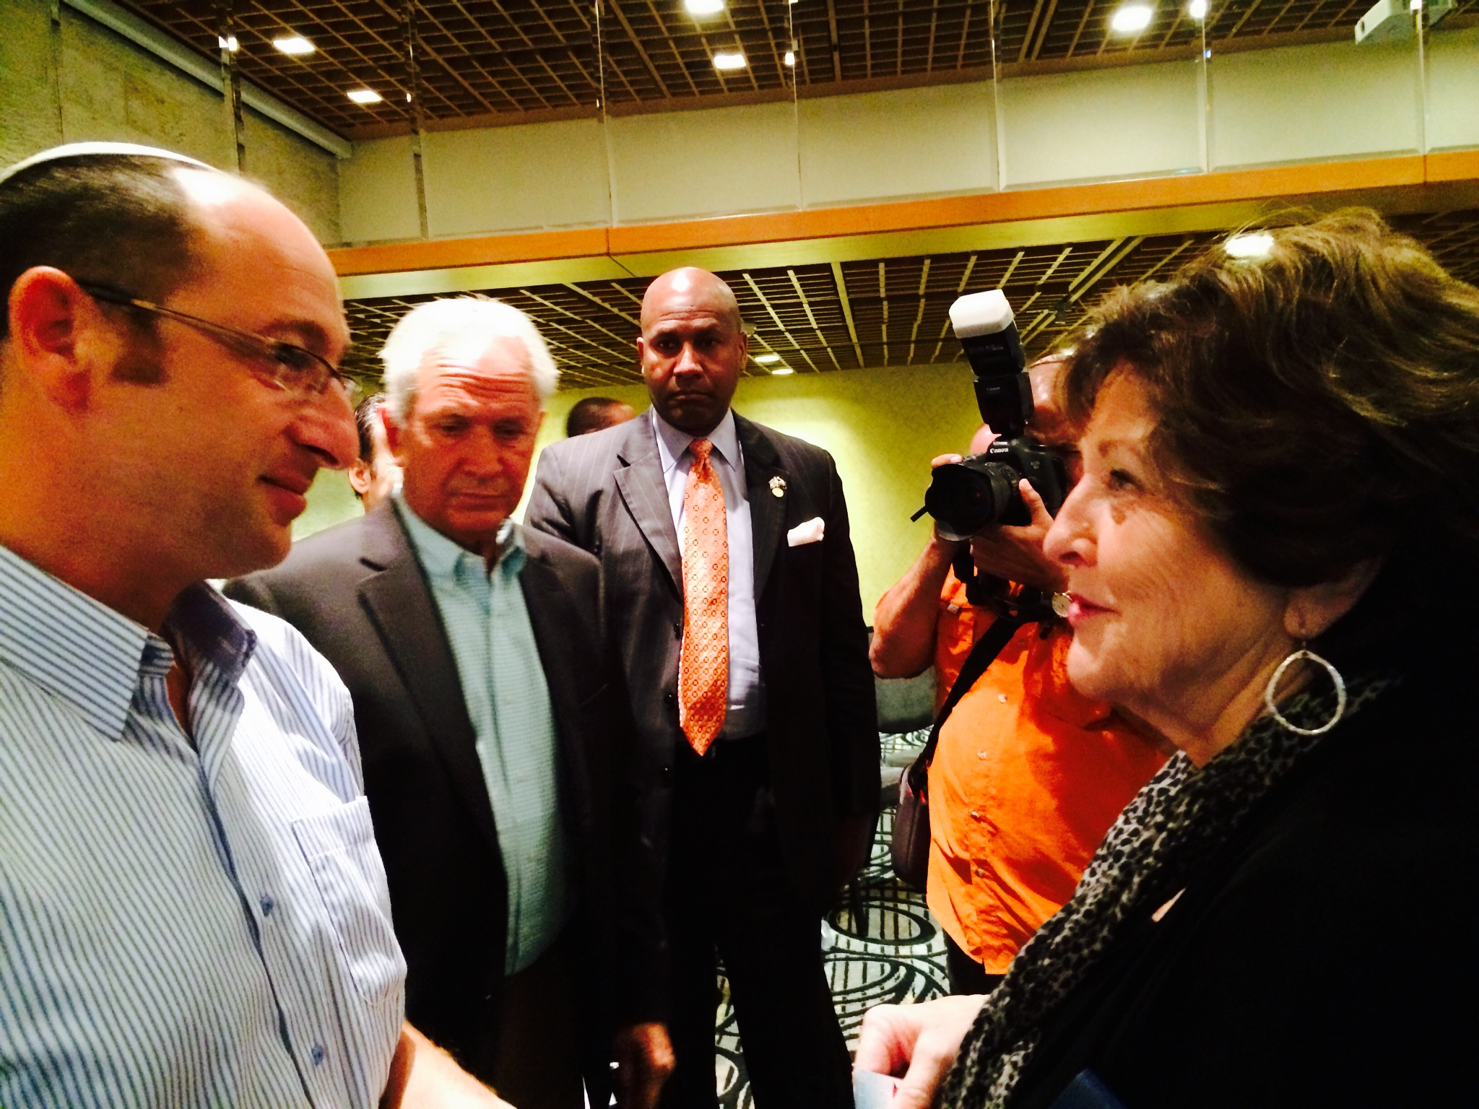
Billye w/ Father of one of teenagers killed

Slide 8
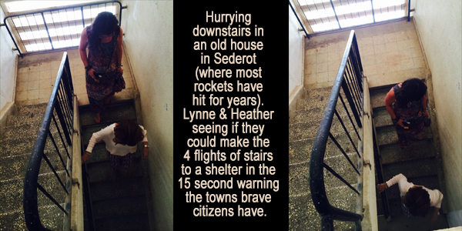
Sederot – Lynne & Heather running stairs

Slide 9
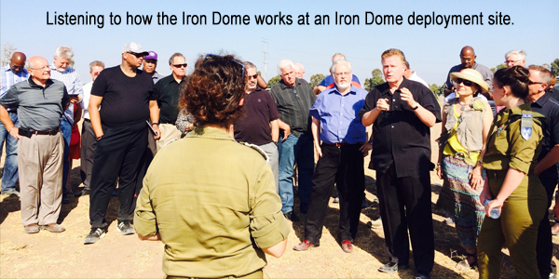
Listening to speaker at Iron Dome deployment site

Slide 10
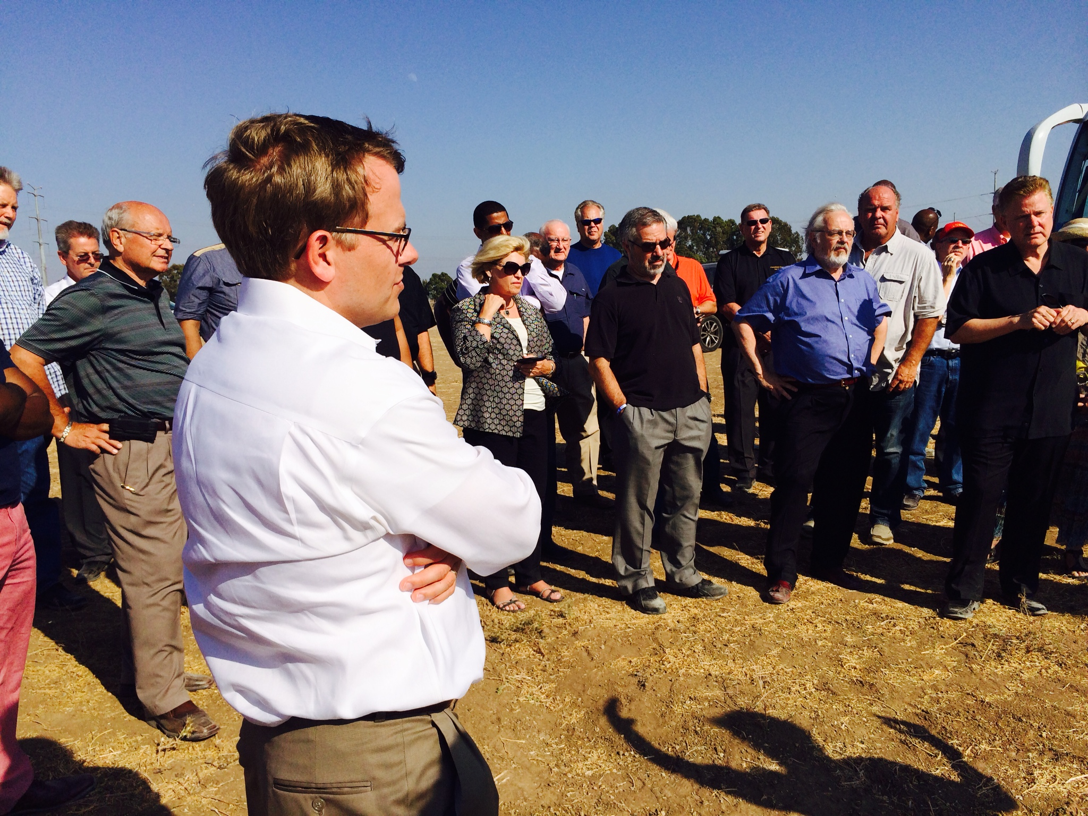
Todd Burpo at Iron Dome deployment site

Slide 11
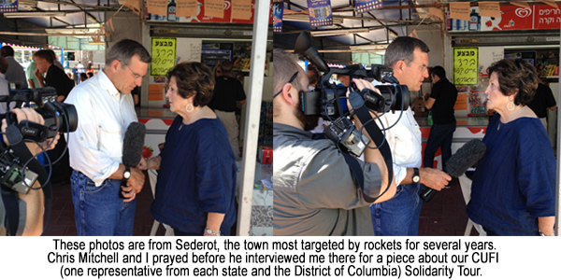
Interview w/ Chris Mitchell

Slide 12
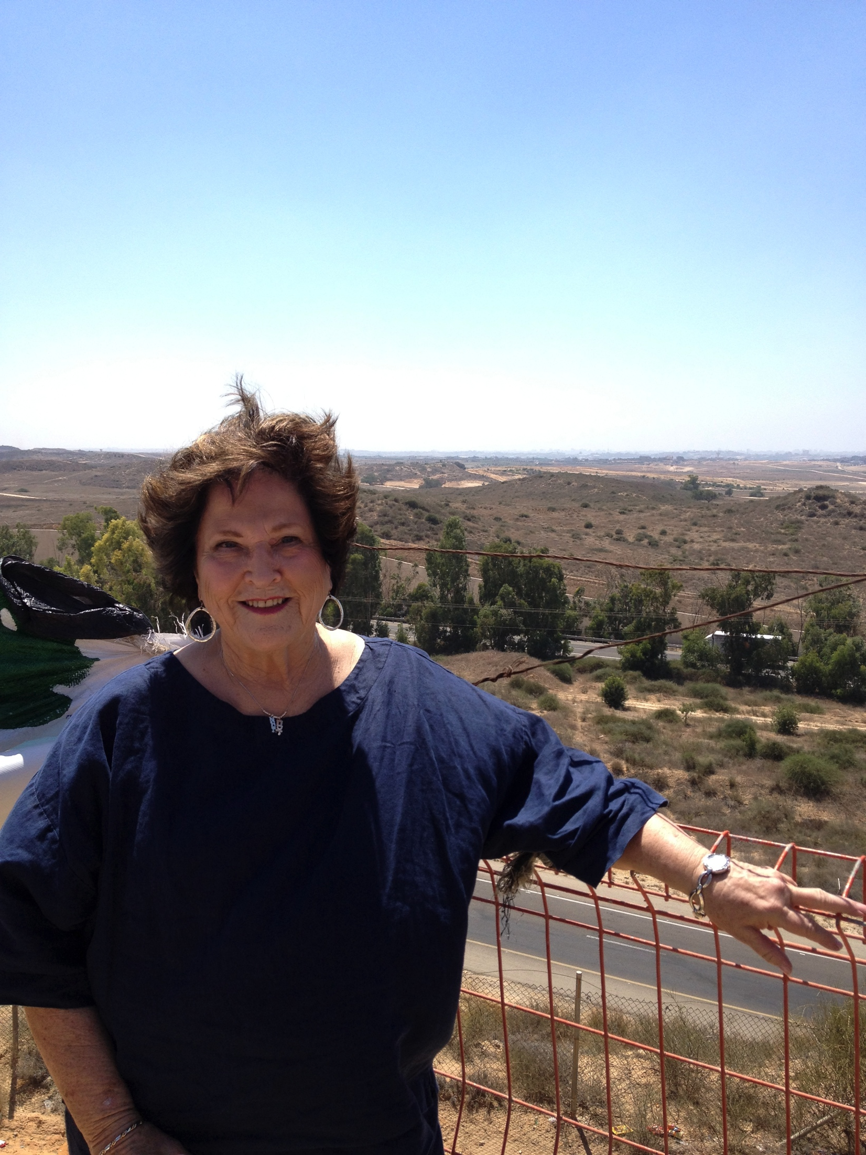
Standing on the overlook into Gaza at Sederot

Slide 13
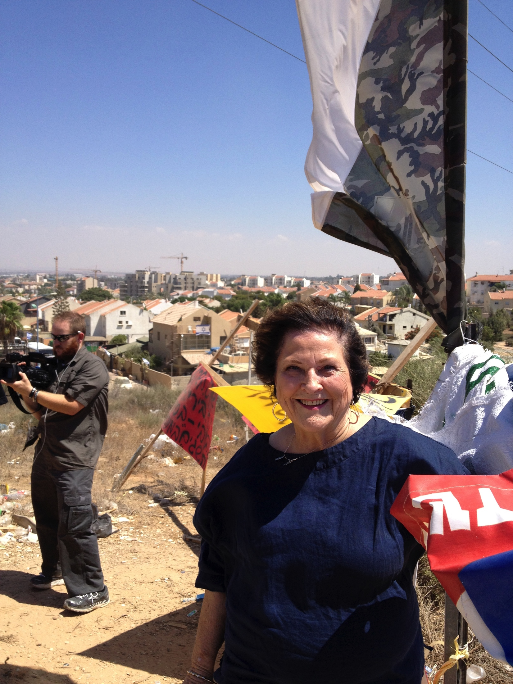
Same overlook looking back into Sederot

Slide 14
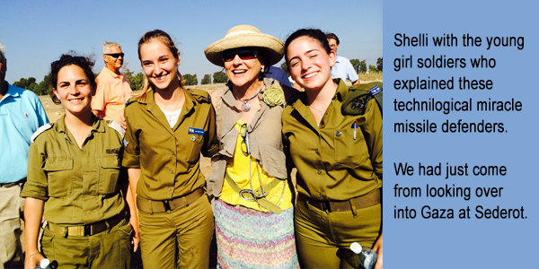
Shelli with young girl soldiers

Slide 15
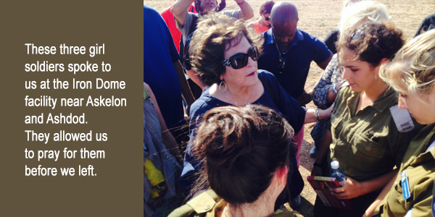
Billye praying with girl soldiers

Slide 16
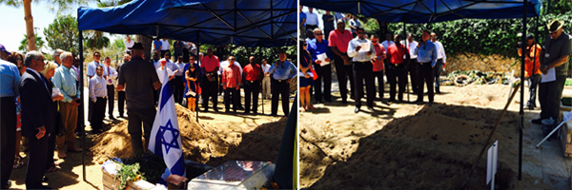
Mt Herzl Cemetary, graves of soldiers

Slide 17
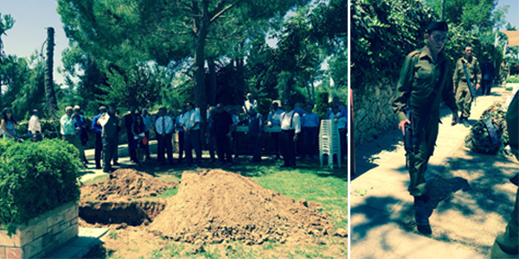
Graveside, young soldiers walking

Slide 18
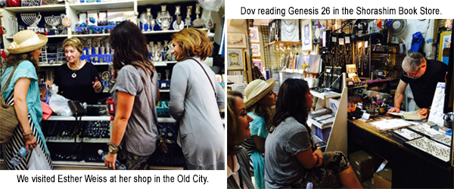
Shops in Jerusalem-Esther Weiss, Dov reading Gen 26

Slide 19
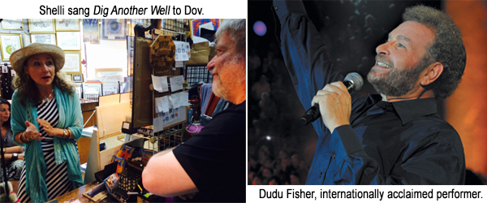
Shelli singing to Dov, Dudu Fisher

Slide 20
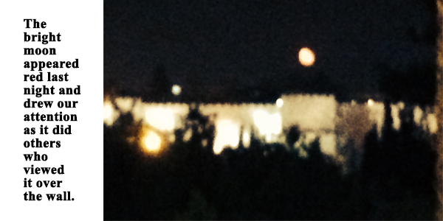
Red moon over the wall

Slide 21
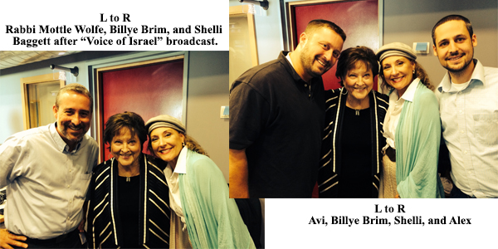
Rabbi Mottle Wolfe, Avi, & Alex – Voice of Israel radio

Slide 22
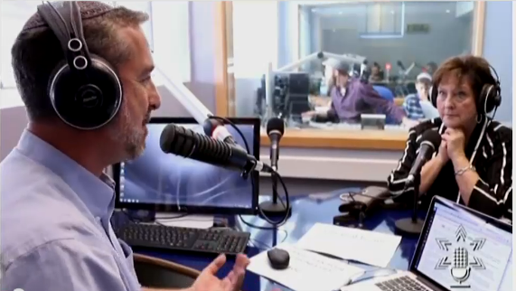
Voice of Israel 1

Slide 23
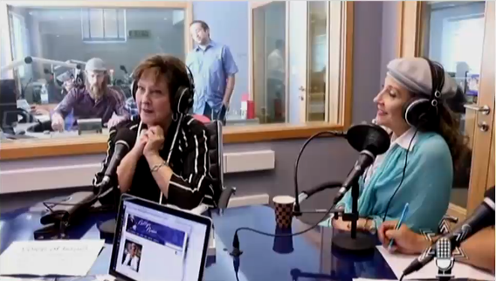
Voice of Israel 2

Slide 24
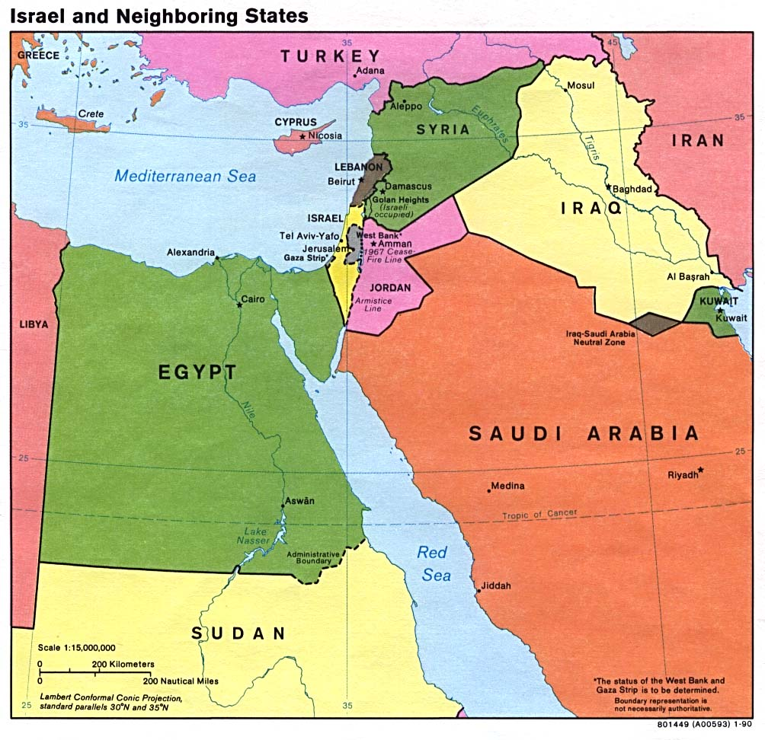
Map –Israel & Neighboring

Slide 25
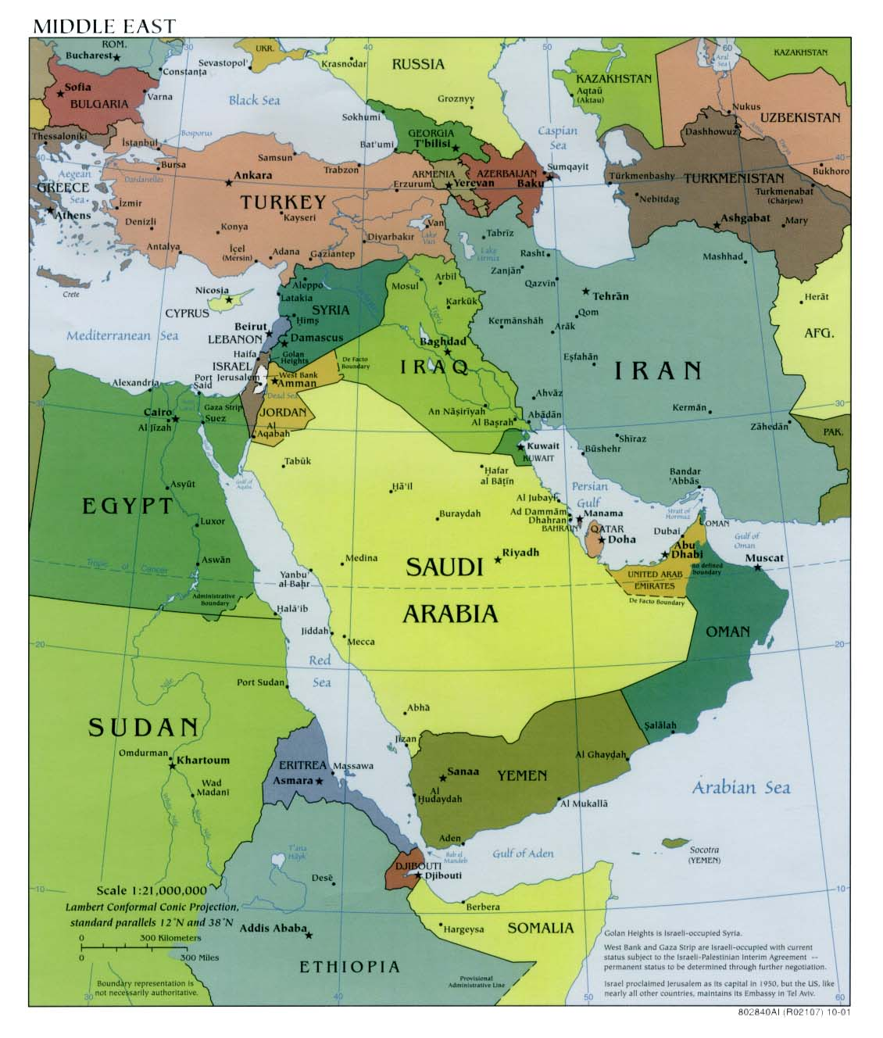
Map –Middle East

Slide 26
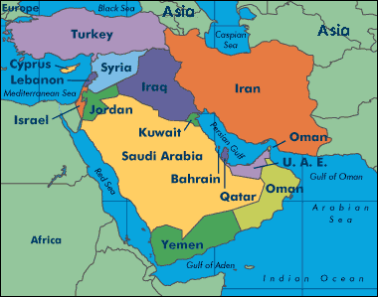
Map –Middle East 2

Slide 27
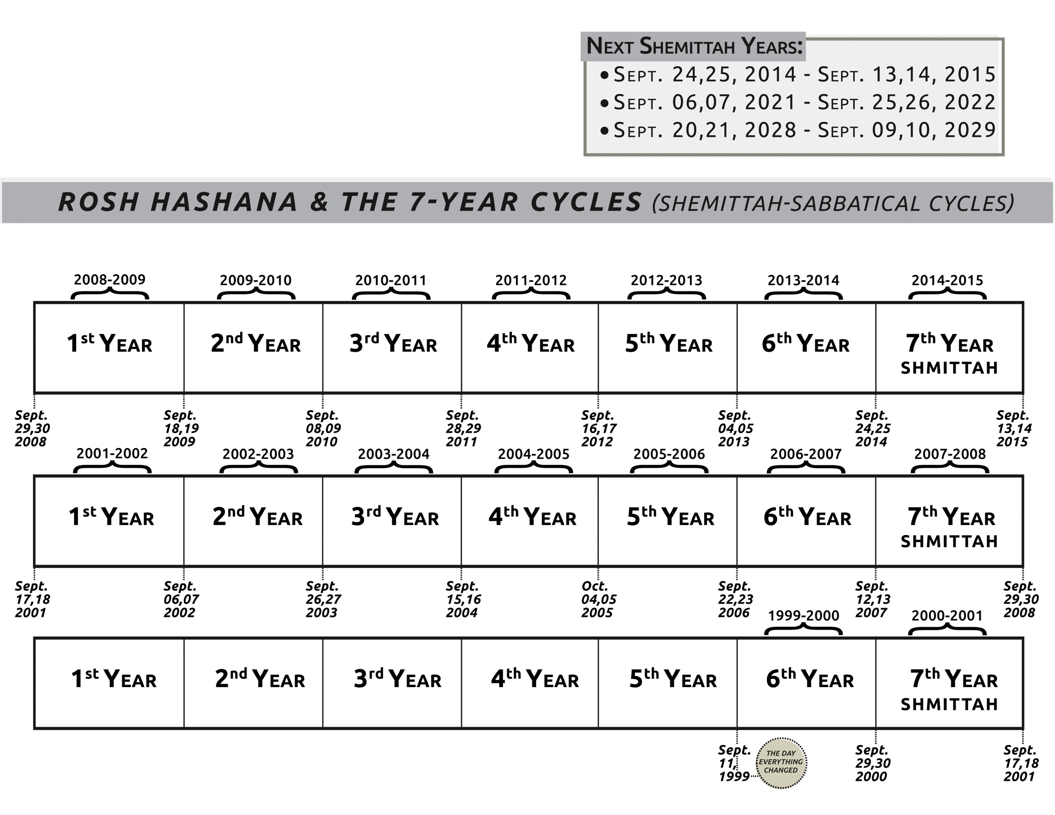
Shemittah chart

Slide 28
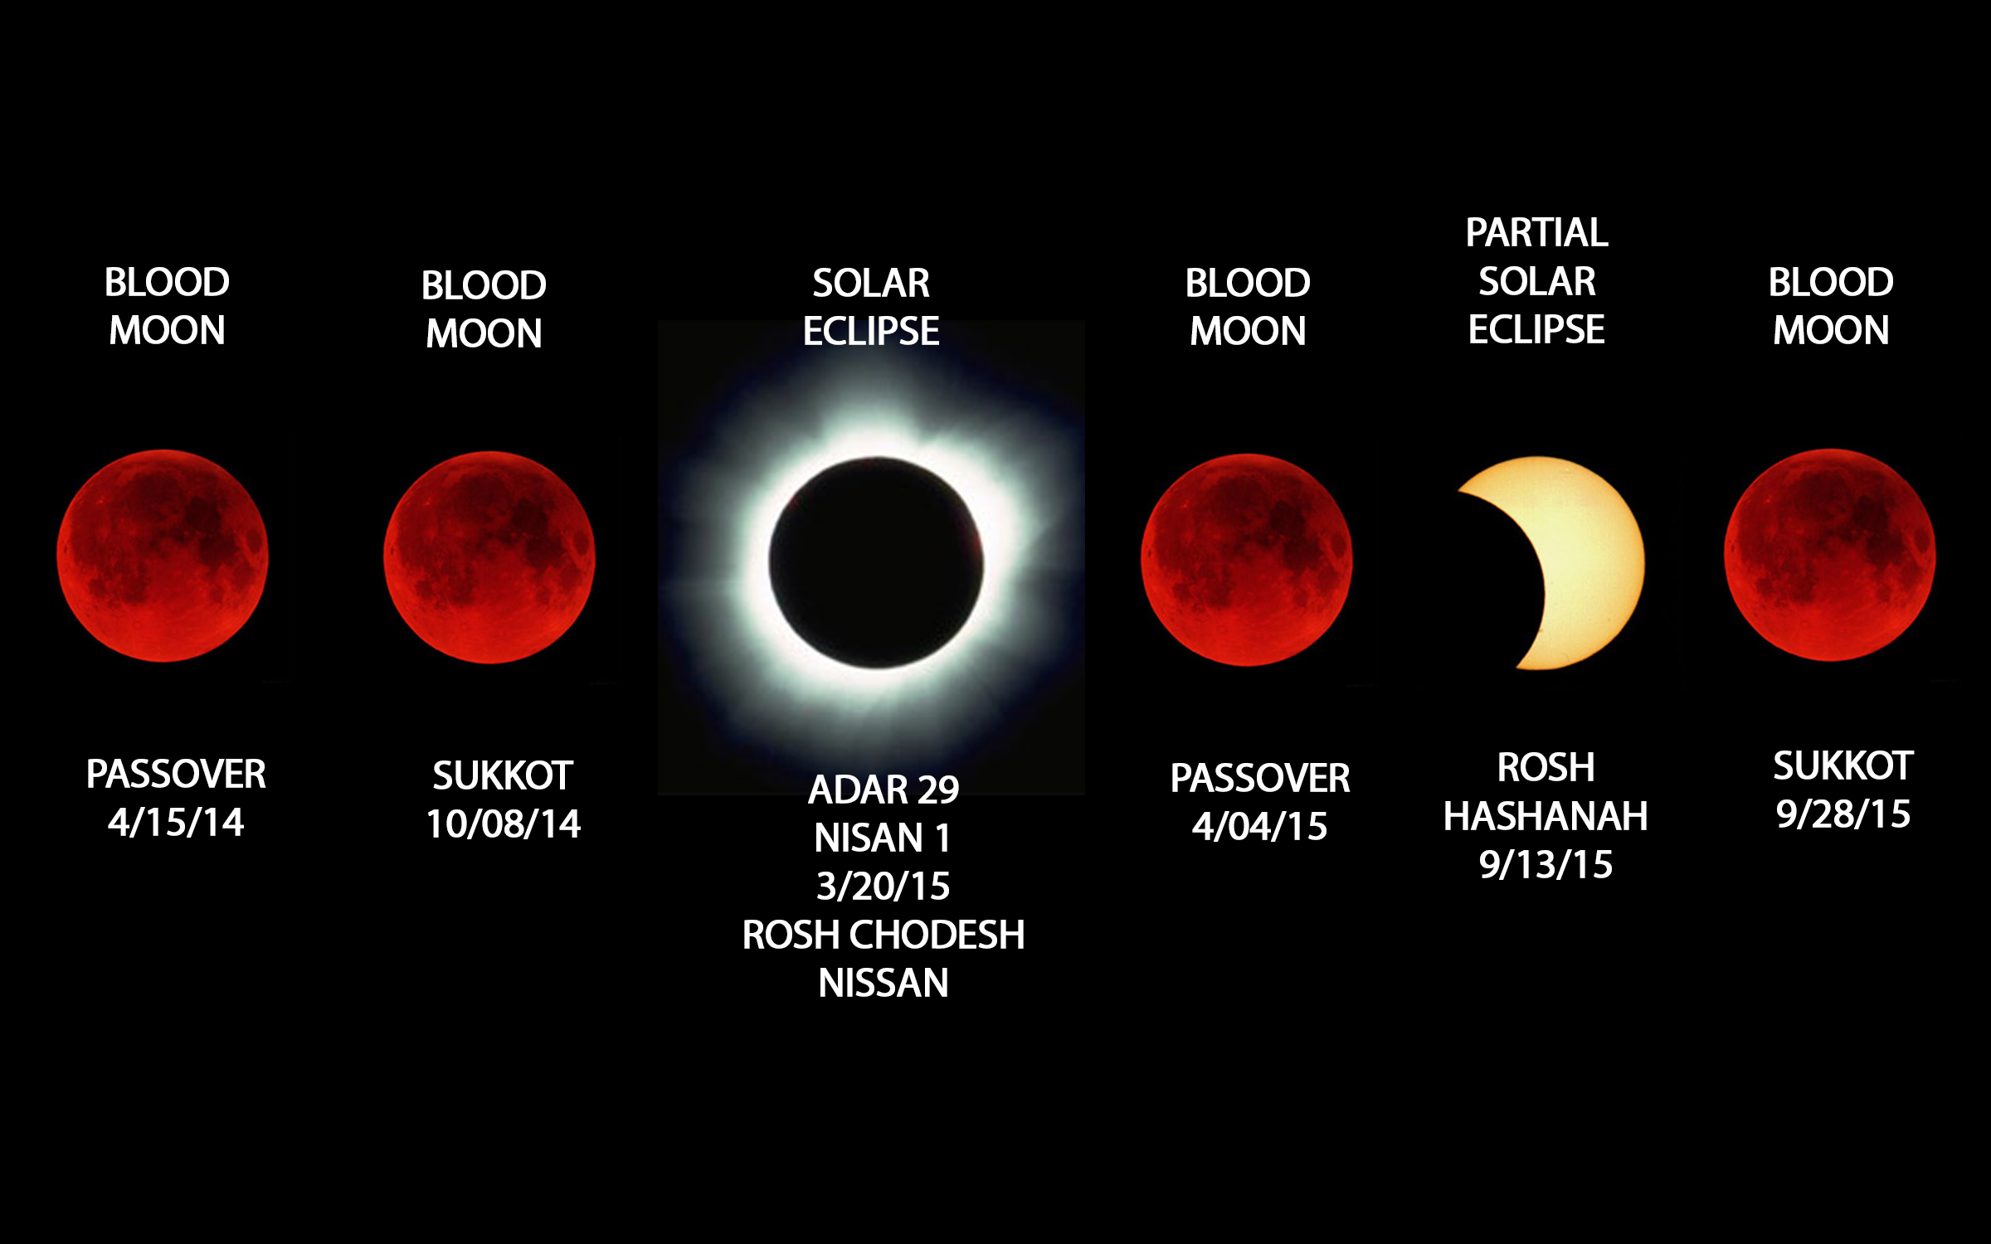
Blood Moons chart

Slide 29
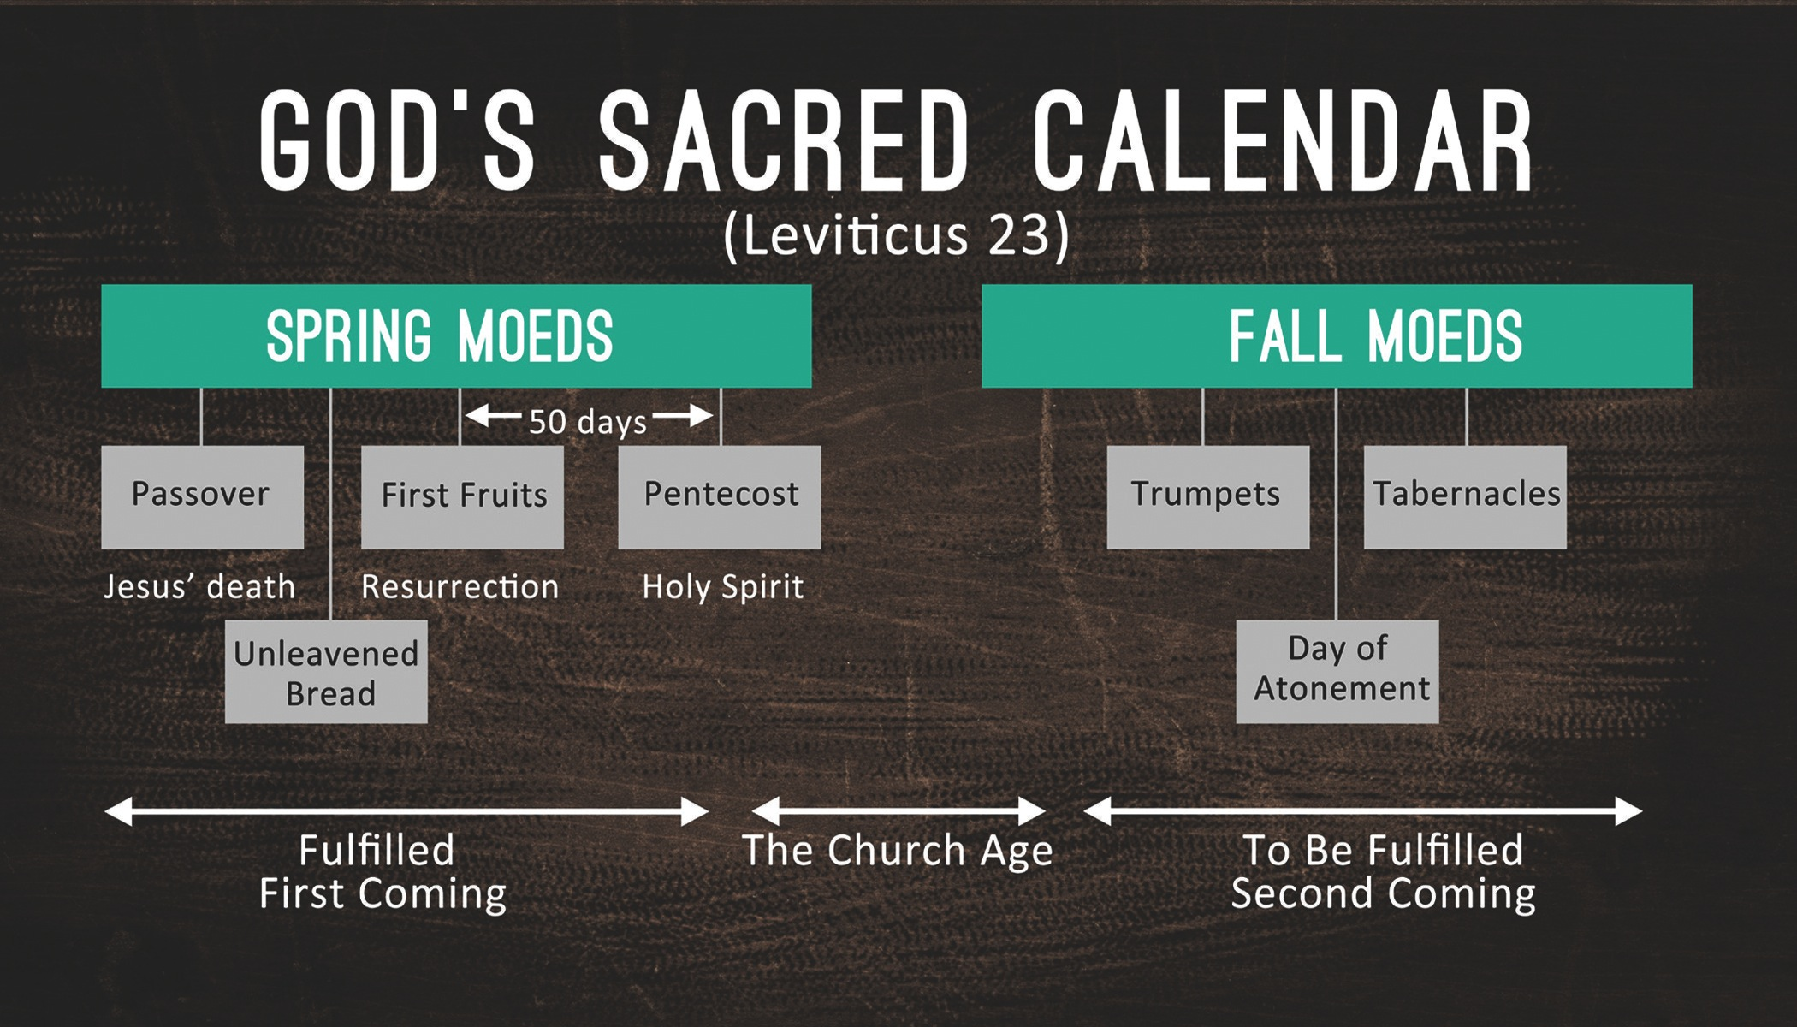
God’s Sacred Calendar (Lev. 23)

Slide 30
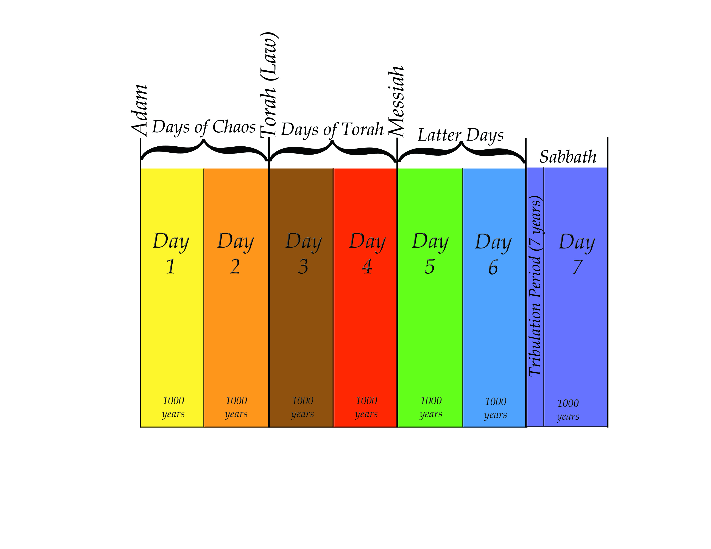
7 Day Chart

Slide 31
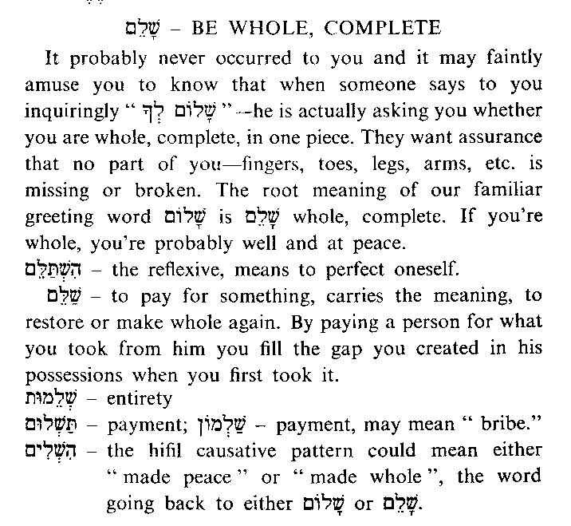
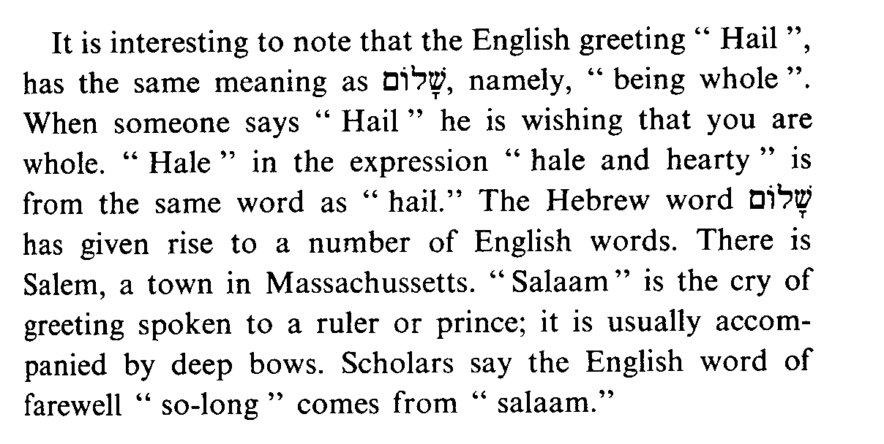
Shalom-Be Whole,
Complete

Slide 32
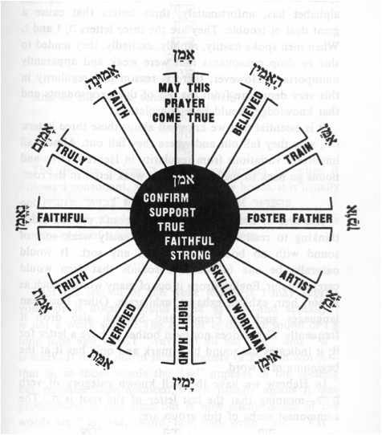
Amen Word Wheel

Slide 33
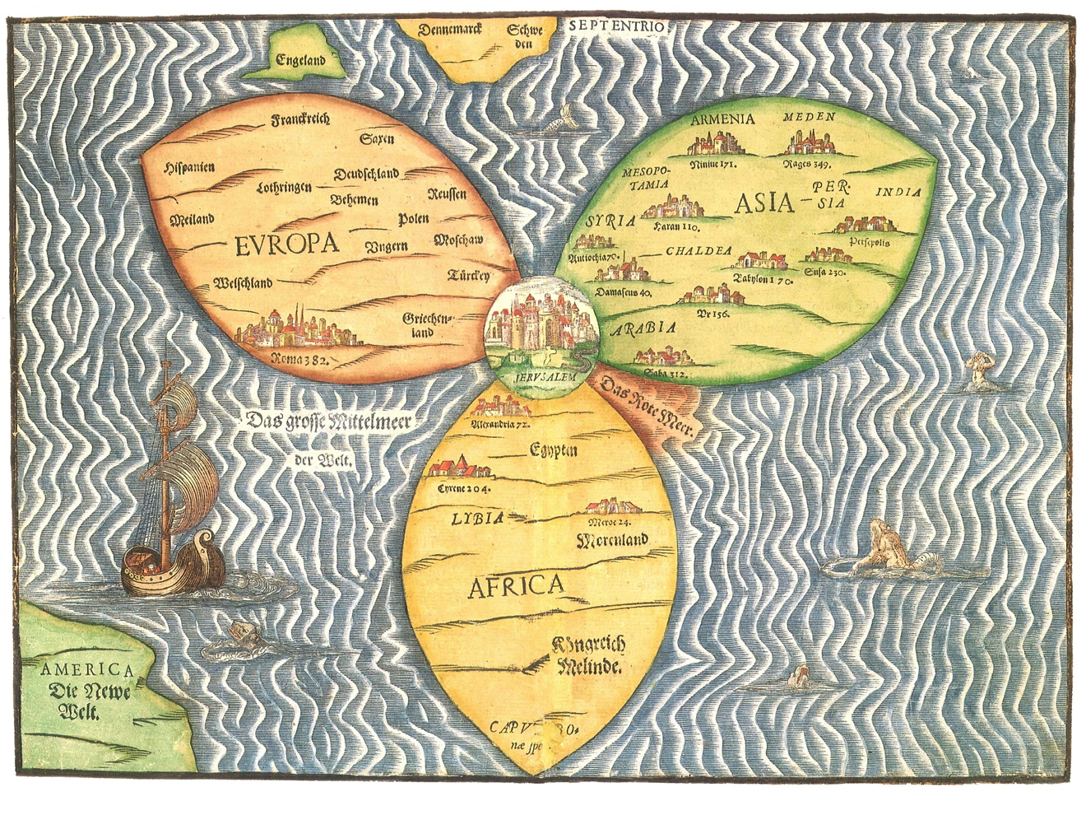
Ancient 3 Petal Map

Slide 34
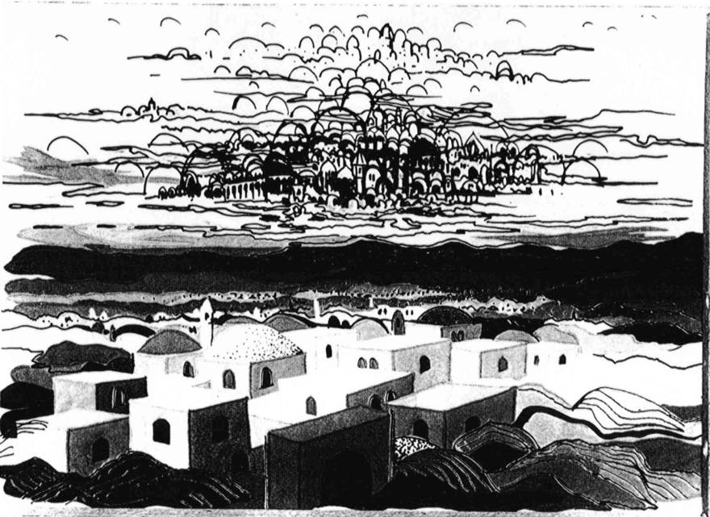
2 Jerusalems Painting B&W

Slide 35
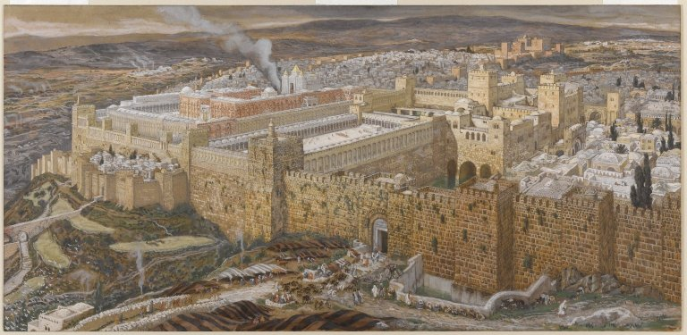
Jerusalem w/Temple Painting
Notes:
James Tissot - Reconstruction of Jerusalem and the Temple of Herod - Brooklyn Museum
This image was uploaded as a donation by the Brooklyn Museum, and is considered to have no known copyright restrictions by the institutions of the Brooklyn Museum.

Slide 36
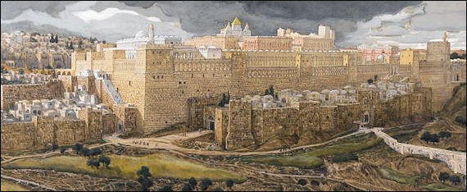
Jeruslaem w/Temple Painting 2
Notes:
James Tissot - Reconstruction of Jerusalem and the Temple of Herod - Brooklyn Museum
This image was uploaded as a donation by the Brooklyn Museum, and is considered to have no known copyright restrictions by the institutions of the Brooklyn Museum.

Slide 37
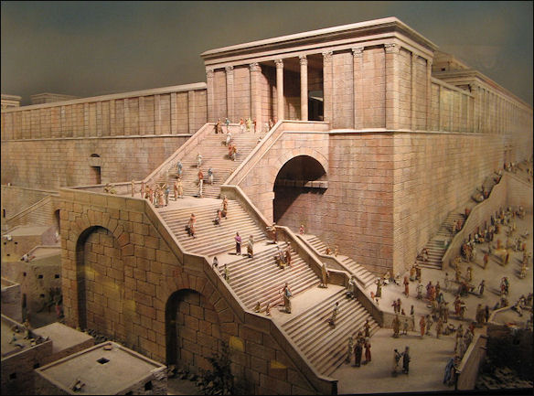
Temple w/Steps Painting
Notes:
This image was uploaded as a donation by the Brooklyn Museum, and is considered to have no known copyright restrictions by the institutions of the Brooklyn Museum.

Slide 38
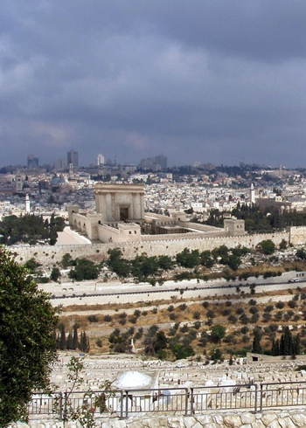
Temple of Tomorrow from The
Temple Institute
Notes:
Taken from www.TheTempleInstitute.org
Used by Permission.

Slide 39
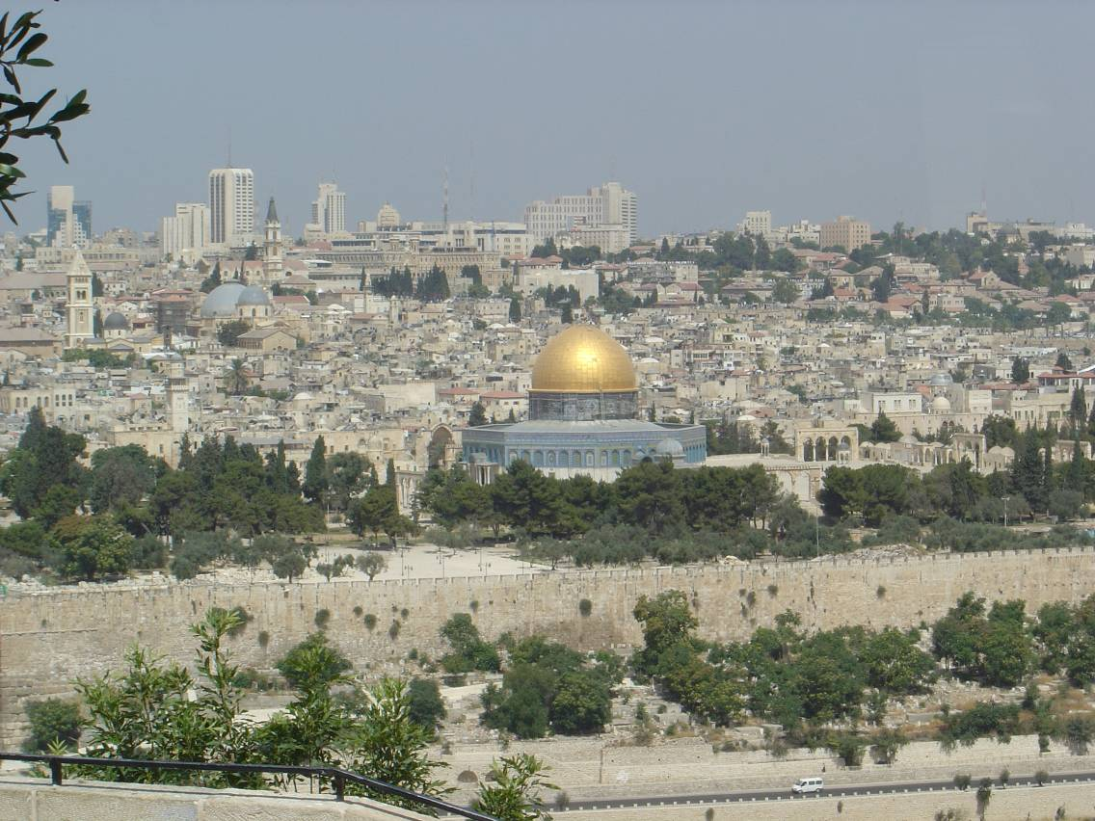
Jerusalem Temple Mount w/Dome

Slide 40
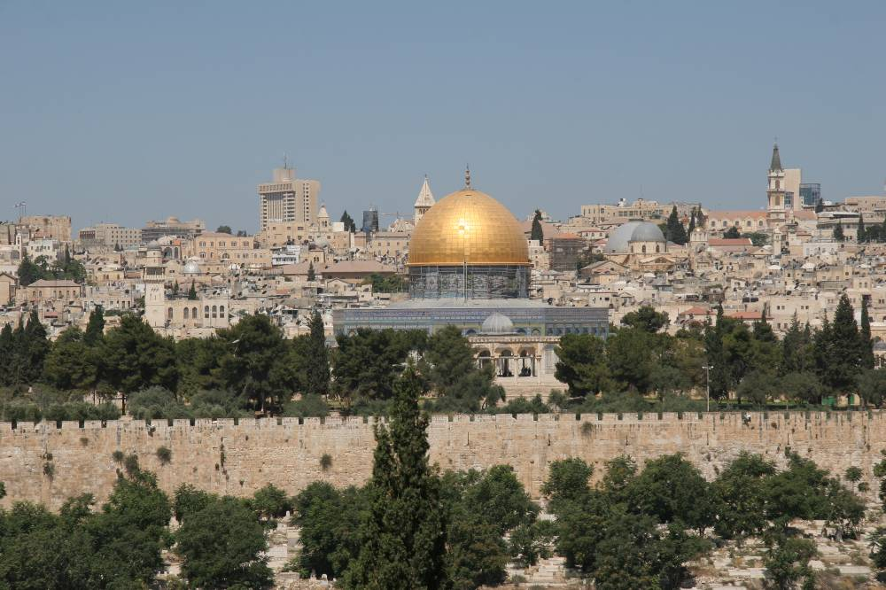
Jerusalem w/Dome

Slide 41
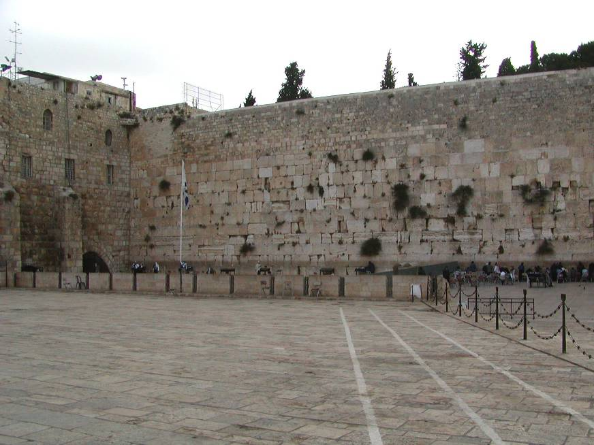
Jerusalem – Western Wall

Slide 42
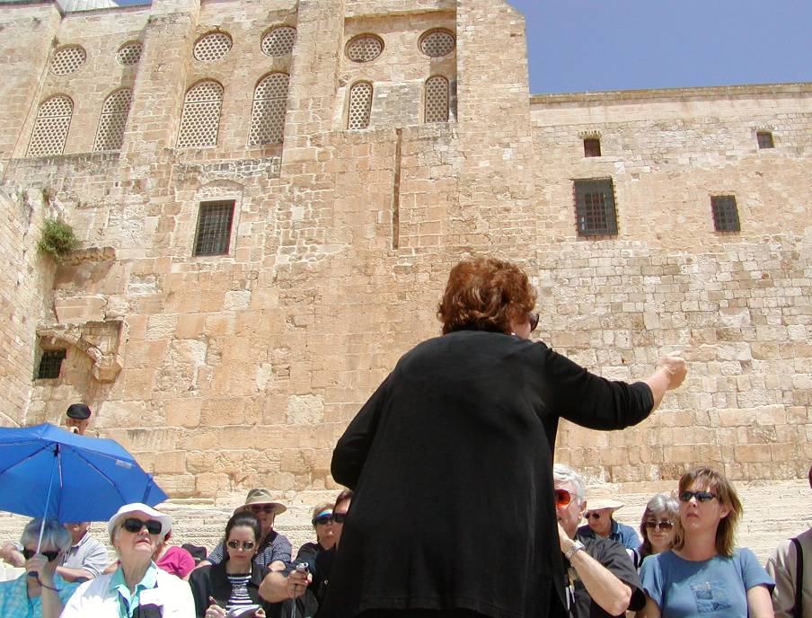
Jerusalem – Temple Southern Steps

Slide 43
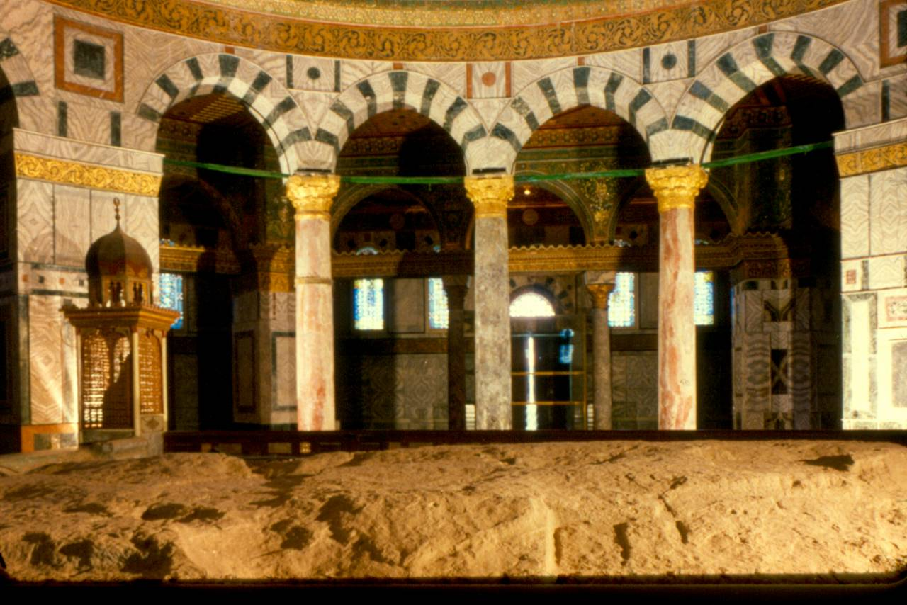
Inside Dome of the Rock

Slide 44
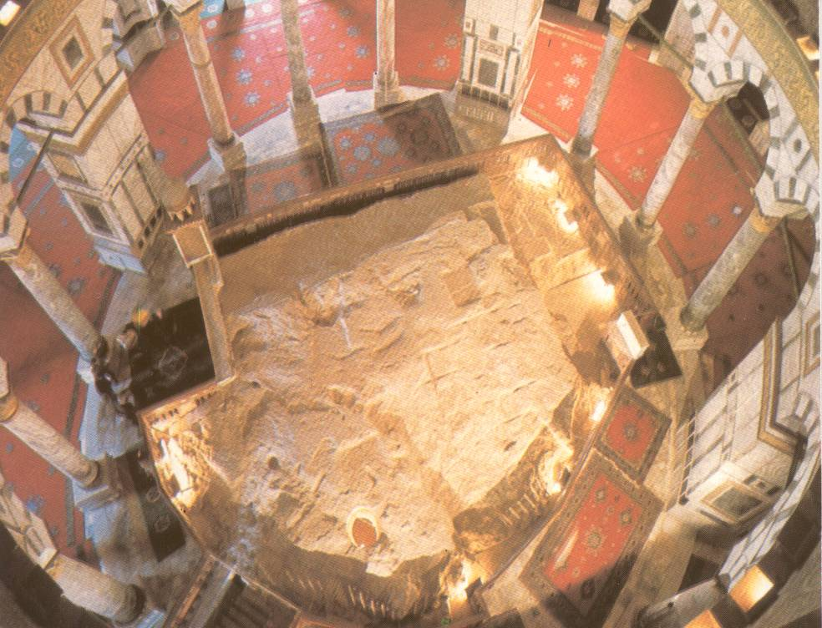
The Rock under the Dome

Slide 45
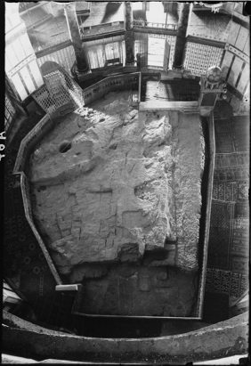
Rock under
Dome B&W

Slide 46
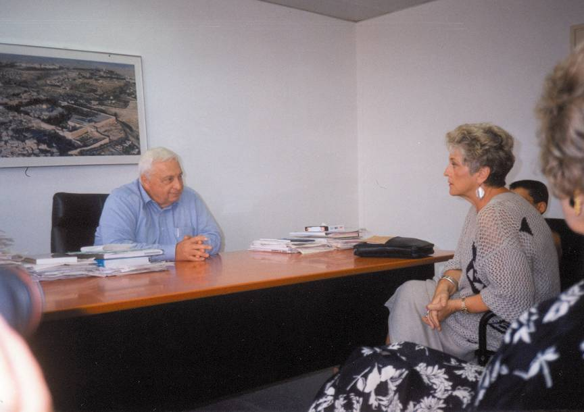
Ariel Sharon-Billye sitting in his office

Slide 47
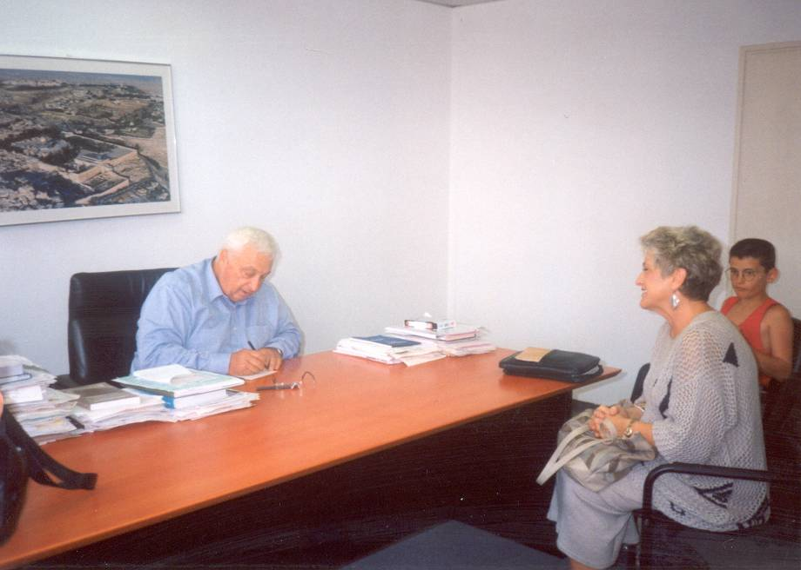
Ariel Sharon-Billye sitting in his office-Sharon writing phone number

Slide 48
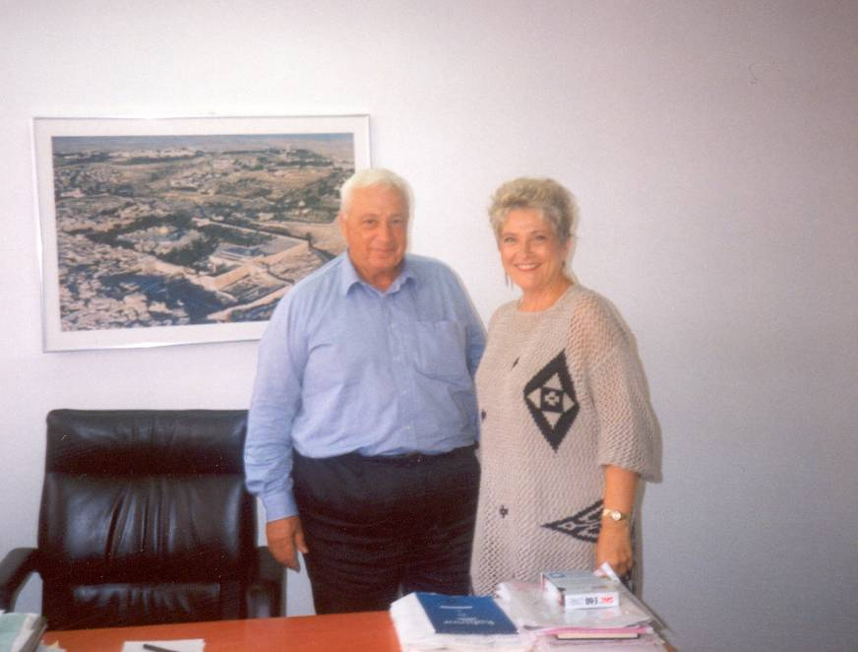
Ariel Sharon- Billye Brim & Ariel Sharon In Front of Jerusalem Picture

Slide 49
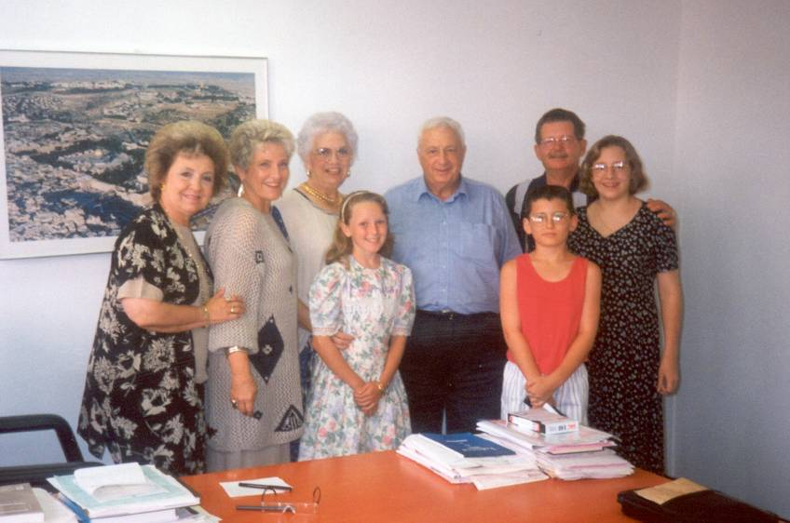
Ariel Sharon-Sharon with Billye, Kylie, Cody, & group

Slide 50
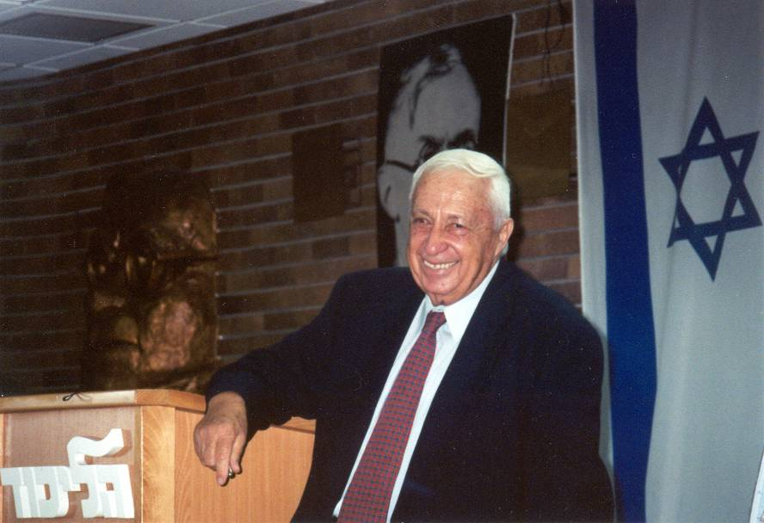
Ariel Sharon-Sharon greets tour of 26 @ Likkud office

Slide 51

Ariel Sharon-Billye shakes hands with Sharon

Slide 52

Ariel Sharon-Billye reads Ps 33:10 to Sharon

Slide 53

Ariel Sharon-Sharon Praying at wall Sept. 28, 2000

Slide 54

Migdal- Billye & Rani Levy w/ Sign

Slide 55

Migdal-Old blgd w/ Arbel Cliffs

Slide 56

Migdal- Jesus’ Path
- Arbel

Slide 57

Migdal- From Behind, Shows Proximity to Sea

Slide 58

Migdal- Panoramic/ Migdal From Sea

Slide 59

Migdal- Aerial view of cleared land

Slide 60

Migdal- ground breaking

Slide 61

Migdal- flag

Slide 62

Migdal- New plans – building drawing

Slide 63

Migdal- New plans – building graphic from above

Slide 64

Migdal- New plans – building graphic from front

Slide 65

Migdal- New plans – building graphic from front at night

Slide 66

Migdal- New plans – building graphic from Southeast

Slide 67

Migdal- New plans – building graphic from South

Slide 68

Map-Roman Empire

Slide 69

Daniel-Image from Nebuchadnezer’s Dream

Slide 70

Model of Pergamon Acropolis

Slide 71

Brussels: The Altar of Zeus (and Athena) at Pergamon

Slide 72

Brussels: Pergamon Altar Picture full view

Slide 73

Brussels-Pergamon Altar, Billye Brim & Pastor on steps

Slide 74

Palais De Justice- Outside Front from Side

Slide 75

Palais de Justice- Entry

Slide 76

Palais De Justice-
Altar to Children

Slide 77

The Zeppelin Grandstand-
Nuremberg, Germany

Slide 78

The Lenin Mausoleum-
Red Square, Moscow

Slide 79

Ishtar Gate
Cover page

Slide 80

Ishtar Gate-Model A

Slide 81

Ishtar Gate-The Processional Way

Slide 82

Tower of Babel-Brueghel’s Painting

Slide 83

Tower of Babel-1/2 Parliament bldg

Slide 84

Tower of Babel-Parliament bldg w/caption

Slide 85

Europe poster: many tongues one voice

Slide 86

EU Woman on bull – metal sculpture

Slide 87

Menorah Graphic

Slide 88

Aleph and Tav

Slide 89

Genesis 1
English & Hebrew

Slide 90

Genesis 1:1 in Hebrew
Close-up

Slide 91

24 Hour Prayer Clock

Slide 92
Title slide address info

