Slide 1

Title slide address info

Slide 2
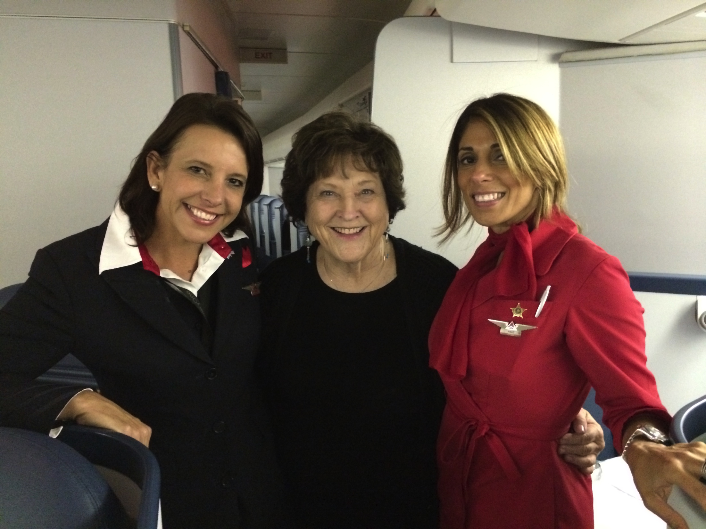
With Delta stewardesses – Linda & Anat

Slide 3
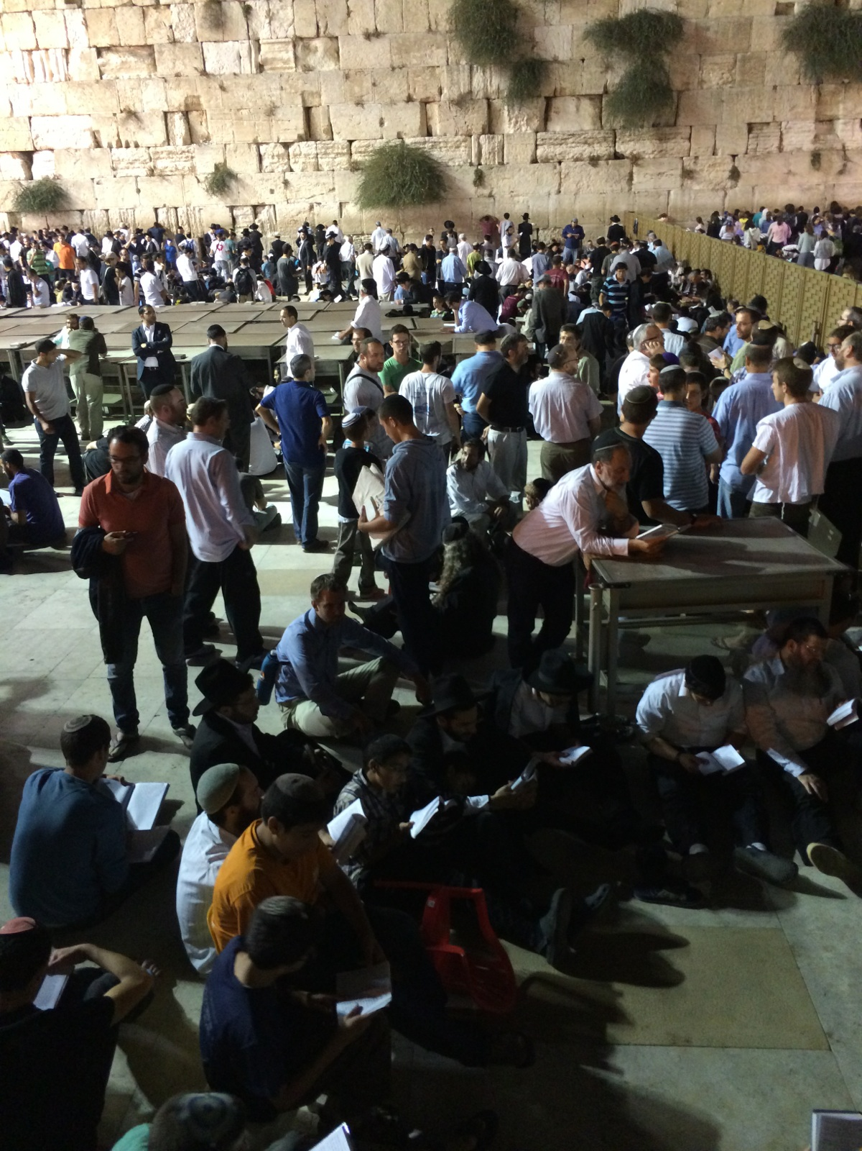
The Western Wall on Tisha b’Av

Slide 4
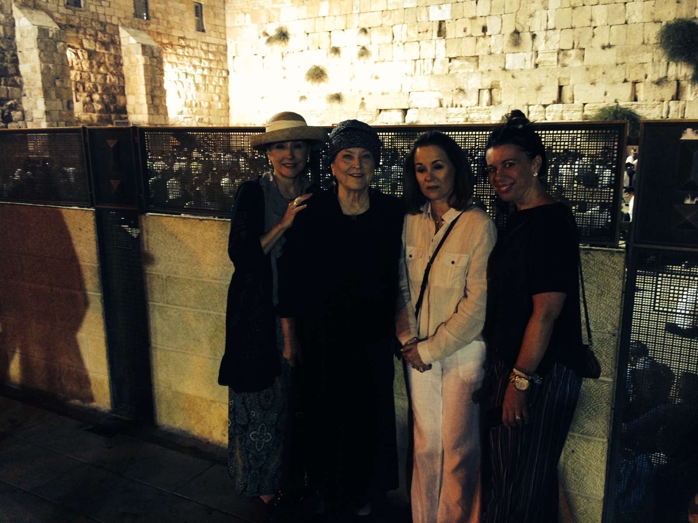
Western Wall – Shelli, Billye, Lynne, Heather

Slide 5
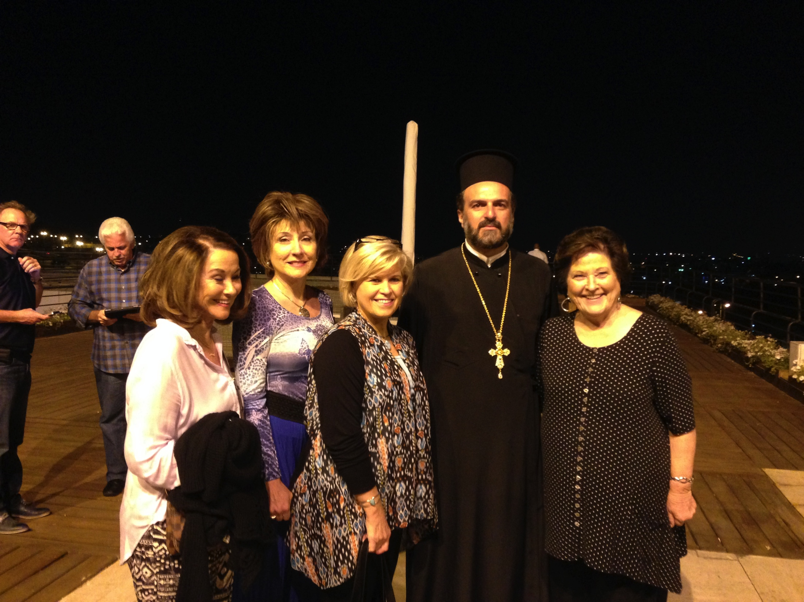
With Sharon Daugherty & Father Gabriel Naddaf

Slide 6
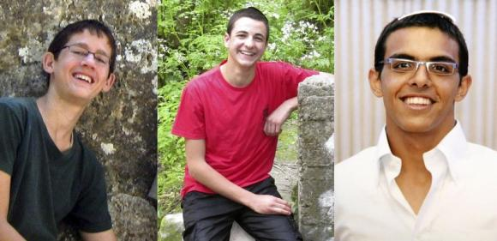
3 Israeli Teens
Naftali Fraenkel Gilad Sharr Eyal Yifrach

Slide 7
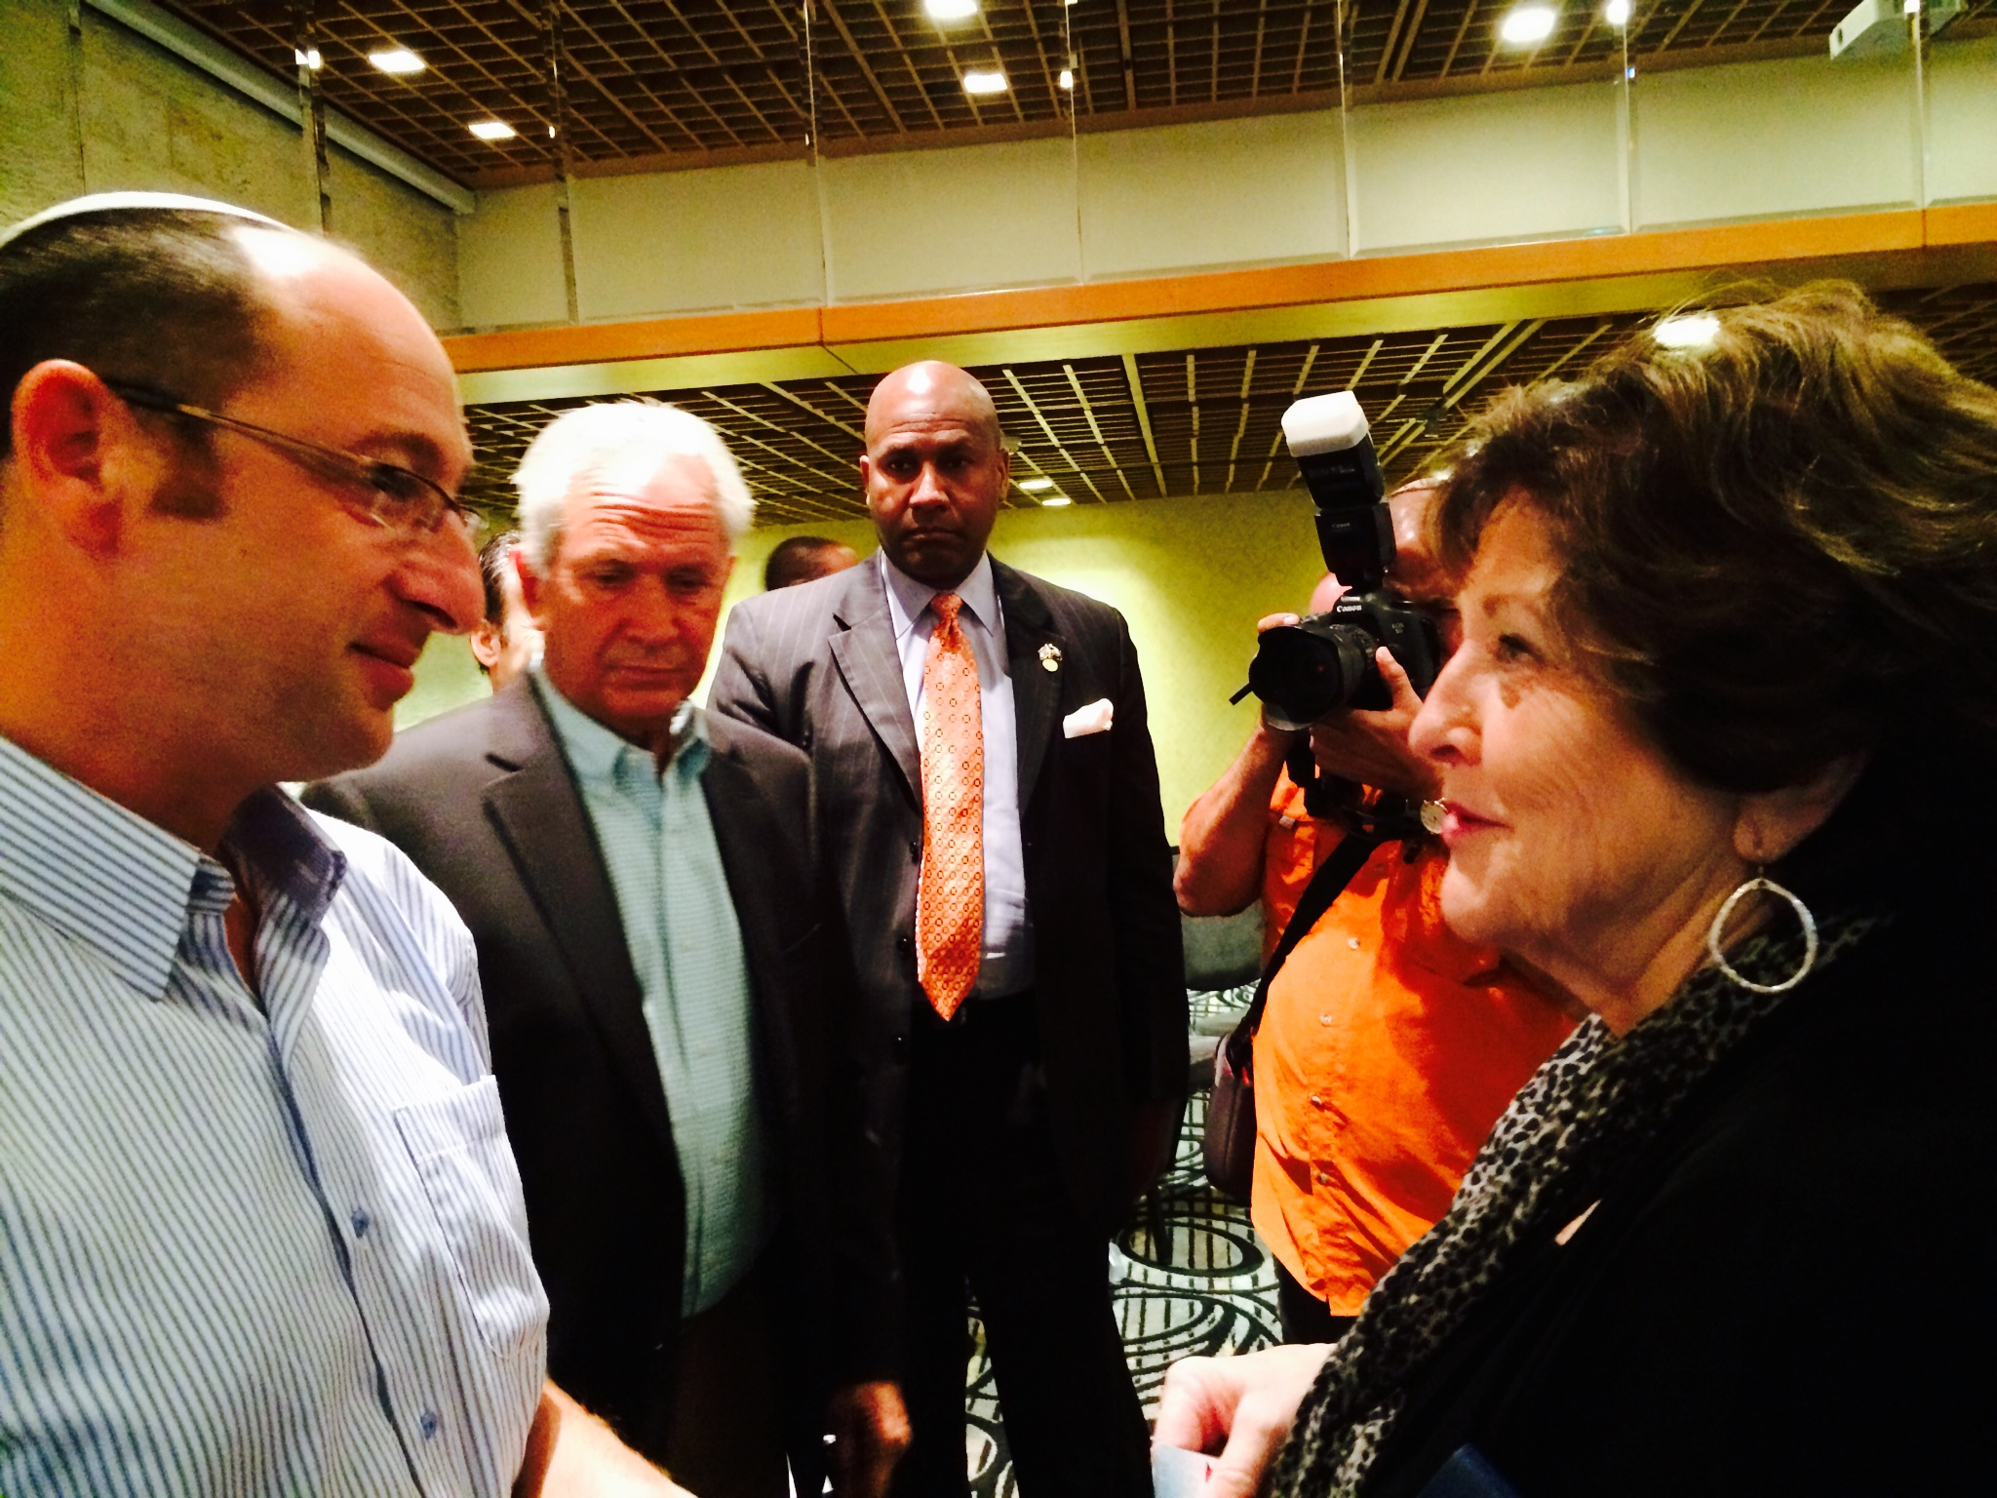
Billye w/ Father of one of teenagers killed

Slide 8
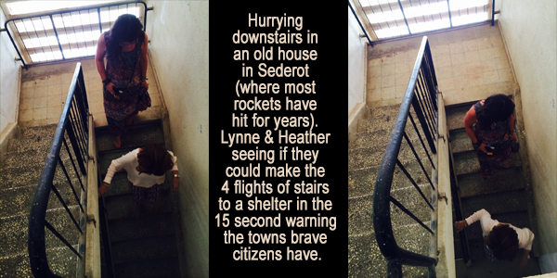
Sederot – Lynne & Heather running stairs

Slide 9
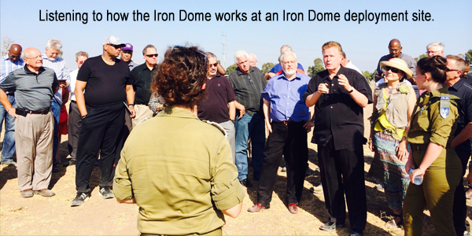
Listening to speaker at Iron Dome deployment site

Slide 10
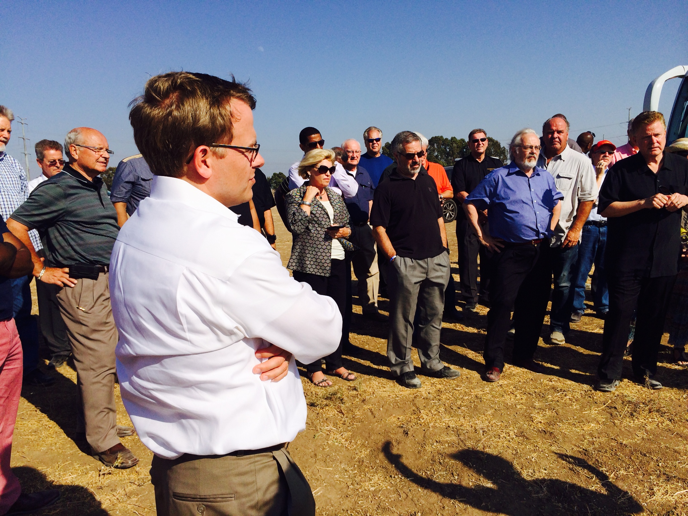
Todd Burpo at Iron Dome deployment site

Slide 11
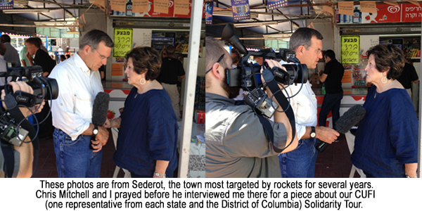
Interview w/ Chris Mitchell

Slide 12
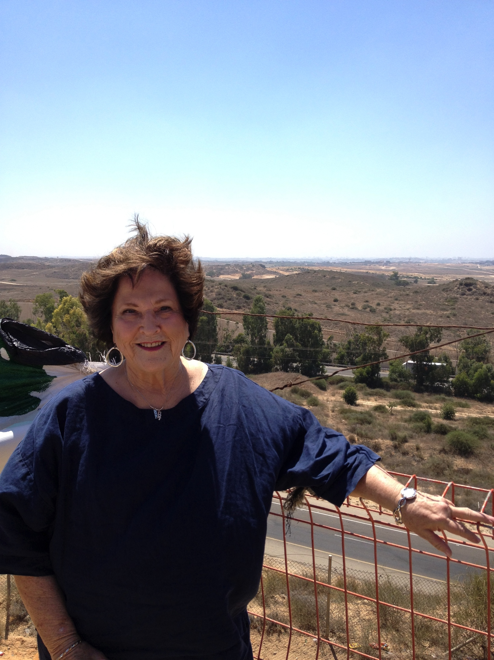
Standing on the overlook into Gaza at Sederot

Slide 13
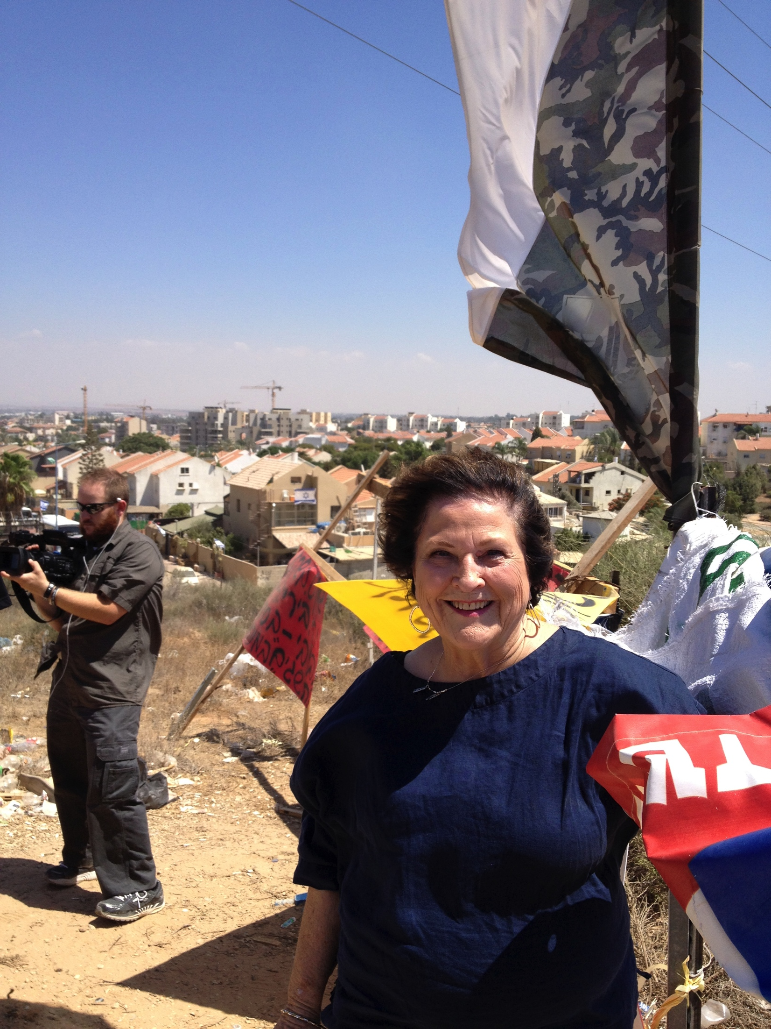
Same overlook looking back into Sederot

Slide 14
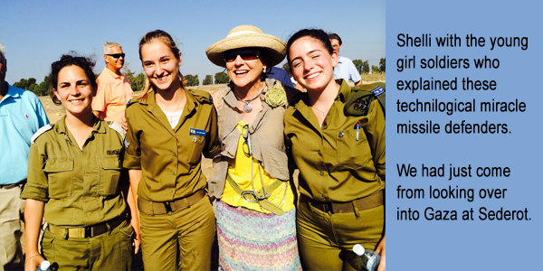
Shelli with young girl soldiers

Slide 15
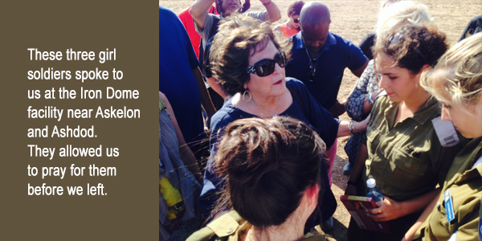
Billye praying with girl soldiers

Slide 16
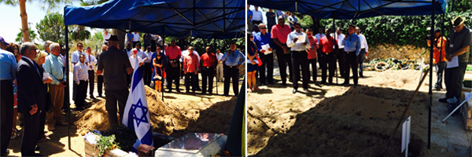
Mt Herzl Cemetary, graves of soldiers

Slide 17
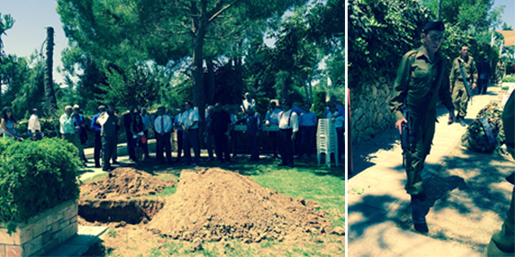
Graveside, young soldiers walking

Slide 18
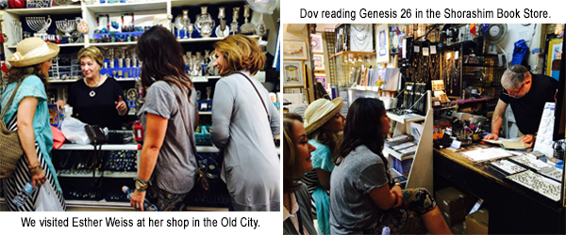
Shops in Jerusalem-Esther Weiss, Dov reading Gen 26

Slide 19
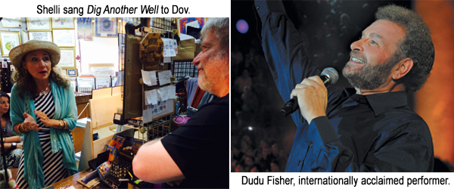
Shelli singing to Dov, Dudu Fisher

Slide 20
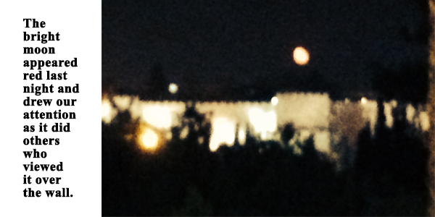
Red moon over the wall

Slide 21
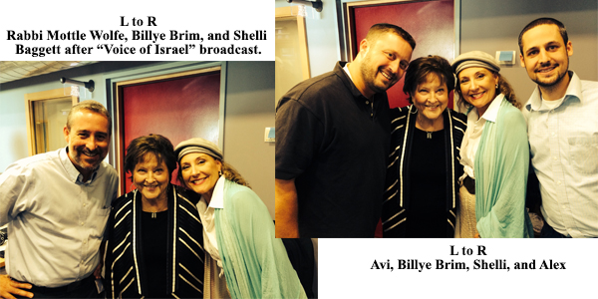
Rabbi Mottle Wolfe, Avi, & Alex – Voice of Israel radio

Slide 22
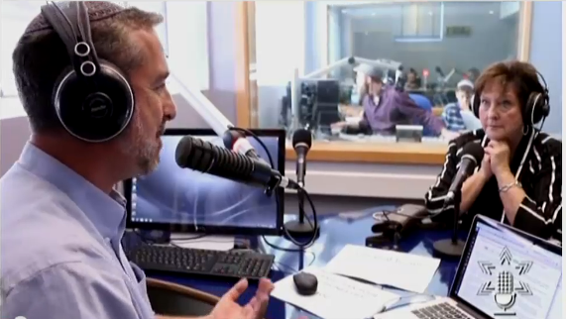
Voice of Israel 1

Slide 23
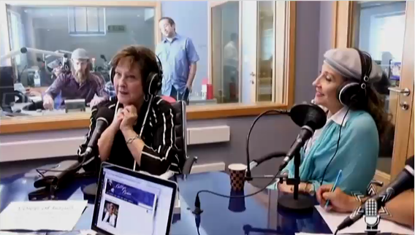
Voice of Israel 2

Slide 24
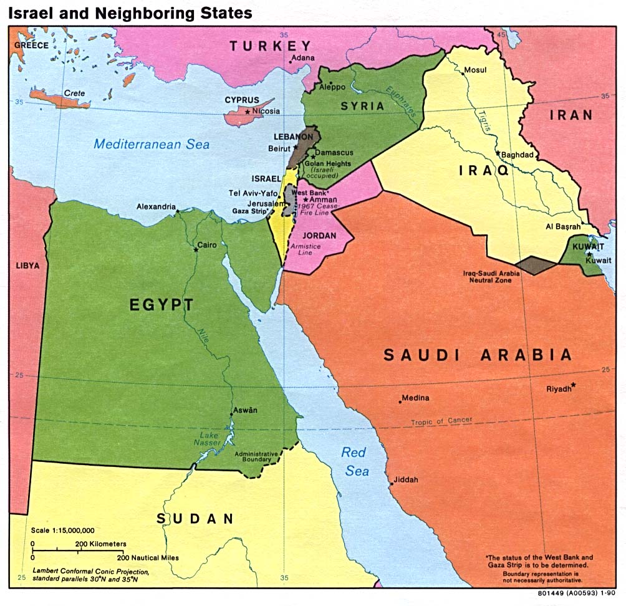
Map –Israel & Neighboring

Slide 25
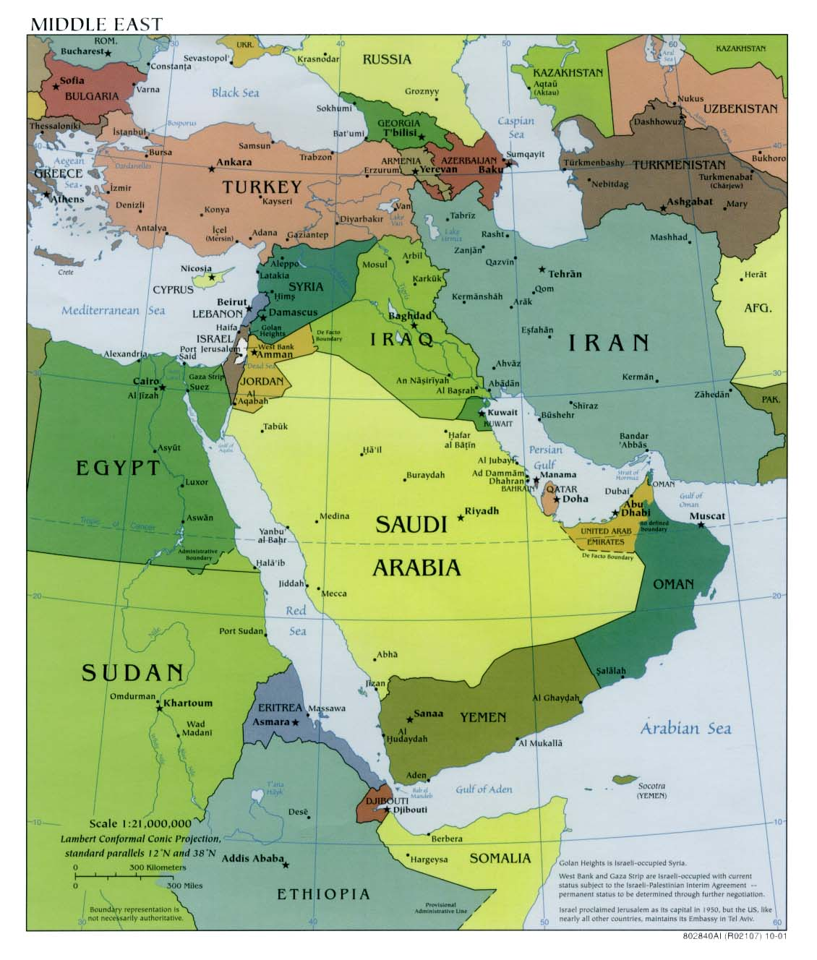
Map –Middle East

Slide 26
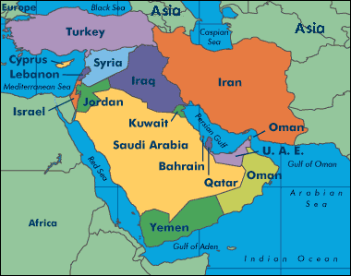
Map –Middle East 2

Slide 27
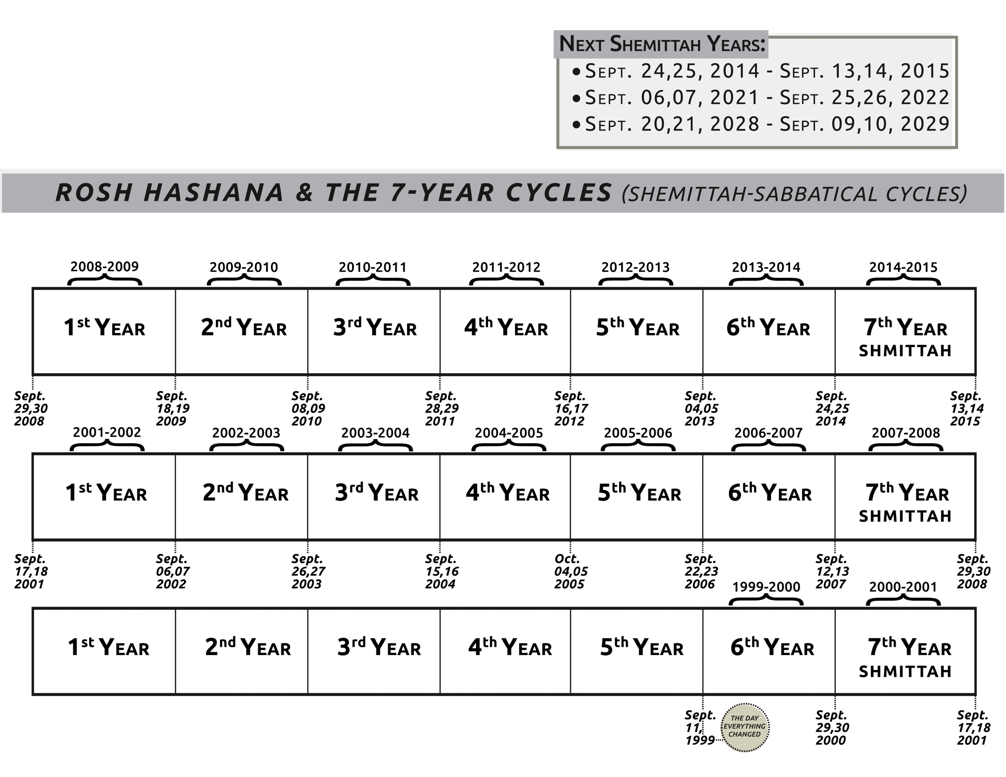
Shemittah chart

Slide 28
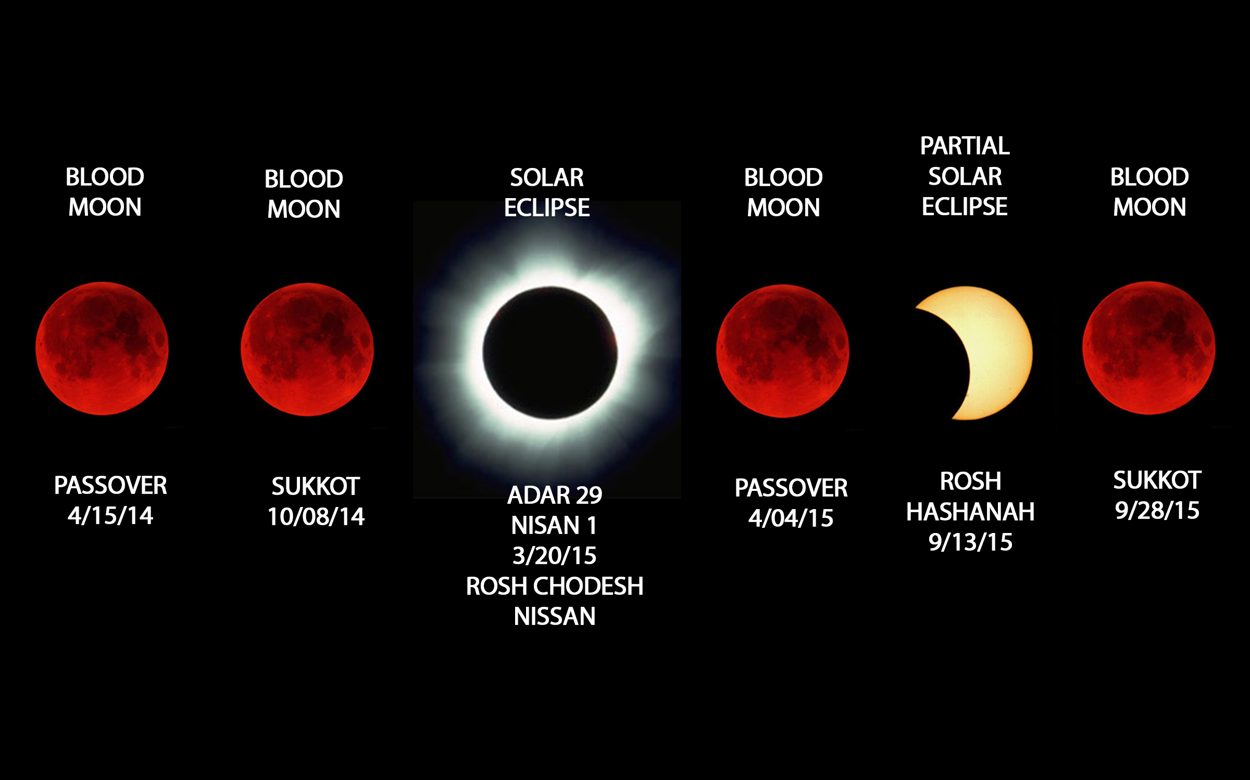
Blood Moons chart

Slide 29
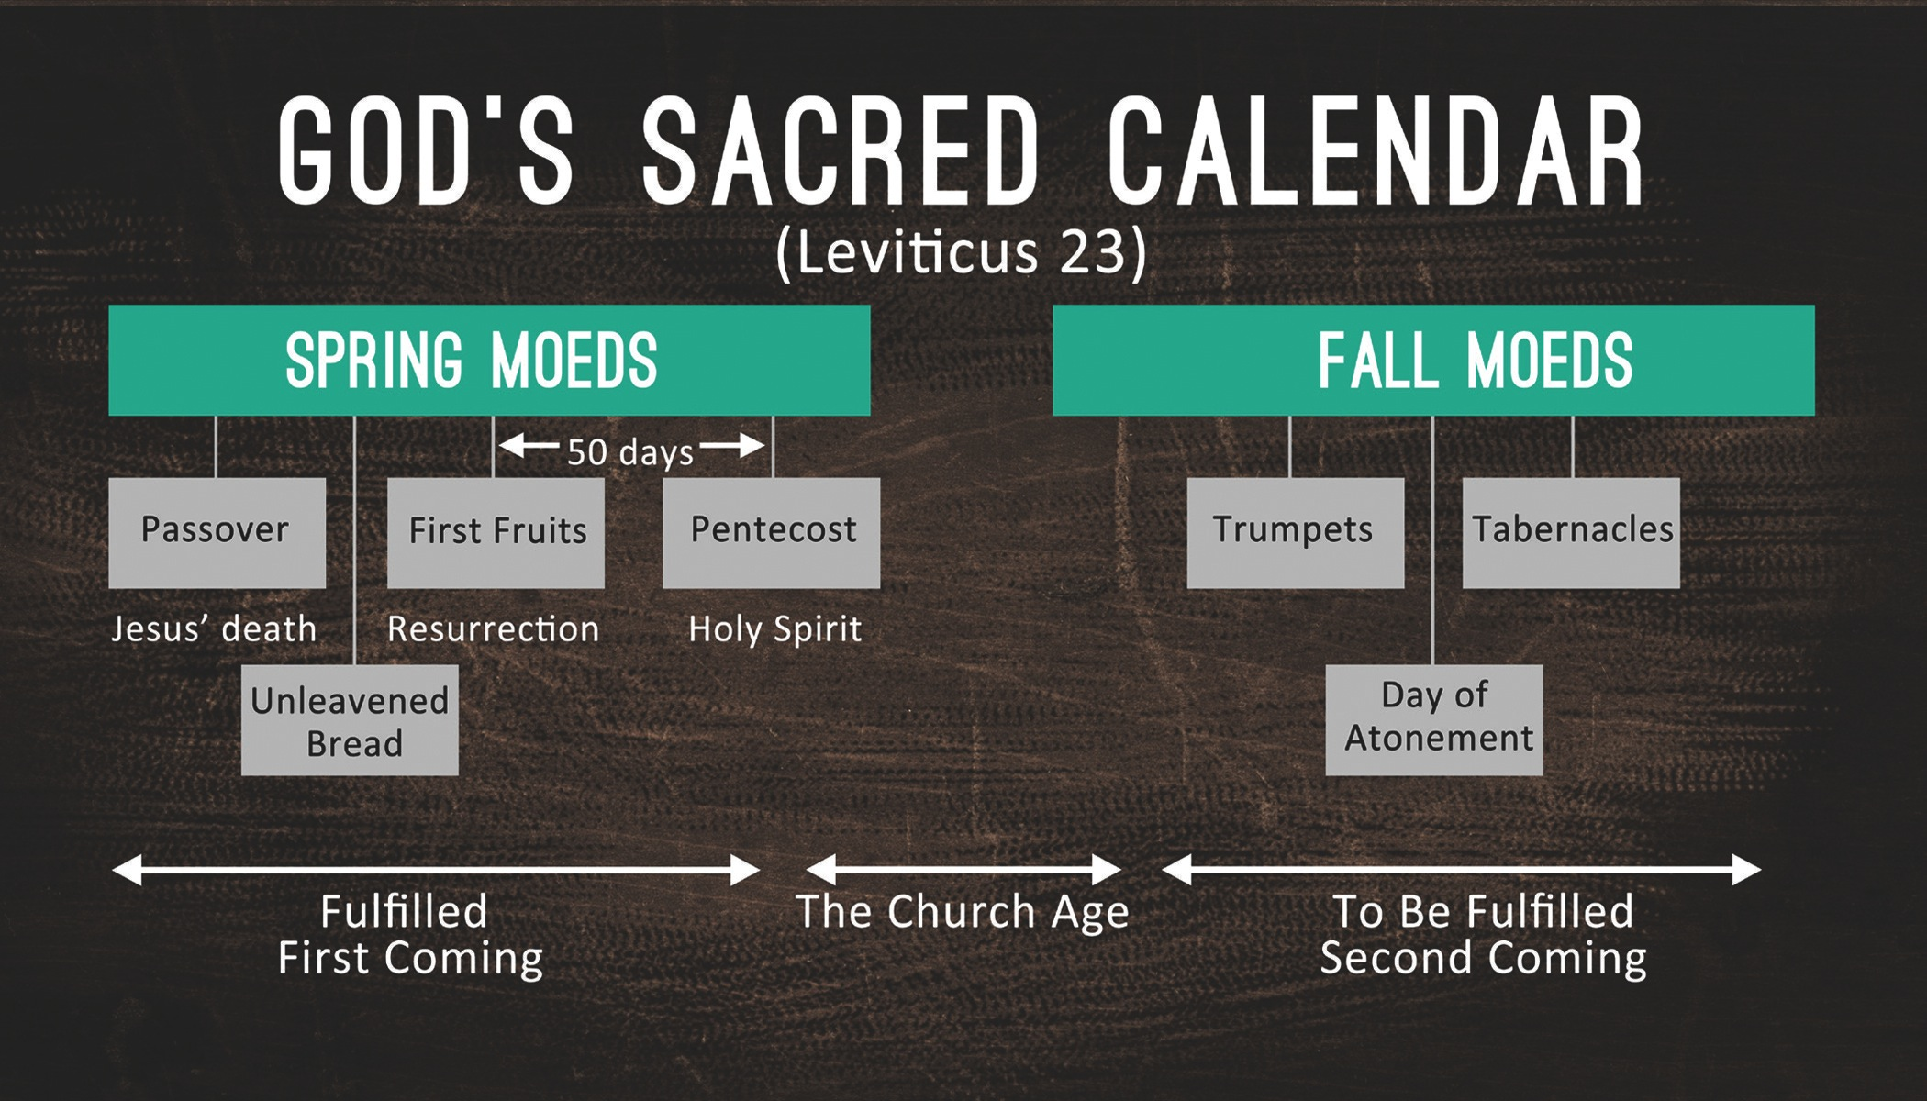
God’s Sacred Calendar (Lev. 23)

Slide 30
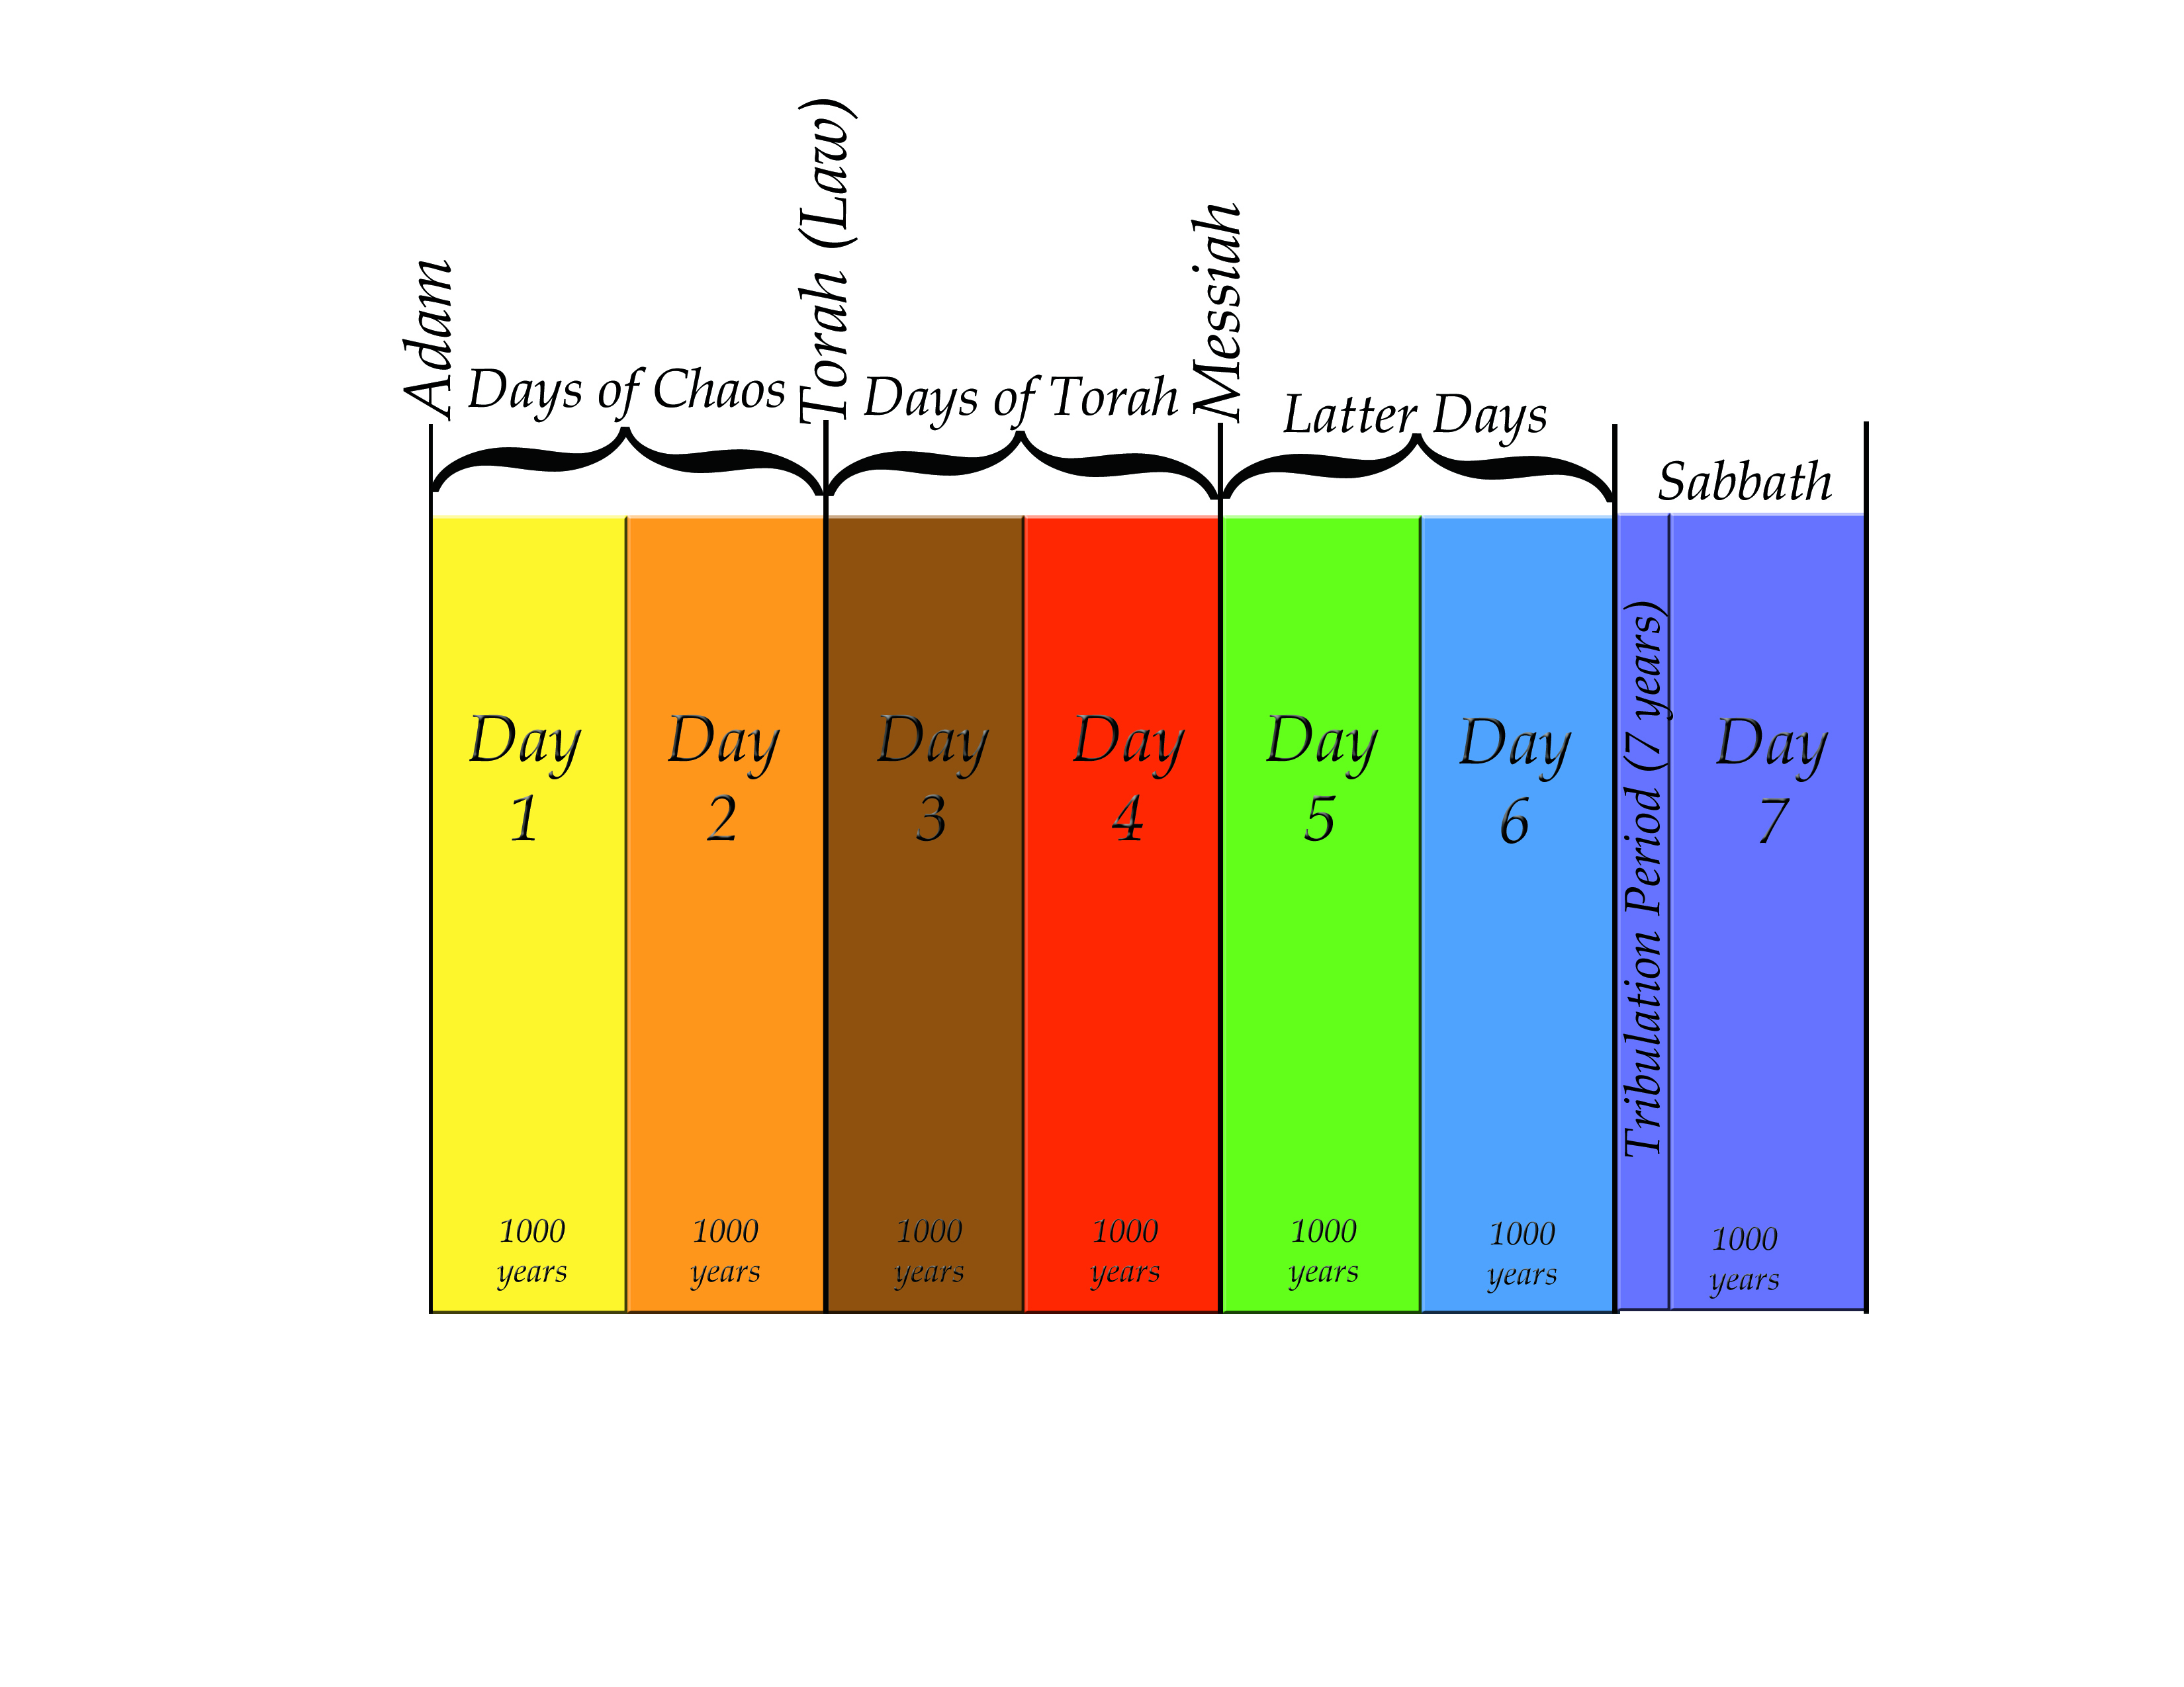
7 Day Chart

Slide 31
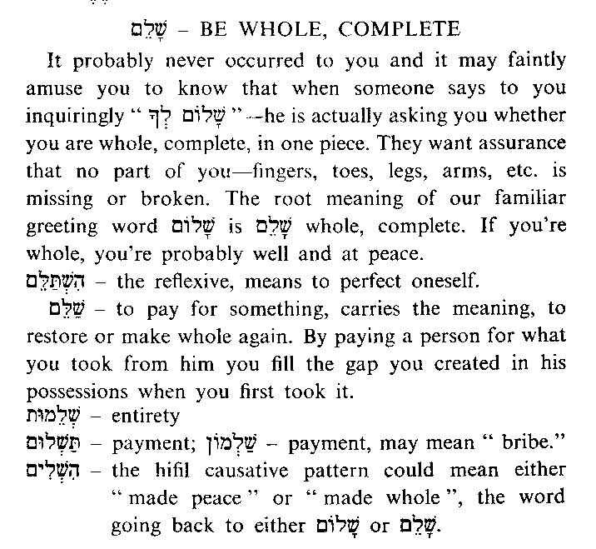
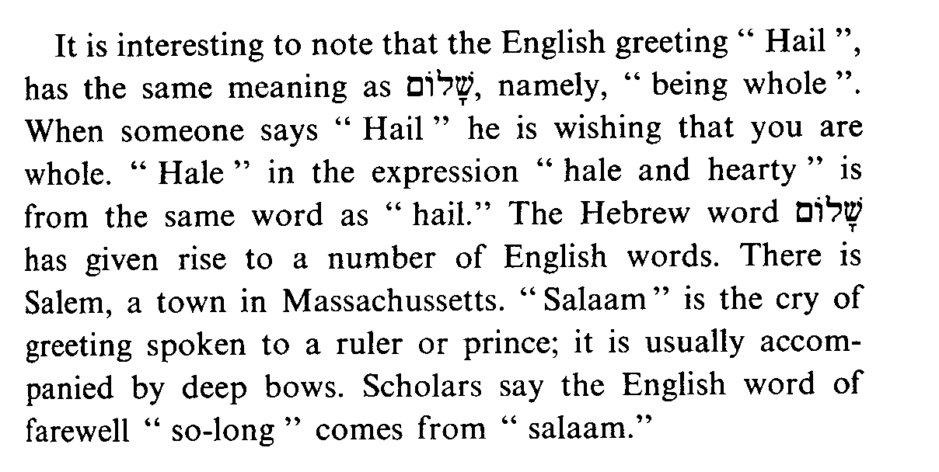
Shalom-Be Whole,
Complete

Slide 32
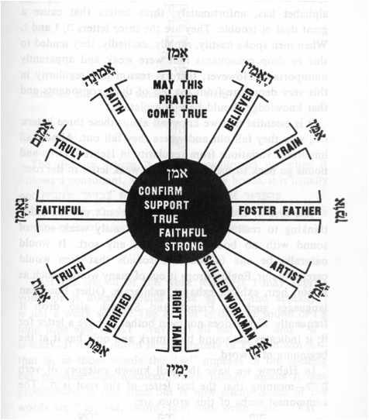
Amen Word Wheel

Slide 33
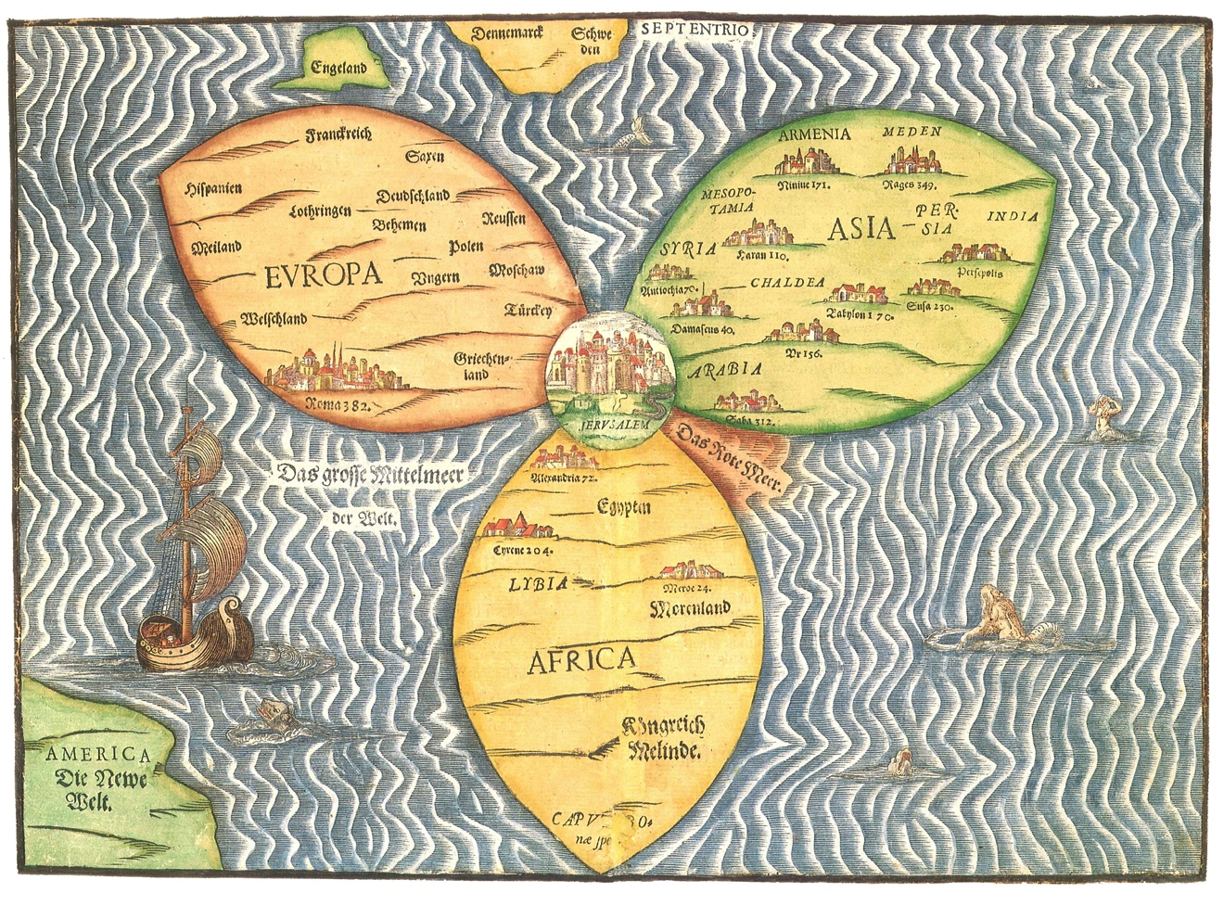
Ancient 3 Petal Map

Slide 34
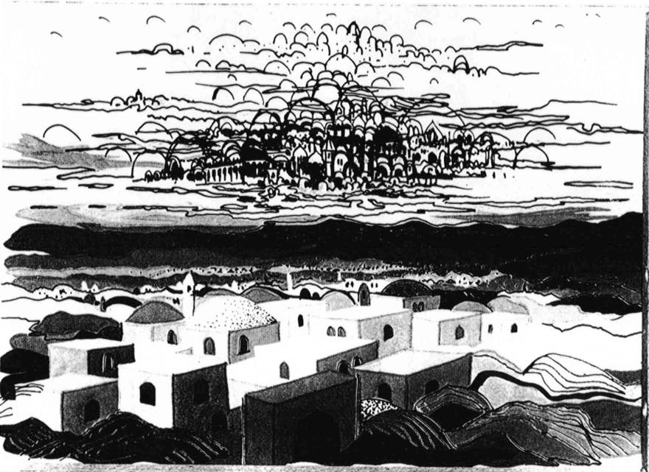
2 Jerusalems Painting B&W

Slide 35
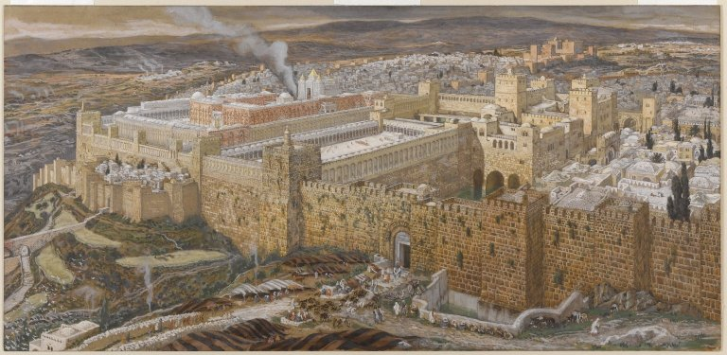
Jerusalem w/Temple Painting
Notes:
James Tissot - Reconstruction of Jerusalem and the Temple of Herod - Brooklyn Museum
This image was uploaded as a donation by the Brooklyn Museum, and is considered to have no known copyright restrictions by the institutions of the Brooklyn Museum.

Slide 36
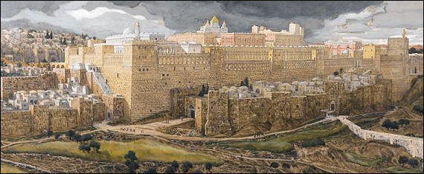
Jeruslaem w/Temple Painting 2
Notes:
James Tissot - Reconstruction of Jerusalem and the Temple of Herod - Brooklyn Museum
This image was uploaded as a donation by the Brooklyn Museum, and is considered to have no known copyright restrictions by the institutions of the Brooklyn Museum.

Slide 37
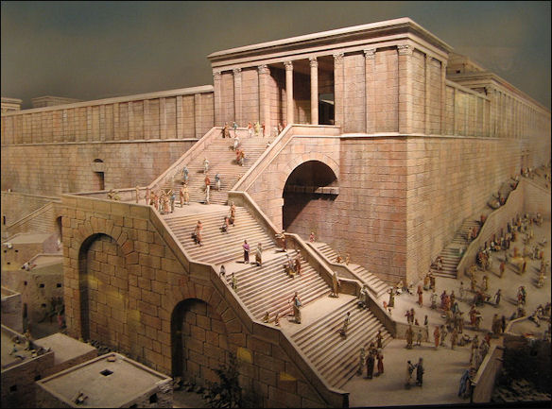
Temple w/Steps Painting
Notes:
This image was uploaded as a donation by the Brooklyn Museum, and is considered to have no known copyright restrictions by the institutions of the Brooklyn Museum.

Slide 38
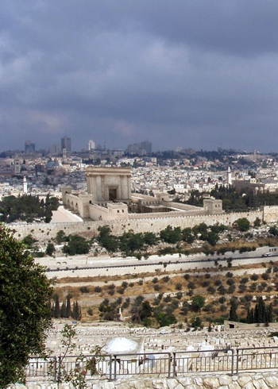
Temple of Tomorrow from The
Temple Institute
Notes:
Taken from www.TheTempleInstitute.org
Used by Permission.

Slide 39
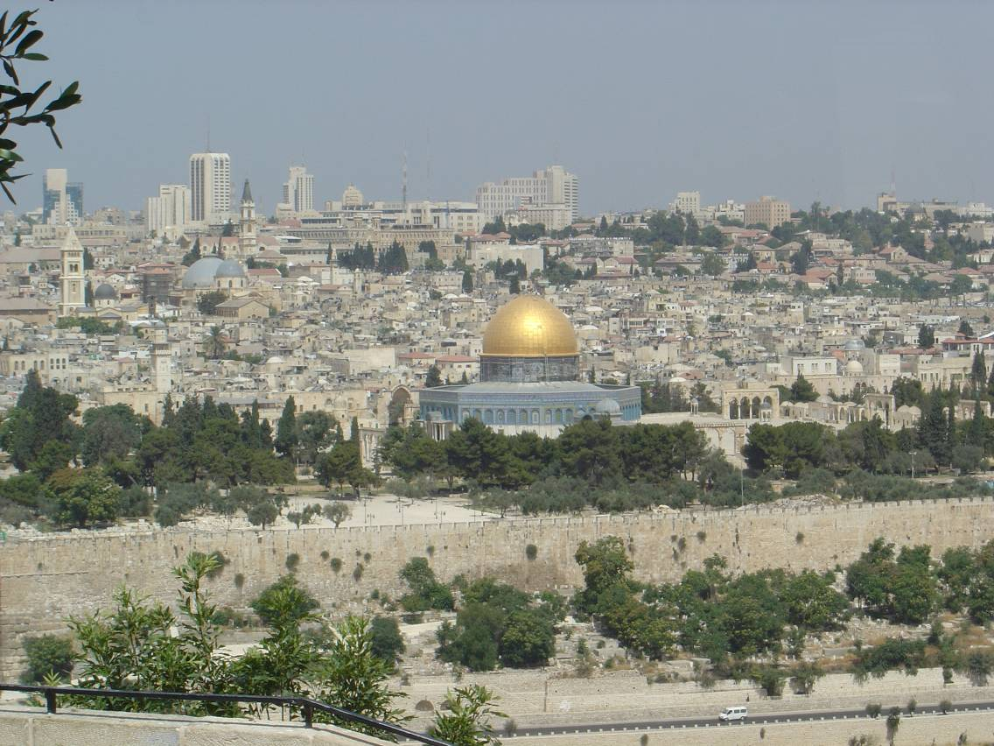
Jerusalem Temple Mount w/Dome

Slide 40
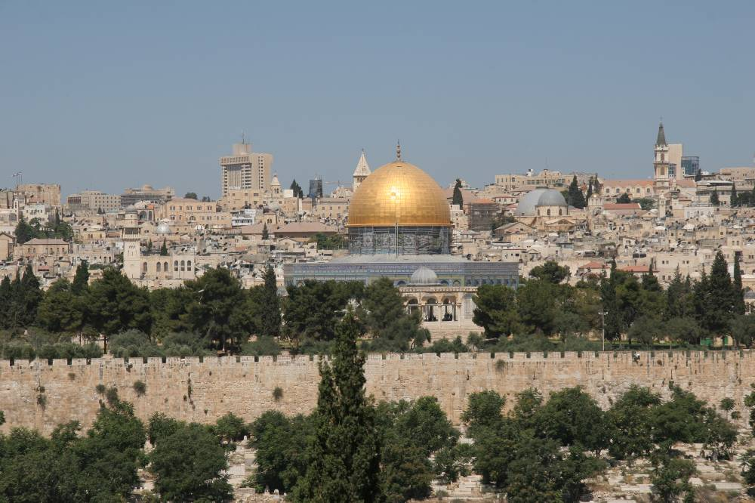
Jerusalem w/Dome

Slide 41
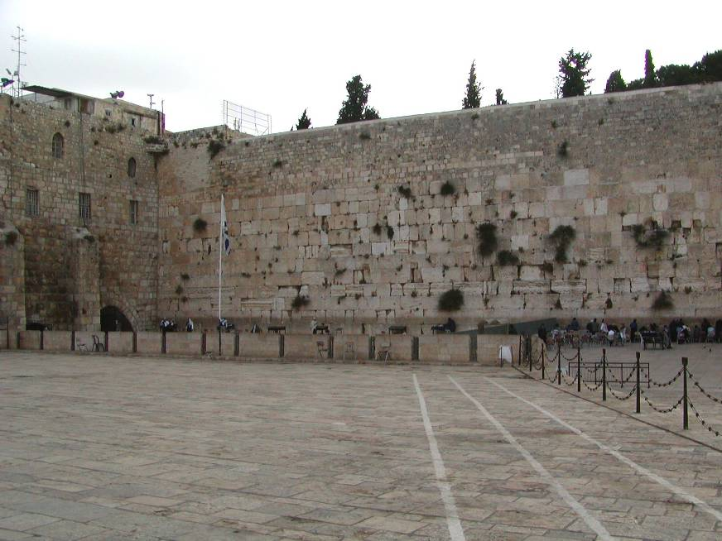
Jerusalem – Western Wall

Slide 42
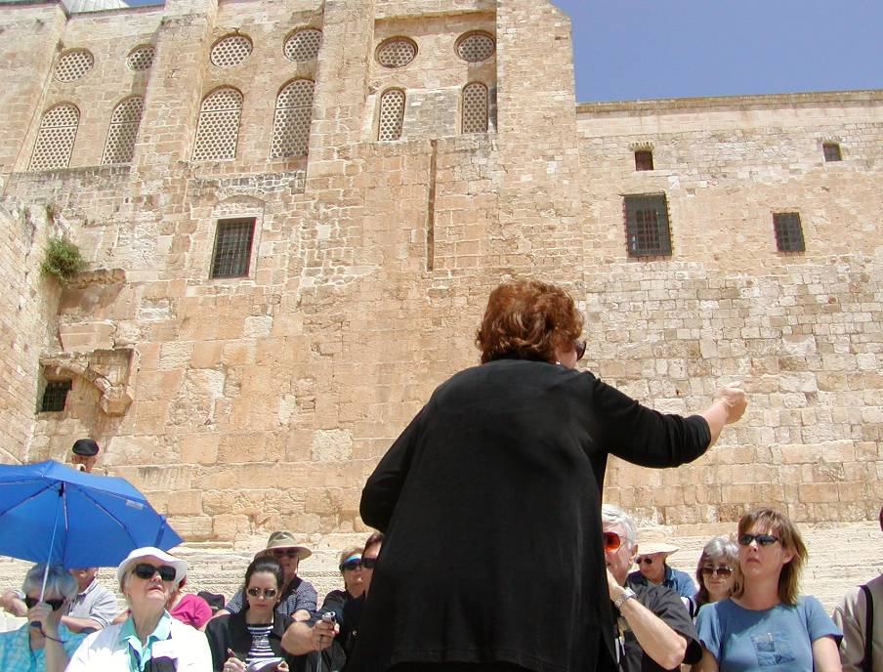
Jerusalem – Temple Southern Steps

Slide 43
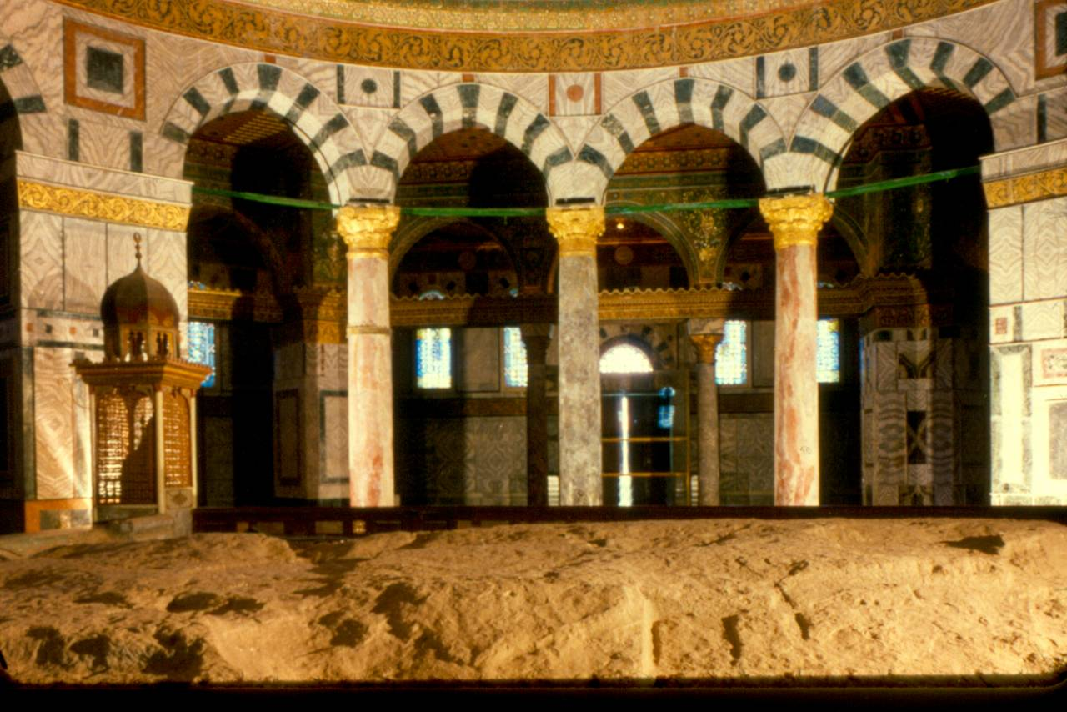
Inside Dome of the Rock

Slide 44
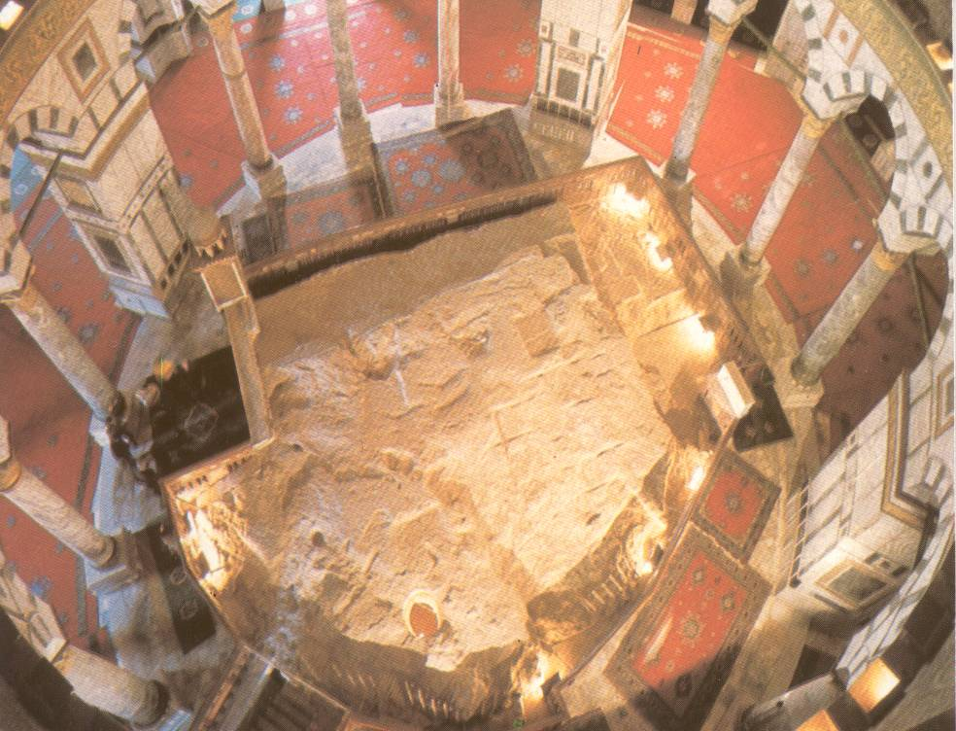
The Rock under the Dome

Slide 45
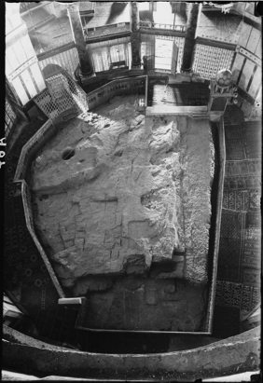
Rock under
Dome B&W

Slide 46
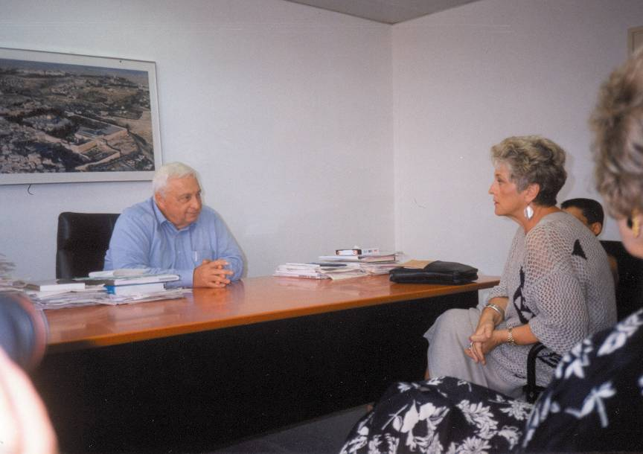
Ariel Sharon-Billye sitting in his office

Slide 47
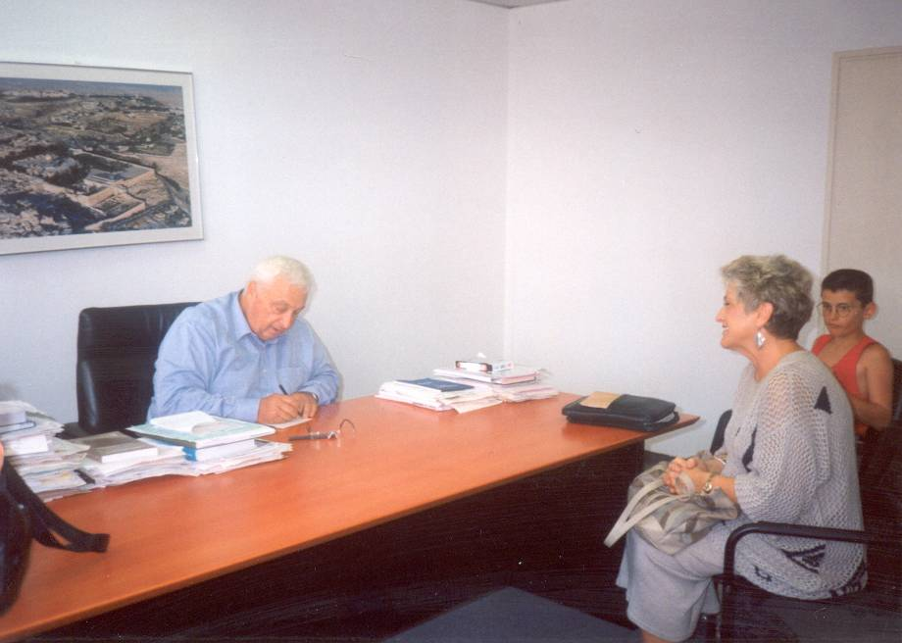
Ariel Sharon-Billye sitting in his office-Sharon writing phone number

Slide 48
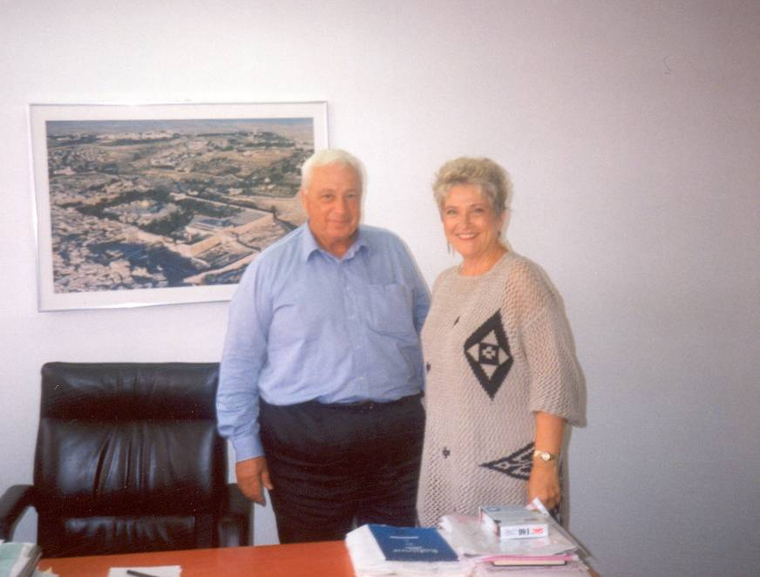
Ariel Sharon- Billye Brim & Ariel Sharon In Front of Jerusalem Picture

Slide 49
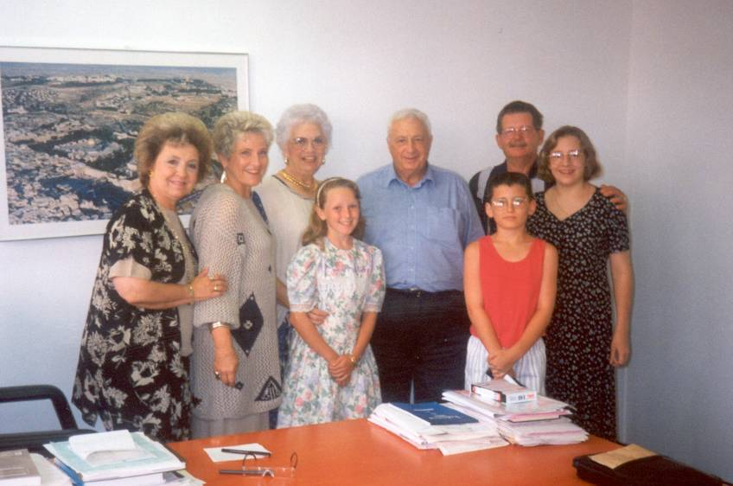
Ariel Sharon-Sharon with Billye, Kylie, Cody, & group

Slide 50
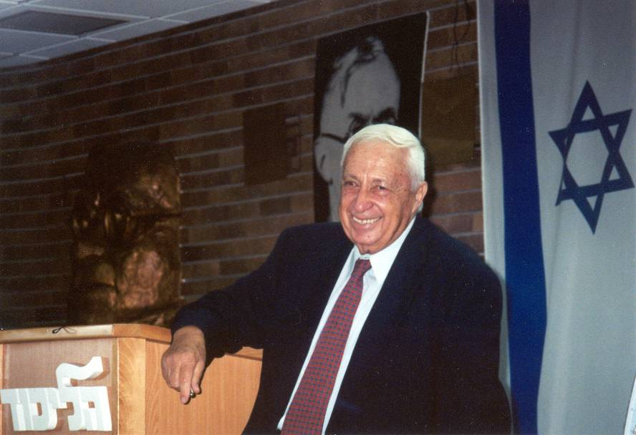
Ariel Sharon-Sharon greets tour of 26 @ Likkud office

Slide 51

Ariel Sharon-Billye shakes hands with Sharon

Slide 52

Ariel Sharon-Billye reads Ps 33:10 to Sharon

Slide 53

Ariel Sharon-Sharon Praying at wall Sept. 28, 2000

Slide 54

Migdal- Billye & Rani Levy w/ Sign

Slide 55

Migdal-Old blgd w/ Arbel Cliffs

Slide 56

Migdal- Jesus’ Path
- Arbel

Slide 57

Migdal- From Behind, Shows Proximity to Sea

Slide 58

Migdal- Panoramic/ Migdal From Sea

Slide 59

Migdal- Aerial view of cleared land

Slide 60

Migdal- ground breaking

Slide 61

Migdal- flag

Slide 62

Migdal- New plans – building drawing

Slide 63

Migdal- New plans – building graphic from above

Slide 64

Migdal- New plans – building graphic from front

Slide 65

Migdal- New plans – building graphic from front at night

Slide 66

Migdal- New plans – building graphic from Southeast

Slide 67

Migdal- New plans – building graphic from South

Slide 68

Map-Roman Empire

Slide 69

Daniel-Image from Nebuchadnezer’s Dream

Slide 70

Model of Pergamon Acropolis

Slide 71

Brussels: The Altar of Zeus (and Athena) at Pergamon

Slide 72

Brussels: Pergamon Altar Picture full view

Slide 73

Brussels-Pergamon Altar, Billye Brim & Pastor on steps

Slide 74

Palais De Justice- Outside Front from Side

Slide 75

Palais de Justice- Entry

Slide 76

Palais De Justice-
Altar to Children

Slide 77

The Zeppelin Grandstand-
Nuremberg, Germany

Slide 78

The Lenin Mausoleum-
Red Square, Moscow

Slide 79

Ishtar Gate
Cover page

Slide 80

Ishtar Gate-Model A

Slide 81

Ishtar Gate-The Processional Way

Slide 82

Tower of Babel-Brueghel’s Painting

Slide 83

Tower of Babel-1/2 Parliament bldg

Slide 84

Tower of Babel-Parliament bldg w/caption

Slide 85

Europe poster: many tongues one voice

Slide 86

EU Woman on bull – metal sculpture

Slide 87

Menorah Graphic

Slide 88

Aleph and Tav

Slide 89

Genesis 1
English & Hebrew

Slide 90

Genesis 1:1 in Hebrew
Close-up

Slide 91

24 Hour Prayer Clock

Slide 92
Title slide address info

Slide 93

Israel and the Middle East Map
Notes:
Free sample map from bjdesign.com
Used by Permission – email from Bruce Jones 2/12/15

Slide 94

Tree at Alon Moreh

Slide 95

BB teaching at Alon Moreh

Slide 96

Kenneth E. Hagin portrait

Slide 97

Kenneth E. Hagin sitting in meeting

Slide 98
Jeanne Wilkerson portrait

Slide 99

Jeanne Wilkerson & Kenneth Hagin during meeting at Rhema 1985

Slide 100

Rhema photo 1985 - Patsy, Billye, Phil, Bro Hagin

Slide 101

Phil Halverson (scan of portrait-not great quality)

Slide 102

Phil & Fern Halverson (scan of snapshot in book)

Slide 103

Phil & Fern Halverson (scan from album cover-not great quality)

Slide 104

Rachel Teafatiller sitting

Slide 105

Rachel Teafatiller portrait

Slide 106

Wilford Reidt (screen shot from video, not good)

Slide 107

Clyde & Eufala McGee

Slide 108

Prayer group in unfinished chapel at Prayer Mountain

Slide 109

Entrance sign at Prayer Mountain

Slide 110

Admin Building at Prayer Mountain

Slide 111

Pickard Place porch

Slide 112

Pickard Place great room

Slide 113

Pickard Place 1 of 3 bedrooms

Slide 114

Halverson House outside

Slide 115

Halverson House inside

Slide 116

Uncle Joes outside

Slide 117

Uncle Joes inside looking down from loft

Slide 118

Uncle Joes kitchen

Slide 119

Uncle Joes loft

Slide 120

AA 2014 Lynne & Teri praying

Slide 121

AA 2014 BB, George, Lynne, Paul, Teri - praying

Slide 122

AA 2014 audience rows w/hands up

Slide 123

AA 2014 Gloria & Billye

Slide 124

AA 2014 Group praying

Slide 125

AA 2014 Jared praying over youth

Slide 126

AA 2014 Youth & Crowd praying

Slide 127

AA 2014 Crowd praying over youth

Slide 128

AA 2014 Tent meeting crowd w/KC

Slide 129

AA 2014 Tent meeting crowd praying

