Slide 1
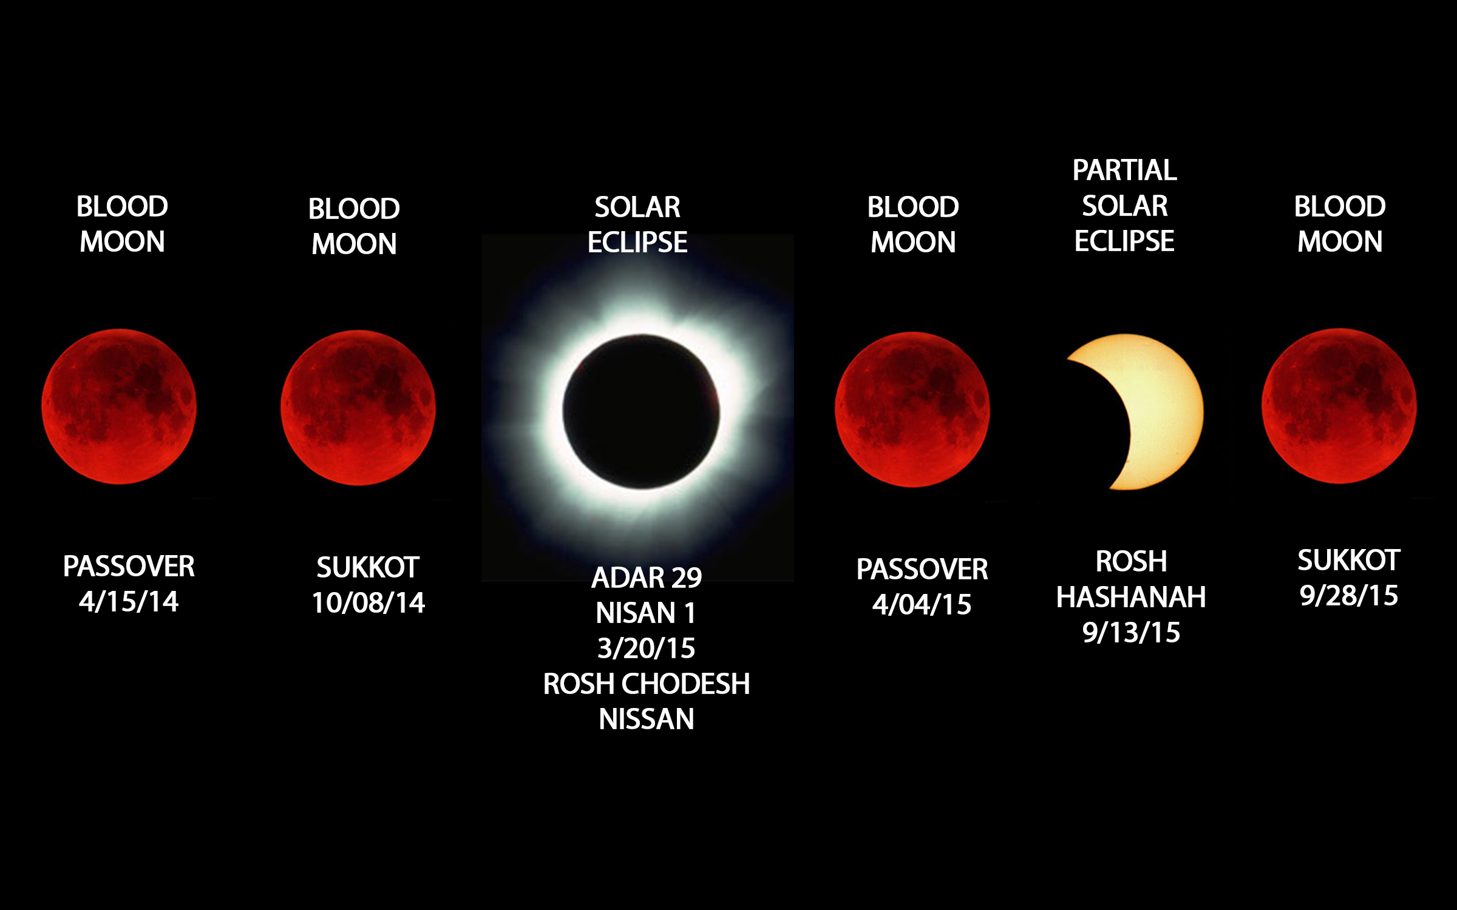
Blood Moons graphic

Slide 2
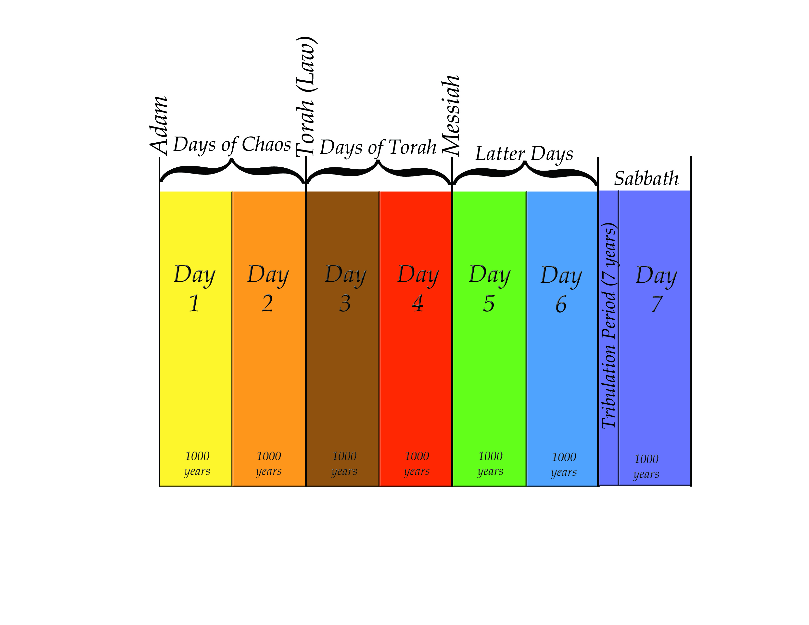
7 days chart

Slide 3
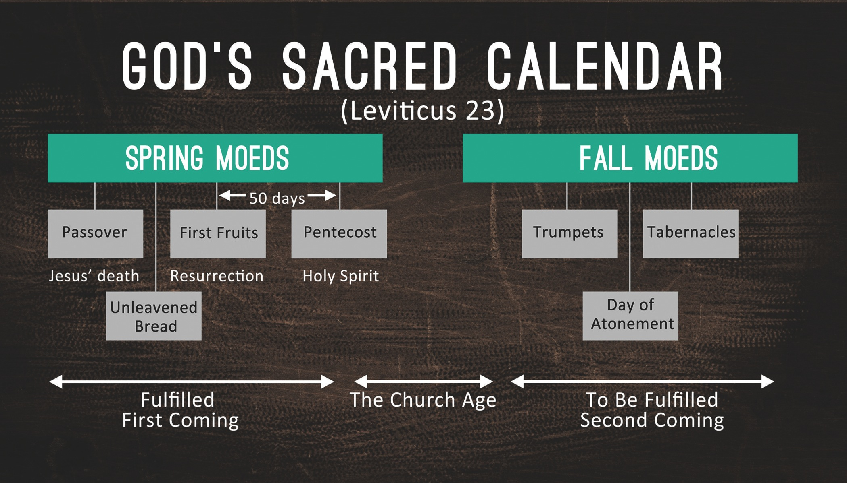
God’s Sacred Calendar

Slide 4
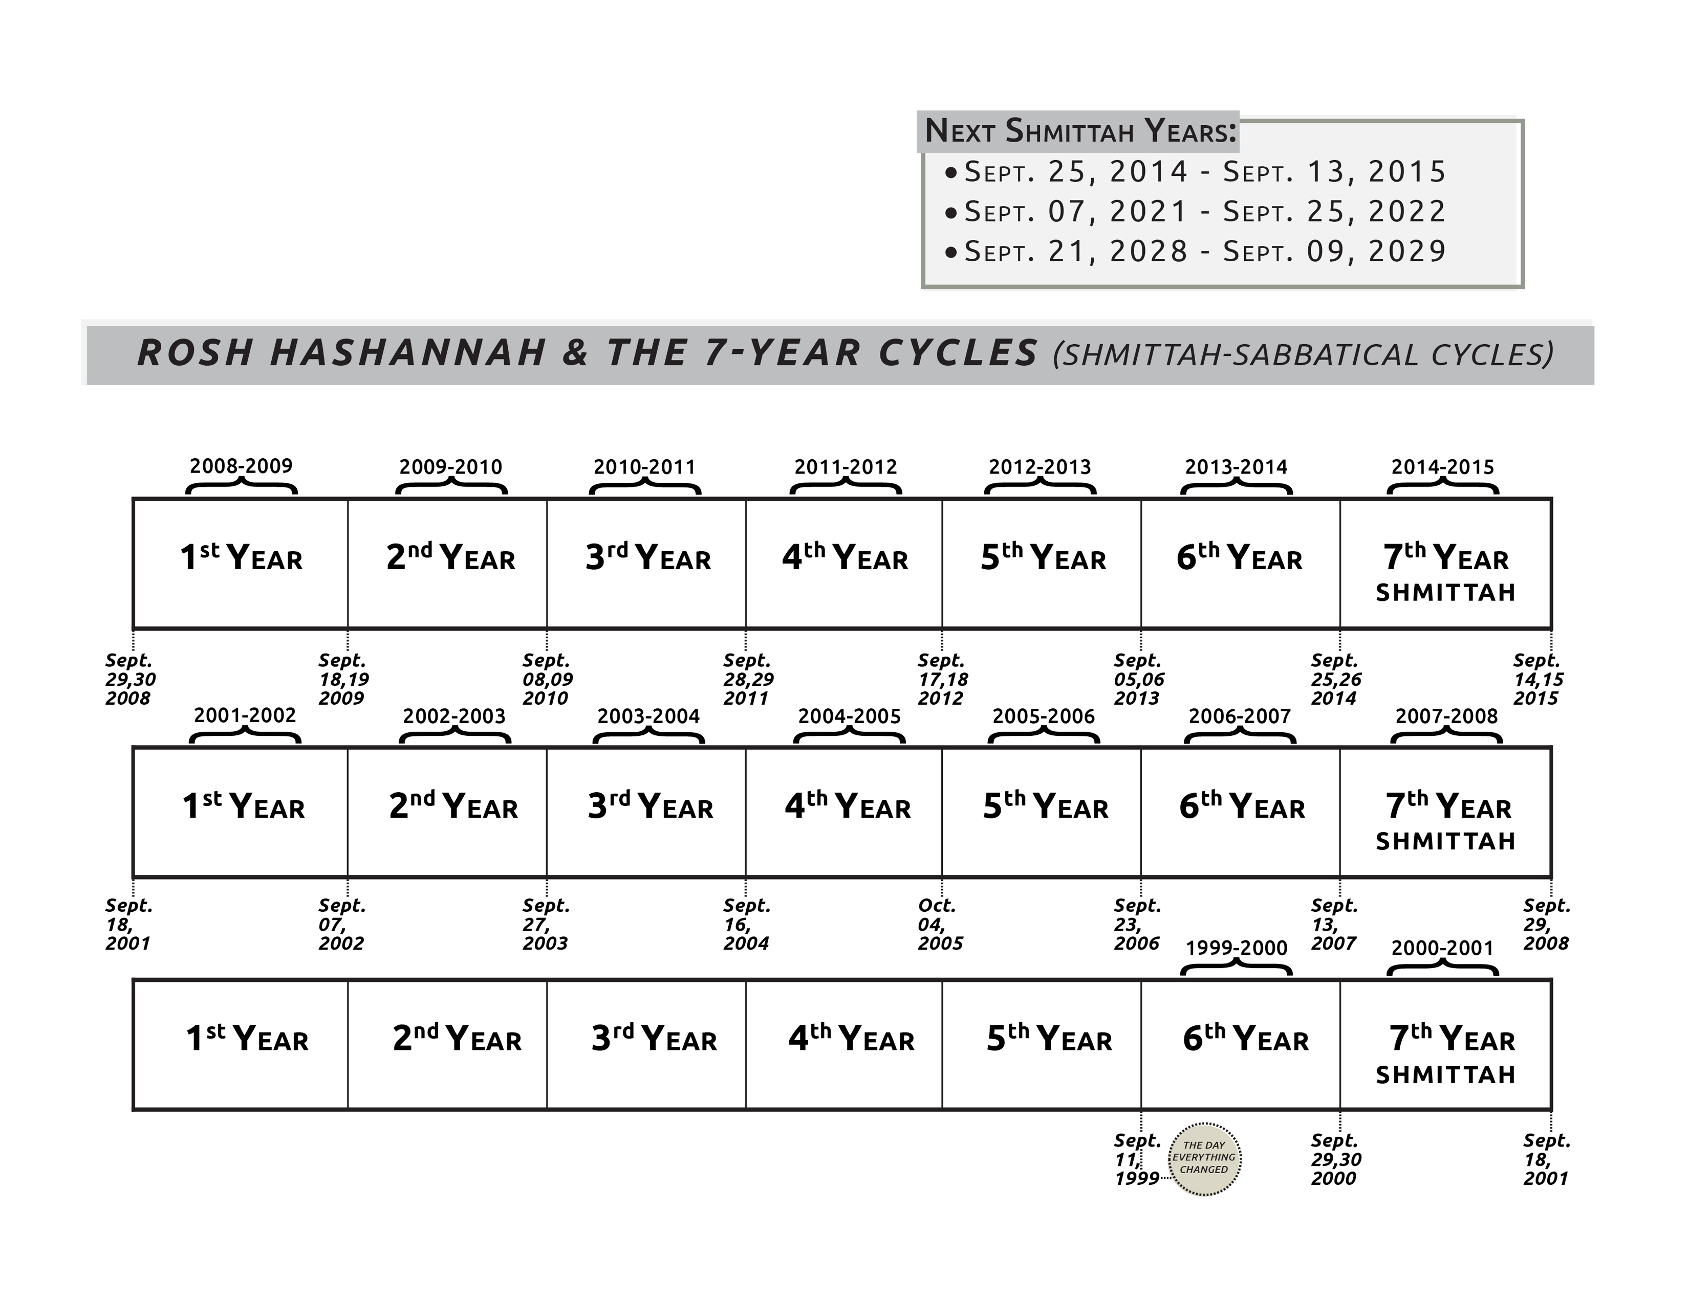
Blood Moons graphic

Slide 5
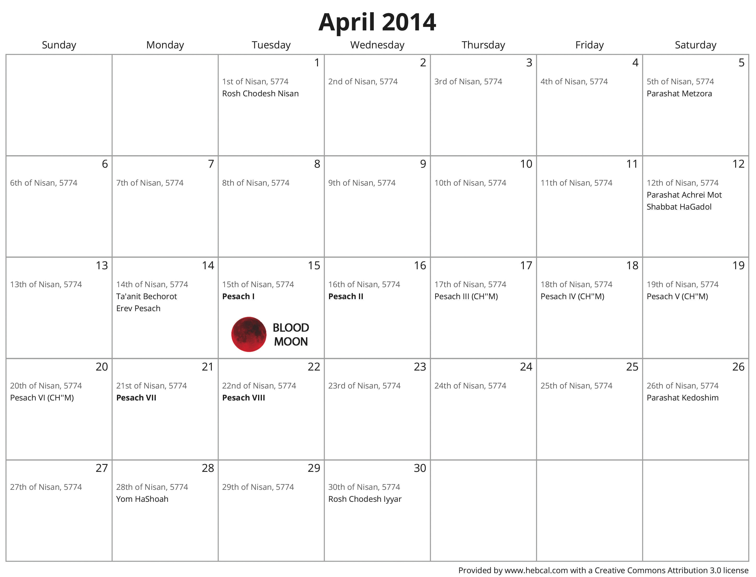
Blood Moons graphic

Slide 6
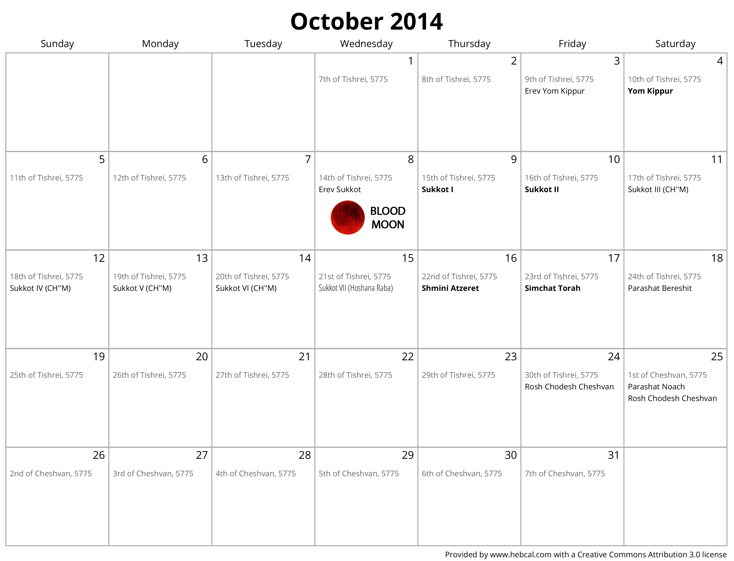
Blood Moons graphic

Slide 7
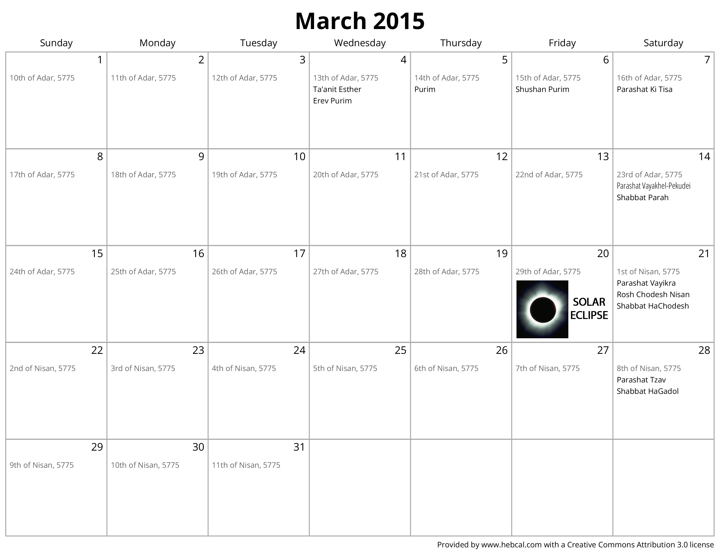
Blood Moons graphic

Slide 8
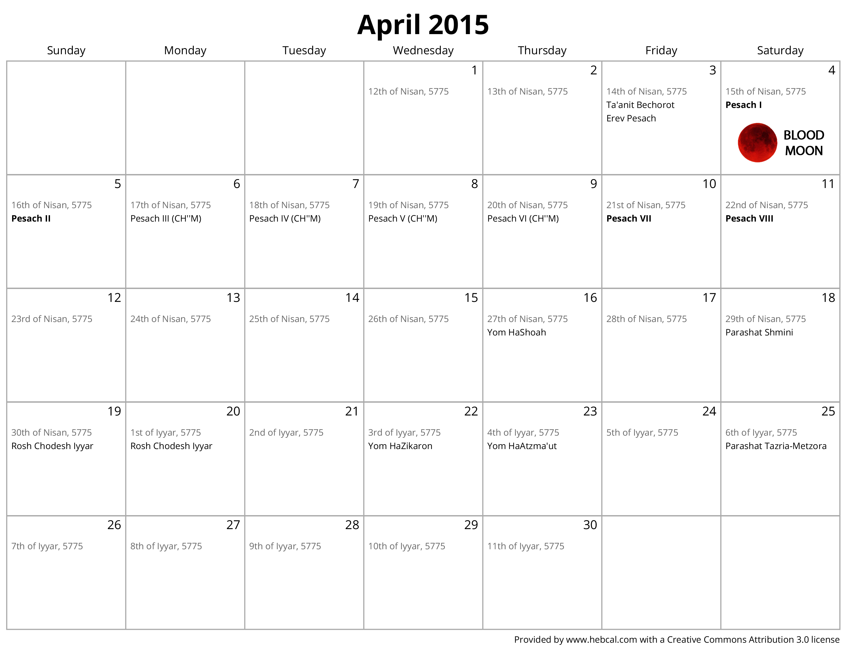
Blood Moons graphic

Slide 9
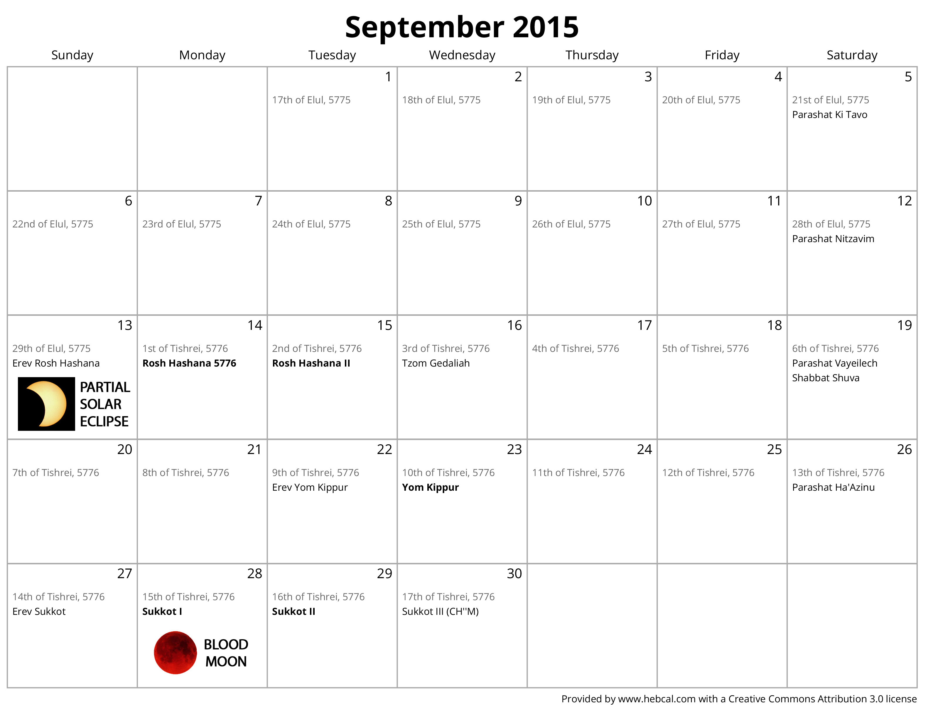
Blood Moons graphic

