Slide 1

Welcome to AAR

Slide 2
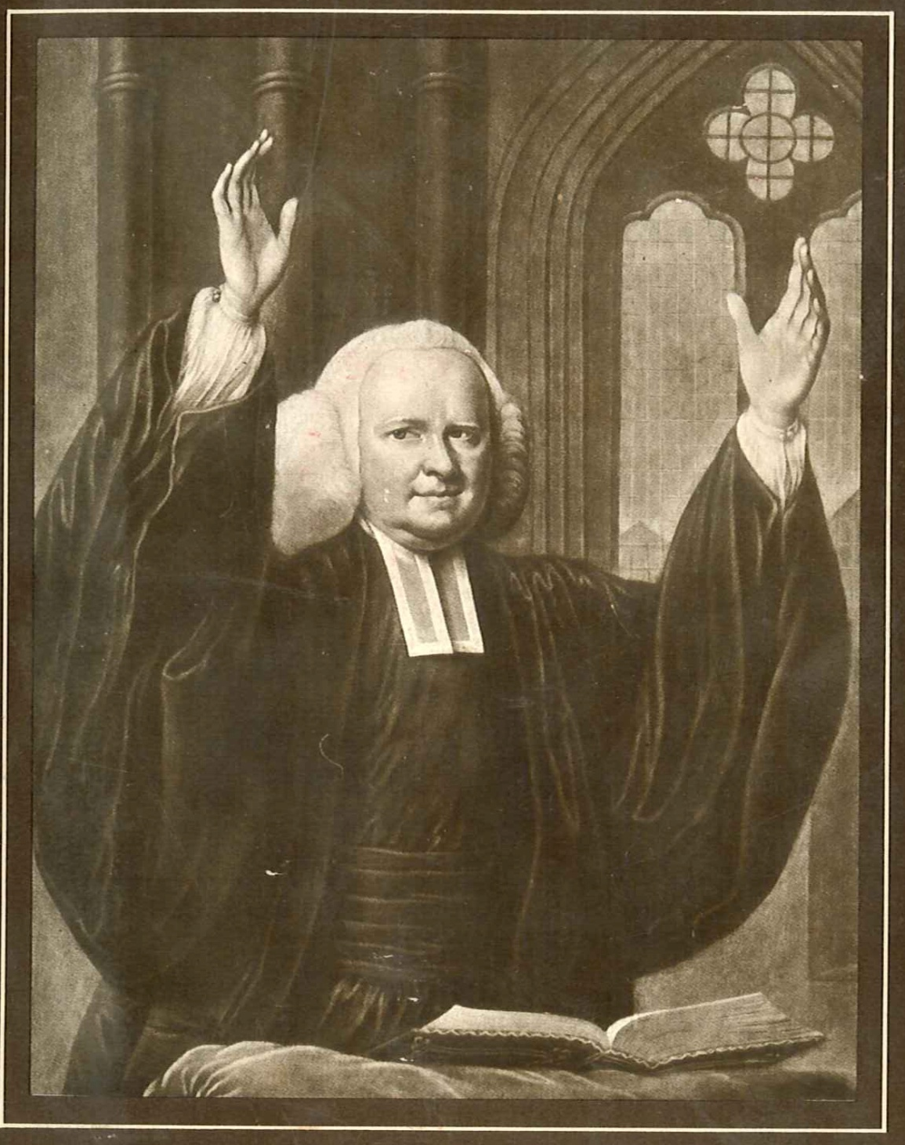
George Whitefield

Slide 3
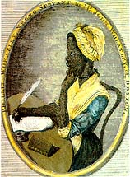
Phillis Wheatley

Slide 4
On the Death of Rev. George Whitefield by Phillis Wheatley
HAIL, happy saint, on thine immortal throne,
Possest of glory, life, and bliss unknown;
We hear no more the music of thy tongue,
Thy wonted auditories cease to throng.
Thy sermons in unequall'd accents flow'd,
And ev'ry bosom with devotion glow'd;
Thou didst in strains of eloquence refin'd
Inflame the heart, and captivate the mind.
Unhappy we the setting sun deplore,
So glorious once, but ah! it shines no more.
Behold the prophet in his tow'ring flight!
He leaves the earth for heav'n's unmeasur'd height,
And worlds unknown receive him from our sight.
There Whitefield wings with rapid course his way,
And sails to Zion through vast seas of day.

Slide 5
Thy pray'rs, great saint, and thine incessant cries
Have pierc'd the bosom of thy native skies.
Thou moon hast seen, and all the stars of light,
How he has wrestled with his God by night.
He pray'd that grace in ev'ry heart might dwell,
He long'd to see America excell;
He charg'd its youth that ev'ry grace divine
Should with full lustre in their conduct shine;
That Saviour, which his soul did first receive,
The greatest gift that ev'n a God can give,
He freely offer'd to the num'rous throng,
That on his lips with list'ning pleasure hung.
"Take him, ye wretched, for your only good,
"Take him ye starving sinners, for your food;
"Ye thirsty, come to this life-giving stream,
"Ye preachers, take him for your joyful theme;

Slide 6
"Take him my dear Americans, he said,
"Be your complaints on his kind bosom laid:
"Take him, ye Africans, he longs for you,
"Impartial Saviour is his title due:
"Wash'd in the fountain of redeeming blood,
"You shall be sons, and kings, and priests to God."
Great Countess,* we Americans revere
Thy name, and mingle in thy grief sincere;
New England deeply feels, the Orphans mourn,
Their more than father will no more return.
But, though arrested by the hand of death,
Whitefield no more exerts his lab'ring breath,
Yet let us view him in th' eternal skies,
Let ev'ry heart to this bright vision rise;
While the tomb safe retains its sacred trust,
Till life divine re-animates his dust.
*The Countess of Huntingdon, to whom Mr. Whitefield was
Chaplain.

Slide 7
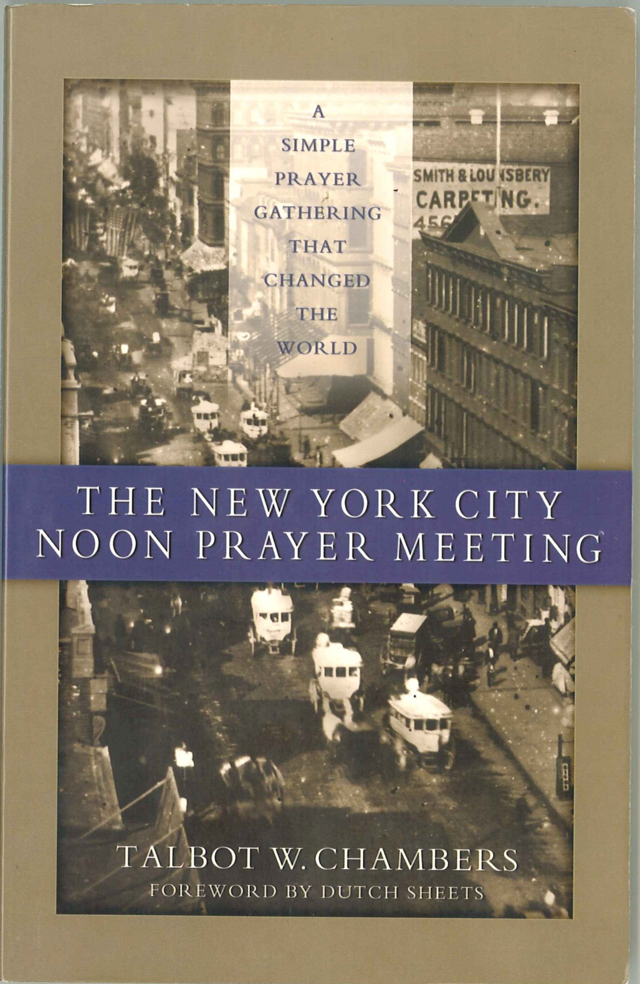
NYC Prayer Mtg book

Slide 8
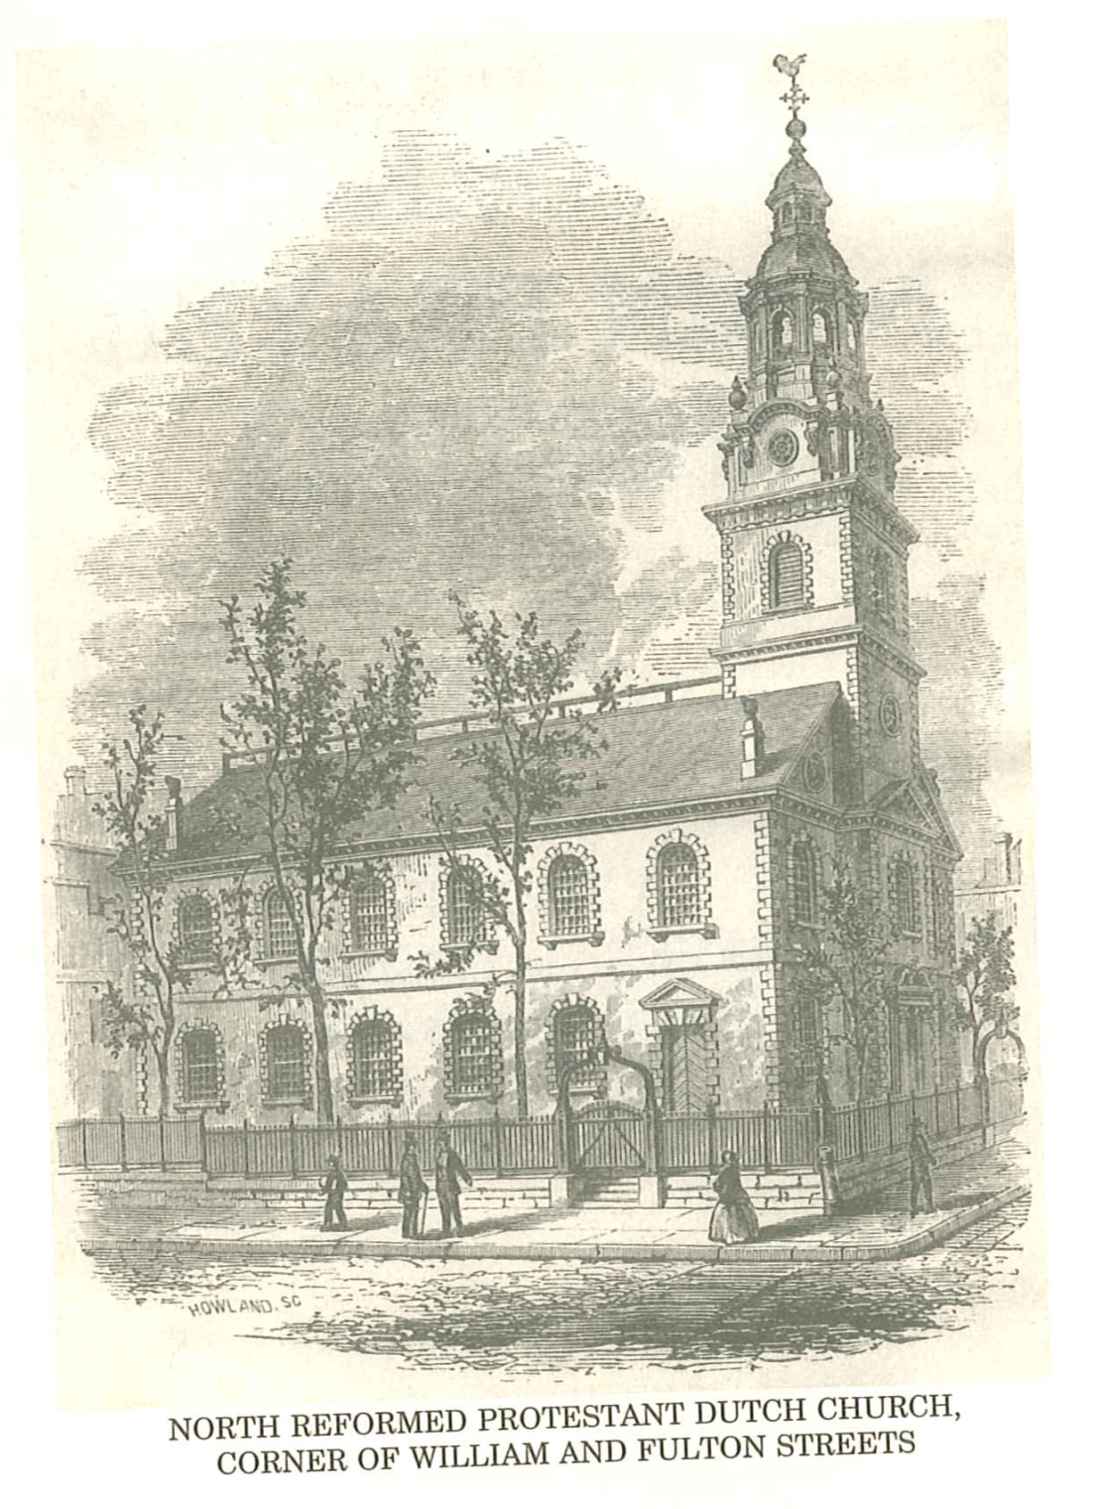
Dutch Church

Slide 9
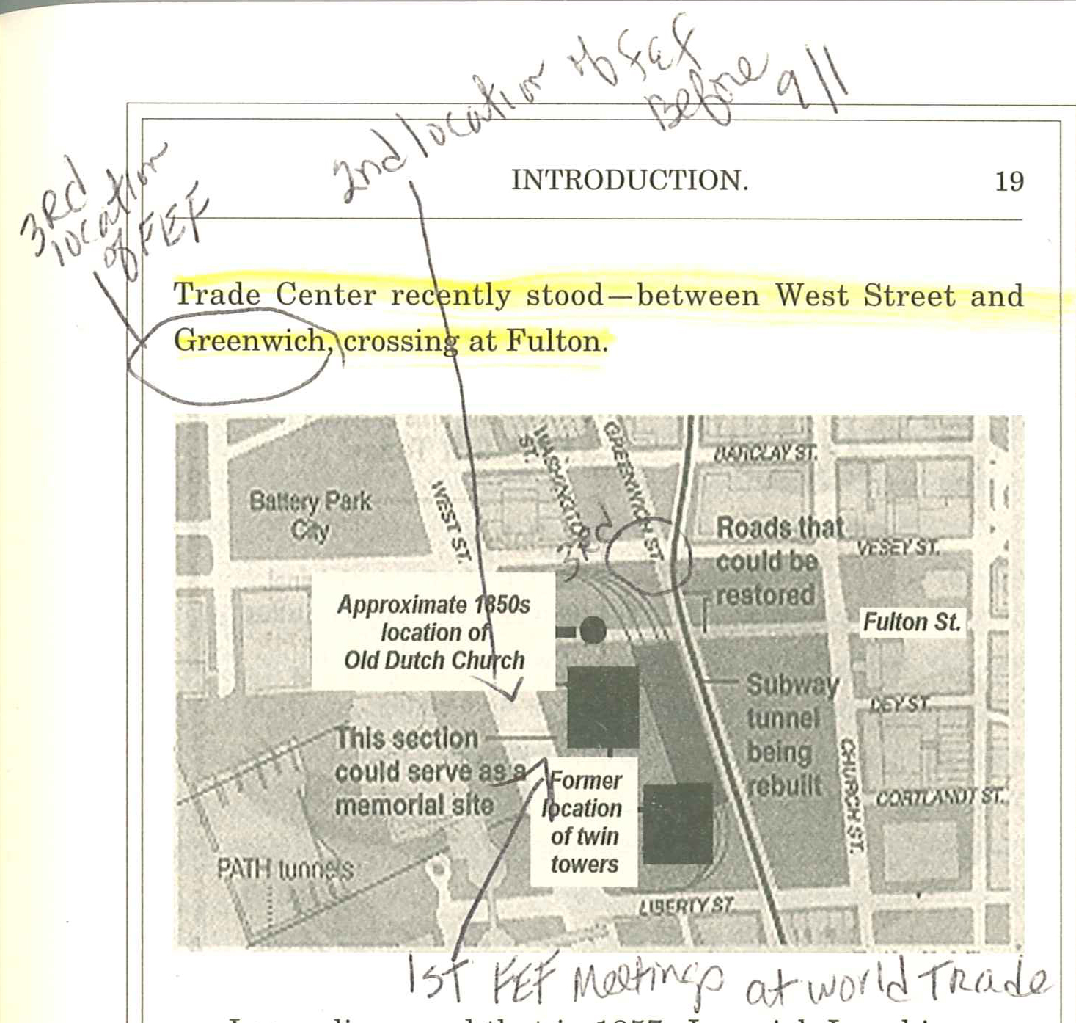
Pg 19 Map

Slide 10
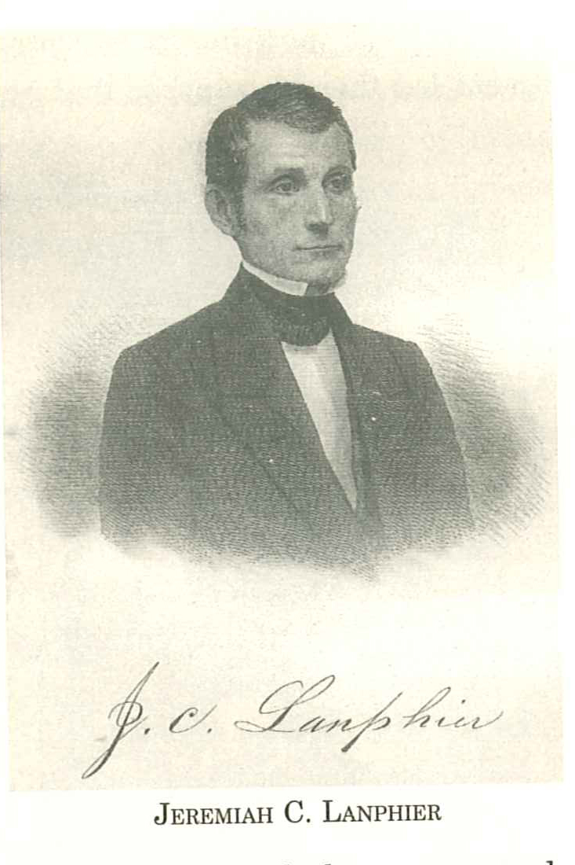
Pg 30 Jeremiah Lanphier

Slide 11
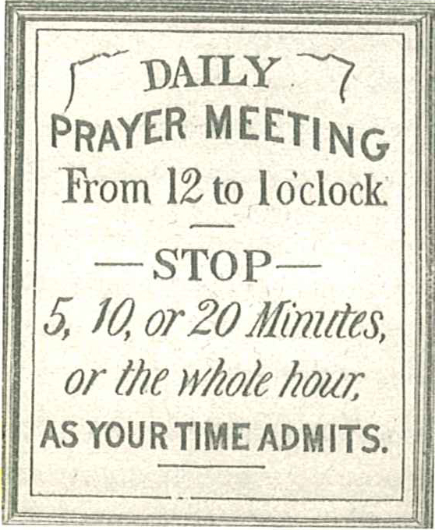
Pg 35 Prayer mtg sign

Slide 12
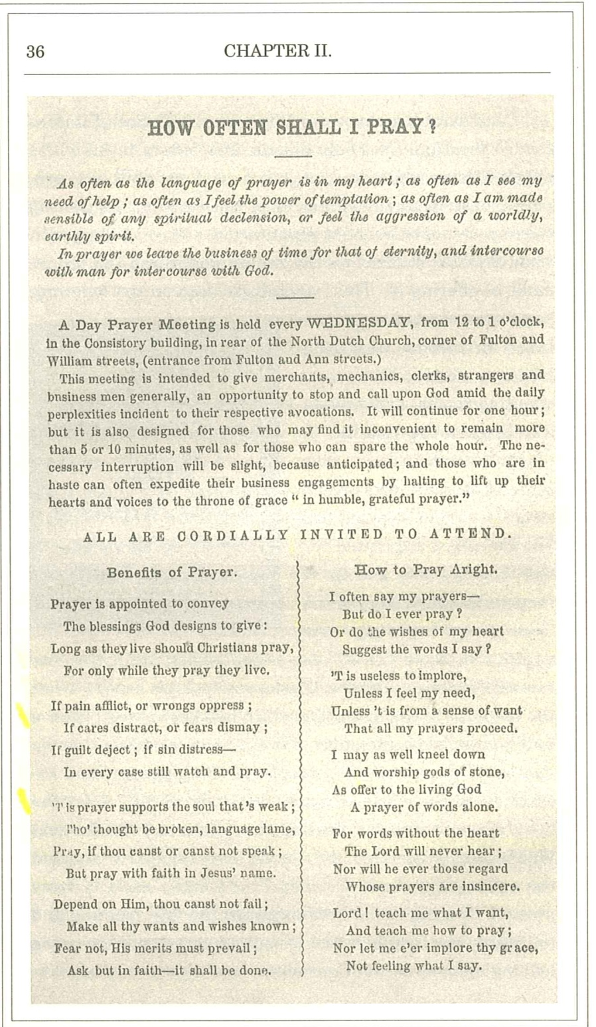
Pg 36 How Often Shall I Pray

Slide 13
Pg 36 How Often Shall I Pray

Slide 14
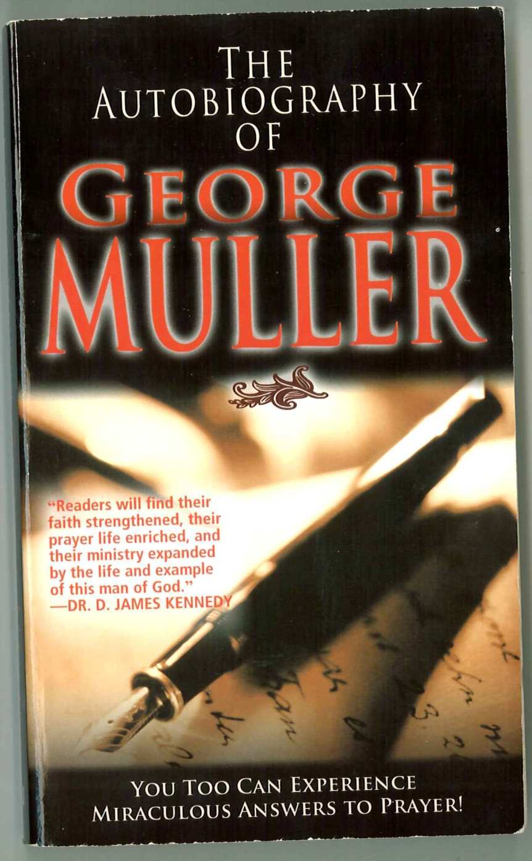
George Muller book

Slide 15
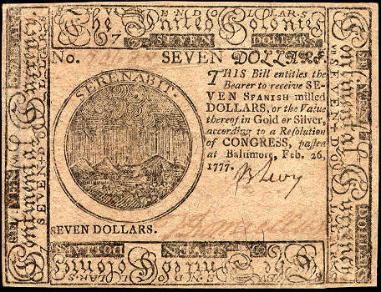
Continental Bank Note

Slide 16
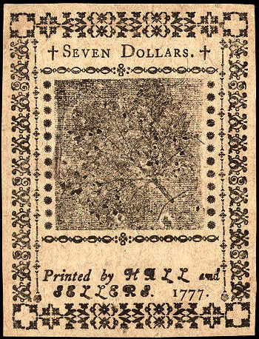
Continental Bank Note $7 1777

Slide 17
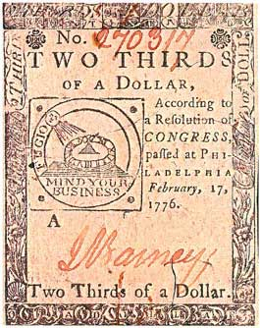
Continental Bank Note 2/3

