Slide 1


with
Dr.
Billye
Brim

Slide 2
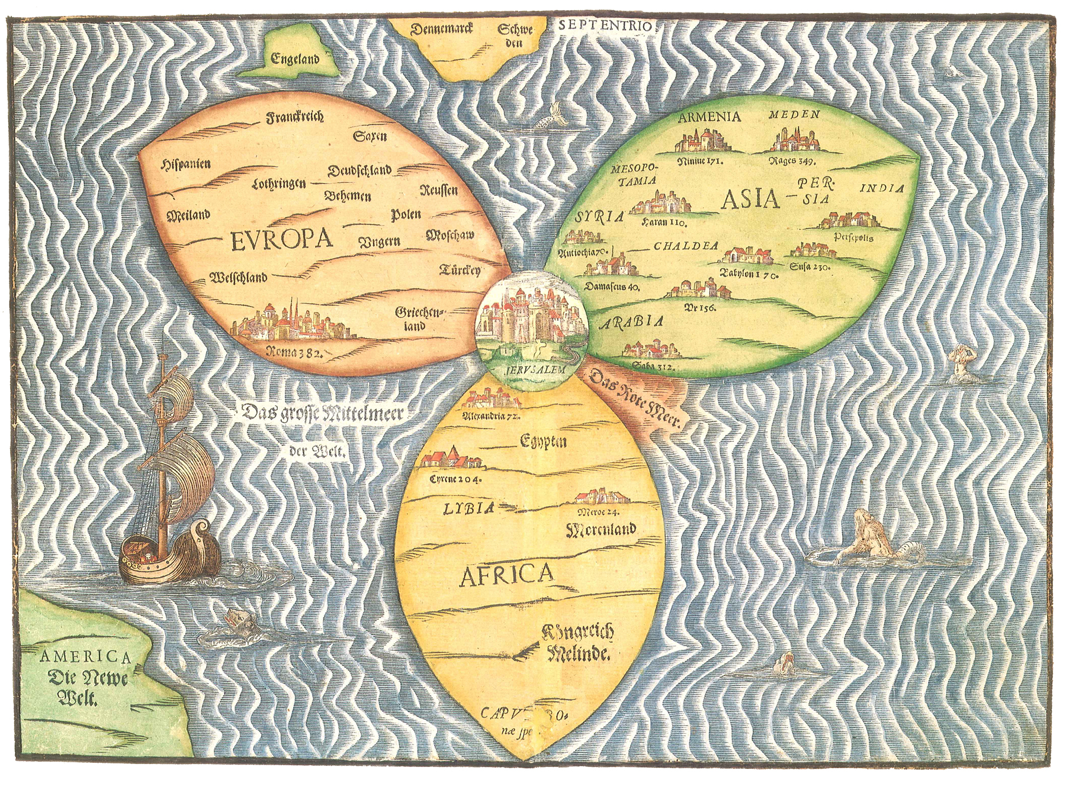
Map- Old Map-Leafs
Notes:
Ancient Map-3 Leaf Shape

Slide 3
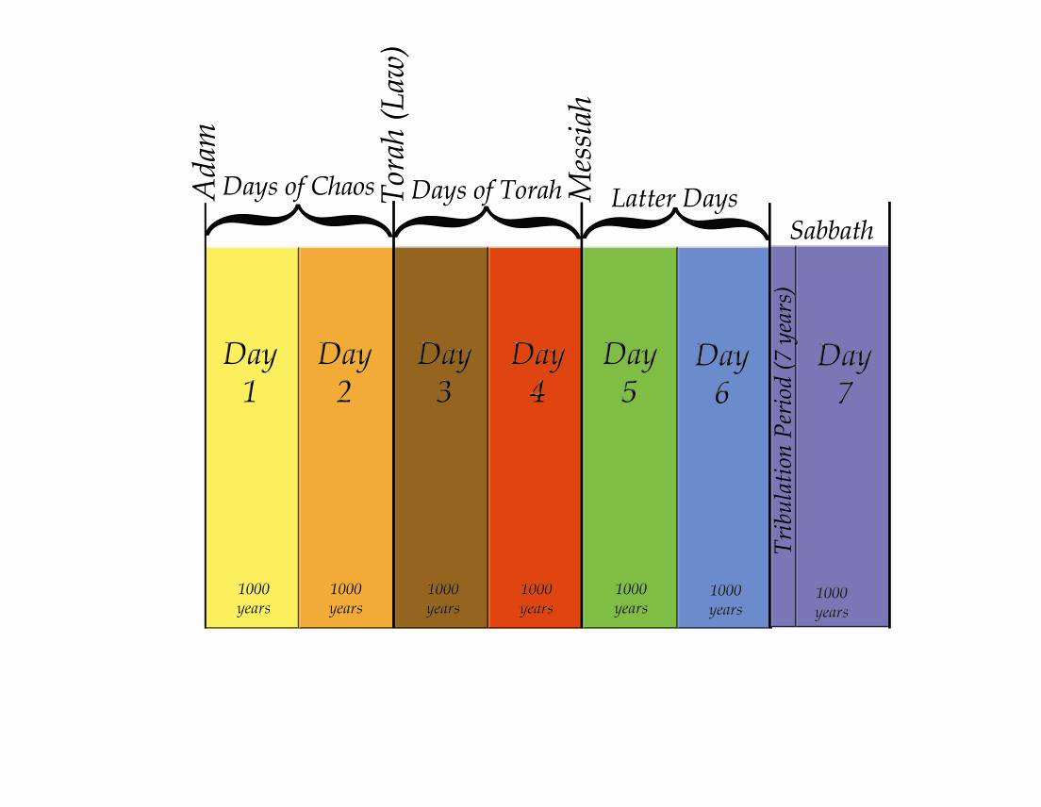
Time Lime
End of Days
Notes:
7 Day Chart - Timeline

Slide 4
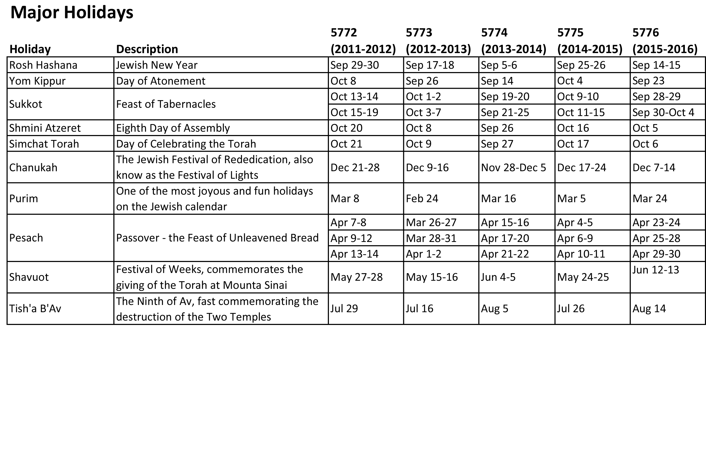
Notes:
Hebrew Calendar – Major Holidays

Slide 5
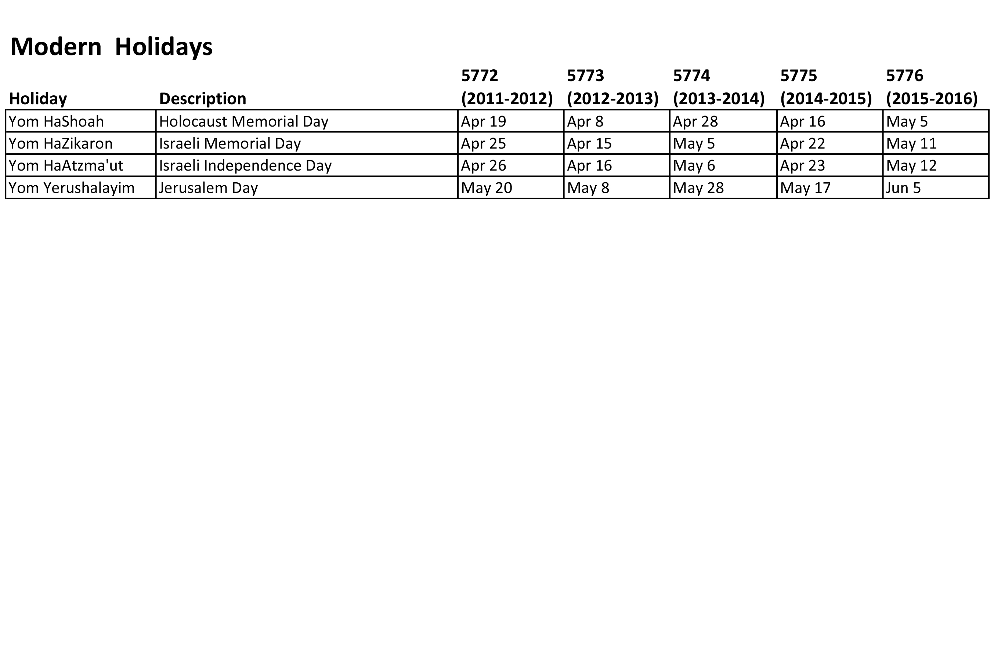
Notes:
Hebrew Calendar – Modern Holidays

Slide 6
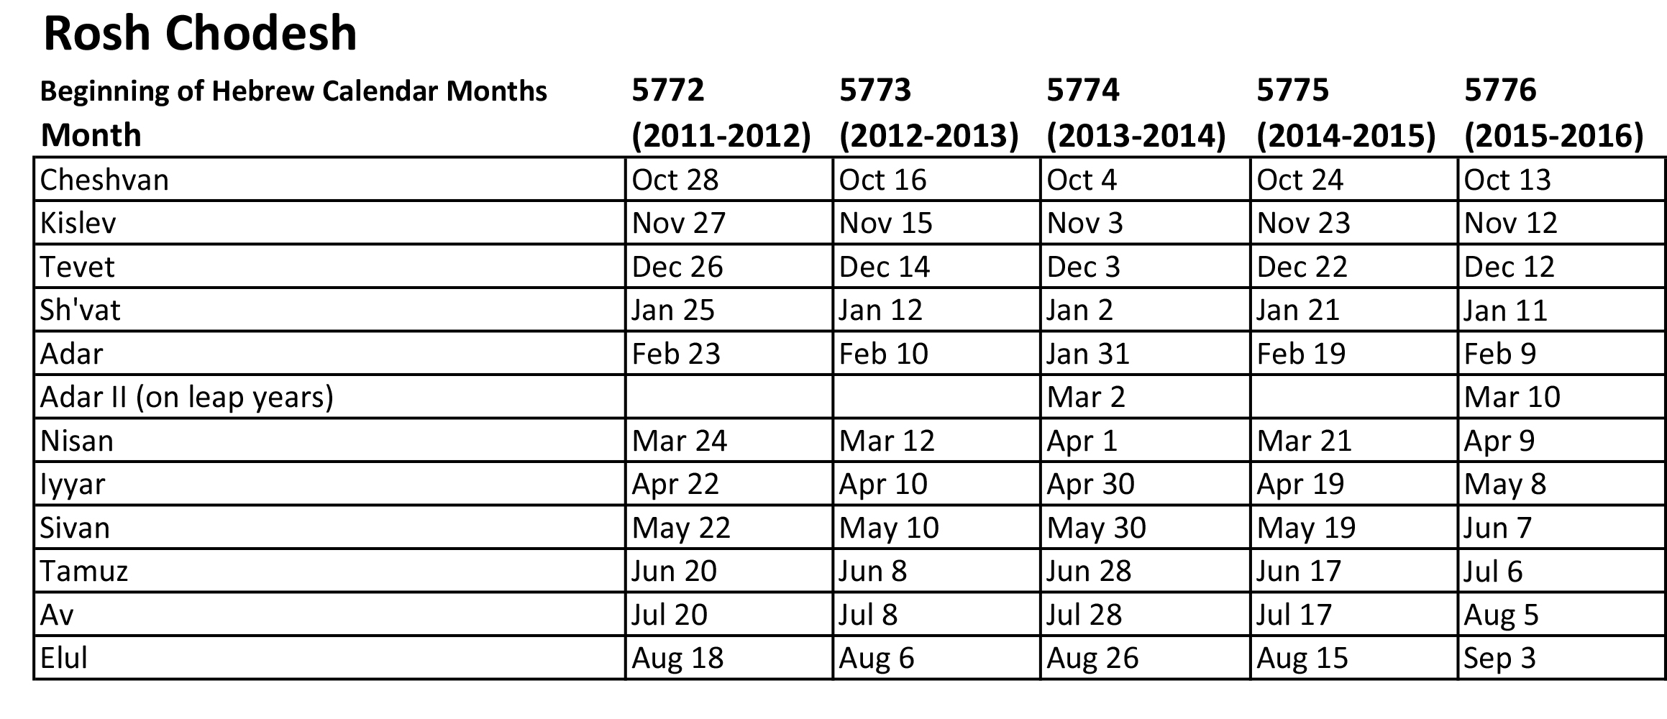
(Beginning of Hebrew Months)
Notes:
Hebrew Calendar – Rosh Chodesh

Slide 7
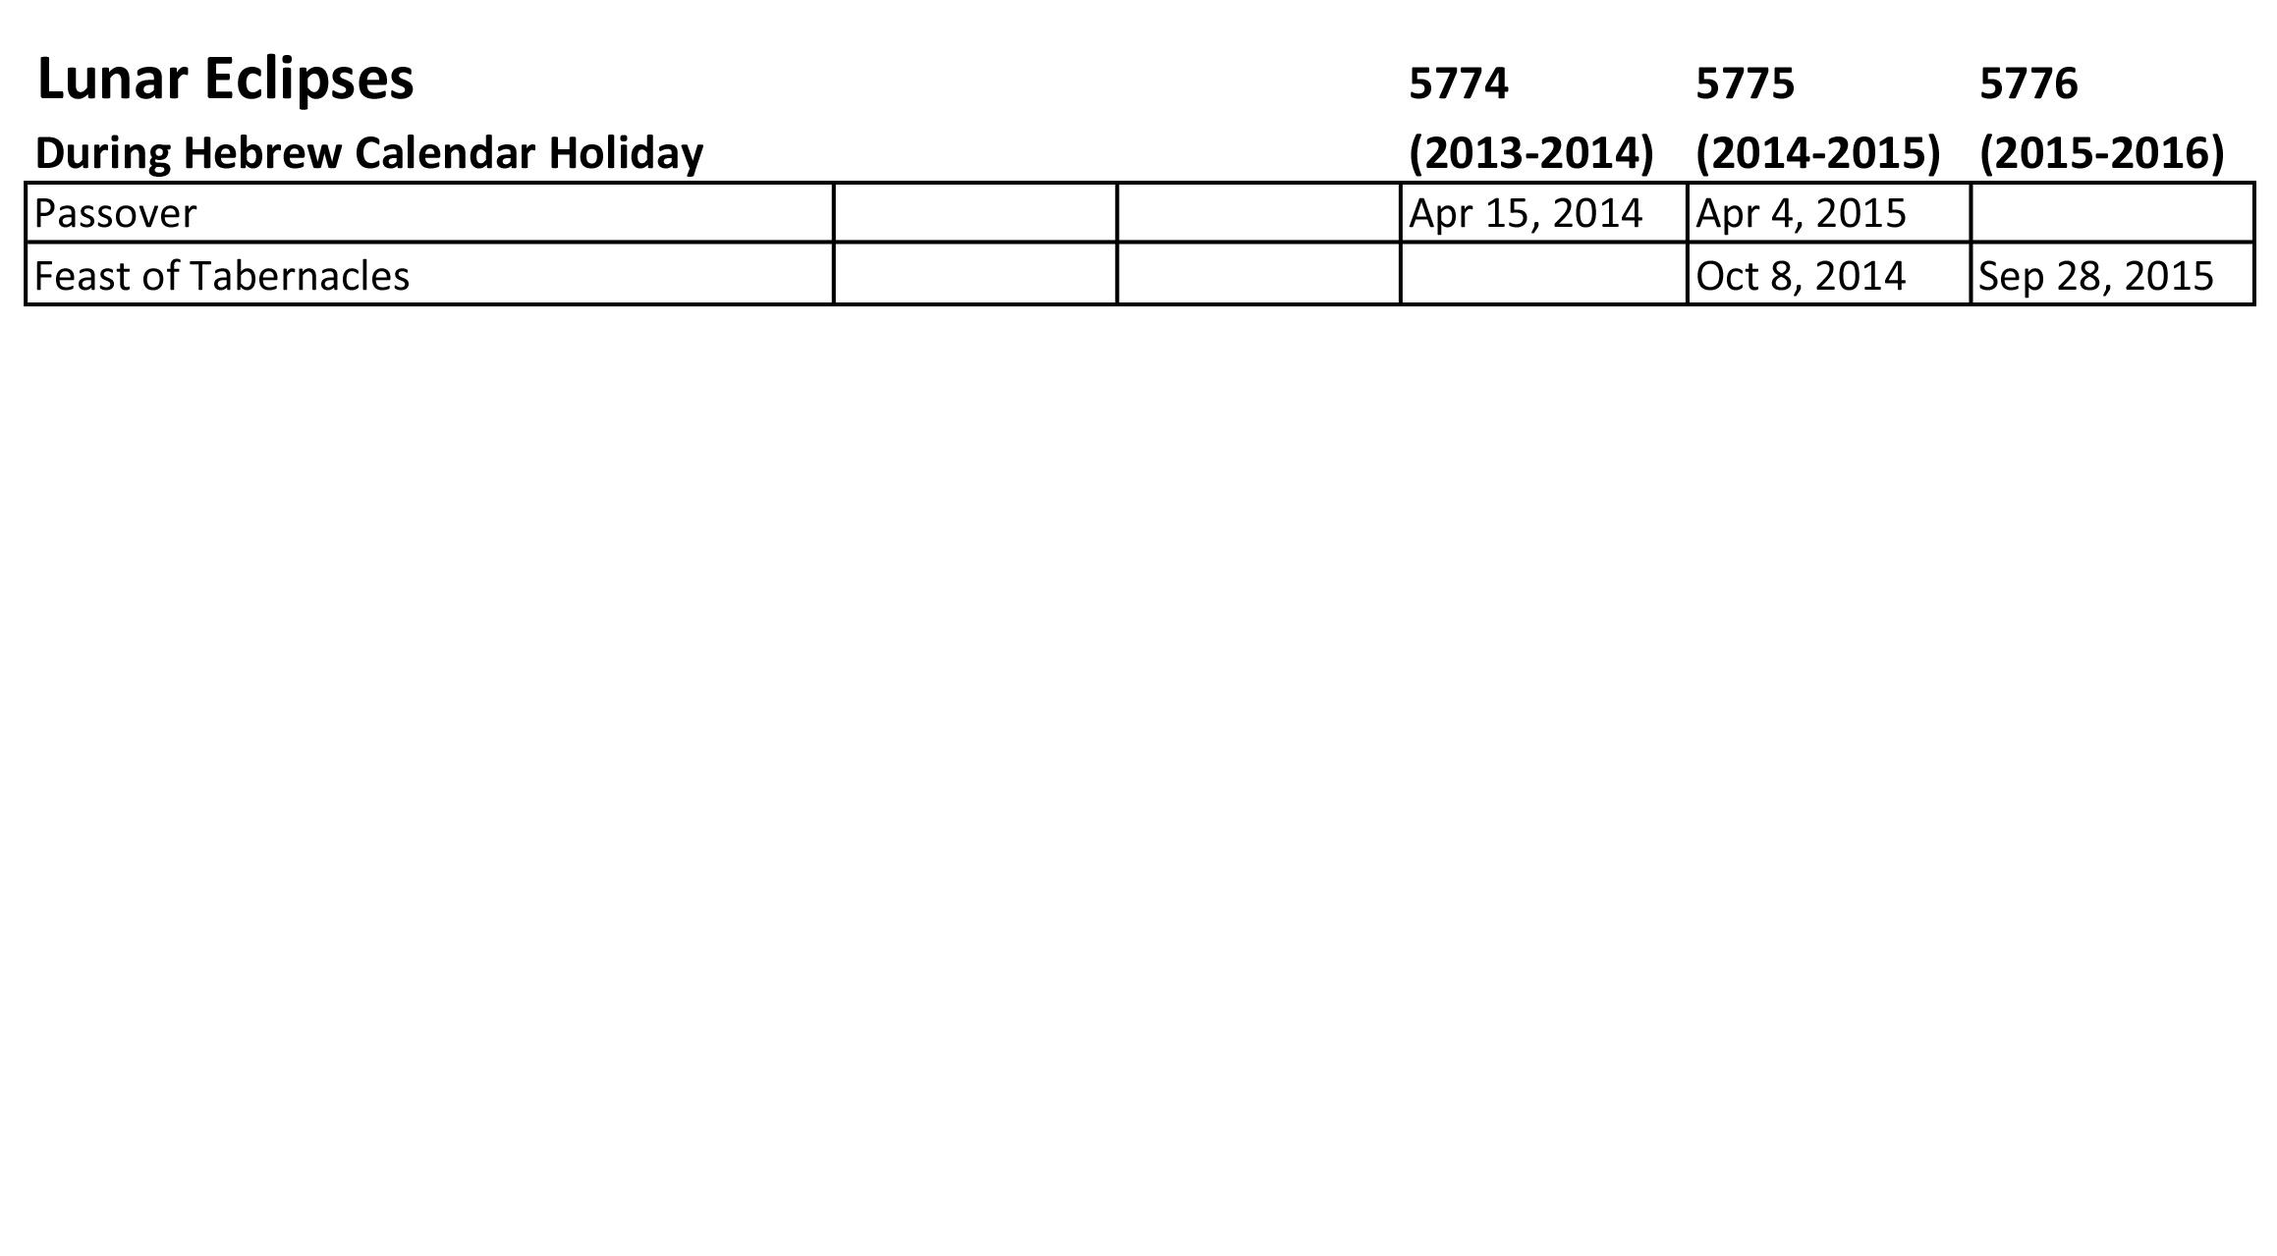
Notes:
Hebrew Calendar – Lunar Eclipses

Slide 8
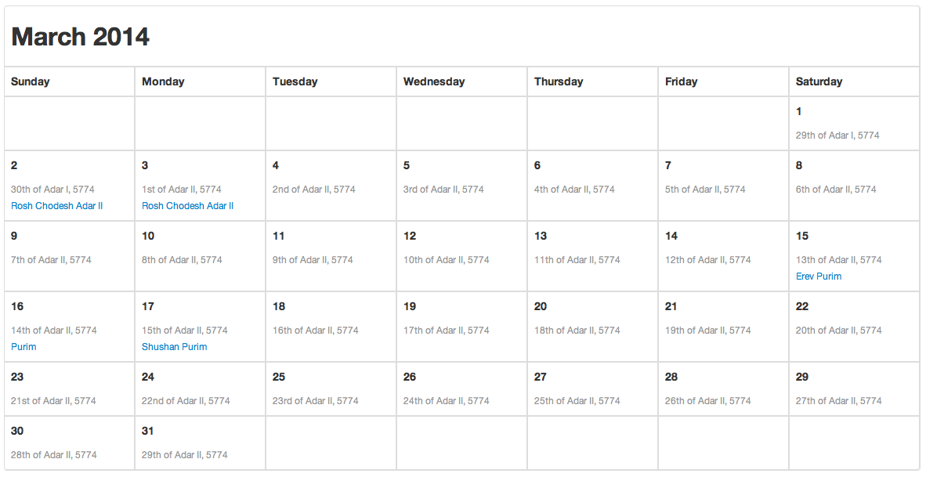
Notes:
Hebrew Calendar – March 2014

Slide 9
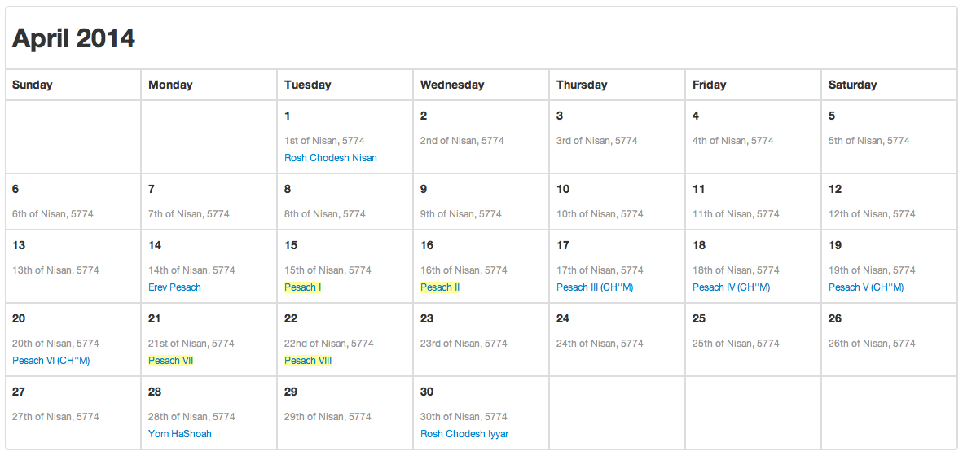
Notes:
Hebrew Calendar – April 2014

Slide 10
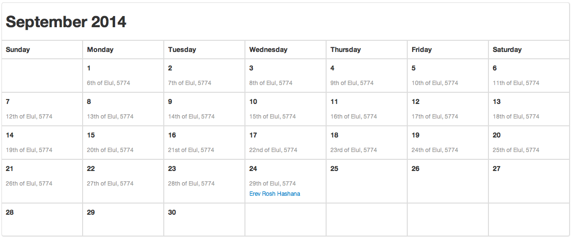
Notes:
Hebrew Calendar – September 2014

Slide 11
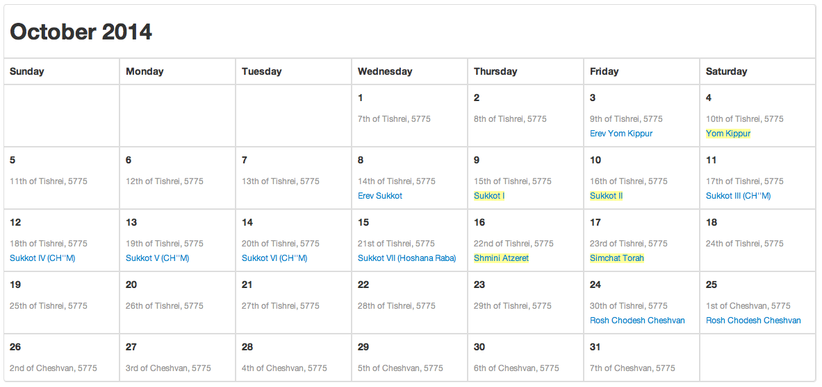
Notes:
Hebrew Calendar – October 2014

Slide 12
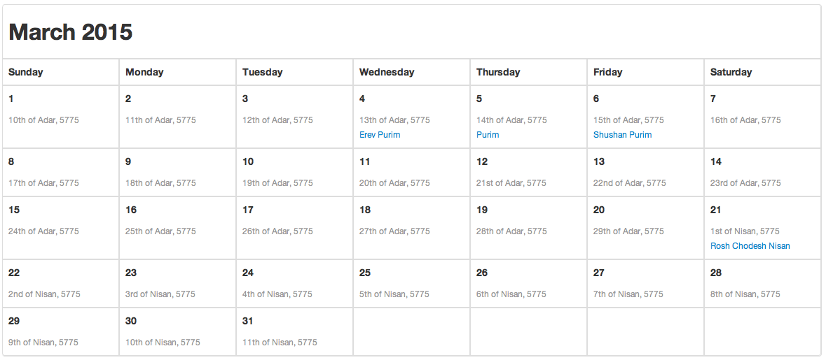
Notes:
Hebrew Calendar – March 2015

Slide 13
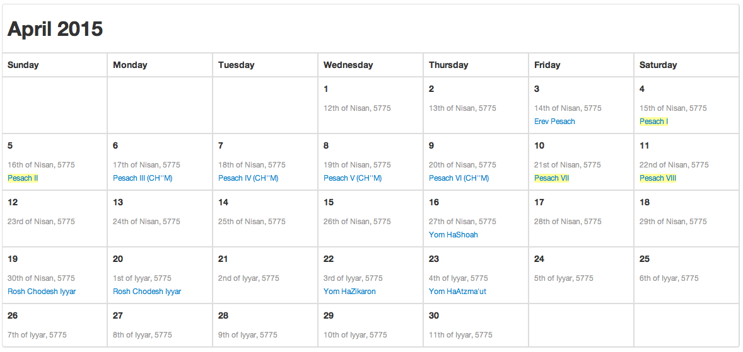
Notes:
Hebrew Calendar – April 2015

Slide 14
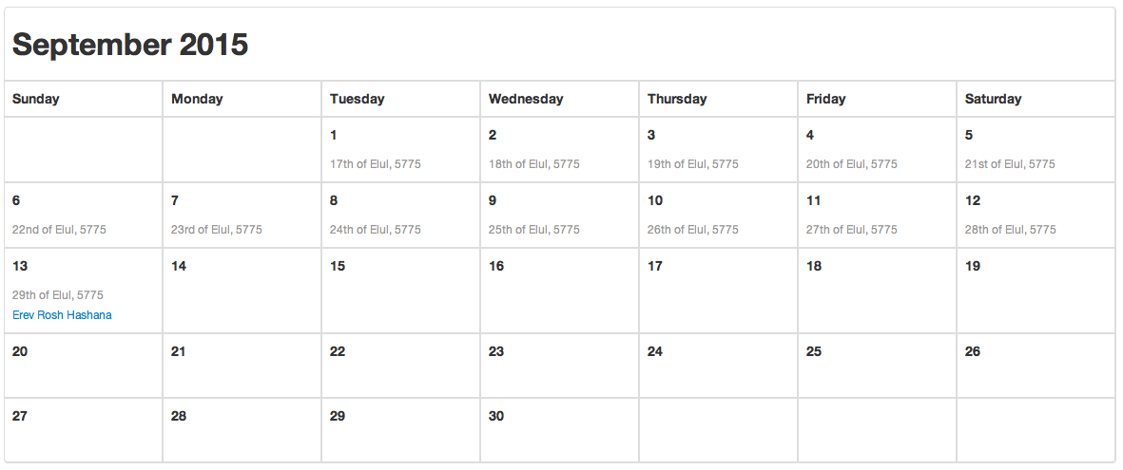
Notes:
Hebrew Calendar – September 2015

Slide 15
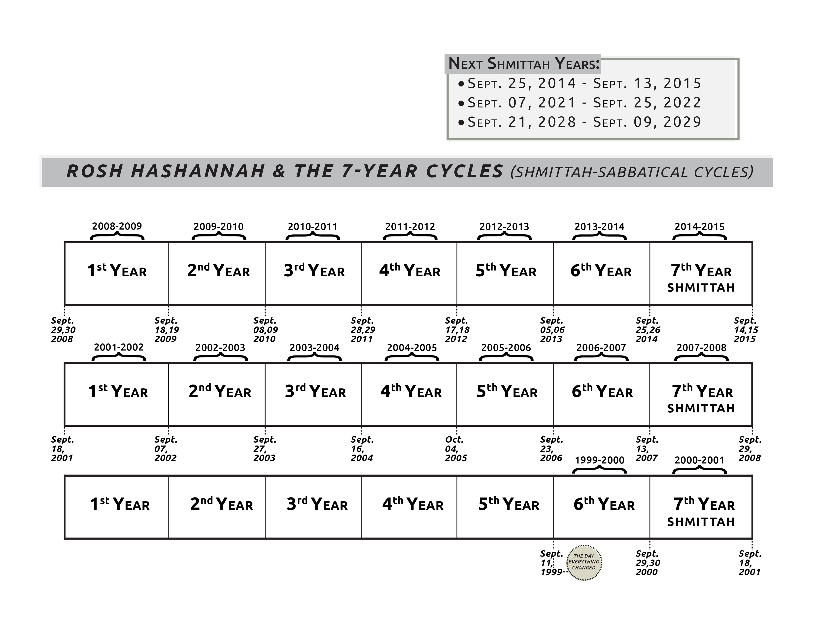

Slide 16
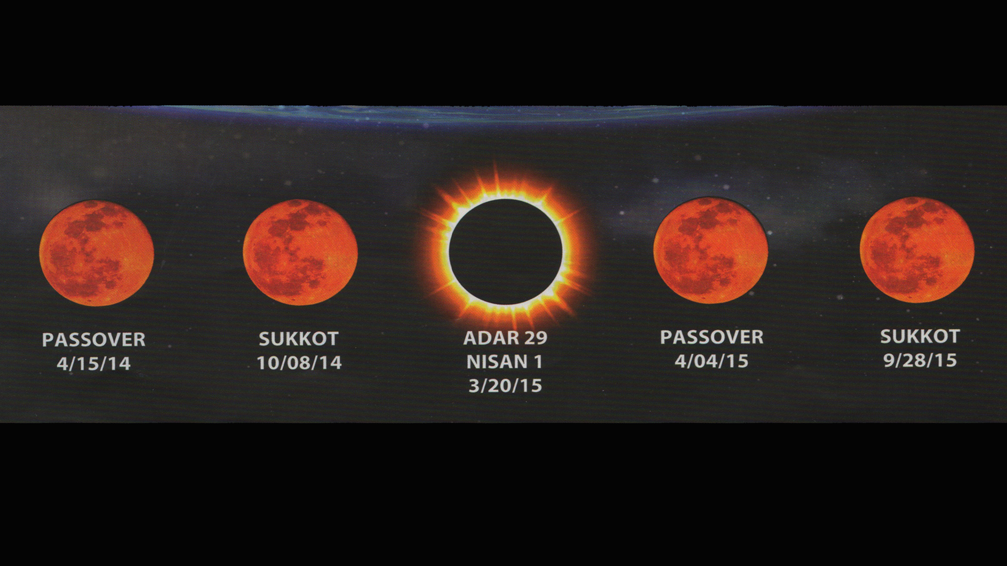

Slide 17
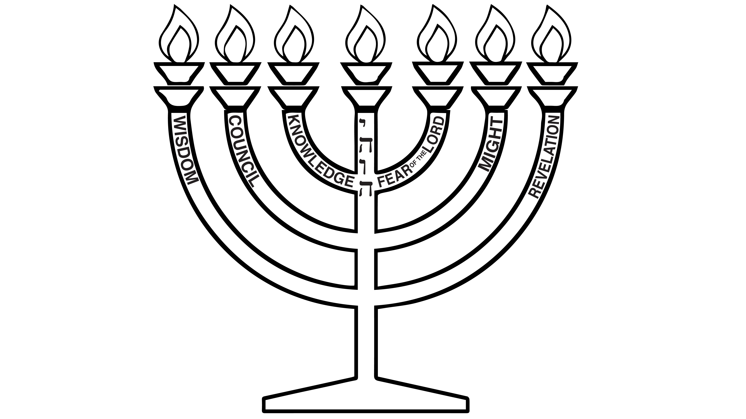
Notes:
Black

Slide 18
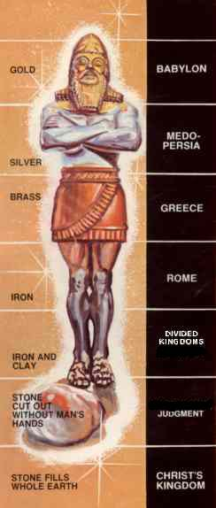
Daniel- Image from dream
Notes:
Daniel- Image from Nebuchadnezzar’s dream

Slide 19
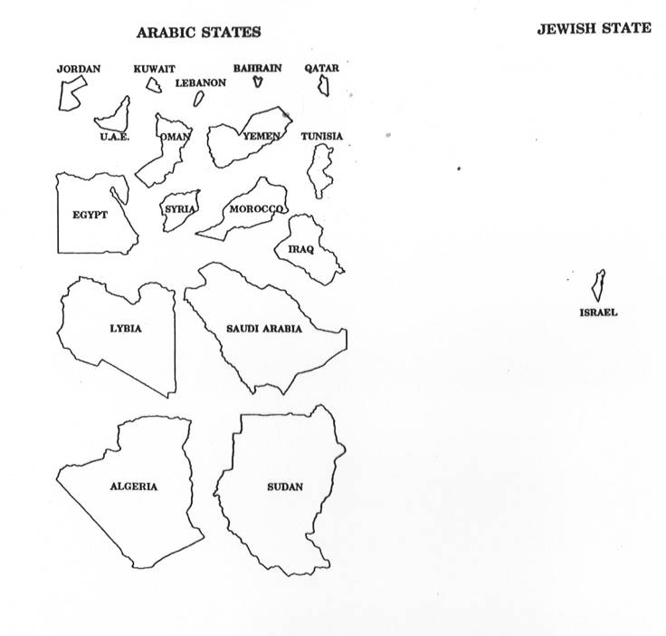
Map- Arabic States/Jewish States
Notes:
Map- Arabic States vs Jewish State comparison

Slide 20
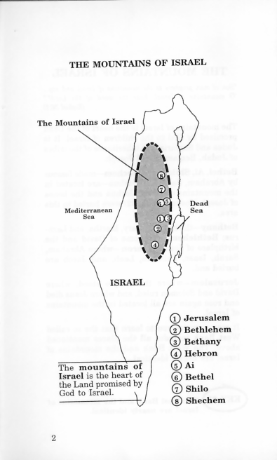
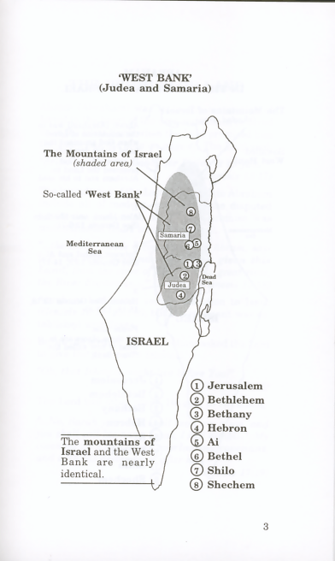
Map- Mountains of Israel/West Bank
Notes:
Map- Mountains of Israel & West Bank

Slide 21
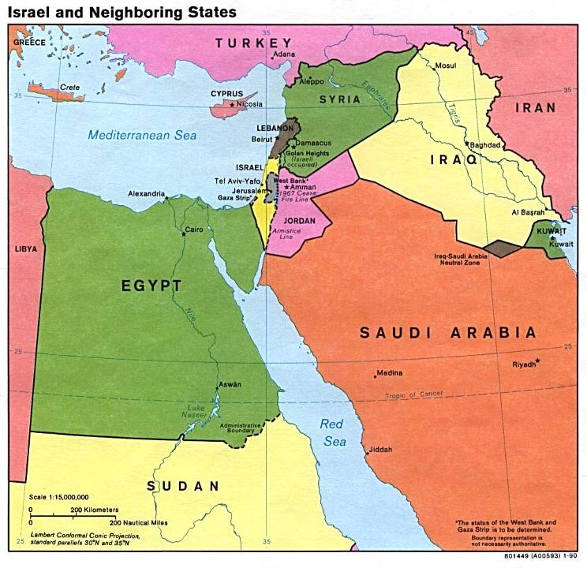
Maps- Israel & Neighboring states
Notes:
Map- Israel & Neighboring states

Slide 22
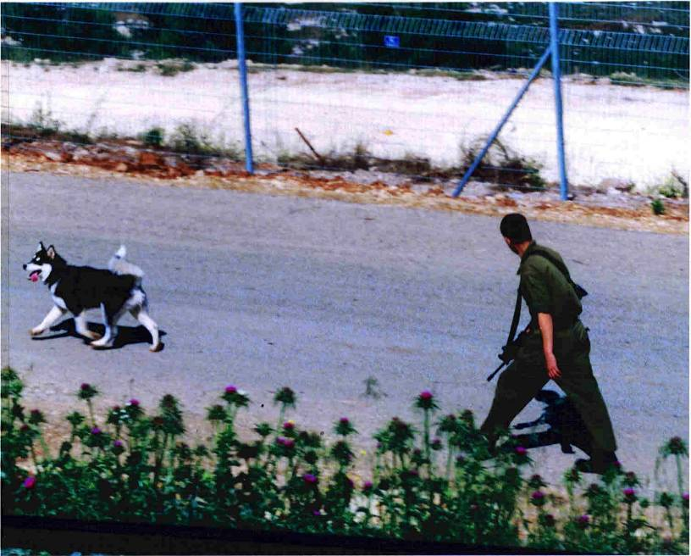
Misgav Am-Soldier & Dog
Notes:
Misgav Am-Soldier & Dog

Slide 23
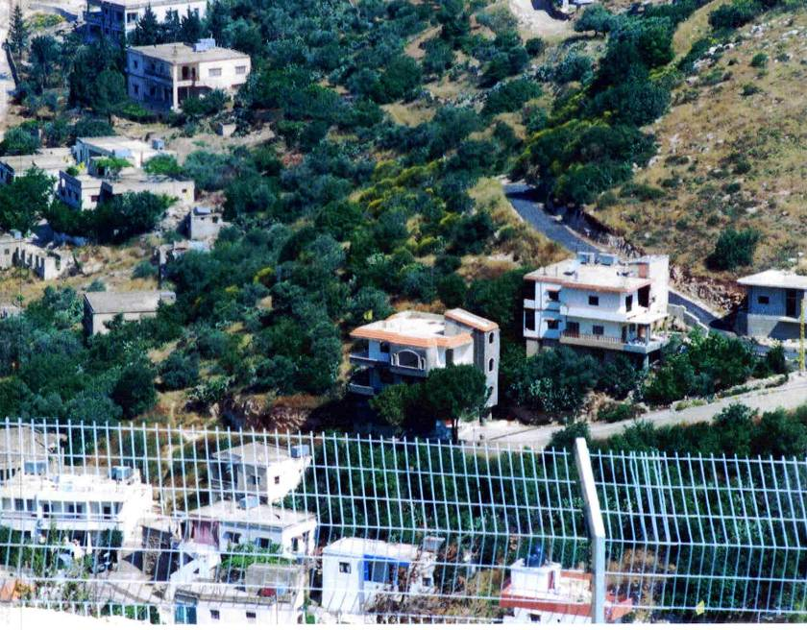
Misgav Am- Hezbollah Flag Distant
Notes:
Misgav Am- Hezbollah Flag Distant

Slide 24
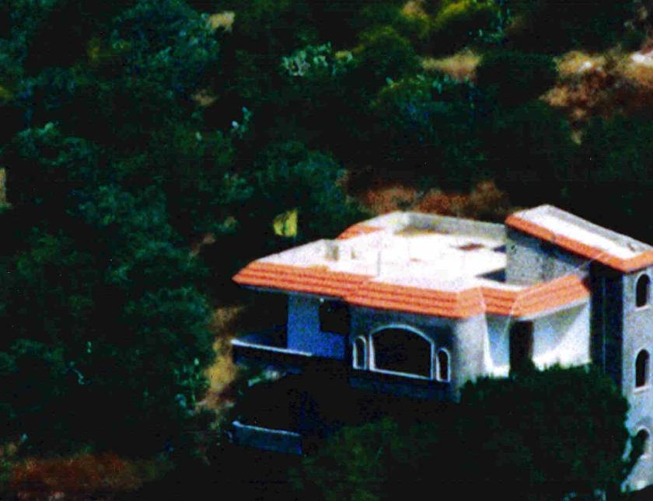
Misgav Am- Hezbollah Flag Closeup
Notes:
Misgav Am- Hezbollah Flag Closeup

Slide 25
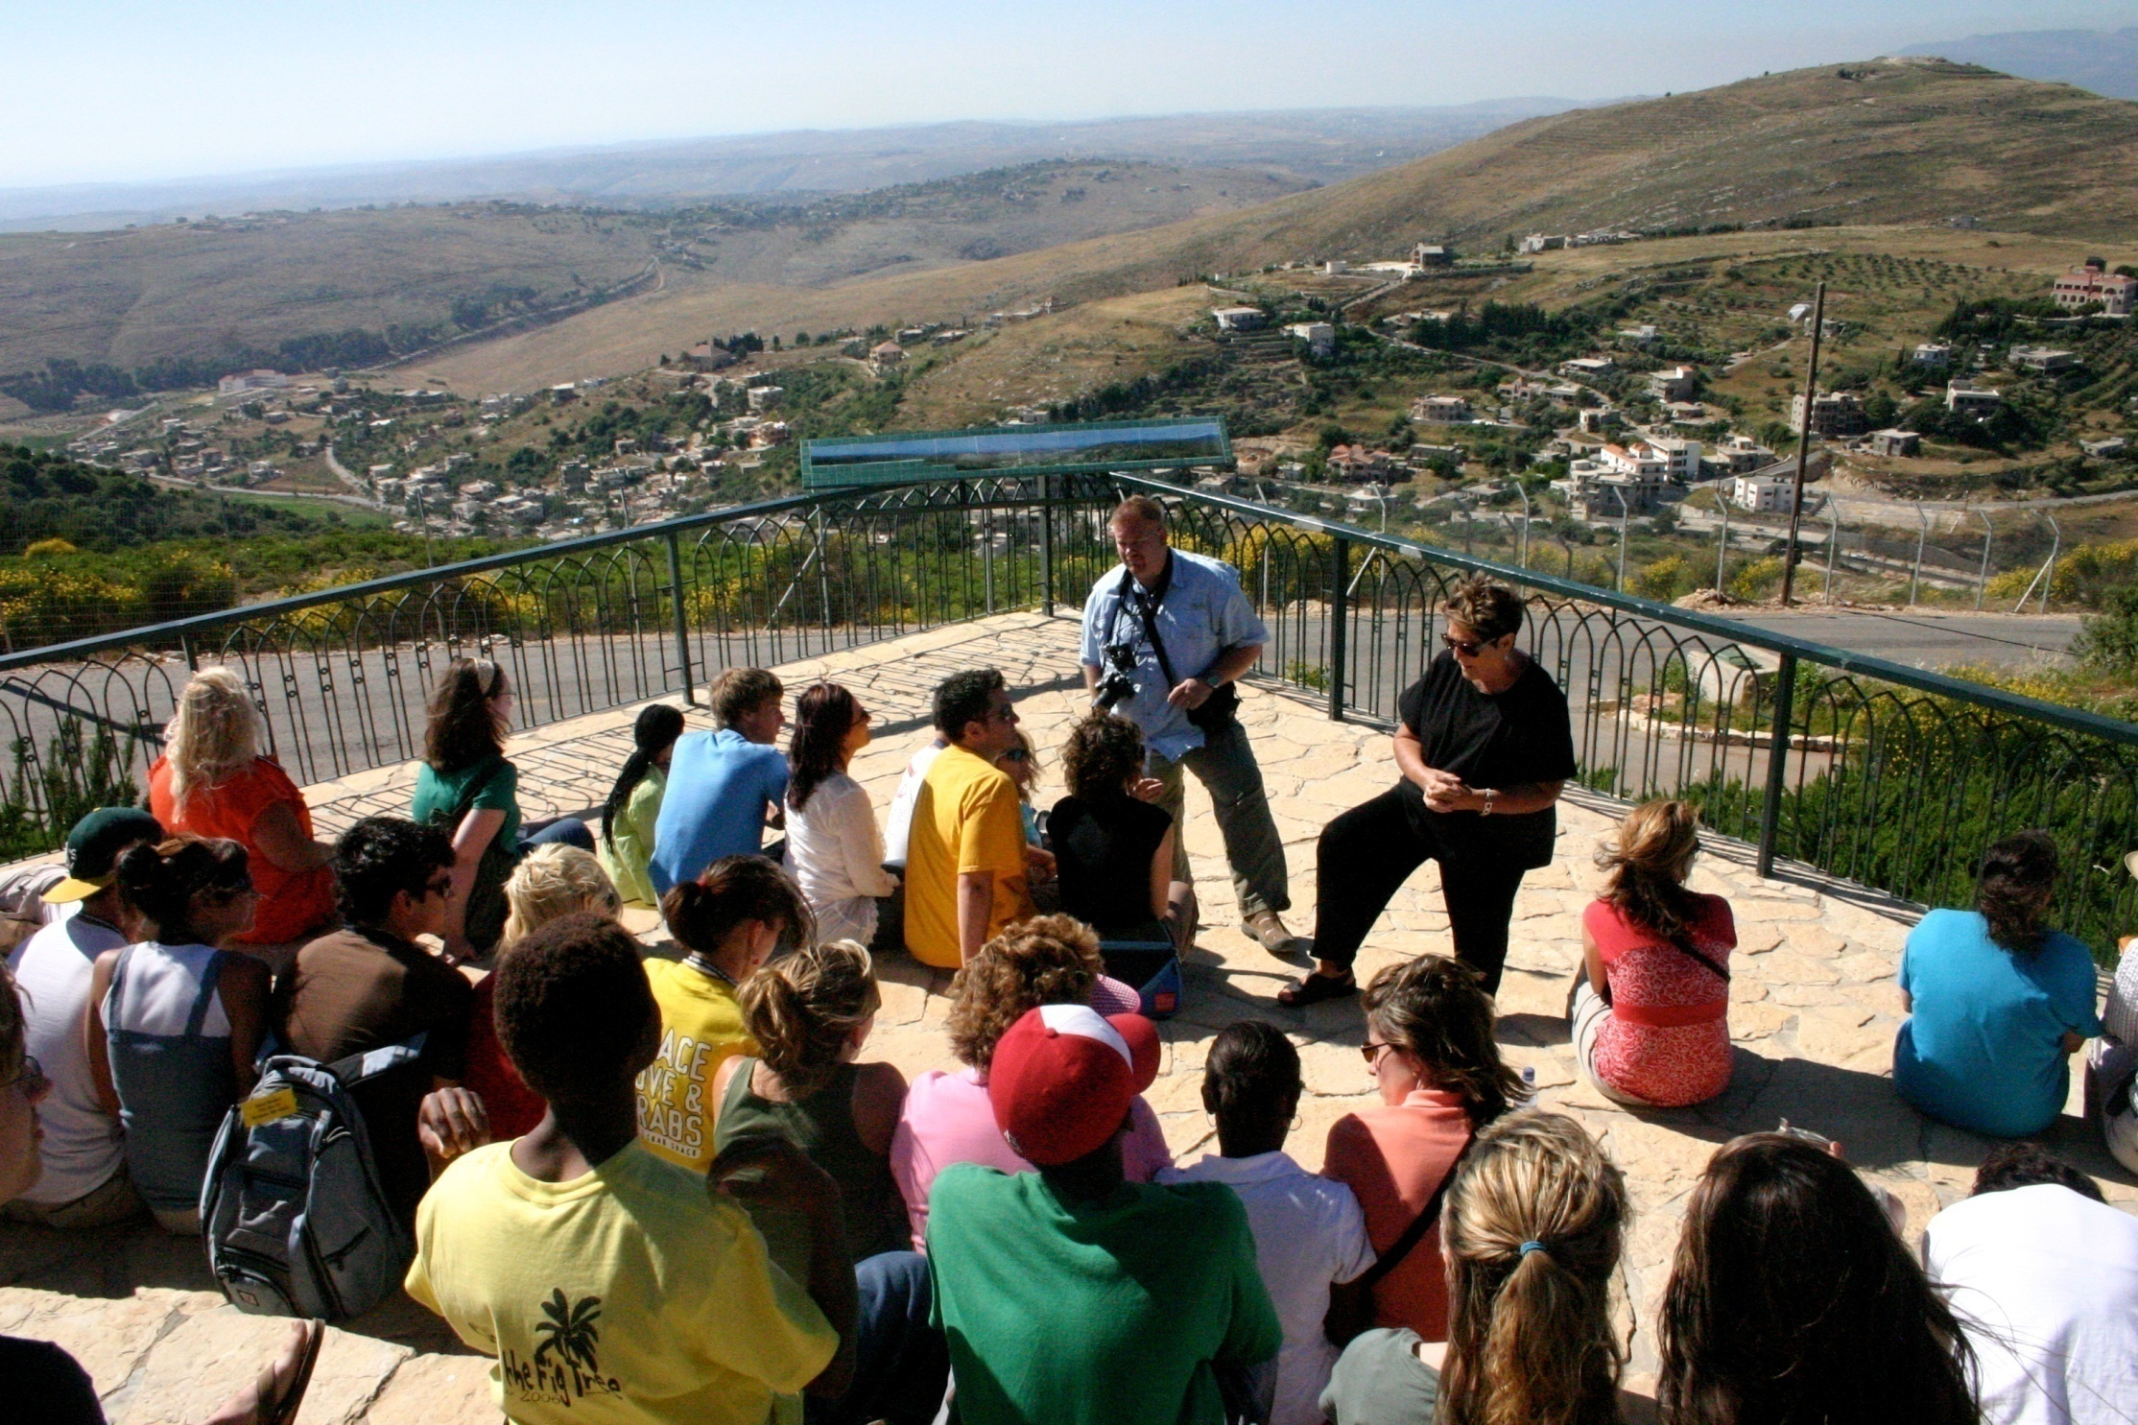
Misgav Am billye/kids hills
Notes:
Youth Tour - Misgav Am - Lebanon

Slide 26
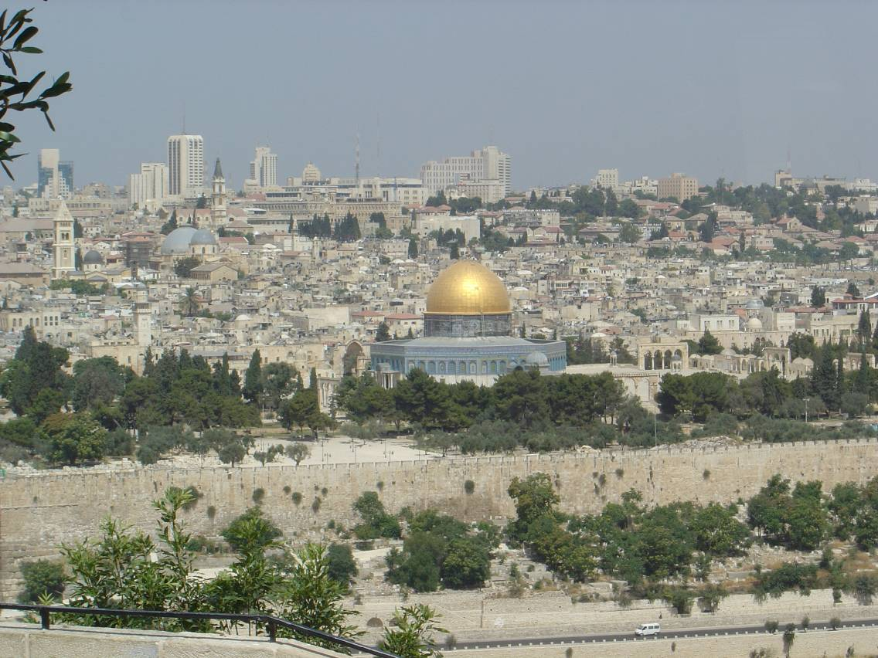
Temple Mnt w/dome
Notes:
Jerusalem - Temple Mount with dome

Slide 27
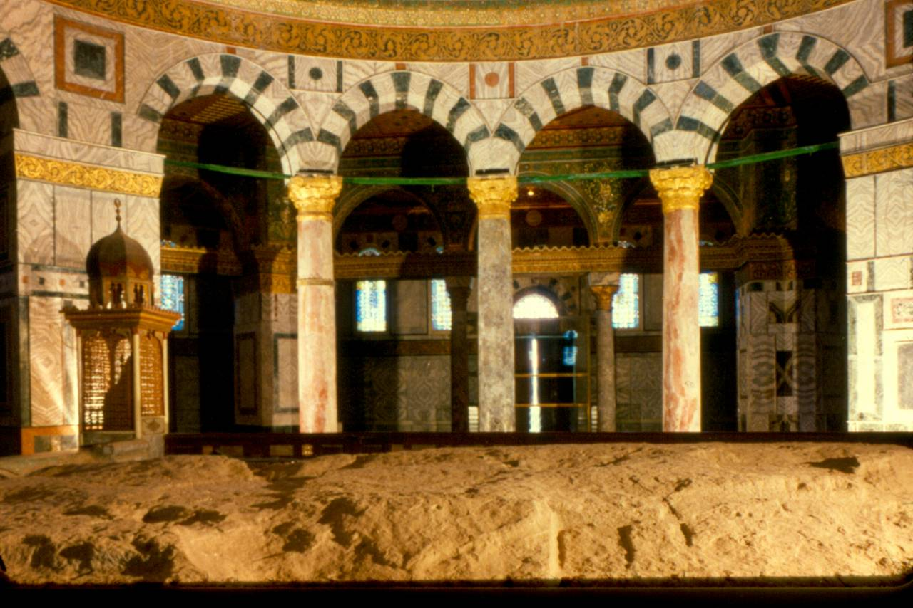
Inside Dome
Notes:
Dome of the Rock – Inside view

Slide 28
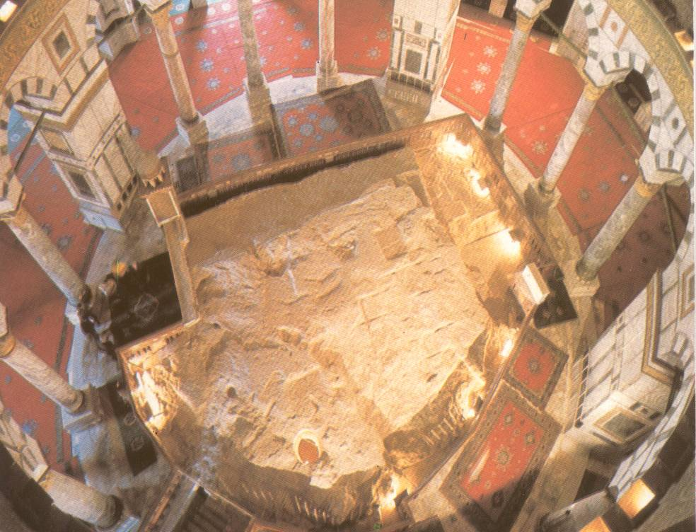
Rock top-view
Notes:
Dome of the Rock – Inside – Top down view

Slide 29
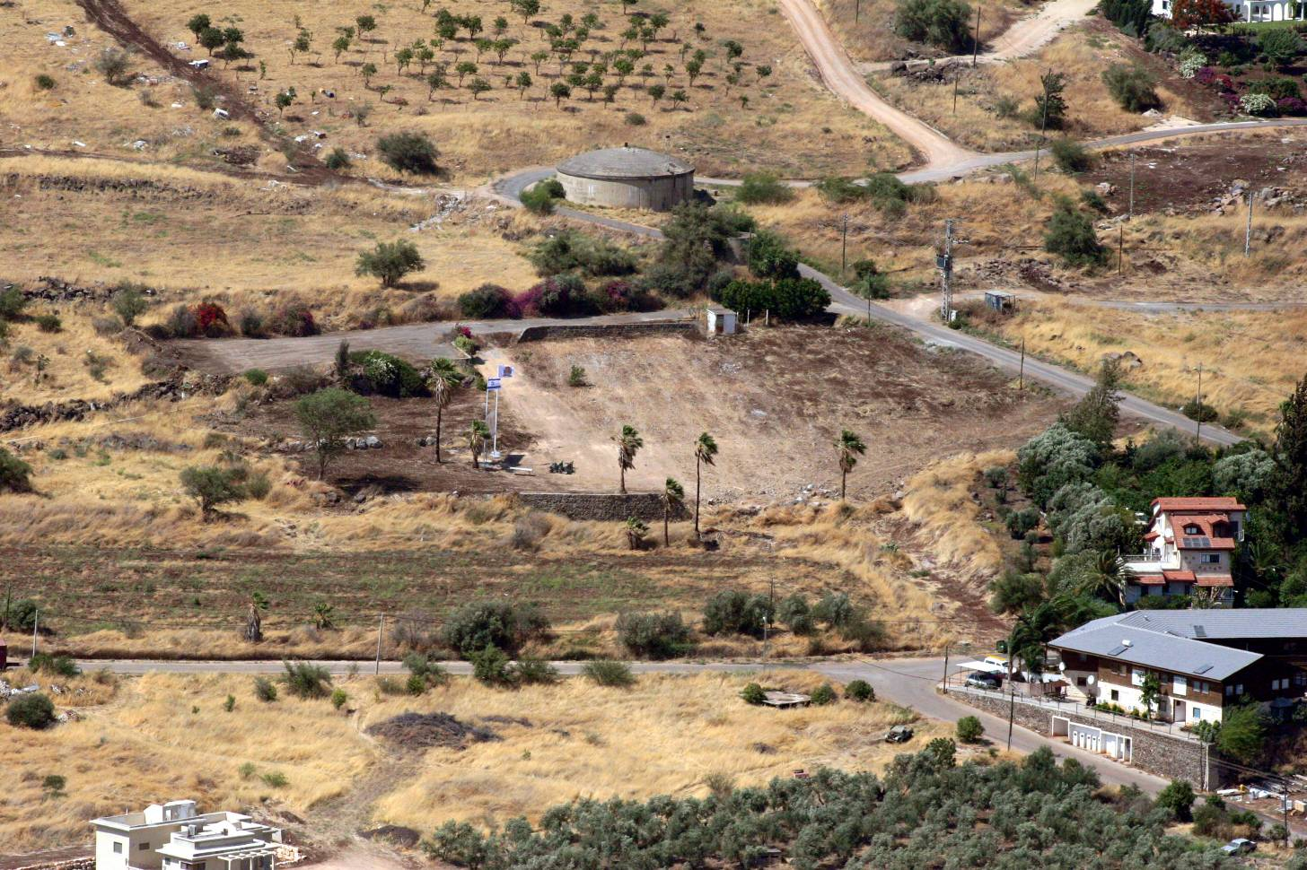
Migdal View
Notes:
Migdal - Aerial View

Slide 30
Notes:
Black

