Slide 2
Oh, say can you see by the dawn's early light
What so proudly we hailed
at the twilight's last gleaming?
Whose broad stripes and bright stars
thru the perilous fight,
O'er the ramparts we watched were so gallantly streaming?
And the rocket's red glare, the bombs bursting in air,
Gave proof through the night that our flag was still there.
Oh, say does that star-spangled banner yet wave
O'er the land of the free and the home of the brave?
The Star Spangled Banner Verse 1

Slide 3
On the shore, dimly seen through the mists of the deep,
Where the foe's haughty host in dread silence reposes,
What is that which the breeze, o'er the towering steep,
As it fitfully blows, half conceals, half discloses?
Now it catches the gleam of the morning's first beam,
In full glory reflected now shines in the stream:
'Tis the star-spangled banner! Oh long may it wave
O'er the land of the free and the home of the brave!
The Star Spangled Banner Verse 2

Slide 4
And where is that band who so vauntingly swore
That the havoc of war and the battle's confusion,
A home and a country should leave us no more!
Their blood has washed out their foul footsteps' pollution.
No refuge could save the hireling and slave
From the terror of flight, or the gloom of the grave:
And the star-spangled banner in triumph doth wave
O'er the land of the free and the home of the brave!
The Star Spangled Banner Verse 3

Slide 5
Oh! thus be it ever, when freemen shall stand
Between their loved home and the war's desolation!
Blest with victory and peace, may the heav'n rescued land
Praise the Power that hath made and preserved us a nation.
Then conquer we must, when our cause it is just,
And this be our motto: "In God is our trust.”
And the star-spangled banner in triumph shall wave
O'er the land of the free and the home of the brave!
The Star Spangled Banner Verse 4

Slide 6
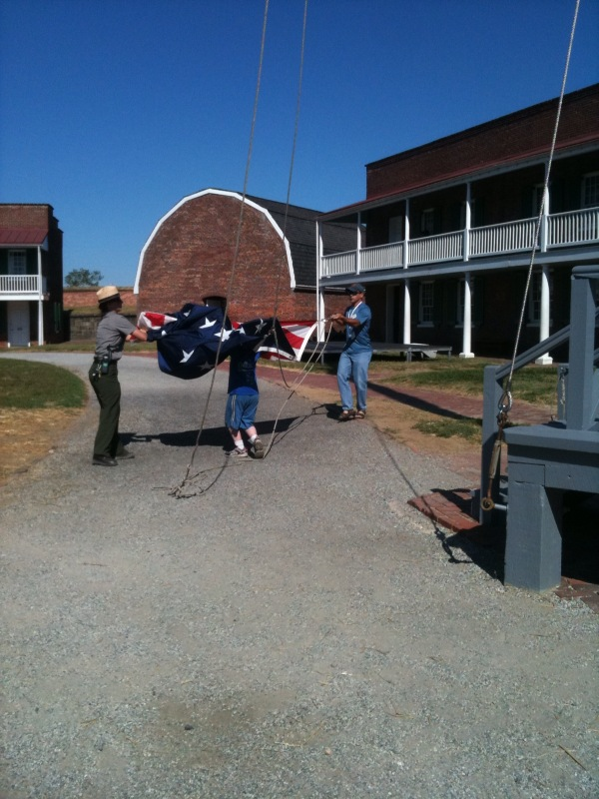

Slide 7
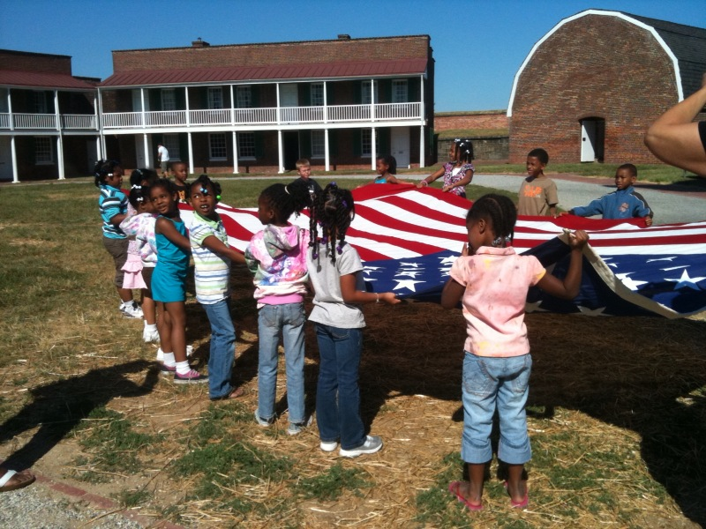

Slide 8
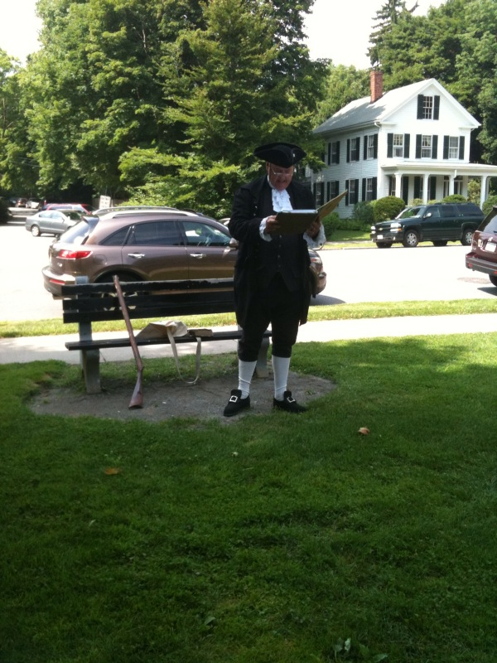

Slide 9
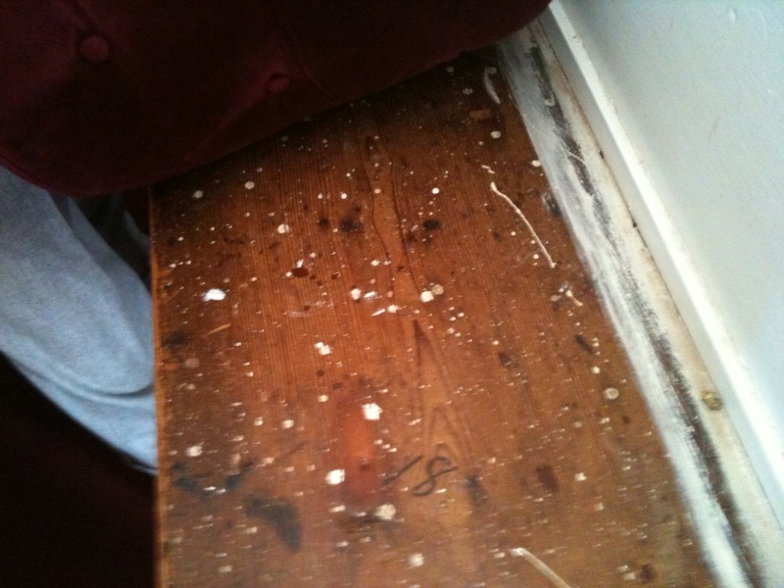

Slide 10
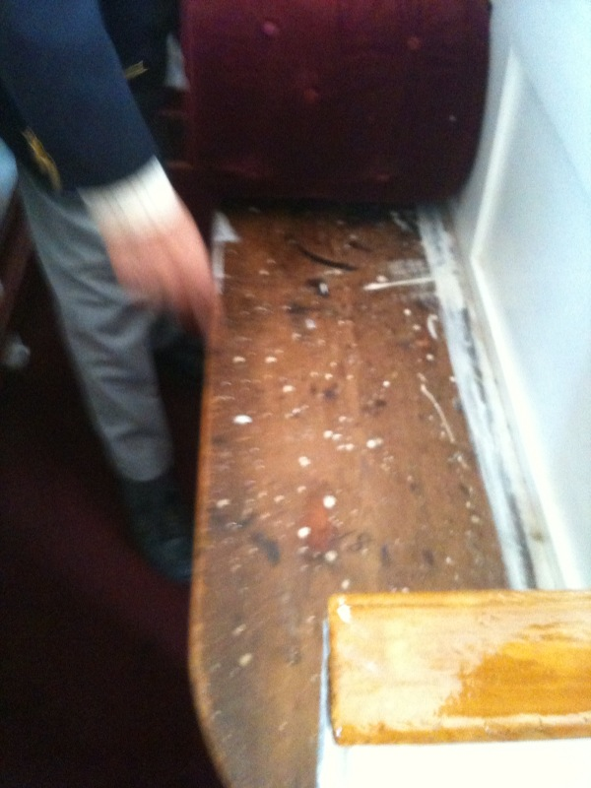

Slide 11
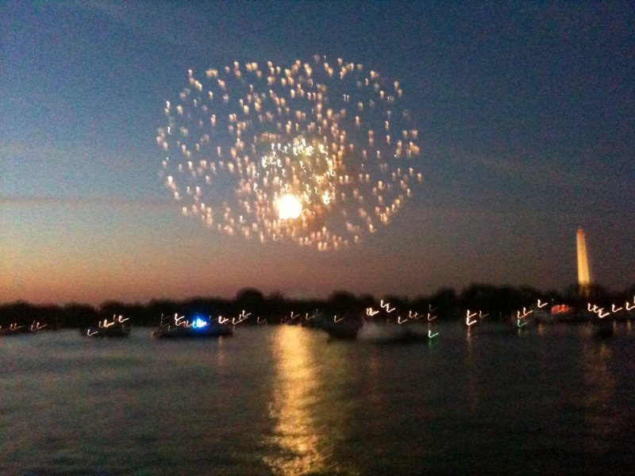

Slide 12
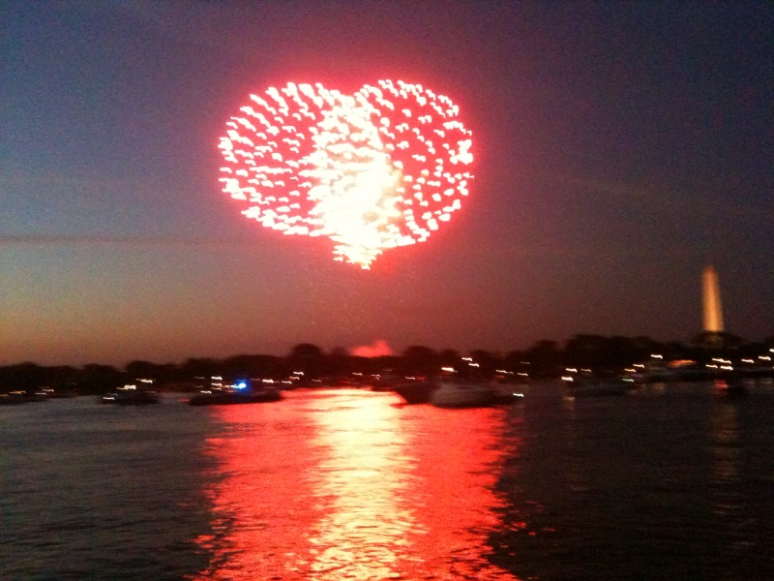

Slide 13
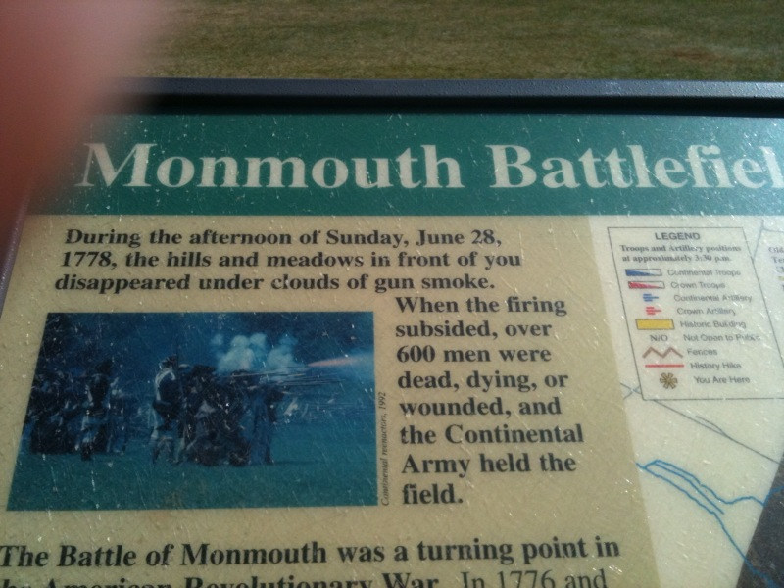

Slide 14
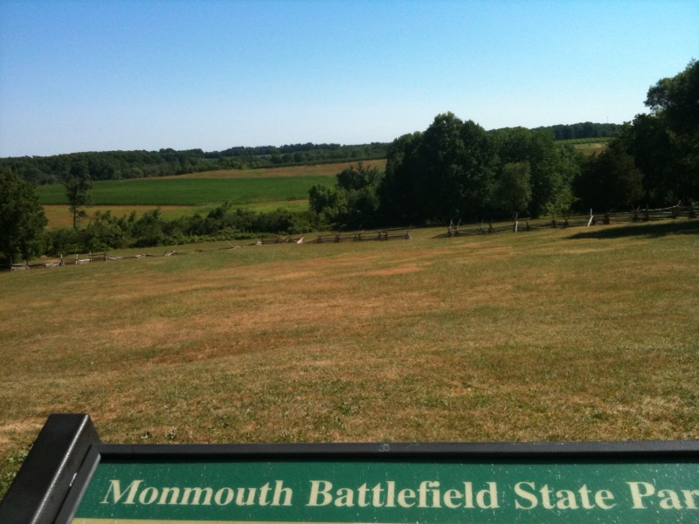

Slide 15
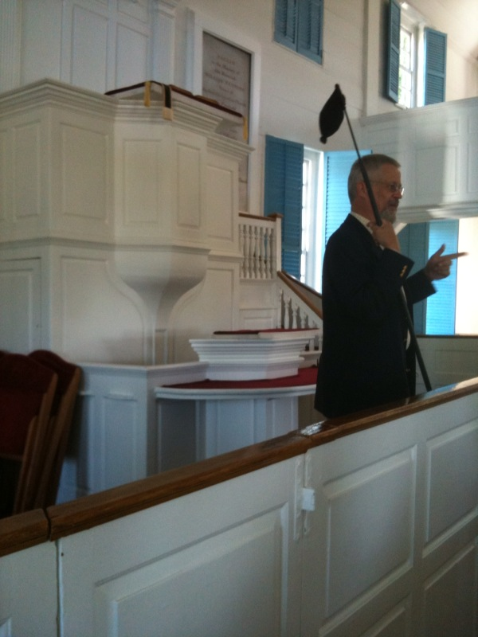

Slide 16
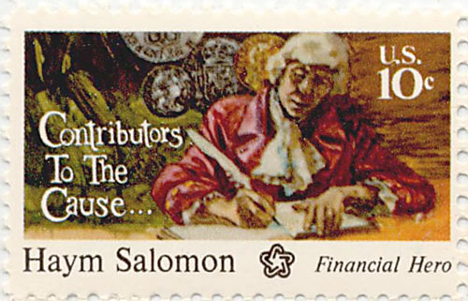

Slide 17
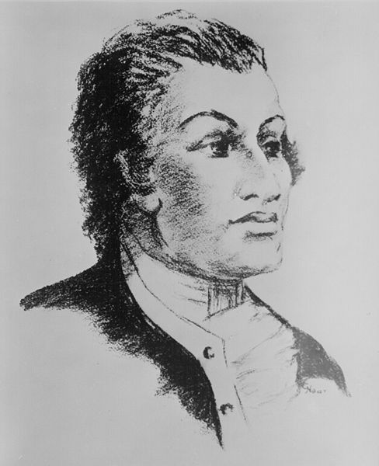

Slide 18
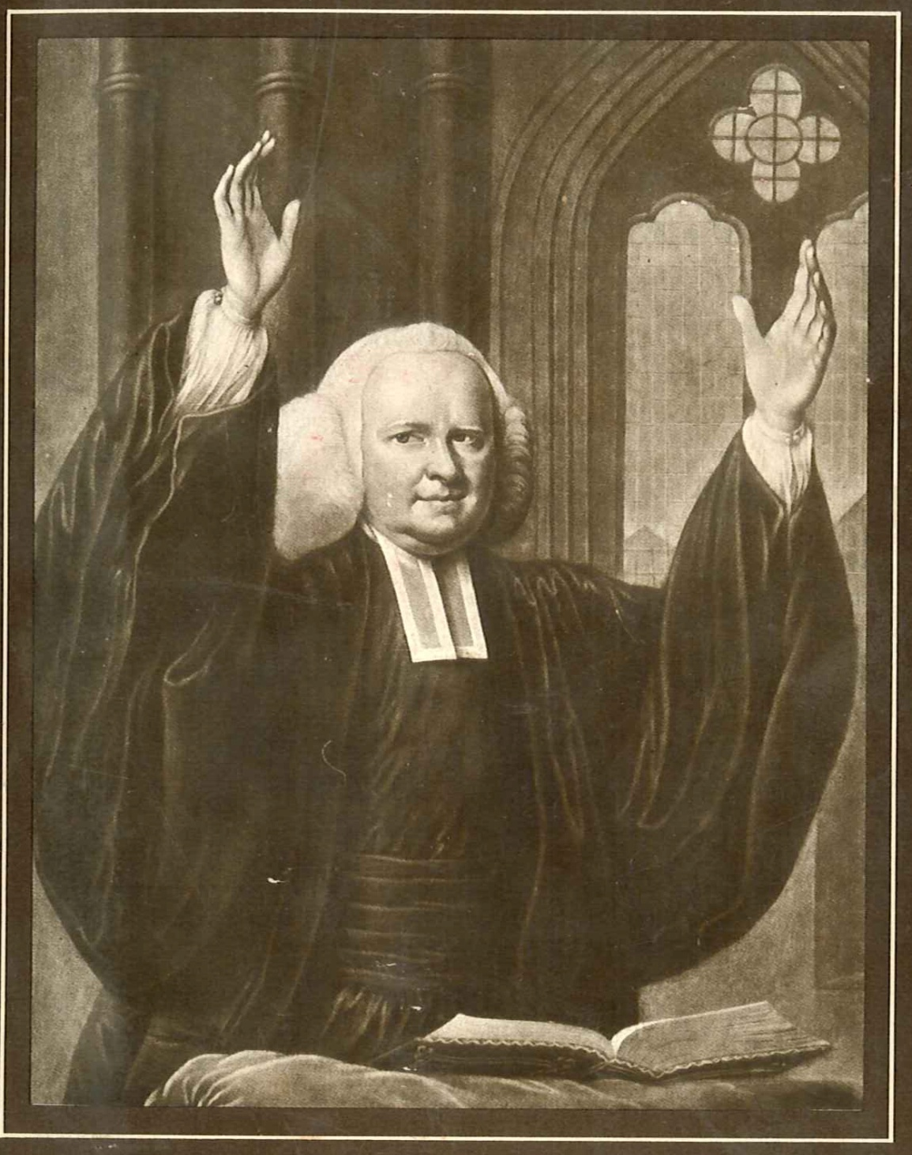
George Whitefield

Slide 19
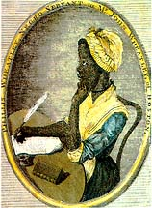
Phillis Wheatley

Slide 20
On the Death of Rev. George Whitefield by Phillis Wheatley
HAIL, happy saint, on thine immortal throne,
Possest of glory, life, and bliss unknown;
We hear no more the music of thy tongue,
Thy wonted auditories cease to throng.
Thy sermons in unequall'd accents flow'd,
And ev'ry bosom with devotion glow'd;
Thou didst in strains of eloquence refin'd
Inflame the heart, and captivate the mind.
Unhappy we the setting sun deplore,
So glorious once, but ah! it shines no more.
Behold the prophet in his tow'ring flight!
He leaves the earth for heav'n's unmeasur'd height,
And worlds unknown receive him from our sight.
There Whitefield wings with rapid course his way,
And sails to Zion through vast seas of day.

Slide 21
Thy pray'rs, great saint, and thine incessant cries
Have pierc'd the bosom of thy native skies.
Thou moon hast seen, and all the stars of light,
How he has wrestled with his God by night.
He pray'd that grace in ev'ry heart might dwell,
He long'd to see America excell;
He charg'd its youth that ev'ry grace divine
Should with full lustre in their conduct shine;
That Saviour, which his soul did first receive,
The greatest gift that ev'n a God can give,
He freely offer'd to the num'rous throng,
That on his lips with list'ning pleasure hung.
"Take him, ye wretched, for your only good,
"Take him ye starving sinners, for your food;
"Ye thirsty, come to this life-giving stream,
"Ye preachers, take him for your joyful theme;

Slide 22
"Take him my dear Americans, he said,
"Be your complaints on his kind bosom laid:
"Take him, ye Africans, he longs for you,
"Impartial Saviour is his title due:
"Wash'd in the fountain of redeeming blood,
"You shall be sons, and kings, and priests to God."
Great Countess,* we Americans revere
Thy name, and mingle in thy grief sincere;
New England deeply feels, the Orphans mourn,
Their more than father will no more return.
But, though arrested by the hand of death,
Whitefield no more exerts his lab'ring breath,
Yet let us view him in th' eternal skies,
Let ev'ry heart to this bright vision rise;
While the tomb safe retains its sacred trust,
Till life divine re-animates his dust.
*The Countess of Huntingdon, to whom Mr. Whitefield was Chaplain.

Slide 23
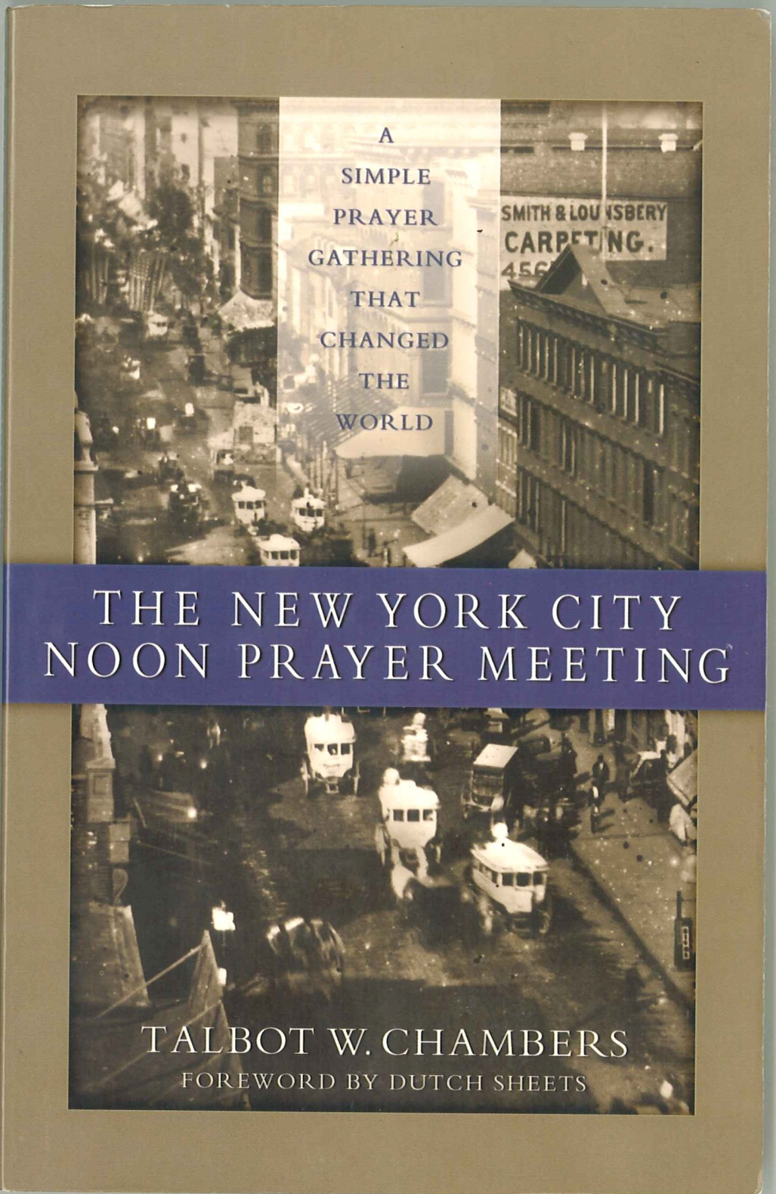
NYC Prayer Mtg book

Slide 24
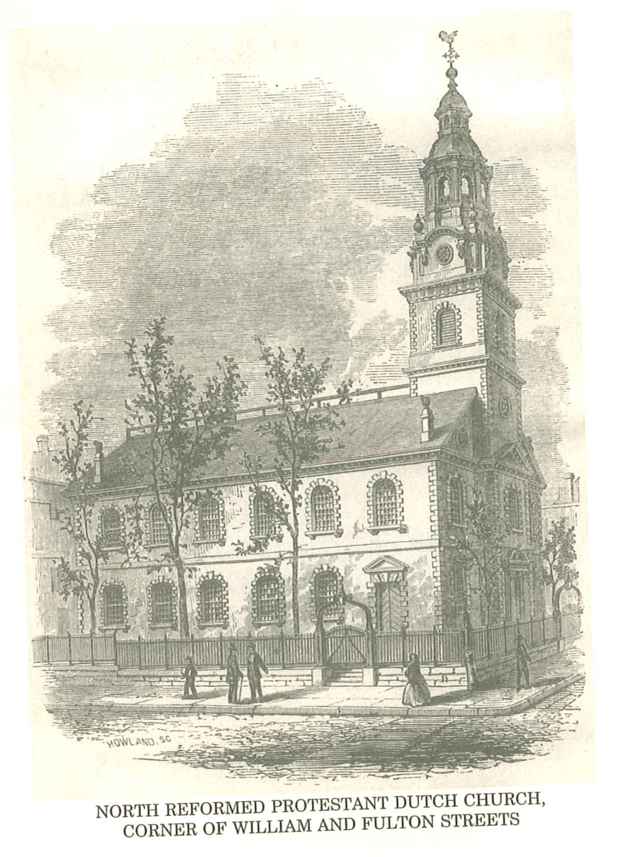
Dutch Church

Slide 25
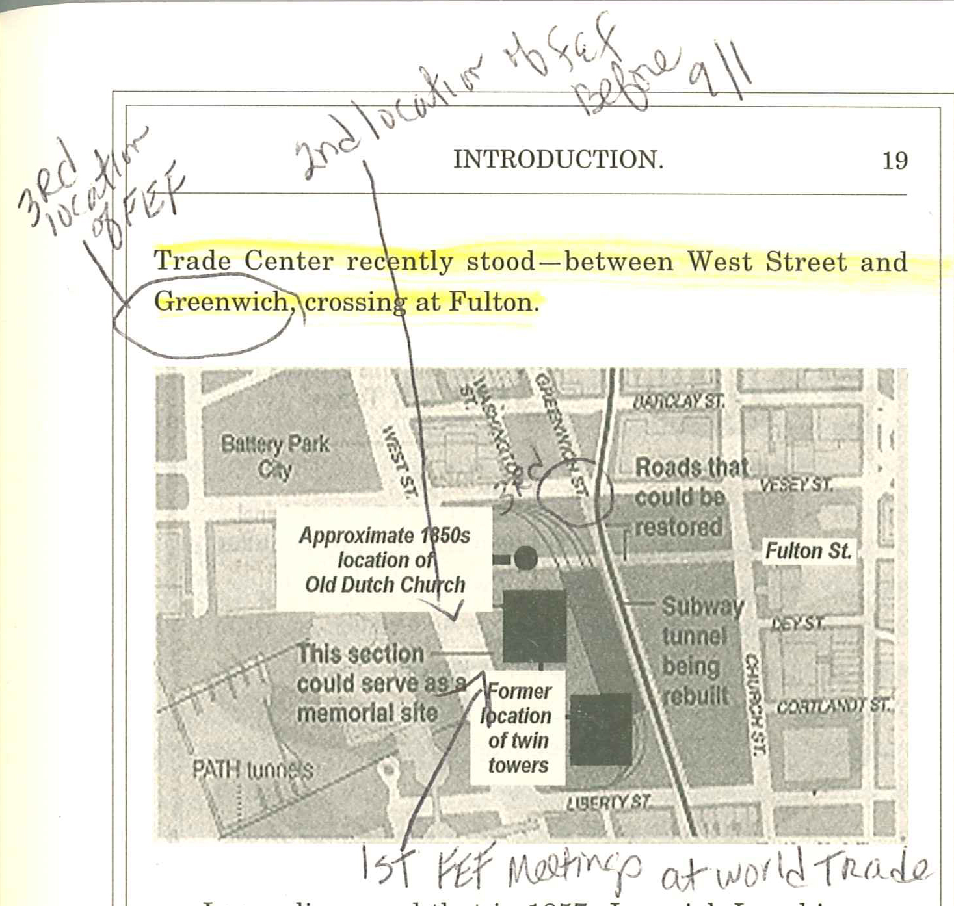
Pg 19 Map

Slide 26
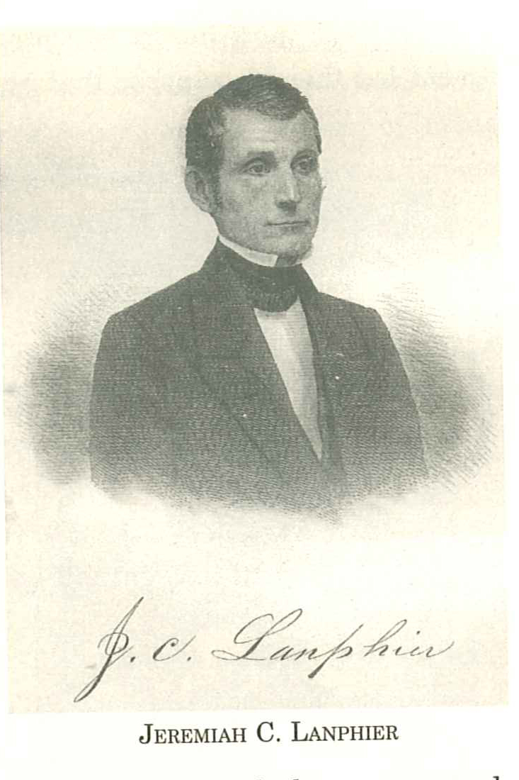
Pg 30 Jeremiah Lanphier

Slide 27
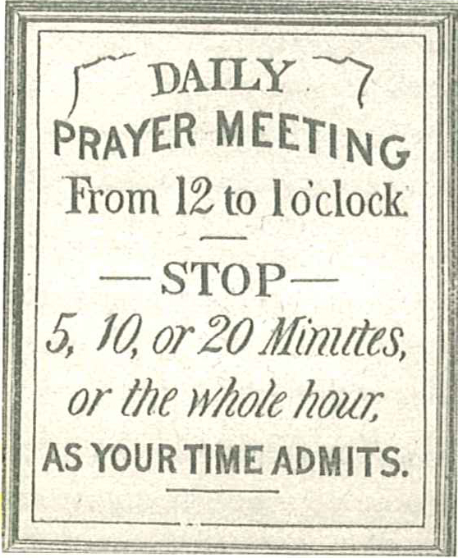
Pg 35 Prayer mtg sign

Slide 28
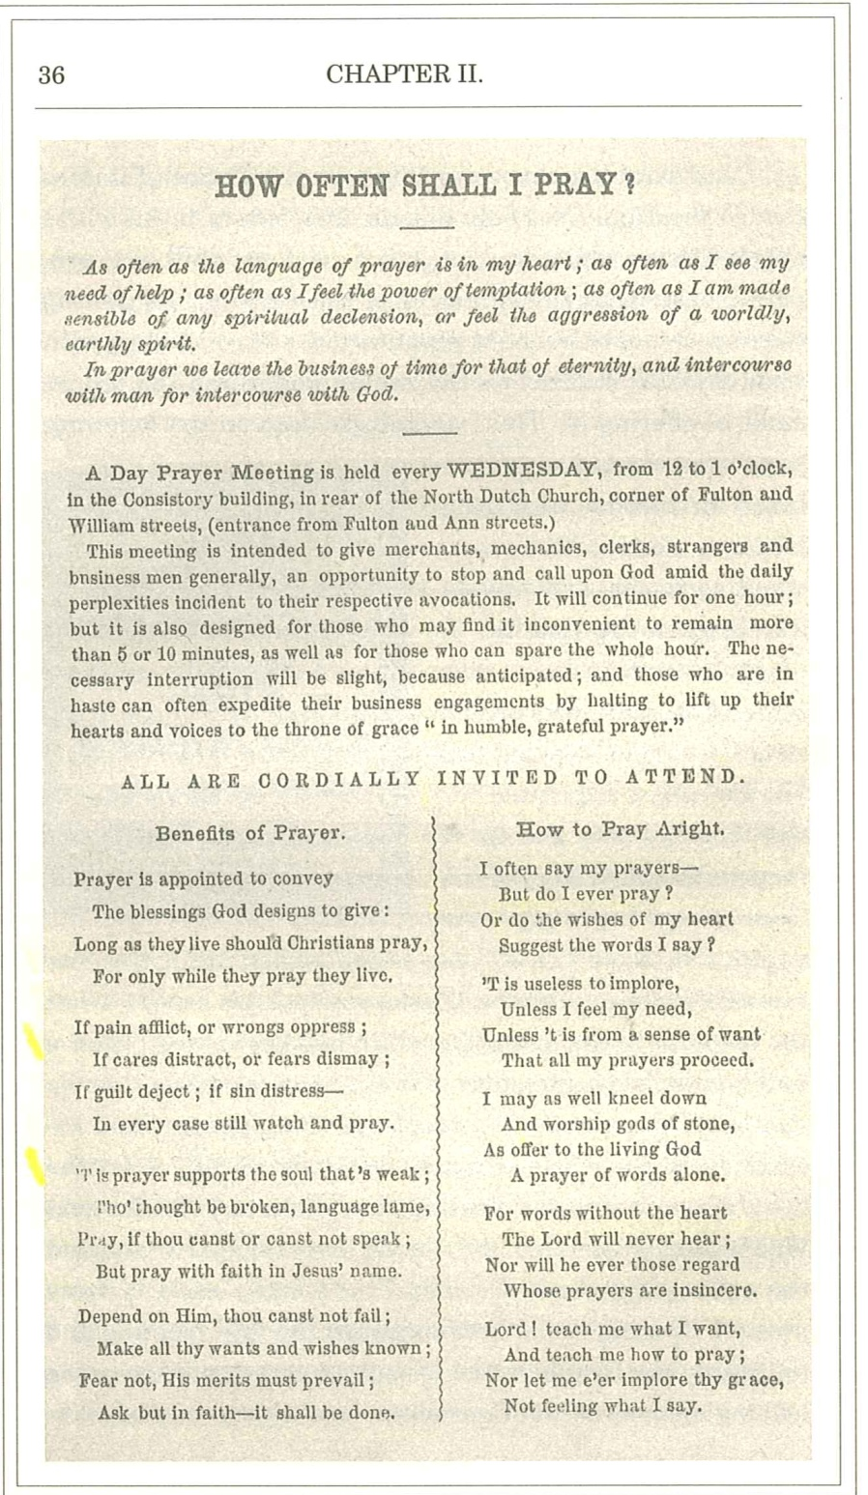
Pg 36 How Often Shall I Pray
Pg 36 How Often Shall I Pray

Slide 29
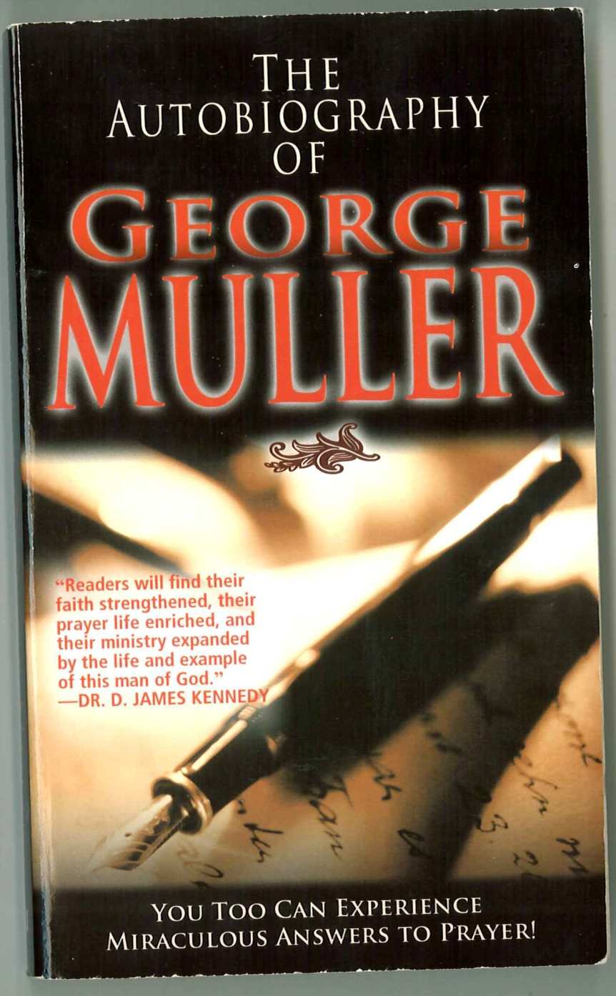
George Muller book

Slide 30
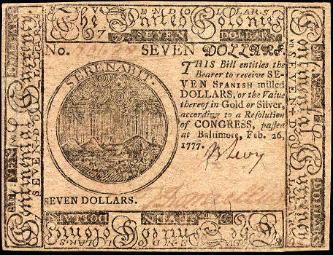
Continental Bank Note

Slide 31
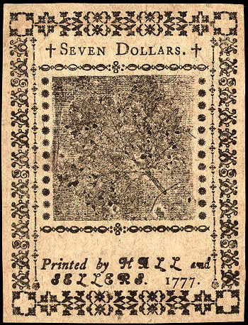
Continental Bank Note $7 1777

Slide 32
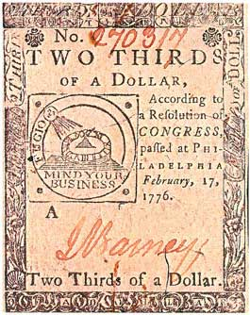
Continental Bank Note 2/3

