Slide 1
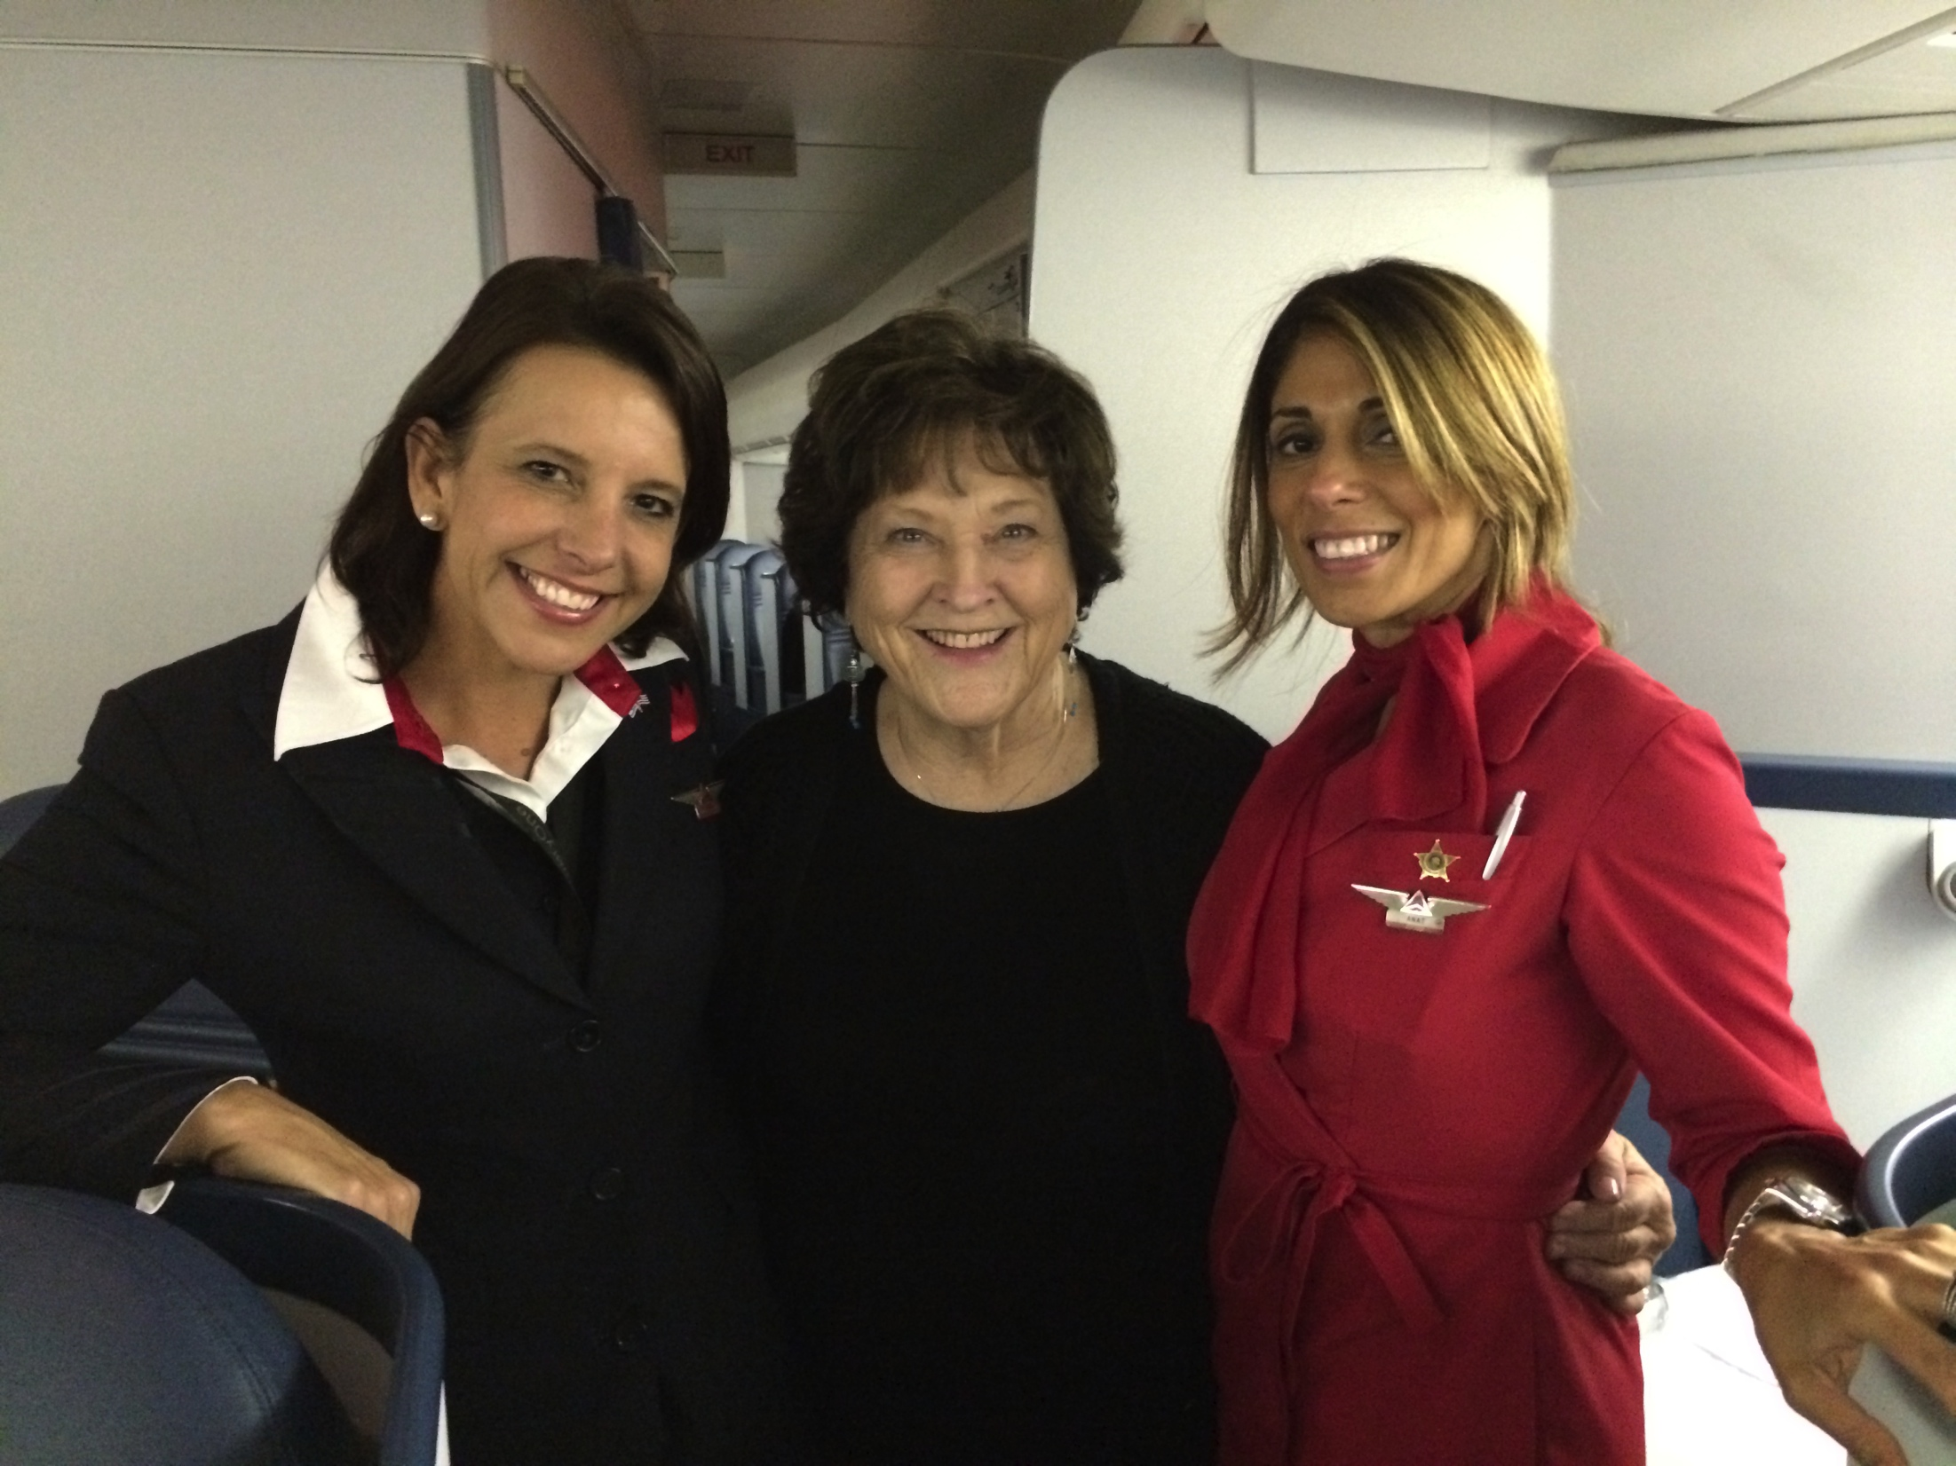
With Delta stewardesses – Linda & Anat

Slide 2
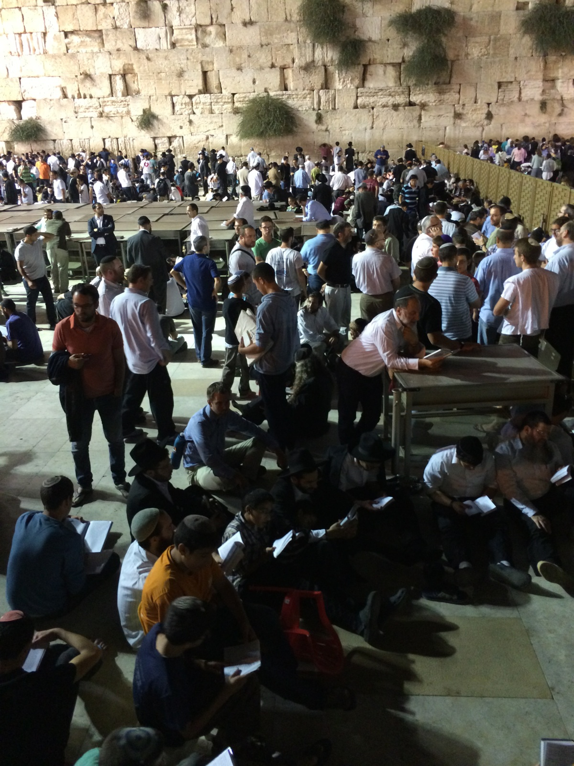
The Western Wall on Tisha b’Av

Slide 3
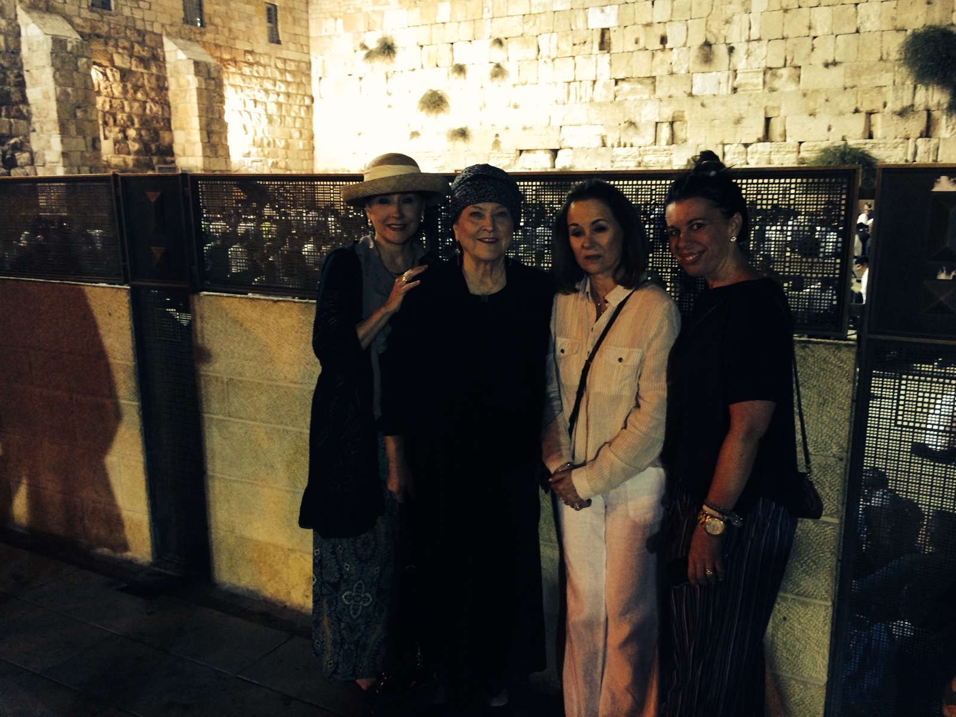
Western Wall – Shelli, Billye, Lynne, Heather

Slide 4
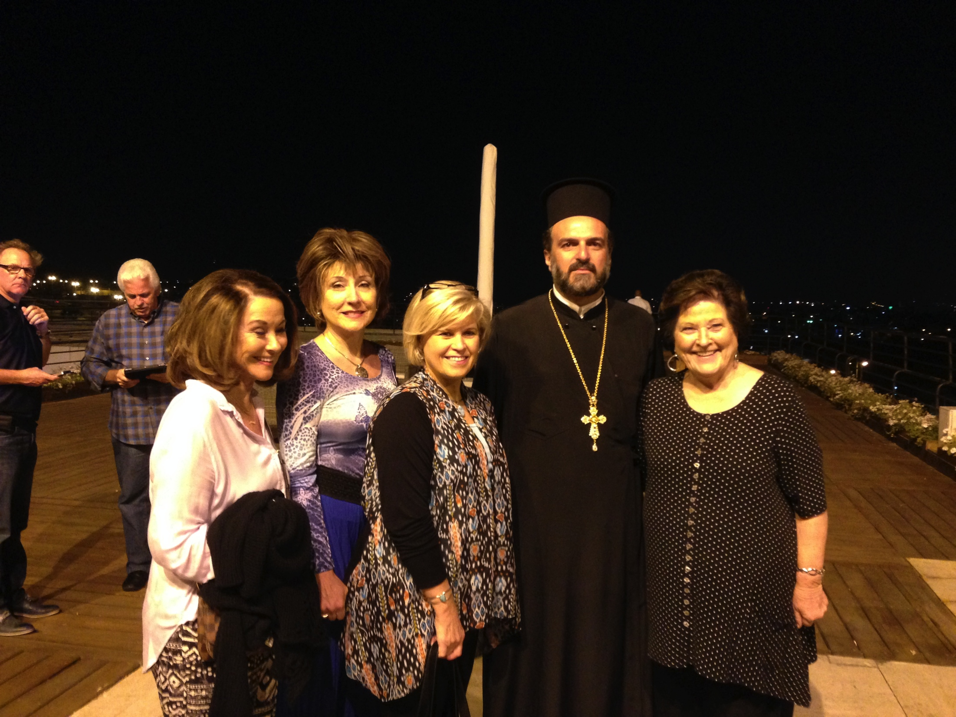
With Sharon Daugherty & Father Gabriel Naddaf

Slide 5
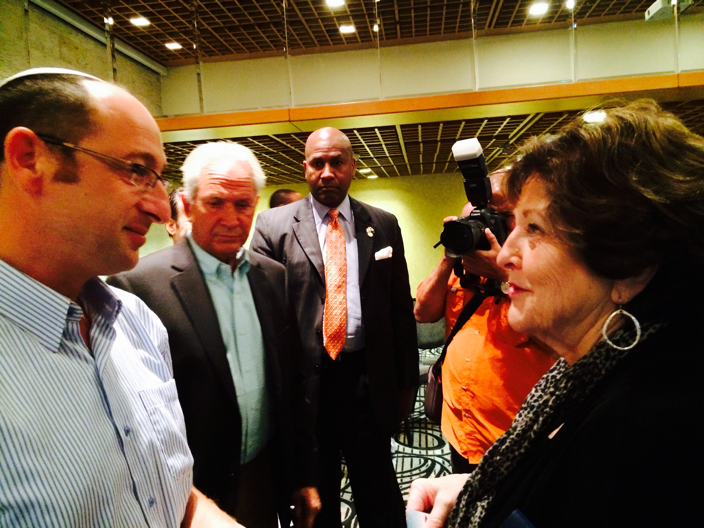
Billye w/ Father of one of teenagers killed

Slide 6
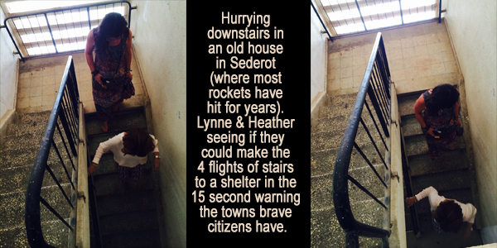
Sederot – Lynne & Heather running stairs

Slide 7
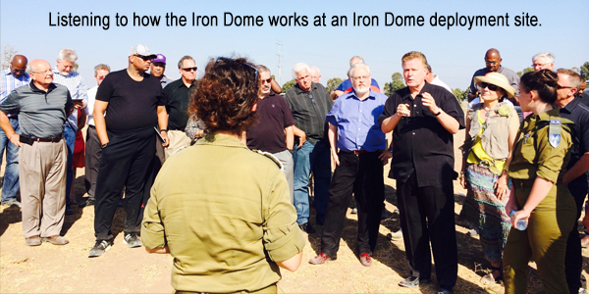
Listening to speaker at Iron Dome deployment site

Slide 8
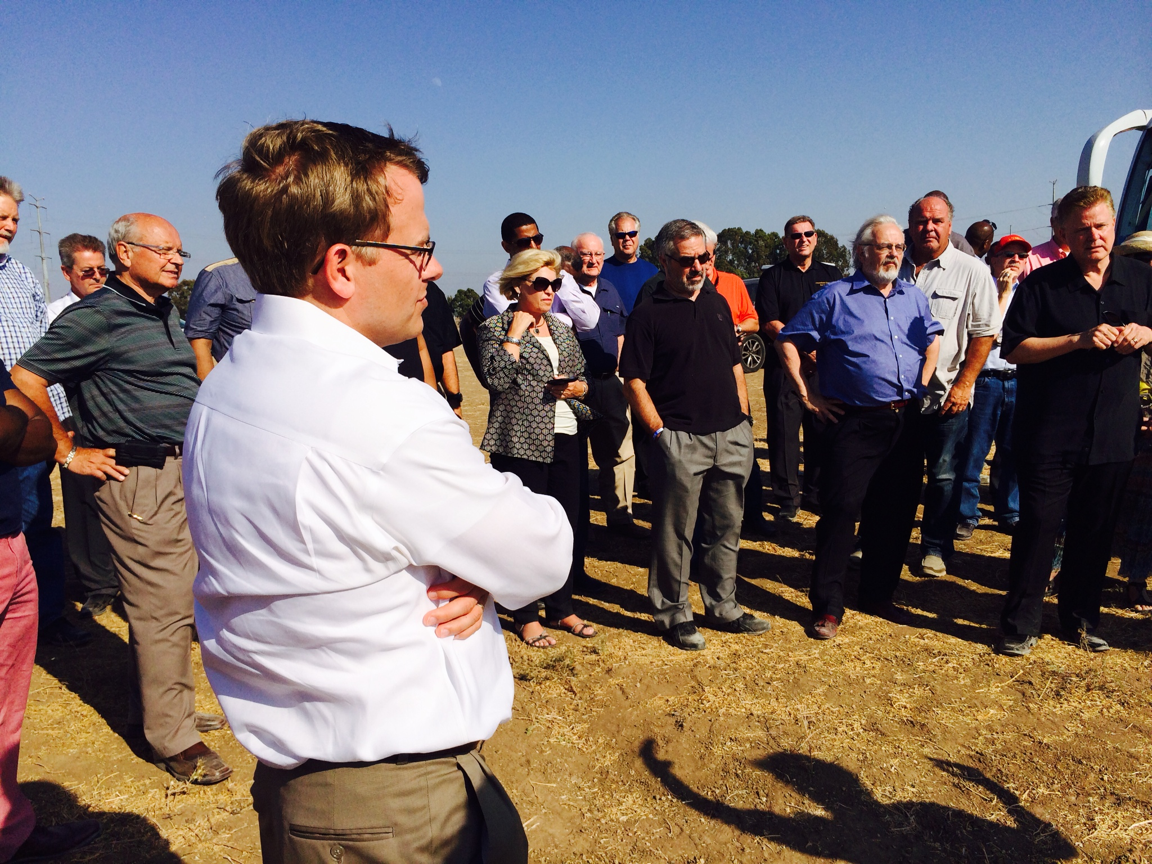
Todd Burpo at Iron Dome deployment site

Slide 9
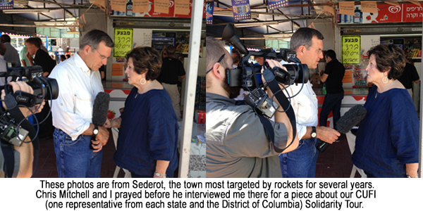
Interview w/ Chris Mitchell

Slide 10
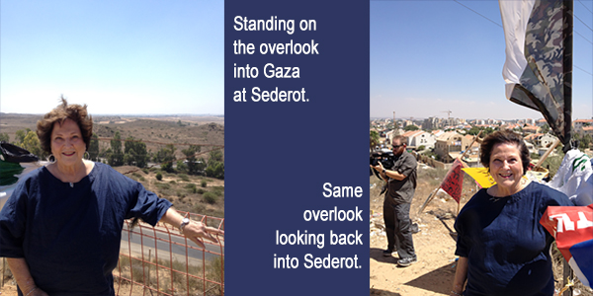
Billye on overlook into Gaza at Sederot

Slide 11
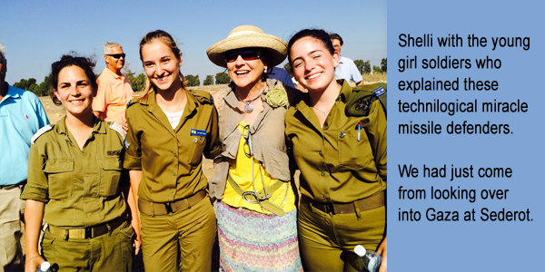
Shelli with young girl soldiers

Slide 12
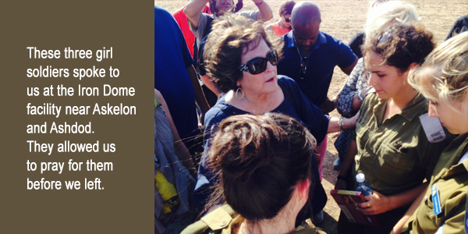
Billye praying with girl soldiers

Slide 13
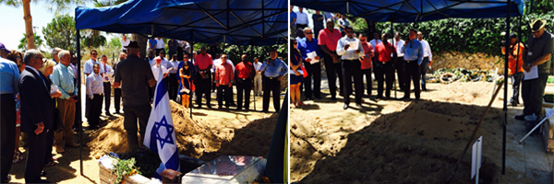
Mt Herzl Cemetary, graves of soldiers

Slide 14
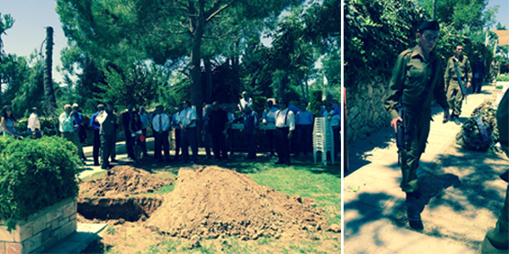
Graveside, young soldiers walking

Slide 15
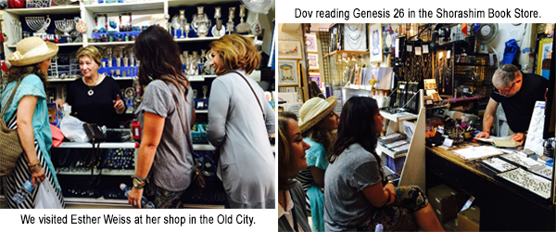
Shops in Jerusalem-Esther Weiss, Dov reading Gen 26

Slide 16
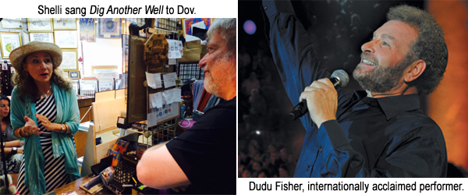
Shelli singing to Dov, Dudu Fisher

Slide 17
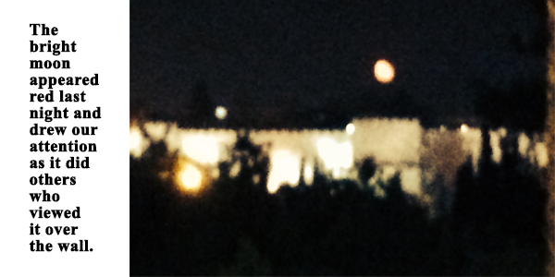
Red moon over the wall

Slide 18
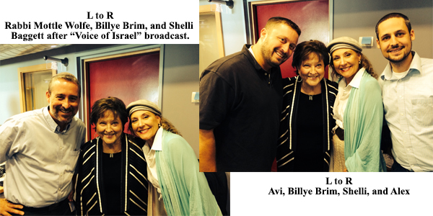
Rabbi Mottle Wolfe, Avi, & Alex – Voice of Israel radio

Slide 19
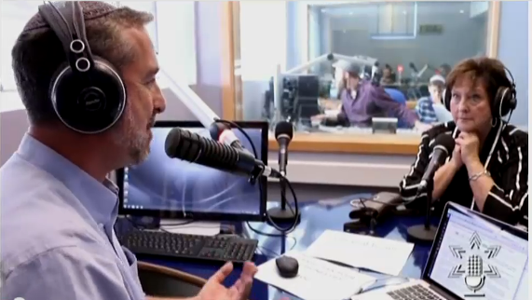
Voice of Israel 1

Slide 20
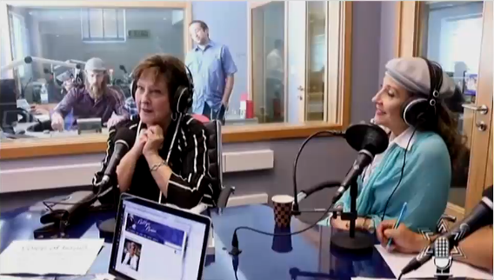
Voice of Israel 2

Slide 21
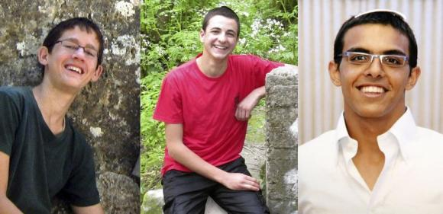
3 Israeli Teens
Naftali Fraenkel Gilad Sharr Eyal Yifrach

Slide 22
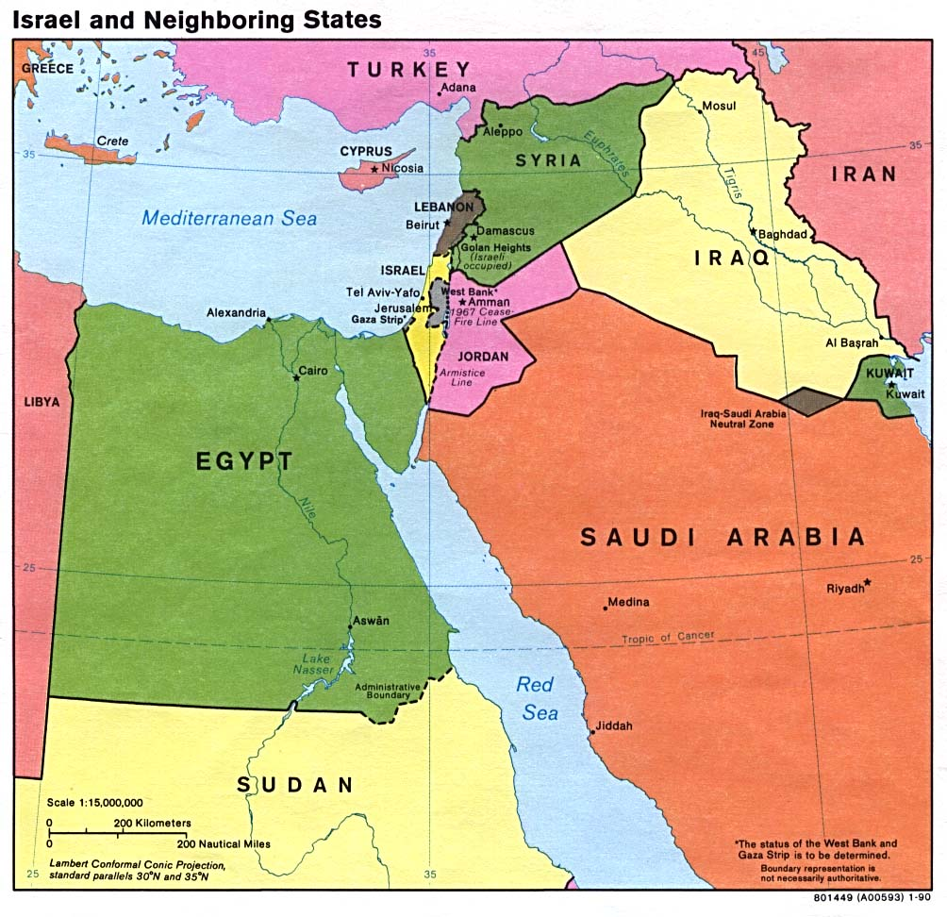
Map –Israel & Neighboring

Slide 23
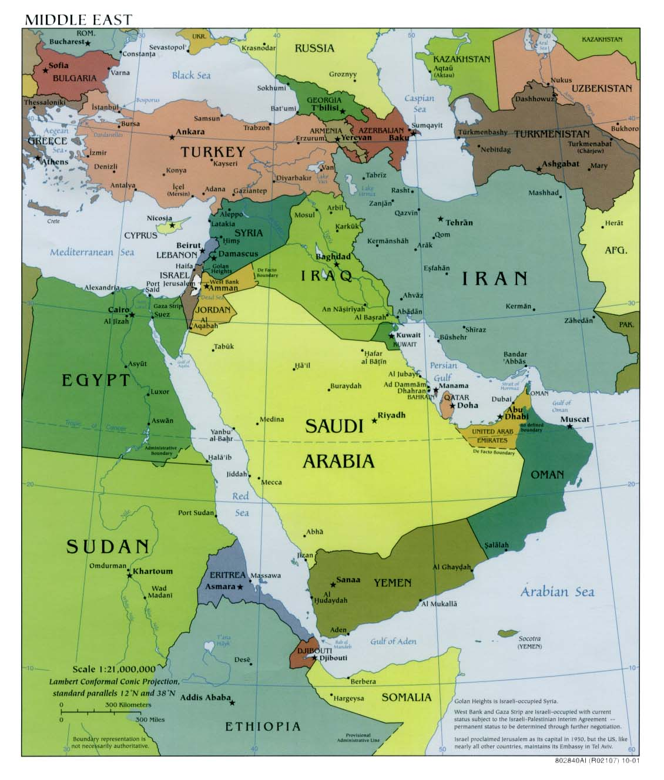
Map –Middle East

Slide 24
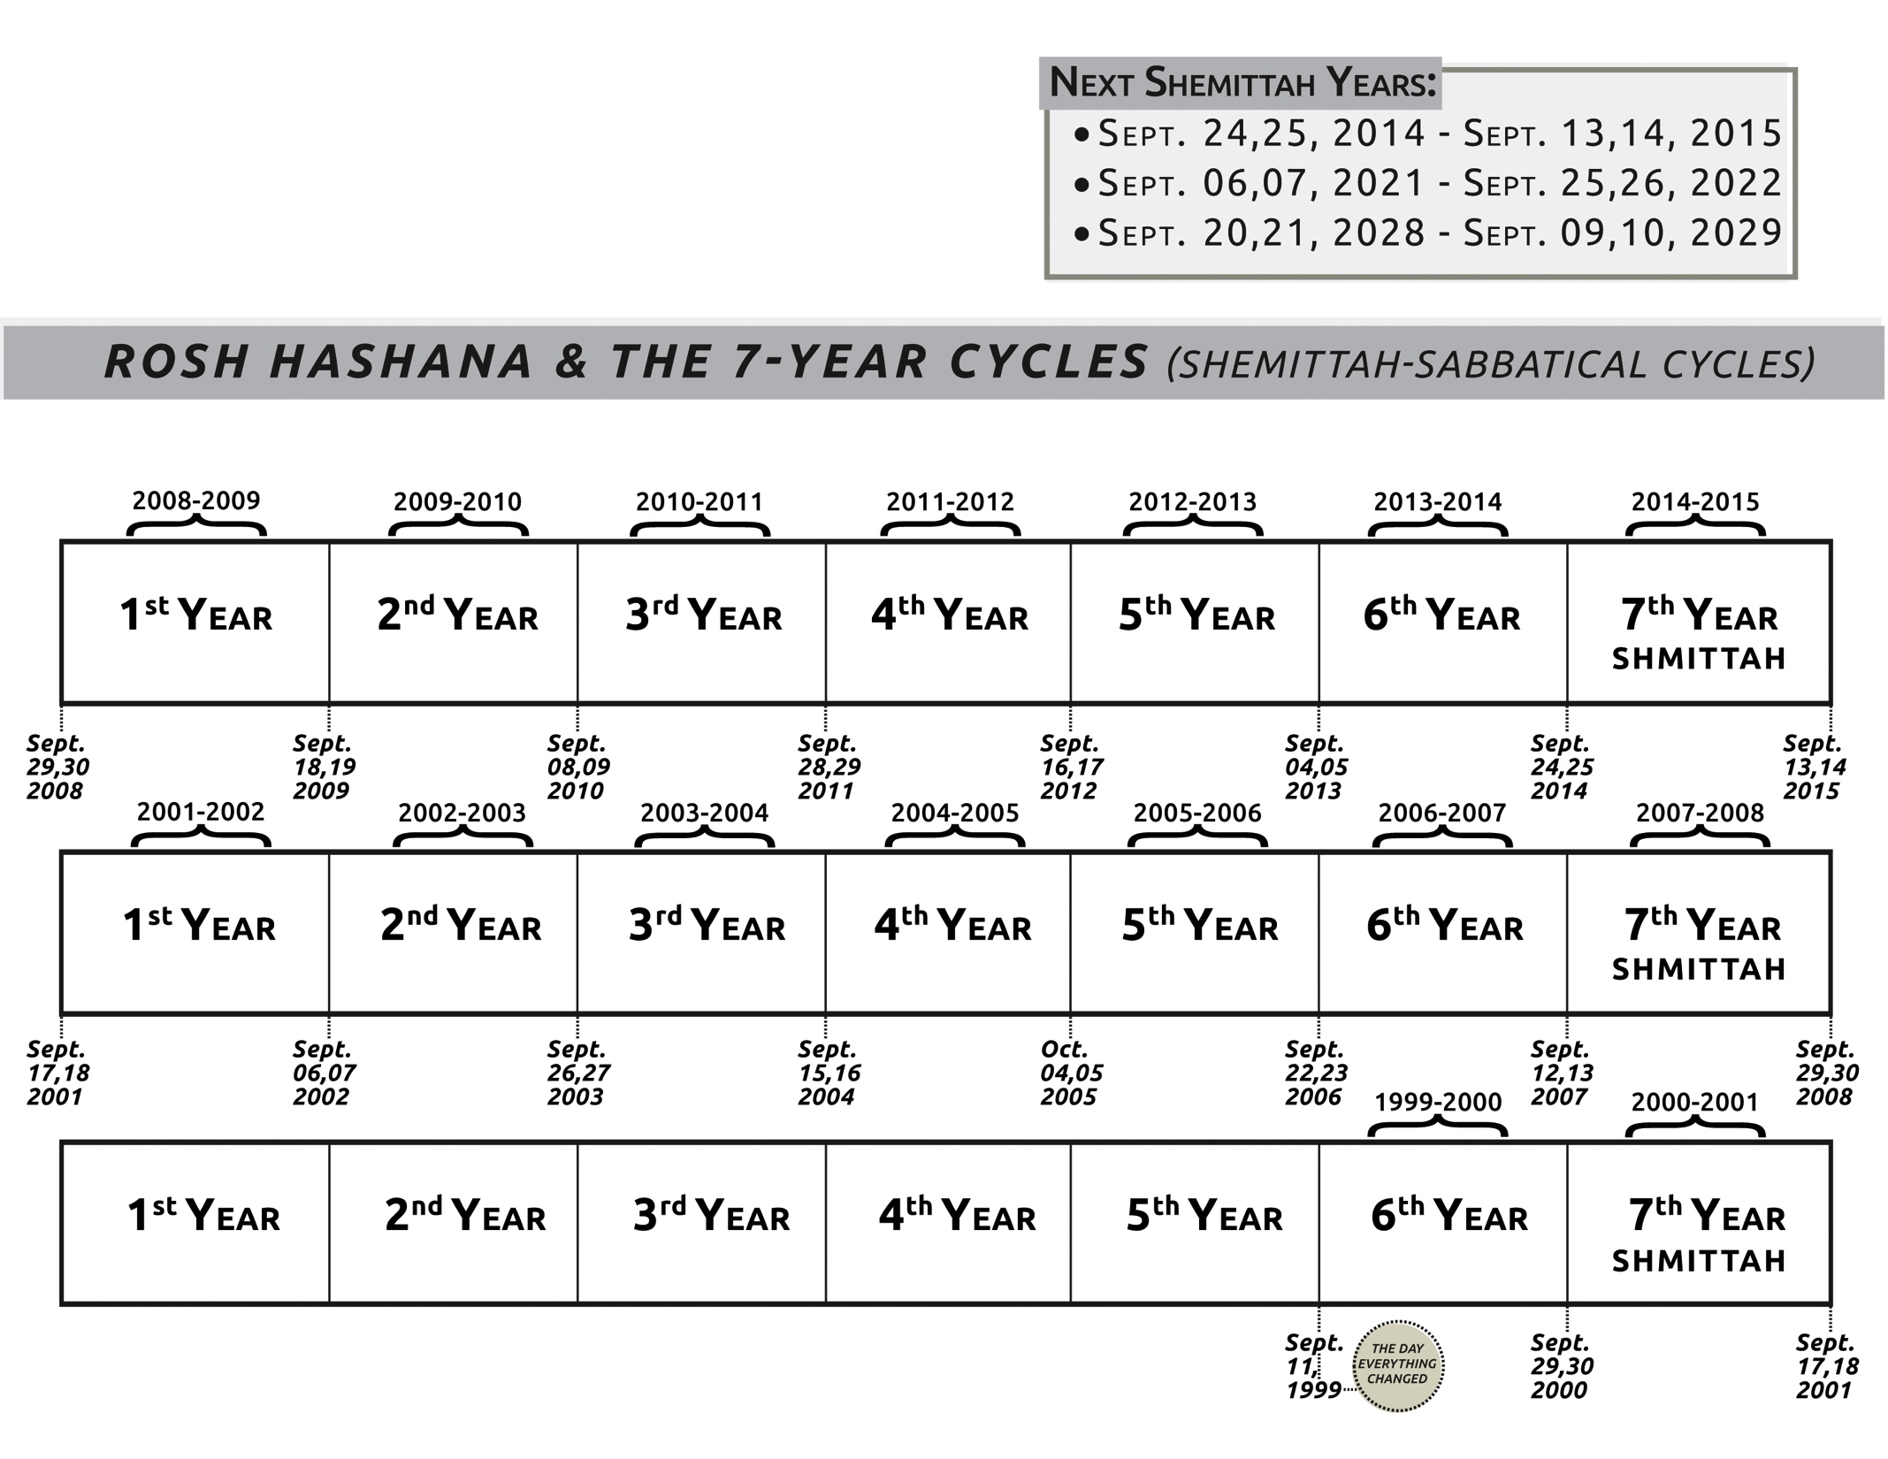
Shemittah chart

Slide 25
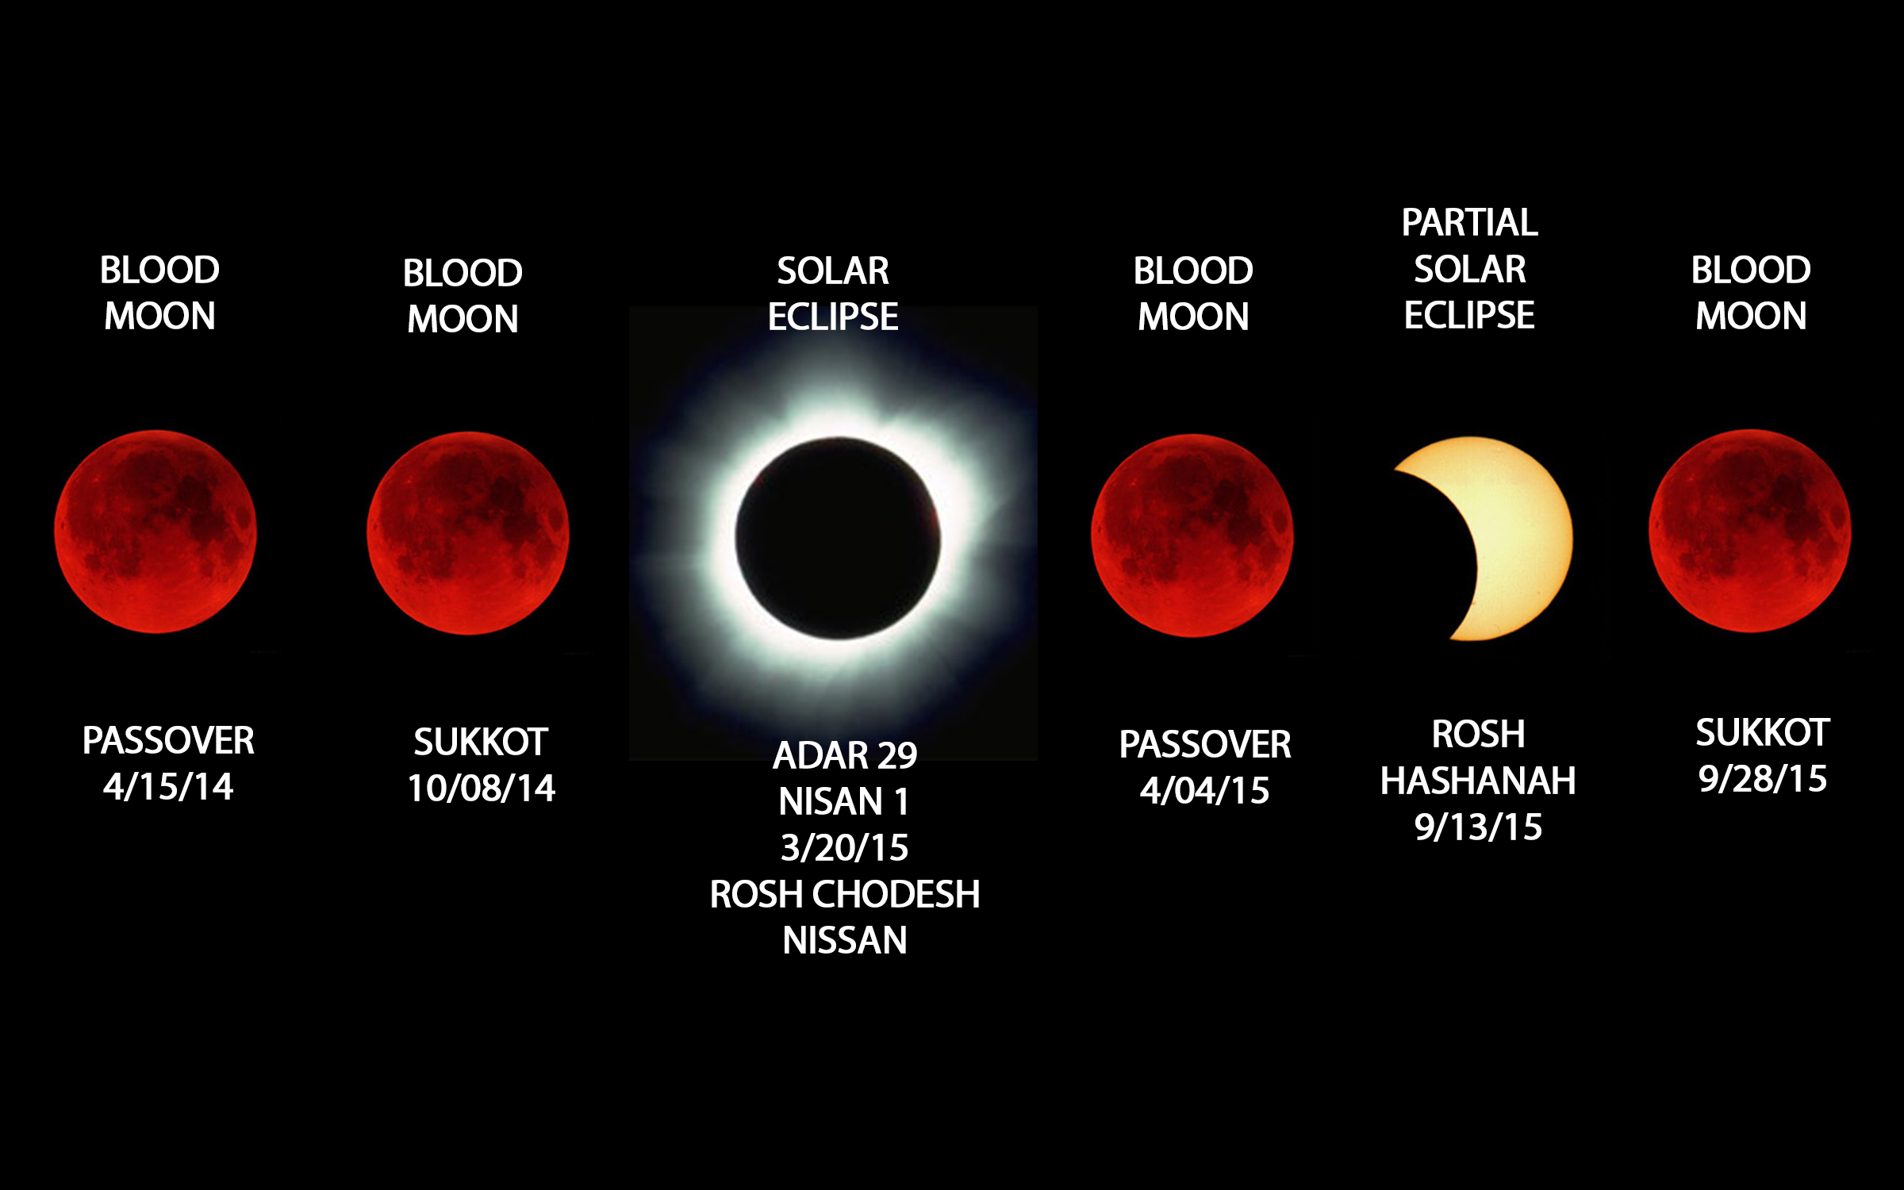
Blood Moons chart

Slide 26
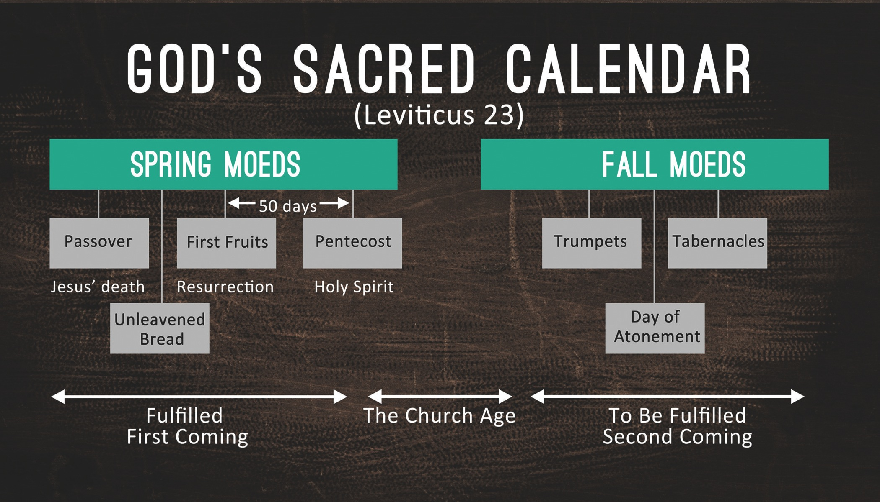
God’s Sacred Calendar

Slide 27
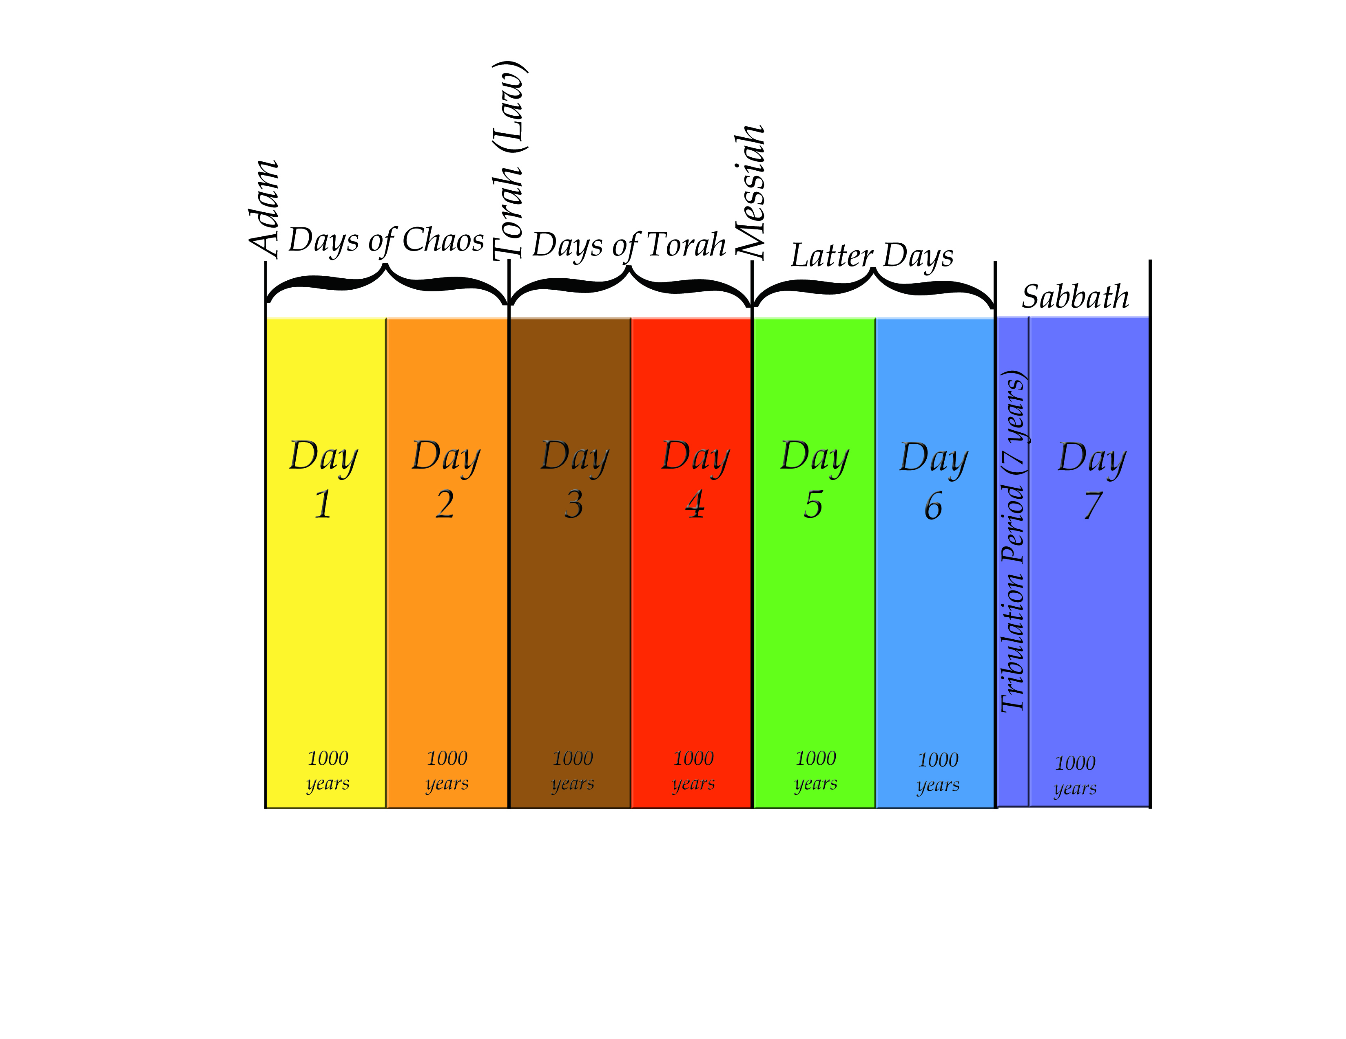
7 Day Chart

Slide 28

Autumn Assembly ad

Slide 29
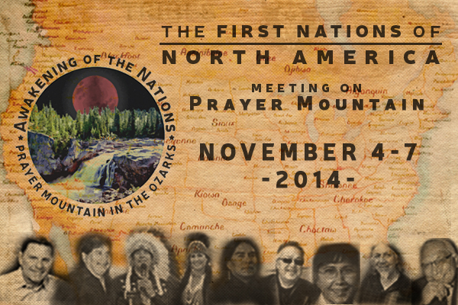
Awakening of the Nations mtg

