Slide 1
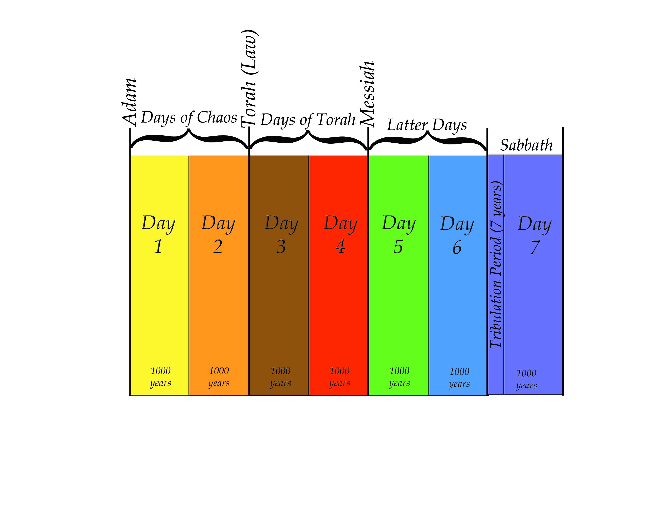
7 days chart

Slide 2
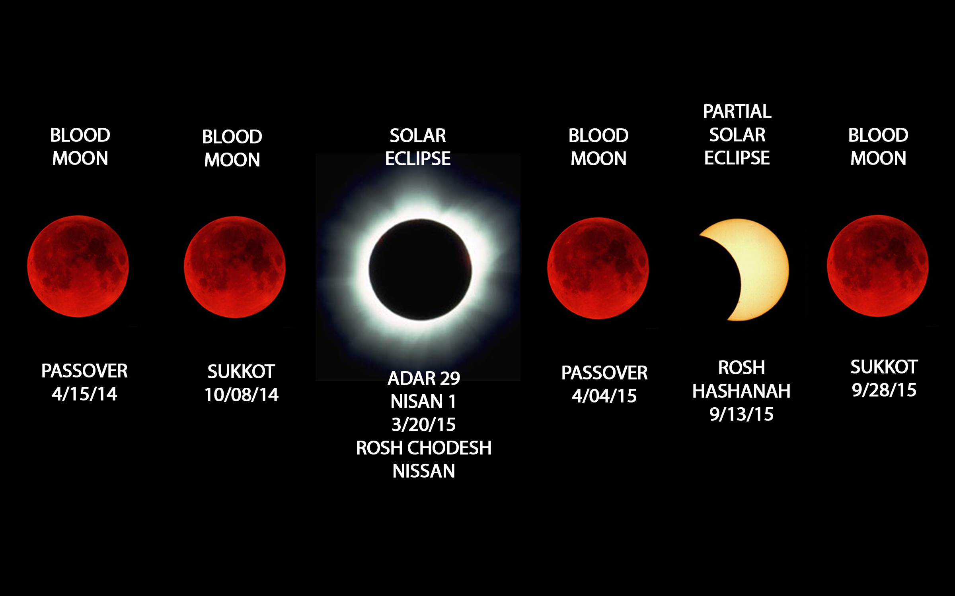
Blood Moons graphic

Slide 3
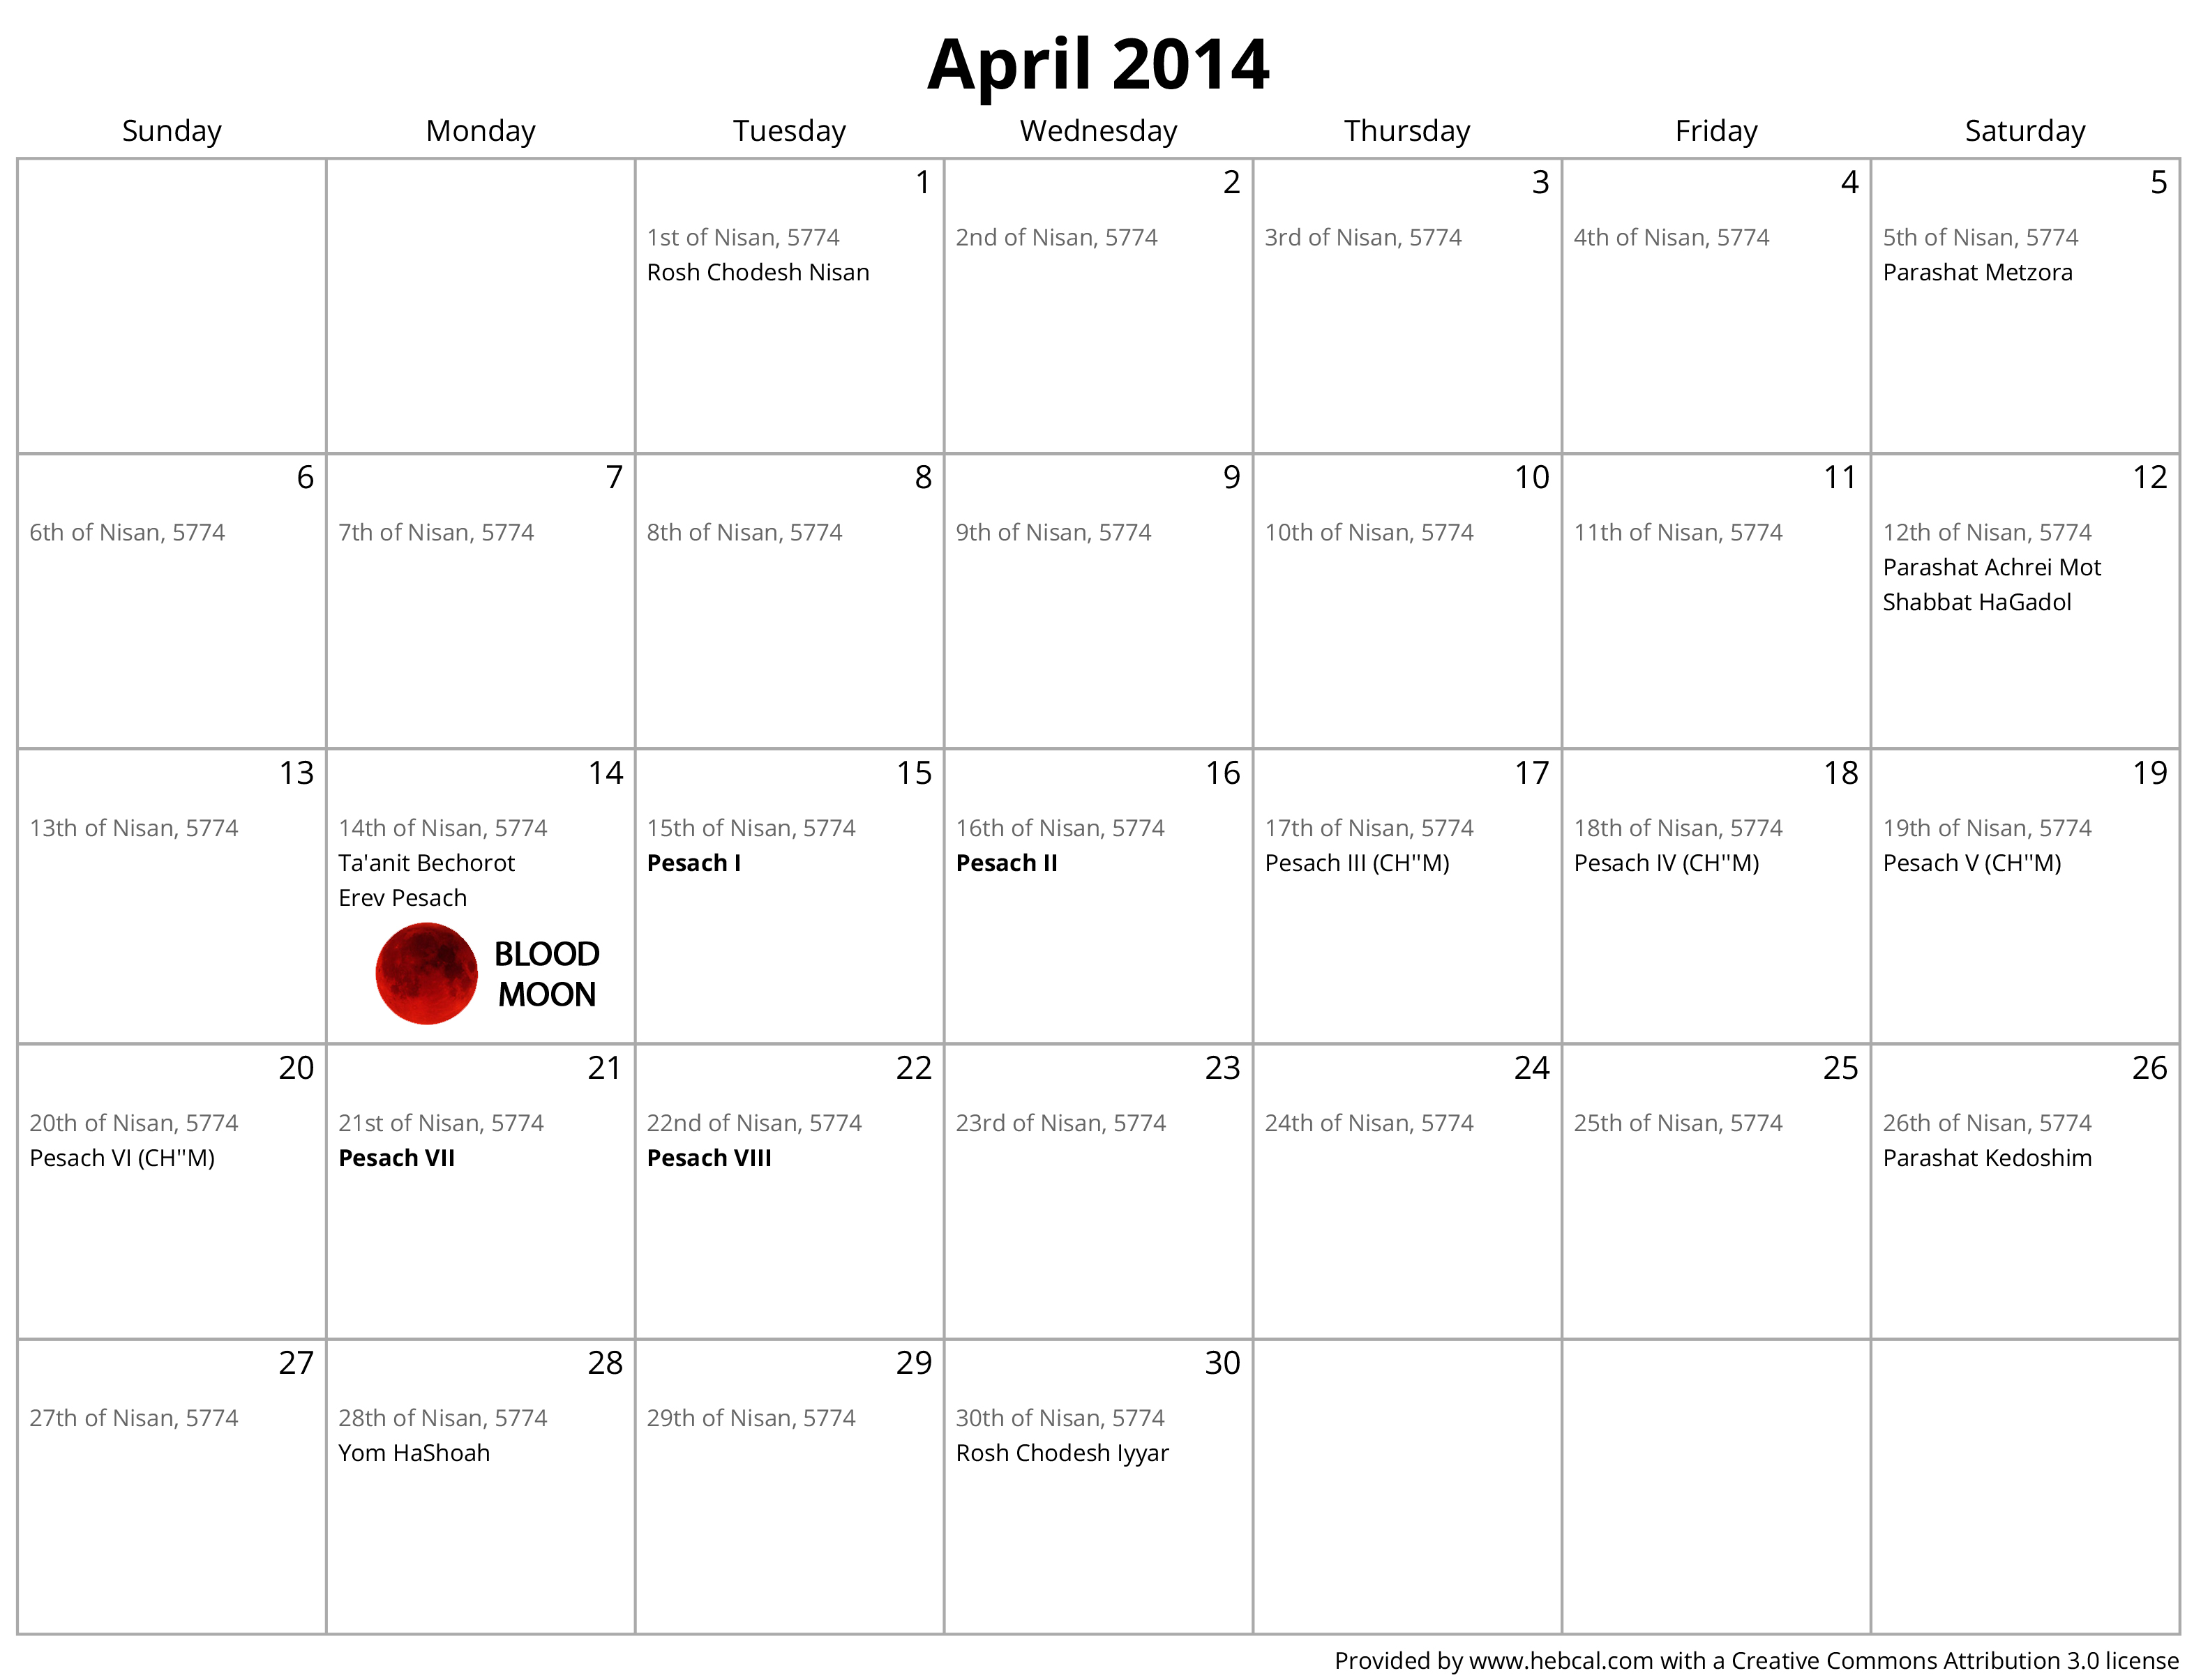
Blood Moons graphic

Slide 4
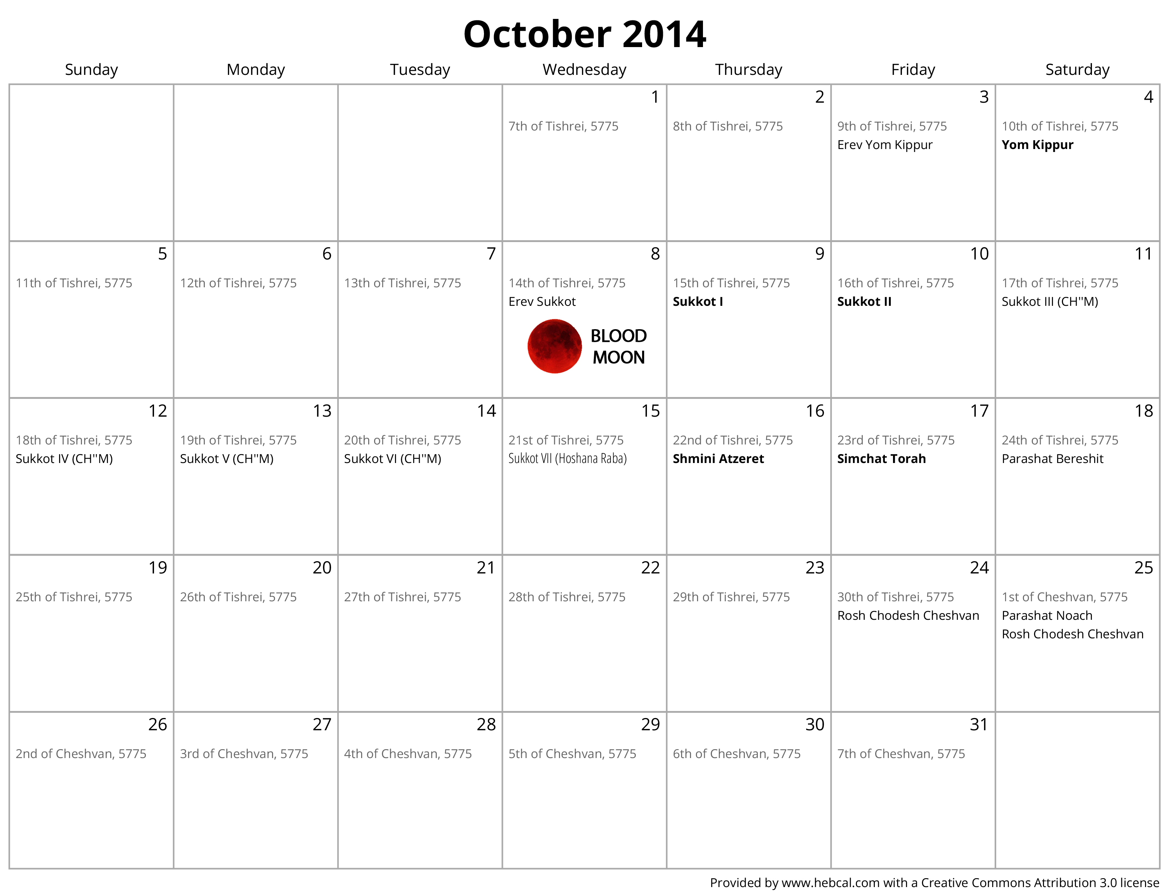
Blood Moons graphic

Slide 5
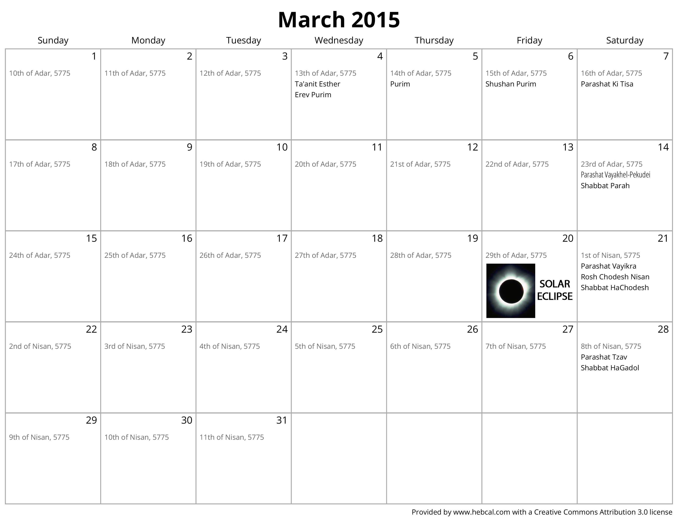
Blood Moons graphic

Slide 6
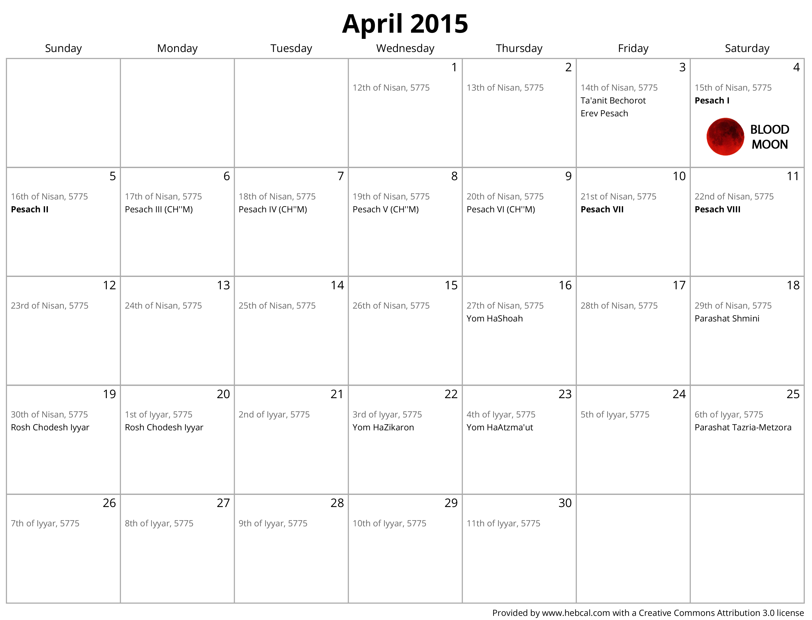
Blood Moons graphic

Slide 7
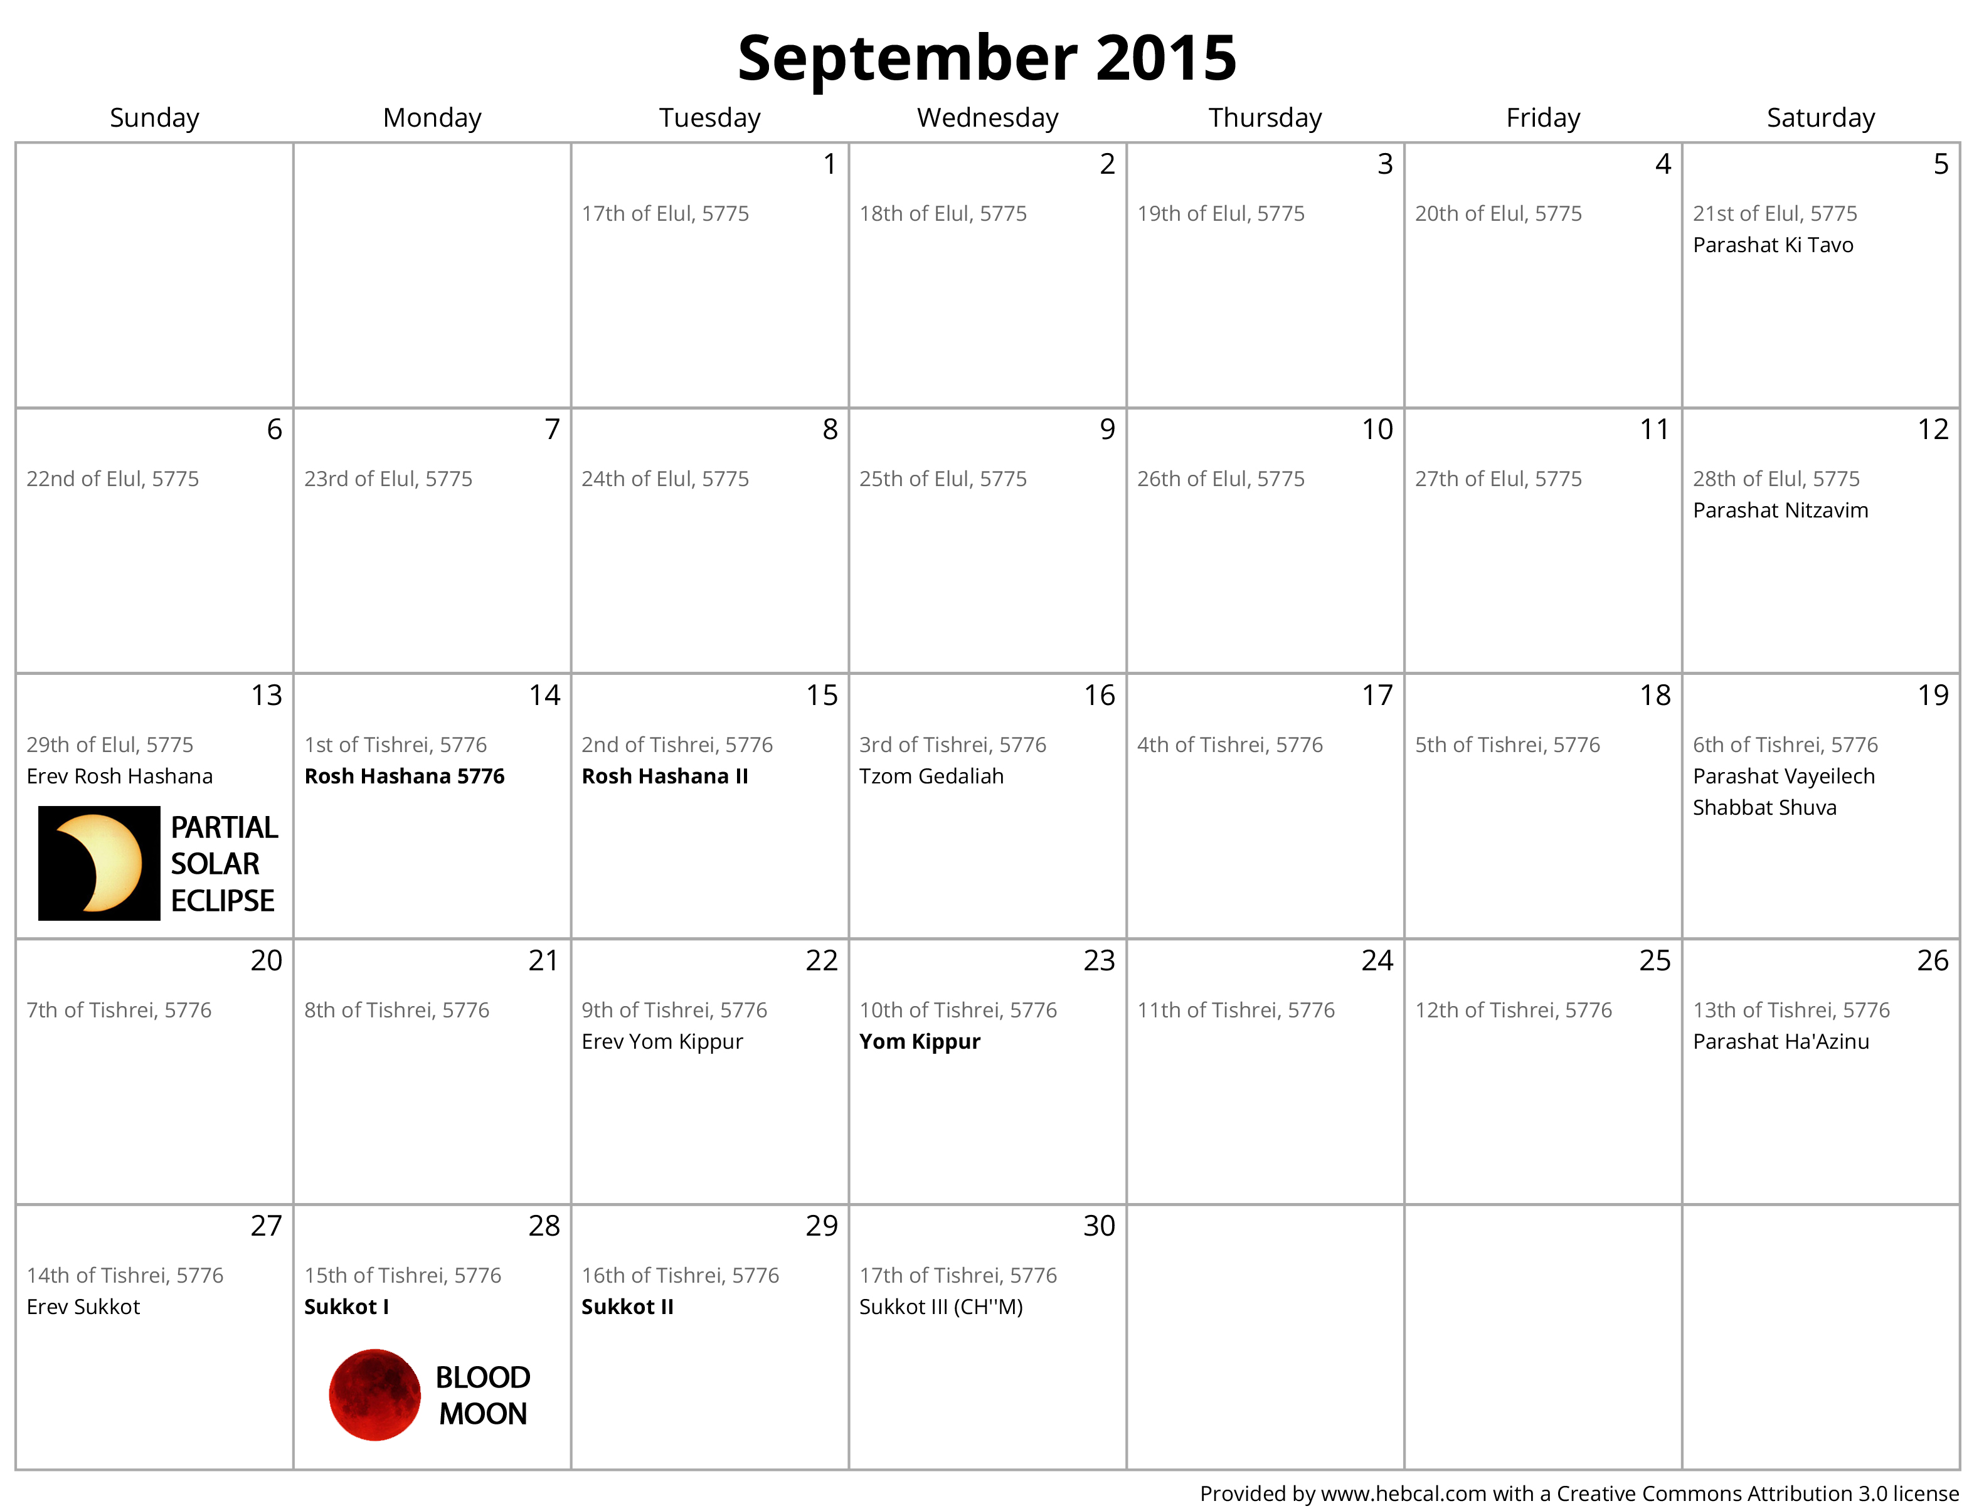
Blood Moons graphic

Slide 8
Blood Moons graphic

